Slide 1
Environmental and climate changes: the role of actuaries
Louise Pryor

Slide 2
Outline
Environmental and climate change background
The risks and how they affect actuaries
What the insurance industry can do

Slide 3
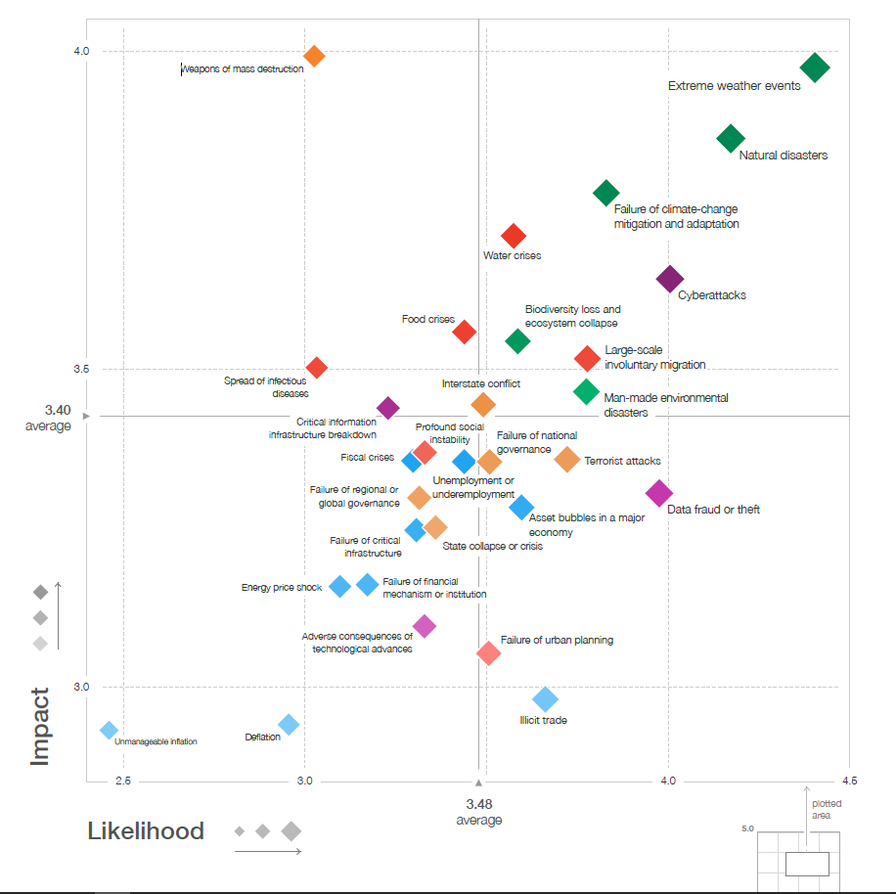
Global risks

Slide 4
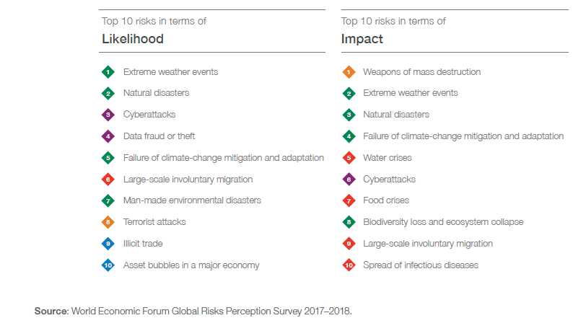
Top 10

Slide 5
Climate change means changing weather
Source: IPCC AR5 SPM

Slide 6
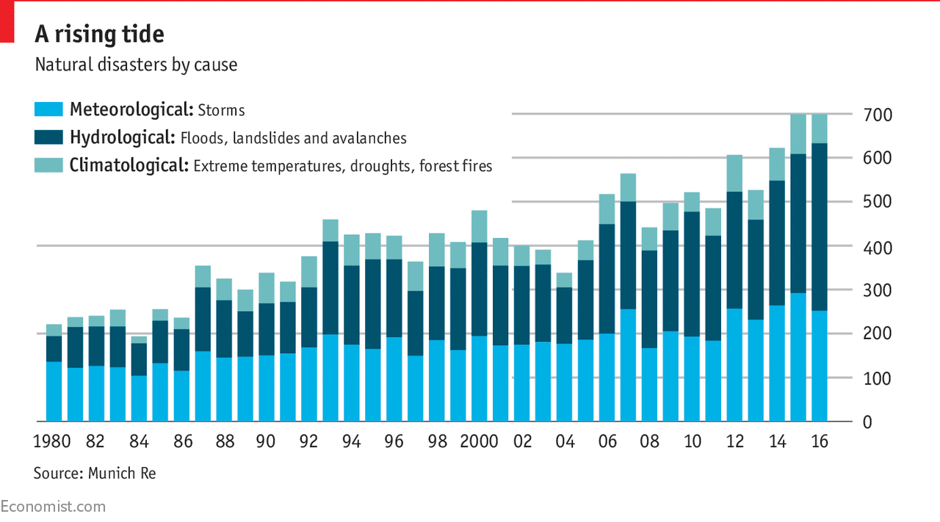
There’s more weather than there was

Slide 7
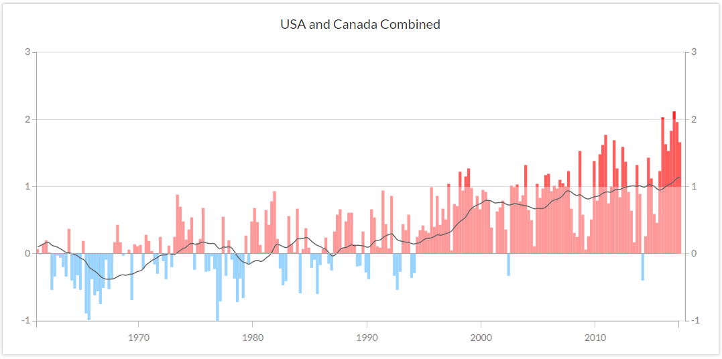
Actuaries Climate Index
www.actuariesclimateindex.org

Slide 8
Long term risks
..with significant financial implications
Physical
Transitional
Liability

Slide 9
IFoA’s actions
Resource and Environment Board
  Research, working parties...
  Consultation responses
  Newsletter
Risk Alert
PRI network supporter
Sustainable Development Goals

Slide 10
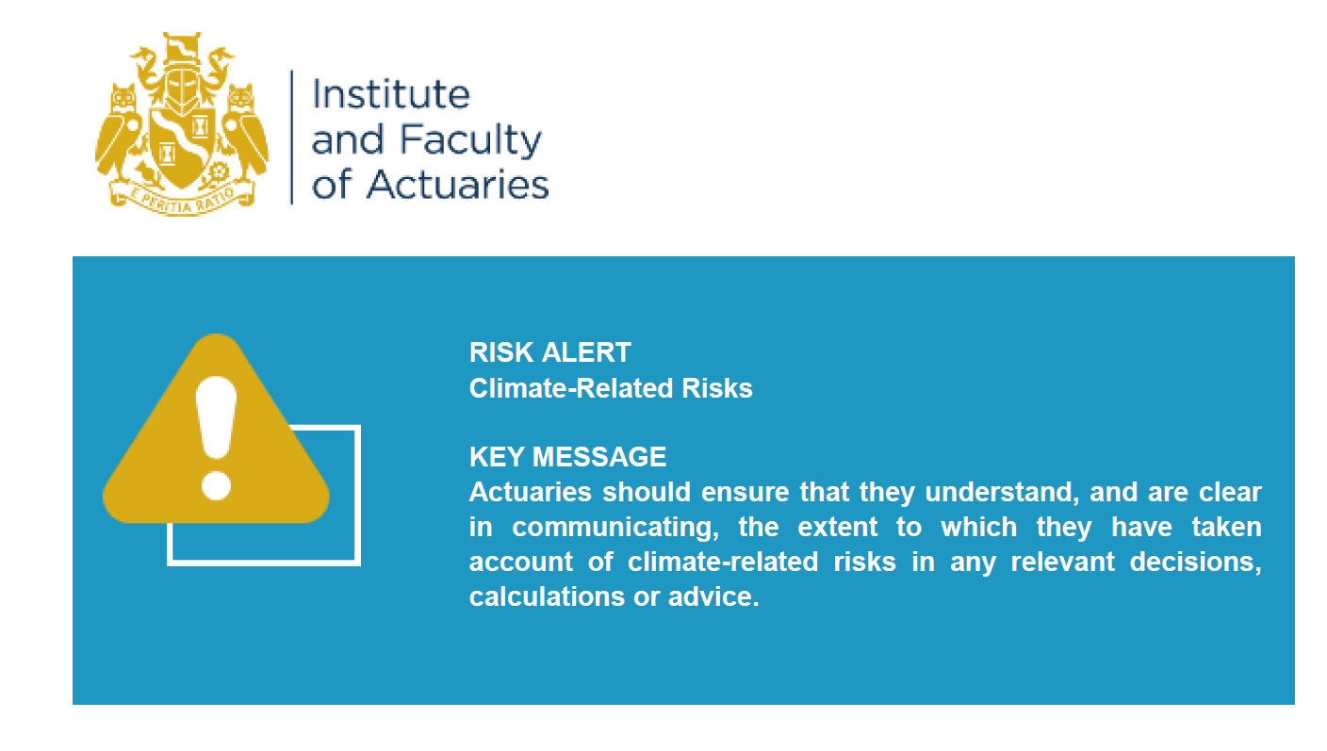
Risk alert

Slide 11

How do actuaries consider the SDGs in their work?
How do the SDGs affect actuaries?
How can actuaries help meet the SDGs?

Slide 12
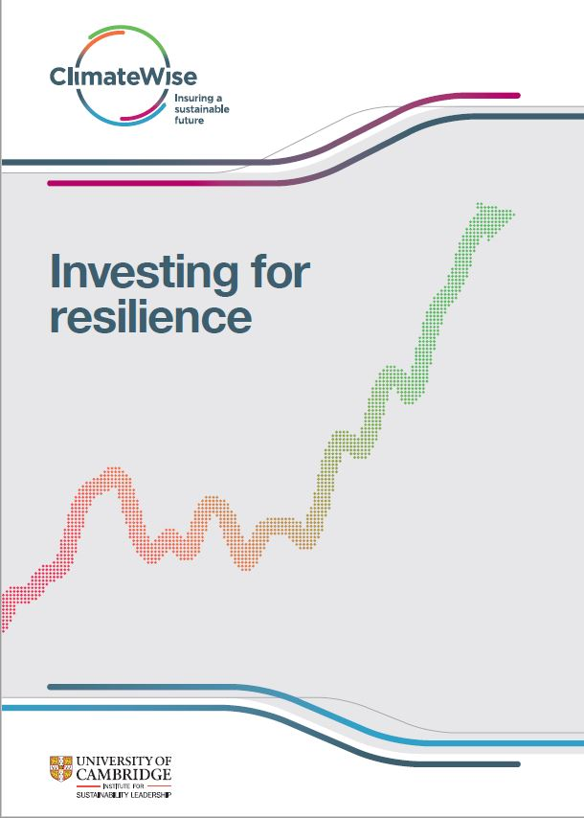
The role of insurers
How insurers can support resilience to environmental risks
https://www.cisl.cam.ac.uk/publications/sustainable-finance-publications/investing-for-resilience

Slide 13
Insurers have levers
Investment portfolios
Financial markets
Underwriting
Marketing
Expertise
CSR / ESG
How can they use these levers to support resilience?

Slide 14
Investment portfolios
Investments that directly enhance resilience
  There’s often a problem with financial returns
Invest in resilient assets
  Help to kick off virtuous circle via increased demand
Invest in corporates whose business is to enhance resilience
Improve their own resilience
  Avoid risk accumulations

Slide 15
Financial markets
Investment in resilience produces significant economic returns
  ... spread over a wide range of beneficiaries
  ... emerging over the medium to long term
Innovative funding mechanisms
  Green bonds
  Impact bonds
    Forest Resilience Impact Bonds

Slide 16
Underwriting
Is resilience reflected in the premium?
Do lower premiums provide incentive for investment?
Are insurance incentives aligned with resilience?
  Resilient reinstatement
  Multi-year policies
  Comprehensive resilience services

Slide 17
Marketing
Education
Investment mandate
  Premiums4Good (QBE)

Slide 18
Expertise
Green Cities platforms
  Urban infrastructure investments for the private sector
Stakeholder partnerships with cities
Staff secondment

Slide 19
CSR / ESG
Land management projects
  Living Lands project (Santam)
  Mangrove planting (Tokio Marine)
Education
  Protecting the North (Suncorp)
Pressure from investors and others?
  Aiming for A
  ClientEarth, Urgenda

Slide 20
Summary
Environmental and climate change risks are serious
They have significant long term financial implications
Actuaries should treat them in the same way as other risks
The insurance industry can contribute to societal resilience

