Slide 1


CILA 2022
The Orchid, Mumbai
9-Dec-2022
InsurTech: Overview
Sumit Ramani
Actuary & Co-founder ProtectMeWell.com

Slide 2
Agenda
01
04
What is InsurTech?
InsurTech Examples
02
Is it a buzzword?
05
Conclusion
03
What does Tech of Insurtech Entail?

Slide 3
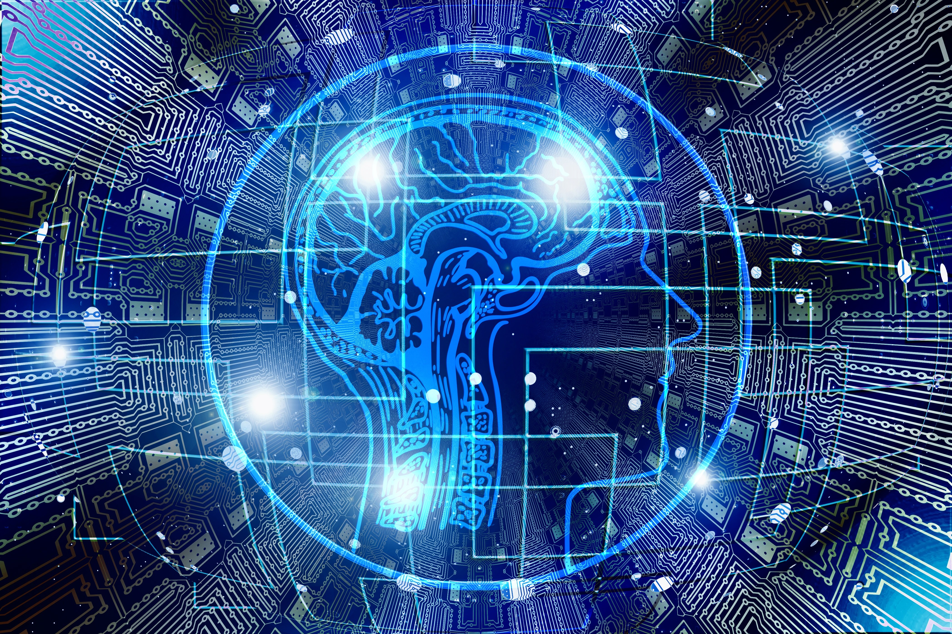
What is InsurTech?

Slide 4
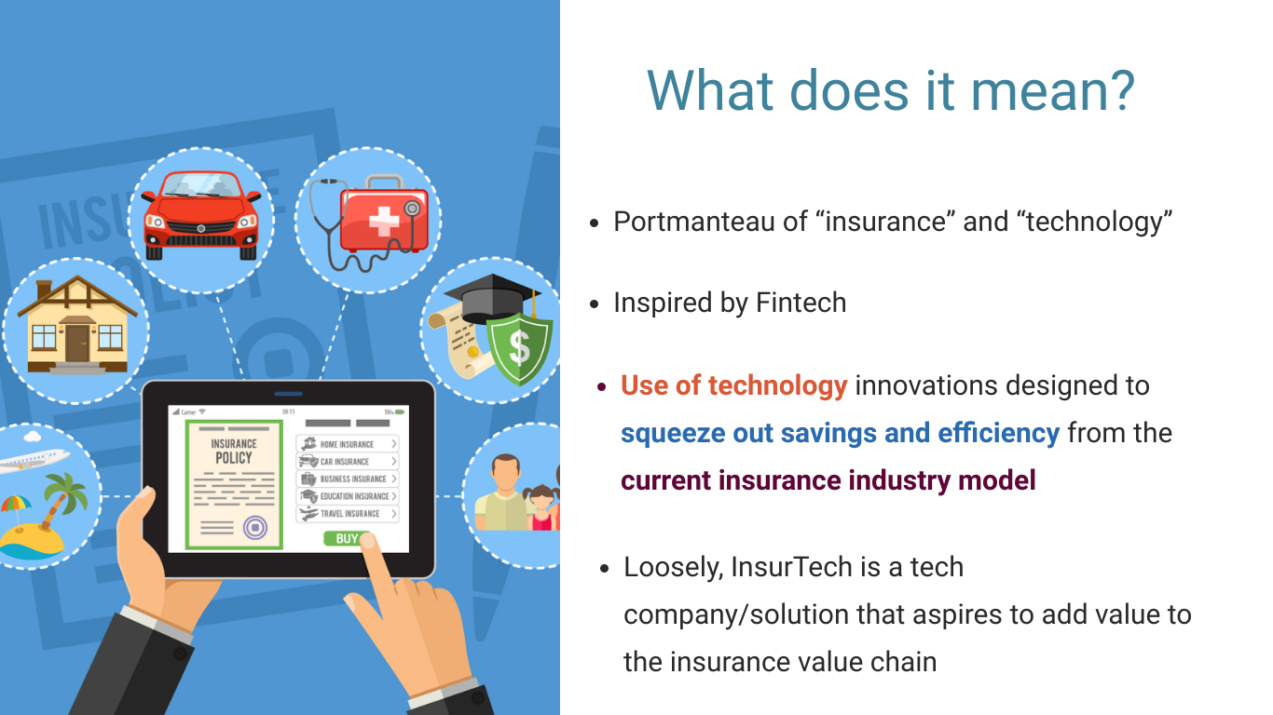

Slide 5

InsurTech – A Technical Definition
InsurTech is the use of emerging hardware, software and user interfaces to address inefficiencies or opportunities in the insurance value chain. It often involves technology, data and analytics. It targets the evolution/disruption of
the interaction between insurers and their customers
the automation of processes
the modification of old/creation of new insurance products
full stack InsurTech (licensed insurer) can also be an InsurTech
Notes:
Example for each point
a) Calling selectively for renewal
b) RPA for filling claims form
c) P2P Insurance/ Parametric Insurance
Talk about dimension
a) Generalist - insurance/banking/retail
b) Maturity - early stage startups to insurance companies

Slide 6
Is it a buzzword?

Slide 7
> 46 billion USD
Is it a buzzword?
> 2500 InsurTechs
Source: Quarterly InsurTech Briefing Q2 2022
Notes:
More skewed towards P&C

Slide 8
Is it a buzzword?
~ 35% InsurTechs have funding from (Re)insurers
Quarterly InsurTech Briefing Q2 2022

Slide 9
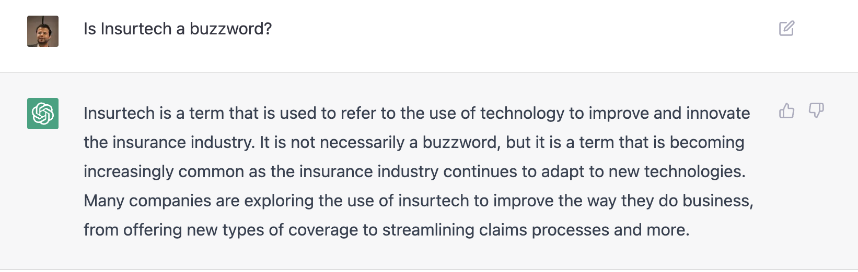
Lemonade, poster boy of InsurTechs went public 2020
Hippo, an InsurTech acquired Spinnaker an insurer
ChatGPT also thinks that it is not a buzzword ☺
Is it a buzzword?

Slide 10
What does the Tech of InsurTech entail?

Slide 11
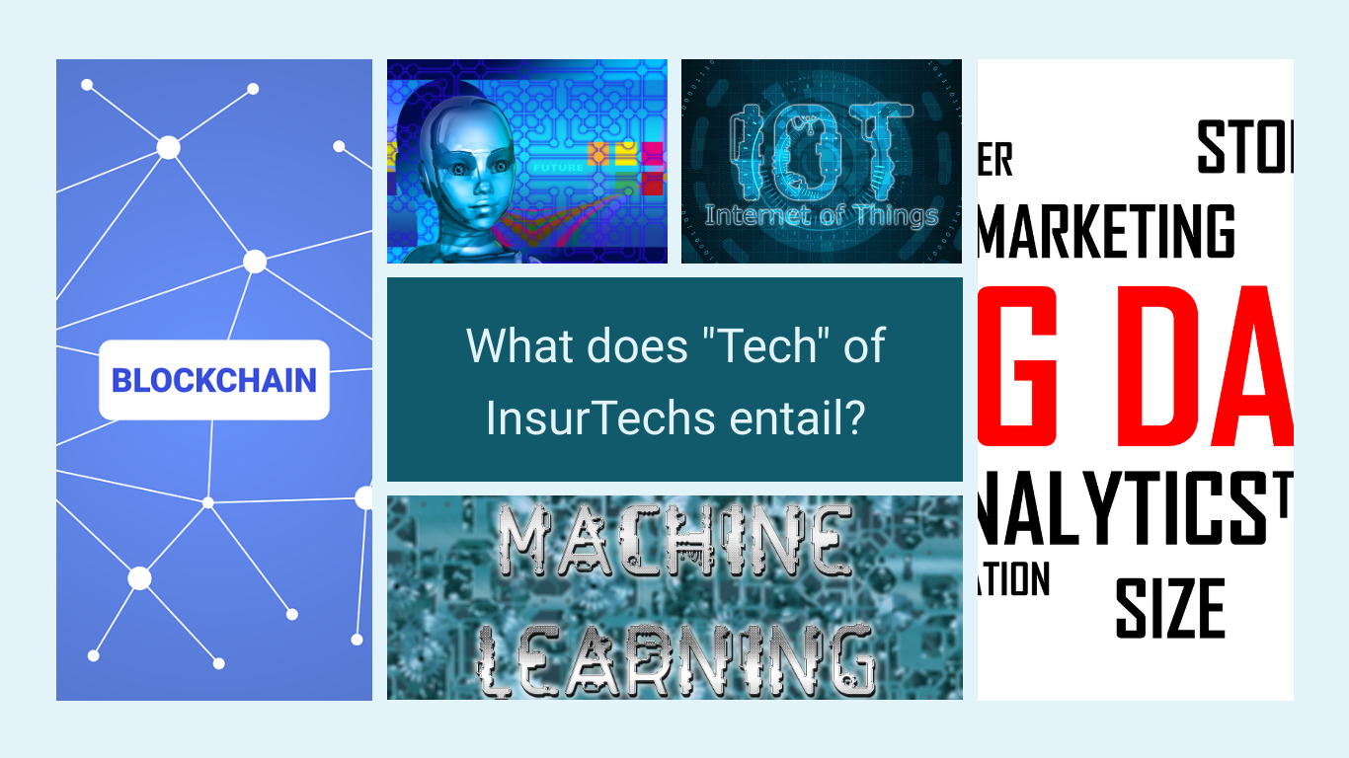
Notes:
Blockchain – Ehterisc – Social Insurance
ioT – Vitality – for health data / Health Iq
Machine Learning - Ethos
Fabric for accelerate underwriting – big data

Slide 12
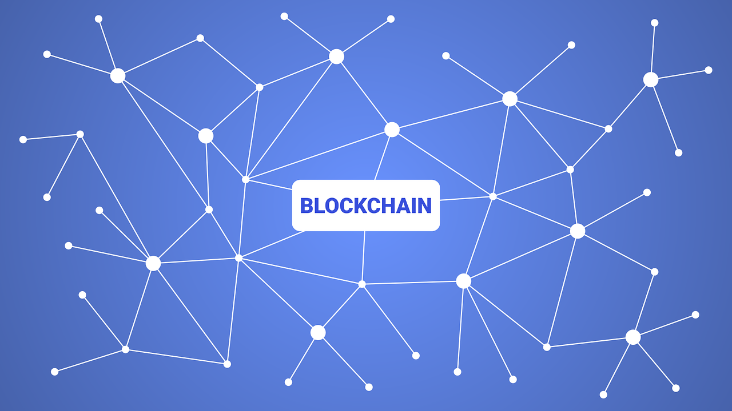
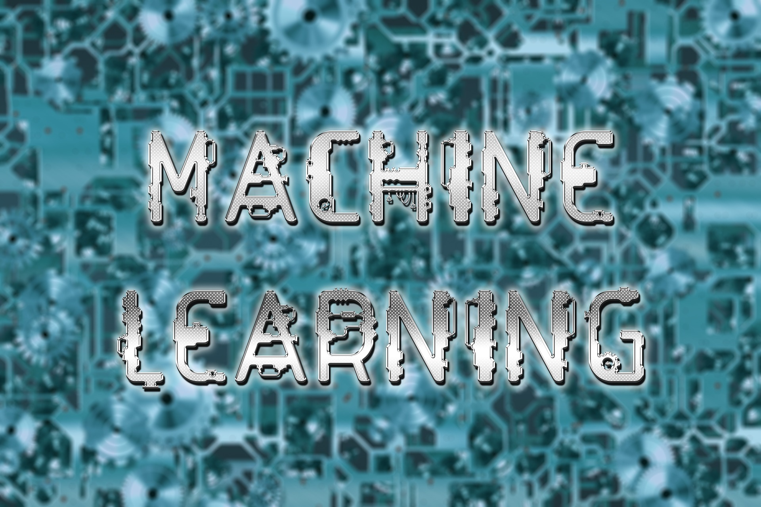
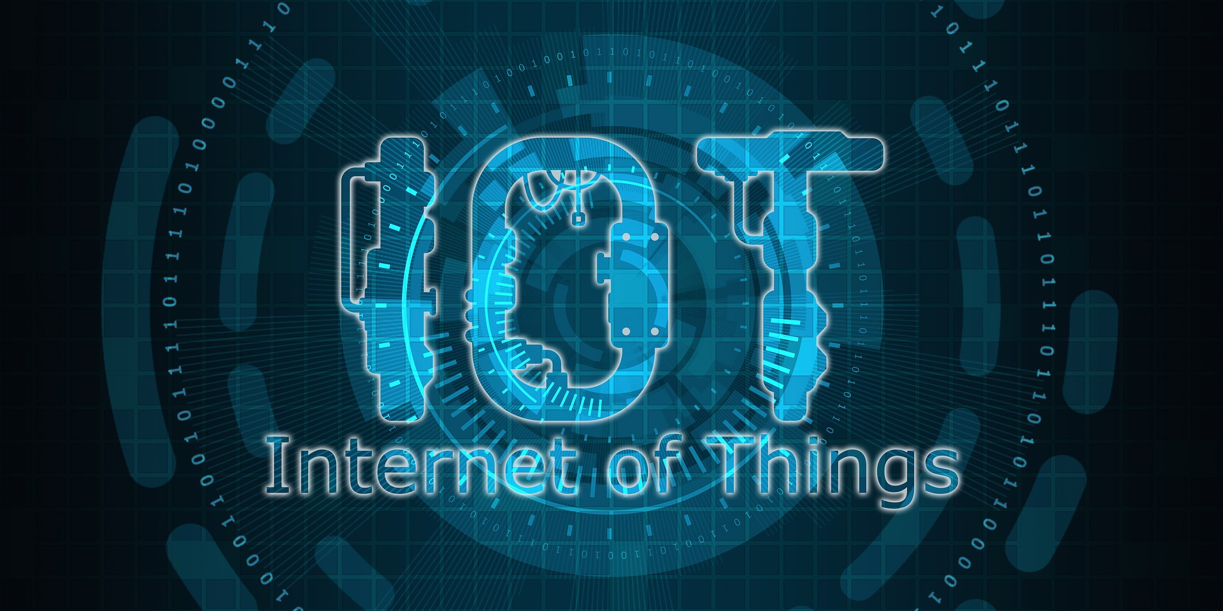






Tech of InsurTechs

Slide 13
InsurTech Examples

Slide 14
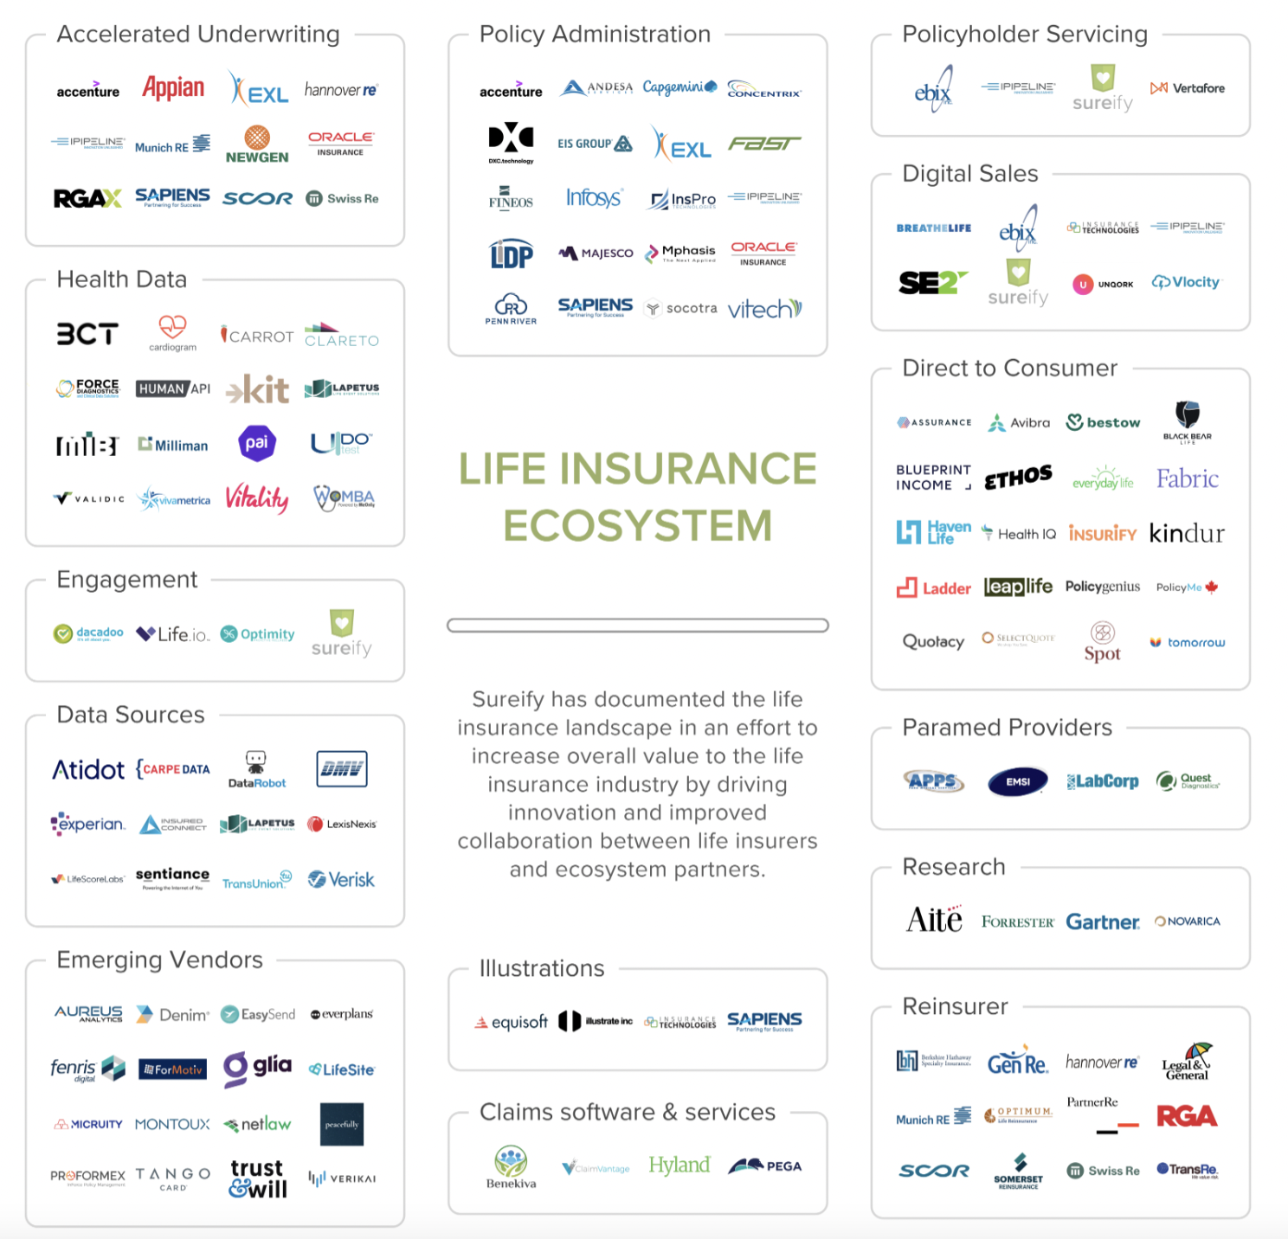


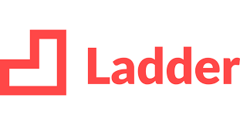


InsurTechs across value chain?
Notes:
Pricing & Underwriting - alternative data source like driving behaviour
Claims Management - Talk about Acko example

Slide 15
Conclusion

Slide 16
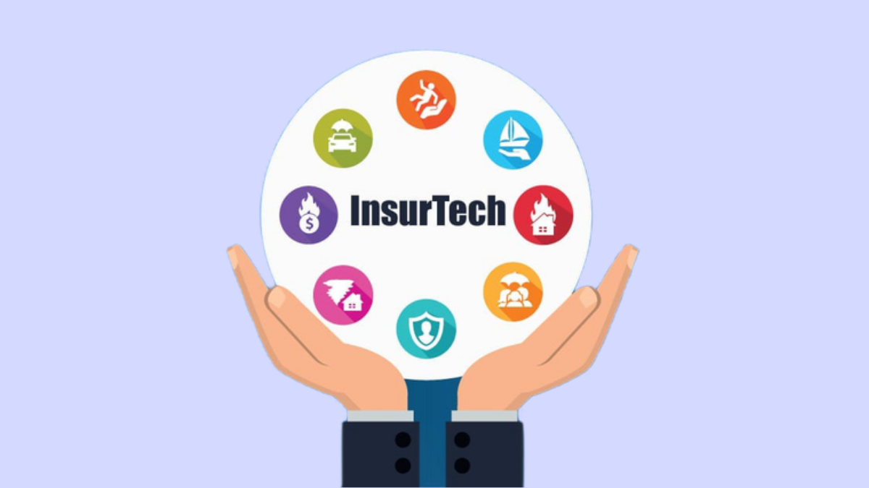
Key Takeaways
InsurTechs are for real and here to stay
InsurTechs have impacted every part of the value chain through
Technologies like blockchain, IoT, Machine Learning and Big Data

Slide 17

