Slide 1


18th Current Issues in Life Assurance (CILA)
9 December 2022
A discussion with equity analysts on life insurance in India:
Growth and value perspectives

Slide 2






Listing-to-date returns for listed insurers
Stock Growth
(CAGR since listing)
EV Growth
5.4%
14.0%
11.9%
18.7%
10.7%
19.4%
Last 5-year SENSEX return is approximately 13%
www.actuariesindia.org

Slide 3
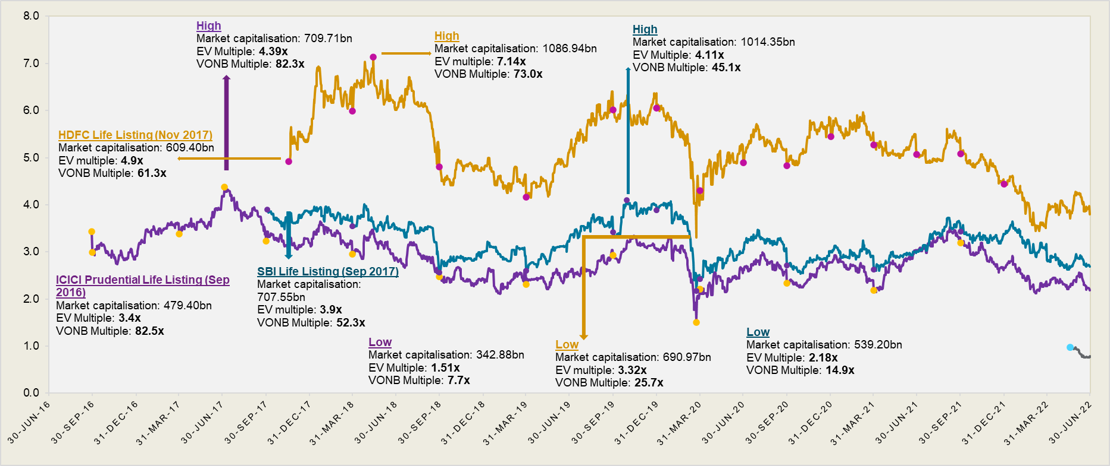
Historic EVx multiples of listed companies
www.actuariesindia.org

Slide 4
Current view of equity analysts on life insurers
www.actuariesindia.org

Slide 5

Which factors are most important for assessing quality of life insurance business in India?
www.actuariesindia.org

