Slide 1


18th CILA
Mumbai
8 December 2022
Global
Consumer
Study 22-23
Hemant Mehta
Head – Life & Health
SCOR SE India Branch

Slide 2





Agenda
01
About GSC
02
7 Key Insights for Insurers
www.actuariesindia.org

Slide 3
About GCS
9th
22
12k
7
Edition
Since 2014
Markets covered
Respondents
Insights for Insurers
www.actuariesindia.org

Slide 4
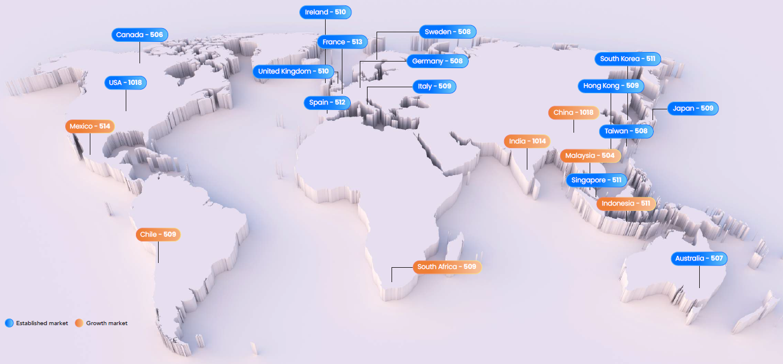
About GCS – Markets covered
www.actuariesindia.org

Slide 5
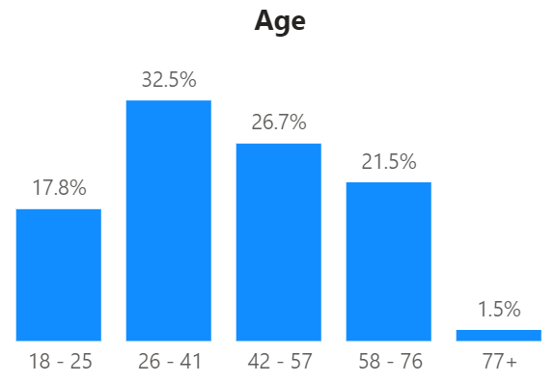
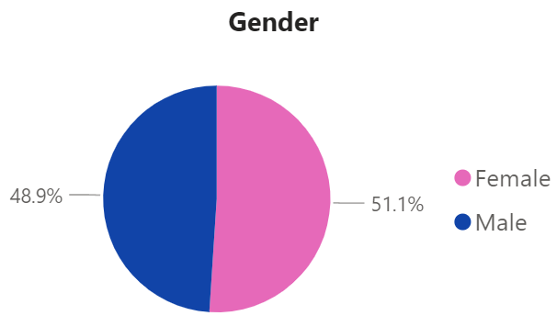
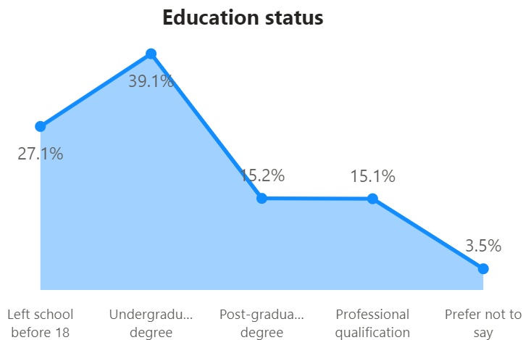
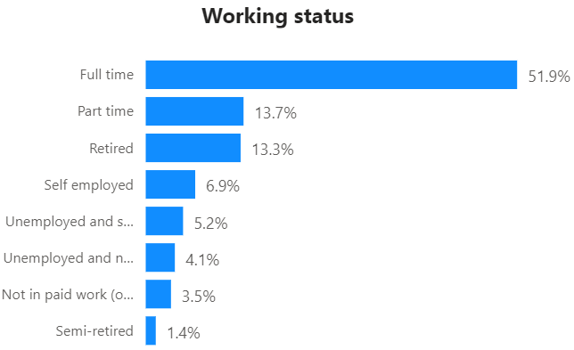
About GCS – Demographics
www.actuariesindia.org

Slide 6

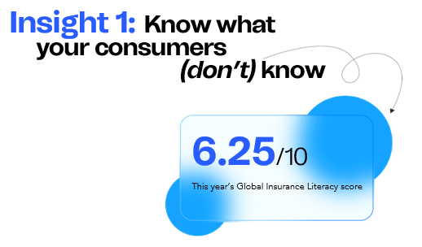
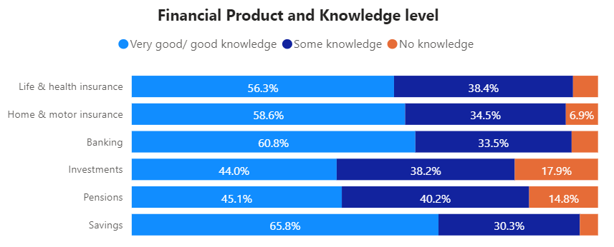
www.actuariesindia.org

Slide 7

a
Less than 4
b
Between 4 – 5
c
Q1
Between 5 – 7
What is the Insurance Literacy Score for India on a 10-point scale?
d
Above 7
www.actuariesindia.org

Slide 8
a
Less than 40%
b
Between 41% – 60%
c
Q2
What percentage of respondents from India think they are familiar with Insurance products?
Between 61% – 80%
d
Above 80%
www.actuariesindia.org

Slide 9


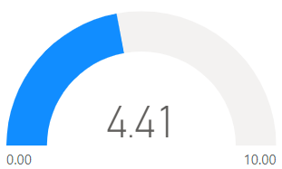
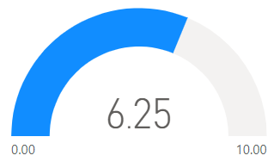
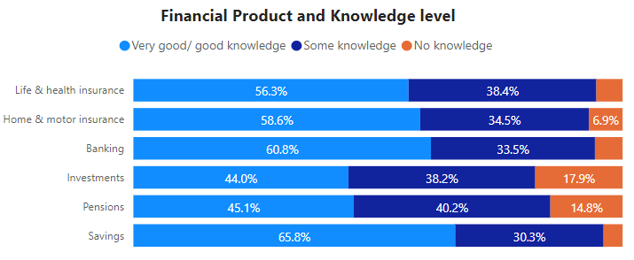
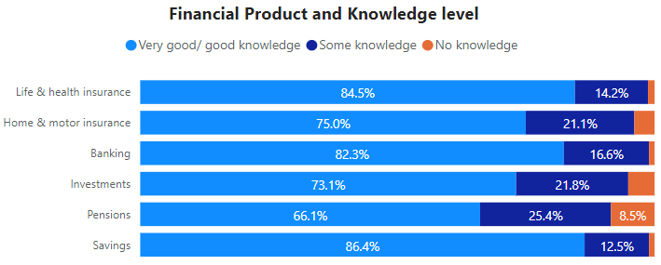
Insurance Literacy Score
www.actuariesindia.org

Slide 10
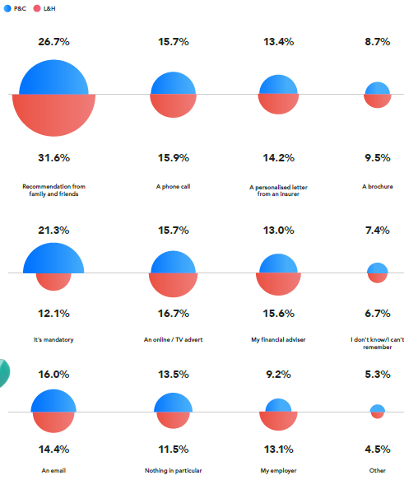
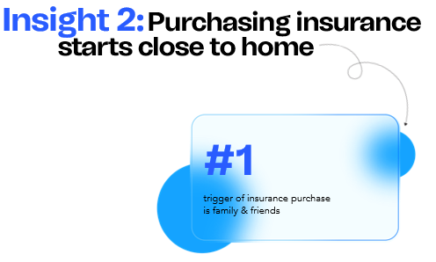
www.actuariesindia.org

Slide 11
a
Recommendation from
family and friends
b
An online / TV advert
c
Q3
Financial adviser
Which is the top initial trigger for buying L&H Products in India?
d
A phone call
www.actuariesindia.org

Slide 12
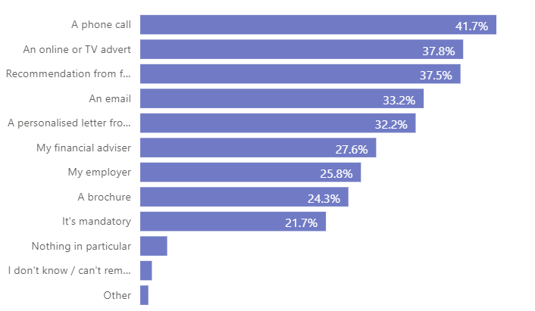
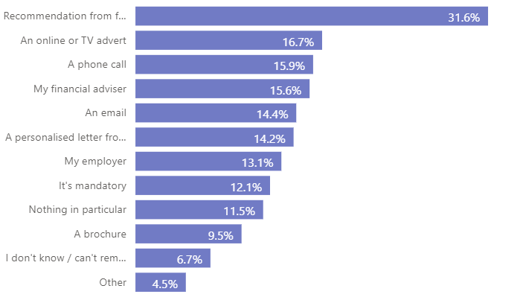
What initially triggered your purchase of the most recent Life & Health product?
www.actuariesindia.org

Slide 13
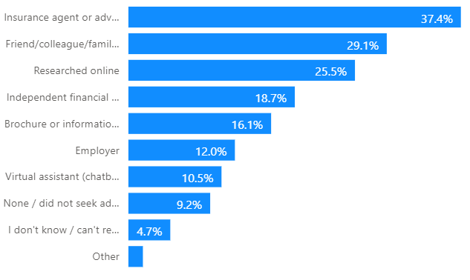
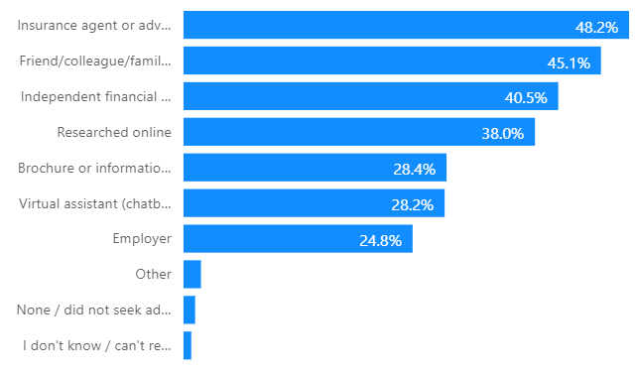
Where did you go for advice before buying your most recent Life & Health product?
www.actuariesindia.org

Slide 14


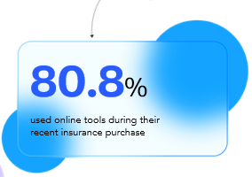
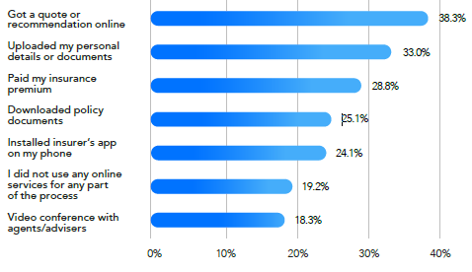
www.actuariesindia.org

Slide 15
a
Less than 5%
b
Between 5% – 10%
c
Q4
What proportion of respondents from India did not use any online services as a part of buying process?
Between 11% – 20%
d
More than 20%
www.actuariesindia.org

Slide 16
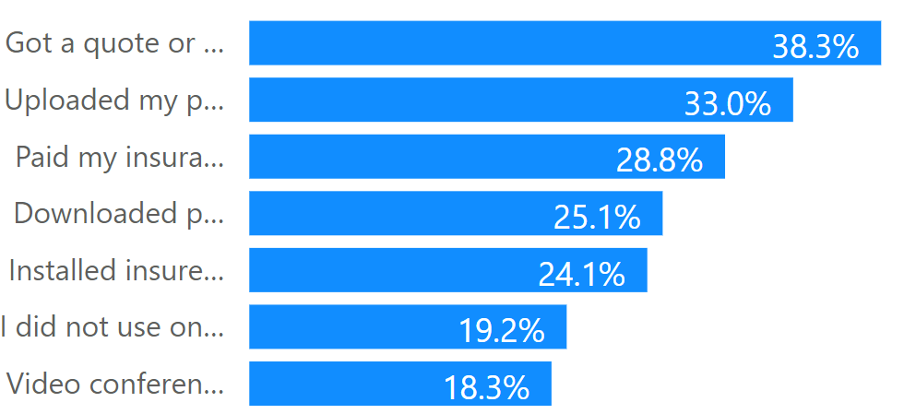
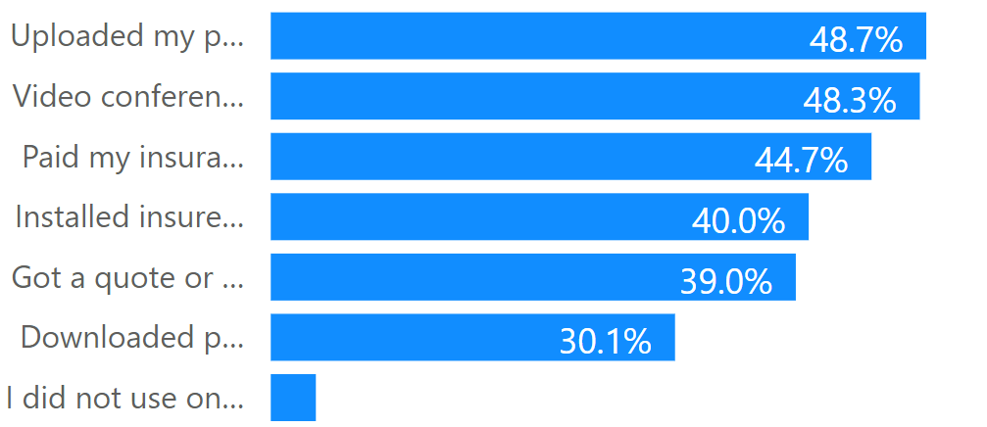
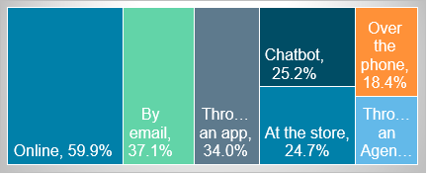
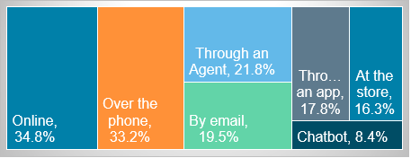
How did you buy?
How did you claim?
www.actuariesindia.org

Slide 17
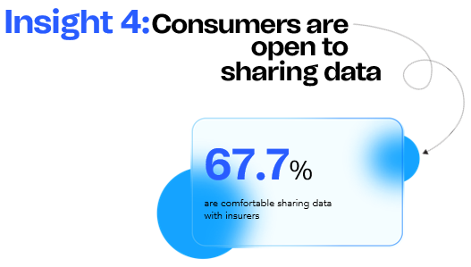
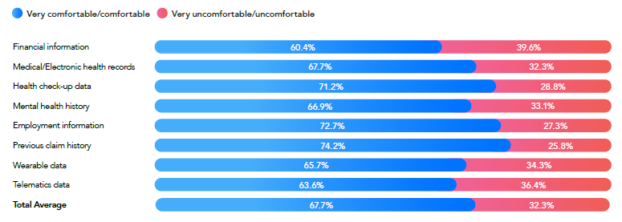
www.actuariesindia.org

Slide 18
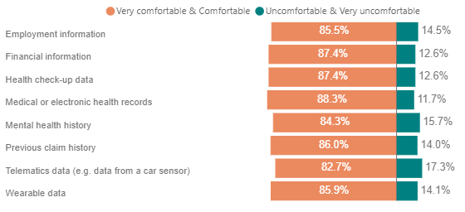
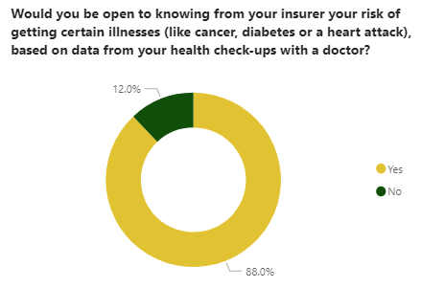

www.actuariesindia.org

Slide 19

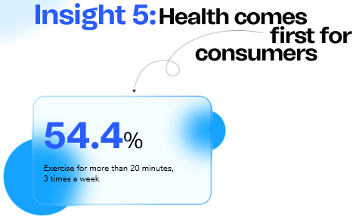
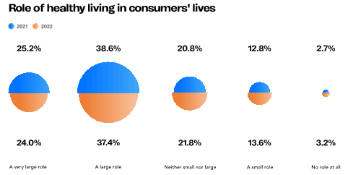
www.actuariesindia.org

Slide 20
a
More than 3 times a week
b
Once or twice a week
c
Q5
Rarely
How often do you exercise for more than 20 minutes?
d
Never
www.actuariesindia.org

Slide 21
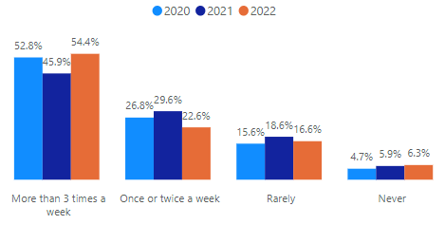
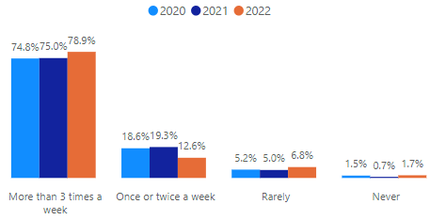
How often do you exercise for more than 20 minutes?
www.actuariesindia.org

Slide 22
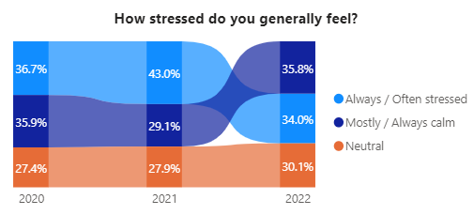

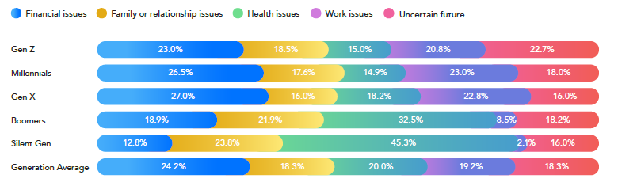
www.actuariesindia.org

Slide 23
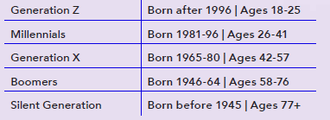
a
Generation Z
b
Millennials
c
Generation X
Q6
d
Which is the most stressed generation?
Boomers
e
Silent Generation
www.actuariesindia.org

Slide 24
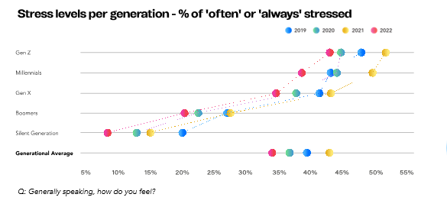
www.actuariesindia.org

Slide 25

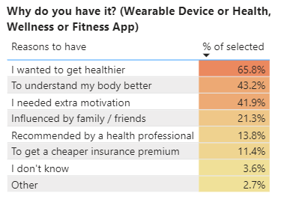
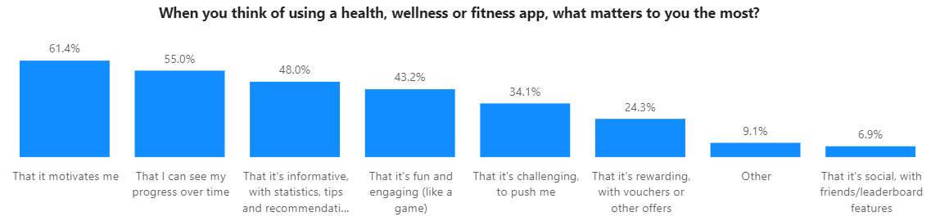
www.actuariesindia.org

Slide 26



GCS 2022-23 – Empowering People
Through Insurance Literacy
            Consumers consistently think they know more about insurance than they do.
Embracing Tech Responsibly
            As risk experts, we make decisions for consumers. This implies greater responsibility.
Data-Optimized Consumer Experience
            Consumers are happy for their data to be processed, if done in a way which benefits them.
www.actuariesindia.org

Slide 27

Thank you!
Download now!
Global
Consumer
Study 22-23
www.remarkgroup.com
www.actuariesindia.org

