Slide 1
5th Seminar on Enterprise Risk Management
Institute of Actuaries of India
10 March 2017
Corporate Governance and
Risk Management Framework
Sanchit Maini

Slide 2
Contents
1
Introduction
2
Governance
3
Risk Management Framework
4
Outlook

Slide 3
introduction.

Slide 4
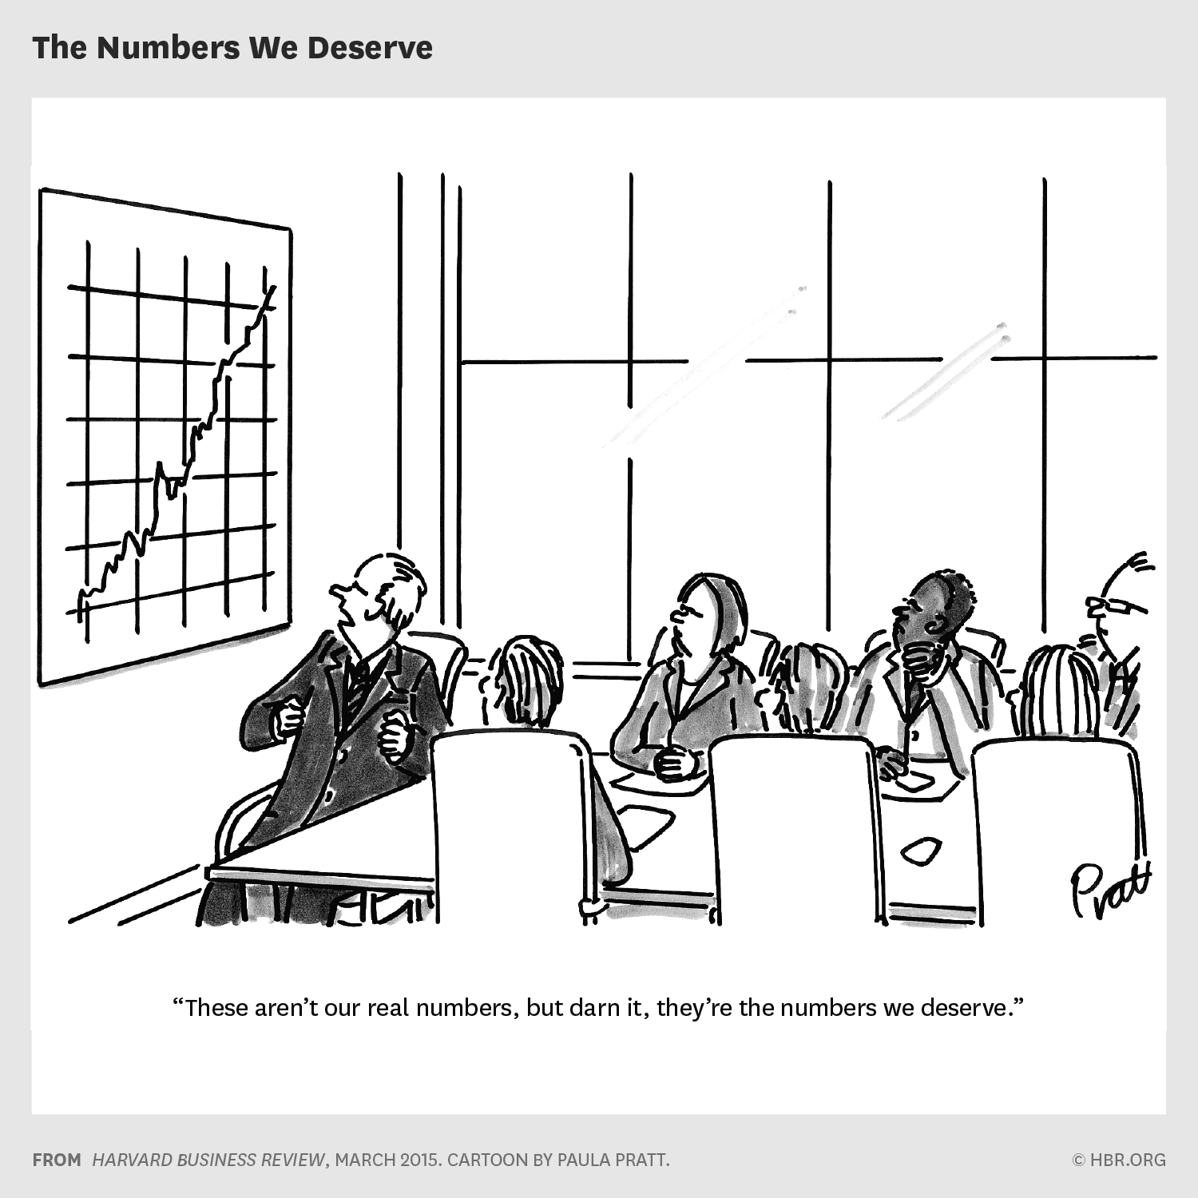
introduction.

Slide 5
Why is Risk Management Gaining Prominence?
1
It makes good business sense
  Sharpens strategy: what you can and cannot do as a business
  Focus on what matters: agreed set of metrics
  Define what outcomes are acceptable: focus on targets & variability (supports the development of risk appetite)
  Focus on management actions to make business outcomes less variable, more predictable and boring!
  Insurers are in the business of managing risk
  Risk taking, risk oversight and assurance separated
  Risk management allows common framework to be applied across risks and enterprise wide
  Capital as a currency for risk and its allowance in value management allows a holistic approach
  Regulatory developments another driving force
  Corporate governance, customer protection and risk based prudential standards
2
3
5

Slide 6
What Influences Are We Seeing on Risk Management Practices?
1
Three lines of defence model
  Separation of risk taking, risk oversight and independent assurance
  Effectiveness varies a lot, strong risk culture critical success factor
  CRO role is gaining prominence
  European insurers and increasingly Asian insurers have raised the CRO role’s profile and made it part of the Executive Committee
  Head of the second line function: Covering risk and compliance
  Solvency II defines controls functions: actuarial, risk, compliance and audit
  Risk based capital and use of internal models
  Need for validation of internal models
  Use Test
  Own Risk and Solvency Assessment
2
3
6

Slide 7
corporate governance.
‘a set of relationships between a company’s management, its board, its shareholders and other stakeholders which provides the structure through which the objectives of the company are set, and the means of attaining those objectives and monitoring performance. It helps define the way authority and responsibility are allocated and how corporate decisions are made’
7

Slide 8
Key Governance Themes
1
Governance increasingly structured around the three lines of defence model
2
Insurance regulators adopting IAIS’ ICPs.
ICP 7: corporate governance framework.
ICP 8 risk management, internal controls and control function effectiveness
3
Appropriate Board composition: NEDs / INEDs, breadth of experience
4
Risk and Audit Committee with individual mandates
INEDs to chair both Risk and Audit Co’s
5
Control functions and key persons
6
Strengthening risk culture
Notes:
A well established Governance map which is well understood by all three lines of defence is the first step
Committees that are taking risk/ managing risk are first line whereas Risk Management Function/ Second line is responsible for the Oversight Activities
As an example, ALCO is a first line committee not a second line committee. Risk Committee is a second line. The second line should have representation on first line committees to provide the risk challenge and oversight. These include ALCO, Product Approval Committees.
Audit should be a part of second line committees. Audit to cover second line work.
Control function effectiveness under ICP 8 covers risk management, compliance, actuarial and internal audit

Slide 9
Governance Map illustrative
First Line
Second Line
Third Line
Board of Directors
Remuneration Co.
Nomination Co.
Risk Co.
Audit Co.
Chief Executive
Product Approval Co.
Risk Co.
Internal Audit
ALCO
Insurance Risk Co.
Credit Risk Co.
Investment Co.
Technical Actuarial Co.
Technical Oversight Co.
Information & Technology Co.
Operational Risk Co.
Emerging Risk Co.
Notes:
A well established Governance map which is well understood by all three lines of defence is the first step
Committees that are taking risk/ managing risk are first line whereas Risk Management Function/ Second line is responsible for the Oversight Activities
As an example, ALCO is a first line committee not a second line committee. Risk Committee is a second line. The second line should have representation on first line committees to provide the risk challenge and oversight. These include ALCO, Product Approval Committees.
Audit should be a part of second line committees. Audit to cover second line work.
Control function effectiveness under ICP 8 covers risk management, compliance, actuarial and internal audit

Slide 10
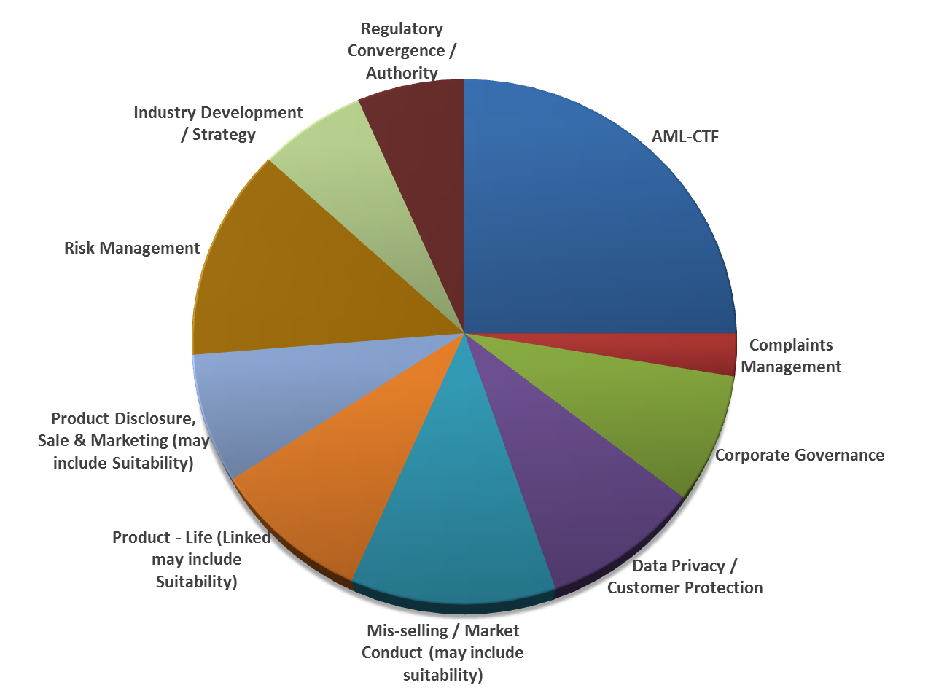
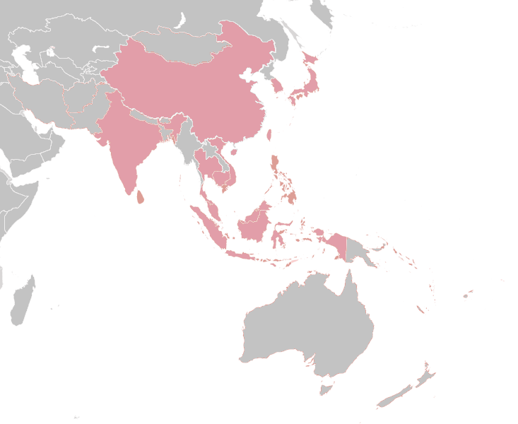
Regulatory Changes in Asia (ex Solvency/ Actuarial)
INDIA
MALAYSIA
SINGAPORE
THAILAND
VIETNAM
China
Korea
Key Themes:
Enhanced Due Diligence
High-Risk Customers / PEPs
Sanctioned Countries
KYC – Beneficial Owners
India
Hong Kong
Taiwan
Vietnam
Philippines
Thailand
Protecting Consumers’ Interest
Malaysia
Singapore
Protecting Consumers’ Interest
Protecting Consumers’ Interest
Indonesia
*For the last 12 months. ”Regulatory Themes” are based on the understanding of the scope and coverage of the relevant regulatory changes or developments identified for the period, other regulatory themes pertained to taxation, solvency, actuarial, etc. not represented here

Slide 11
Regulatory Developments in Asia Pacific (1/3)
  Australia
  Life Insurance
  Cap on upfront commission (as per cent of premiums): 80% from Jul 2016, 70% from Jul 2017 and 60% from Jul 2018.
  Renewal commission cap of 20%
  Two year commission clawback period: 100% of FYC in case policy lapses in 1st policy year, 60% in case policy lapses in 2nd year
  Ban on volume based payments being proposed
  Health Insurance
  From July 2015 the regulator of health insurance industry changed from PHIAC (Private Health Insurance Administration Council) to APRA (Australian Prudential Regulatory Authority)
  Insurers are concerned on risk management function becoming mandatory and the capital standards being strengthened
  China
  Introduction of C-ROSS from Jan 2016
  Risk oriented solvency regime using the three pillar approach of quantitative risk assessment, qualitative risk assessment and disclosure requirements
  Aligns the financial reporting system with the solvency system hence not fully economic
  Hong Kong
  Establishment of Independent Insurance Authority in phases
  RBC to be developed along the three pillar structure, not likely before 2020
  Conduct guidance: GN15 and GN16 covering product design, commission structure, marketing literature, illustrations
  GN10 covering Corporate Governance
  Impact from Mainland China owing to capital restrictions – however MCH sales in HK continue to be strong
  Source: KPMG

Slide 12
Regulatory Developments in Asia Pacific (2/3)
  Singapore
  ORSAs implemented from Dec 2015
  RBC2 consultations continue with QIS2 released, MAS looking to adopt by 2018/19
  Will impact insurers product, investment and capital strategy
  MAS continuing to look at Board to set tone at the top, perform stewardship role, and exercise effective oversight: fair treatment of customers, foster strong risk culture by defining risk objectives, promoting risk awareness and translating it to all aspects of business
  MAS set up a FinTech and Innovation Group in 2015: Regulatory sandbox announced
  FAIR: Financial Advisory Industry Review includes several aspects: higher CPD for advisors, more stringent licensing conditions for financial advisory firms, new minimum base capital requirements, balanced scorecard for remuneration, direct channel for simple insurance products, web aggregator for enhanced comparability
  Malaysia
  BNM approval required before dividend distribution to shareholders to ensure healthy CAR ratios
  LIFE Framework: Life Insurance and Family Takaful: aims to improve distribution diversification, gradual removal of limits on costs, to promote product innovation, strengthened market conduct to enhance customer protection
  Indonesia
  New reinsurance regulations (minimum domestic ceding)
  Temporary relaxation of capital requirements: option to use amortised cost as the valuation basis for debt, reduction in minimum RBC requirement of 50 per cent provided RBC ratio of 120%
  Marketing and approval of insurance: OJK’s prior approval
  Source: KPMG

Slide 13
Regulatory Developments in Asia Pacific (3/3)
  India
  FDI increase to 49% from 26%
  Reinsurers allowed to set up branches including Lloyds
  Insurers can issue capital other than equity shares
  Expense management including requirements on submission of expense allocation across product segments
  Corporate agents allowed to distribute three insurers products, previously were restricted to one of each life/health/non-life
  Taiwan
  Peer review of appointed actuary’s report every 3 years
  ORSA submission commencing in 2016
  Possibility of new RBC measurement as a standardised approximation to economic capital being discussed in the industry
  Thailand
  RBC changes being considered: QIS during 2016, transition period during which Op Risk charge to be introduced, focus on ORSA.
  At some point OIC will increase confidence level from 95 per cent VaR to 99.5 per cent VaR
  Source: KPMG

Slide 14
IAIS Supervisory Framework (1/2)
  IAIS is developing a ComFrame to supervise internationally active insurers (IAIGs)
  ComFrame or Common Framework includes Insurance Capital Standards (ICS) - global capital standard for increasingly globalised insurance market
Tier | Legal Entity | Group | IAIG |  | G-SII
Insurance Core Principles (ICPs) | ✓ ICPs applicable to LEs | ✓* * ICPs applicable to LEs and Groups
Com Frame | ✗ | ✗ | ✓ | ✓
G-SII package | ✗ | ✗ | ✗ | ✓
1
2
3
  ComFrame further builds on ICPs covering capital requirements for IAIGs, qualitative requirements for IAIGs, scope of group-wide supervision, requirements for supervisors, crisis management and resolution
  G-SII: Global Systemically Important Insurers published by Financial Stability Board www.fsb.org
  IAIG: Internationally Active Insurance Group published by the International Association of Insurance Supervisors

Slide 15
IAIS Supervisory Framework (2/2)
  ICS includes a G-SII package
Basic Capital Requirement
Finalised in 2014 with confidential reporting in 2015
Factor based approach to allow global comparability and ensure minimum capital requirements
To be replaced by ICS eventually
International Capital Standard
In development and annual field testing
Intended to produce a consistent global measure of capital
Current calibration 1-in-200 VaR
Version 1 reporting in 2017
Version 2 in 2019 to have greater comparability, may allow internal models
IAIS’s ultimate aim is to have a single ICS with common methodology globally
HLA
Higher Loss Absorbency
Initial form concluded in Oct 2015
Additional capital for G-SIIs to cover systemic risk
BCR+33% (uplift for G-SII)+HLA
Firm | List | ICS | BCR | HLA
G-SII | 9: Aegon, Allianz, AIG Aviva, Axa, MetLife, Ping An, Prudential Financial Prudential plc | ✓ | ✓ | ✓
IAIG | c.50 | ✓ | ✗ | ✗
Non-IAIG |  | ✗ | ✗ | ✗
G-SII package
  Source: IAIS, EY

Slide 16
APRA CPS220 Risk Management
Requirement of Boards
‘…forms a view of risk culture in the institution, and the extent to which that culture supports the ability of the institution to operate consistently within its risk appetite, identifies any desirable changes to risk culture and ensures the institution takes steps to address those changes’
  Source: APRA

Slide 17
APRA on undesirable behaviours
pursuing short-term financial interests, including personal interests, with little or no consideration of customer interests;
observing the letter of relevant law and regulation, while contravening the spirit of those laws and regulations;
treating risk management processes and/or controls as inconveniences which can be disregarded when expedient to do so;
poorly defining management accountabilities for risks;
failing to reward good risk management and/or apply consequences for poor management of risks;
senior executives and/or directors failing to take timely actions to mitigate significant risks;
concealing problems, rather than resolving the underlying causes of the problems; and
failing to challenge the status quo and consider alternative viewpoints, resulting in a false sense of security and risk blind spots.
  Source: APRA

Slide 18
risk management framework.

Slide 19
Risk Management Building Blocks
Governance
Roles & Responsibilities
Risk Policies
Culture
Identification
Risk Appetite
Risk Cycle
Risk-based Decision Making
Measurement
Monitoring
& Reporting
Internal Model
Technology

Slide 20
Risk Framework
Risk Framework
A
B
Risk Processes
Risk Governance
Risk Appetite
Risk Policies
Description of Risk Governance Arrangements
Risk Appetite Statements and aggregate limits
Examples:
Credit Risk, Insurance Risk, Liquidity Risk, Market Risk and Operational Risk Policies
Product Policy
In-Force Management Policy
Internal Model Policy (IM Companies only)
Model Risk Policy, Compliance, Customer, Investment,
Risk Management Cycle & ORSA
Approved Limits
by risk type
C
Risk-Based Decision
Making
Risk Culture
Risk Definition &
Categorization
Financial & Operational Incidents Procedure
Model Governance
Operational Standards and Risk Management Guidance Notes

Slide 21
Risk Appetite example
A
Capital
Solvency II regulatory capital
Internal Economic Capital
Earnings Volatility
EV Operating Profit
IFRS Operating Profit
Liquidity
Liquidity Coverage Ratio
Group
Group Limits
Risks significant at Group level
Operational Risk Level 2
Capital
Local solvency
Internal Economic Capital
Earnings Volatility
EV OP, VNB
Liquidity
Liquidity Coverage Ratio
Operational Risk
# of incidents
Cumulative losses
Local
Local Limits
By Risk Type (eg Counterparty Risk, Interest Rate Risk, Equity Risk)
Operational Risk
Group red/amber flags
  “1-in-x” fall
  Board decision to approve the “x”
  Limits reset at each planning cycle
  Risk budgets to local businesses
  Regular limits monitoring. Frequency varying by momentum of individual risk driver
  High level agreement of management actions at defined levels [Link with ORSA]
Notes:
Approved limits should have associated triggers and a framework to monitor actual exposure at an appropriate frequency.
The frequency should have regard to the risk’s momentum
1 in x where x is a matter for the Board to articulate with support from management
In the case of S2 and Ecap, given the volatility in results due to the market movements the risk appetite includes a counter cyclical buffer. So when the economic conditions are strong, a higher level of capital buffer is maintained which is partly released as the conditions get tighter.
Solvency ladder of intervention – associated with the targets and counter cyclical buffers, an increasing intensity of management actions (with increase frequency of reporting) would need to be defined and agreed.
Key is to agree, in advance, the broad management actions that would be triggered. Also important to ensure actions can be taken before breaching risk appetite.

Slide 22
Risk Policies
B
1
Ownership should be clearly established
2
Annual certification process with risk function providing oversight for first line policies. Audit to provide process assurance
3
Operating Standards to underpin the Policies
4
Recent regulatory focus on Model Risk Policy. IAA recently released ISAP on Model Risk
Notes:
A well established Governance map which is well understood by all three lines of defence is the first step
Committees that are taking risk/ managing risk are first line whereas Risk Management Function/ Second line is responsible for the Oversight Activities
As an example, ALCO is a first line committee not a second line committee. Risk Committee is a second line. The second line should have representation on first line committees to provide the risk challenge and oversight. These include ALCO, Product Approval Committees.

Slide 23
Risk Based Decision Making
Processes
C
1
Product development
2
Risk Transfer
3
Strategic Decisions/ M&A
4
Strategic Asset Allocation / Investments
5
Capital Management
6
Business Planning
Notes:
Requirements and key metrics for each of the RBDM processes is agreed with stakeholders.

Slide 24
outlook.

Slide 25
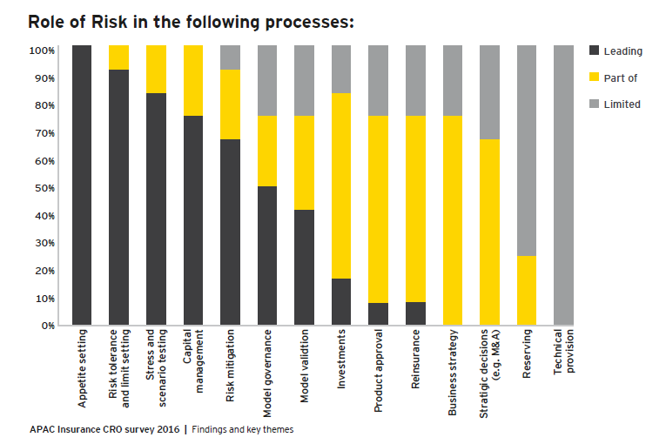
Role of Risk Across Processes
  Source: EY
Notes:
Requirements and key metrics for each of the RBDM processes is agreed with stakeholders.

Slide 26
8 Key Success Factors for Risk Functions
1
5
Early intervention
Reputational risk management
2
6
Score of “Wins” by Risk Function
Risk Appetite
3
Keep abreast of regulatory developments
7
Skills of a risk manager
4
Know the competition
8
Strong risk culture
Notes:
Early intervention
Earlier involvement of risk function is better.
Consultation time, ability to influence the decision before it is fully baked
Product design especially good example of this
2. Risk Appetite
Clarity on what it is, across functions, especially first line.
Precise, agreed and understood
Risk function should then guard the risk appetite jealously
3. Keep abreast of regulatory developments
Possibly stay ahead of regulatory changes
Consultation documents are good lead indicators of where regulations might be headed and as such are useful material
4. Know the Competition
Understanding the problems they face is particularly useful, as these might become our problems and hence lead indicators.
5. Reputational Risk management
Important to understand what risks might lead to reputation risk
Momentum and scope
6. Score of “Wins” by Risk Function
Proof of challenge , evidence of potential losses avoided
Regulators increasingly looking for evidence of effective risk challenge
Also supports the case for Risk Management internally
7. Skills of a Risk Manager
Developing the right skills / appropriate first line and business experience
Skills and characteristics
Ability to influence in an appropriate manner considering the culture
8. What You Want to Achieve from the Risk Committee
Clear expectations from the RC – noting/ for decision etc
Where you are seeking support to drive a decision with first line be clear.

Slide 27
Most institutions are still grappling with how best to clearly articulate what type of risk culture they aspire to, identify any specific weaknesses in their current risk culture, and how they most effectively address those weaknesses. It is therefore critical that this attention on risk culture be sustained
  Source: APRA

Slide 28

Notes:
Requirements and key metrics for each of the RBDM processes is agreed with stakeholders.

