Slide 1

28th India Fellowship Seminar
Topic: MCEV VS EEV Approach – discussion on approach adopted by companies before public listing
Guide Name: Asha Murali
Presenters Name:
1. Krithika Verma
2. Aditya Shah
3 Mithil Sejpal
Date: 9 November 2017
Mumbai
Indian Actuarial Profession
Serving the Cause of Public Interest

Slide 2
AGENDA
Need for Embedded Value (EV)
Historical Developments
Today’s challenges
EEV vs. MCEV
Implementation challenges of MCEV
Advantages of MCEV
Listing process – A perspective
APS 10 Requirements
Other listing requirements

Slide 3
Why is there a need for Embedded Value (EV) ?
Measures to compute value of a life insurer:
Balance sheet Assets less Liabilities (Book value basis)
Profit & Loss (Historic measure)
Income (No allowance for risk and cost of capital)
EV represents the consolidated value of shareholder’s interests in the business
Internal
Uses
Performance Measurement (Management)
Performance Measurement (Product)
External
Uses
Mergers & Acquisition
Raise Capital
Capital Allocation
Comparison of companies

Slide 4
EV has come a long way !
2009
APM / TEV
EEV
MCEV
Not prescribed
MCEV Amended
2008
2004
2001
1980s
1980s
AMP – Pearl merger (Criticized)
2001
Lack of consistency & transparency
2004
Improved allowance for risk
2008
2009
Risk neutral probabilities
Dysfunctional Markets
Liquidity premium
Stochastic valuation of options & guarantees
Market consistent assumptions
Lack of published financial information
Options & guarantees computed deterministically
Lack of computing power
Subjectivity in setting RDR

Slide 5

A look around us
TEV / EEV
{No formal disclosures}
TEV / EEV
{No formal disclosures}
Notes:
Market consistent EEV describes a company reporting in compliance with EEV principles but on a market consistent basis

Slide 6
And the debate continues…
Cost of Capital
Convergence of EV and SII
Choice of risk-free rate in illiquid and non-existent markets
Curve construction - Interpolation/extrapolation methodology
Whether and how to allow for a liquidity premium

Slide 7
MCEV v EEV

Slide 8
European Embedded Value (EEV)
European
Embedded Value
Shareholder’s Net Worth
+
Value In Force
Required
Capital
TVOG
Free Surplus
+
PV of Future
Profits
-
COC

Slide 9
Market Consistent Embedded Value (MCEV)
Market Consistent
Embedded Value
Shareholder’s Net Worth
+
Value In Force
Required
Capital
TVOG
Free Surplus
+
PV of Future
Profits
-
FRCC
CRNHR

Slide 10
Key changes to EV methodology under MCEV
Risk Neutral Valuation
  All assets are assumed to earn the risk free rate (RFR)
  RFR is taken as the swap yield curve including a liquidity premium for illiquid liabilities
Cost of Non Hedgeable Risk (CRNHR)
  Risks not included elsewhere
  Includes correlations, dynamic customer behaviour that are not accounted for

Slide 11
Key changes to EV methodology under MCEV
Frictional Cost of Capital (FRCC)
  Represents the cost of holding “Required Capital” from shareholder’s perspective
  Costs include: investment expenses and tax on investment return
Time Value of Options and Guarantees (TVOG)
  Clear guidance to use risk neutral approach
  Use prices of similar instruments that mirror the liability cash flows

Slide 12
Challenges in implementing MCEV
Risk Neutral Valuation
  Markets where swap curves are not sufficiently robust
  Potentially volatile results in turbulent markets
  Valuing cash flows with longer durations
Cost of Non Hedgeable Risk
  Lacks detailed guidance with respect to its computation
Modeling
  Policyholder options and guarantees
  Dynamic policyholder behaviour and management action

Slide 13
Advantages of MCEV over its predecessors
Higher degree of comparability between results of different companies
  Standard format for movement analysis
Has injected more objectivity in the process of producing results
  Mark to market basis
Reduces the scope of “managing” the results
  Strengthening of requirement for external review
  Wider range of sensitivities

Slide 14
Listing Process – A Perspective

Slide 15
Why is EV important for Listing?
Life Insurance Valuation
Embedded Value
Structural Value
Expected NBM X Next year’s APE
Capitalization Factor
EPV# of profits on business already written
(ViF)
Expected future growth in NBM
Expected future growth in APE
Adjusted Net worth
(ANW)
Generally Expressed as a Multiple of EV
Multiple would vary as per the New Business Profitability
# Expected Present Value

Slide 16
The Listing Process
Data Audit, Model Audit
Month 1 | Month 2 | Month 3 | Month 4 | Month 5 | Month 6 | Month 7
Appointment of Bankers, Lawyers Independent Actuary, Data Auditors (APS10 Report)
IRDAI approval to IPO
Submission of EV Report
Preparation of Draft Red Hearing Prospectus
Business positioning and key metrics
Financial statements
Due-diligence
Securities and Exchange Board of India approval
Marketing
Pricing and allocation

Slide 17
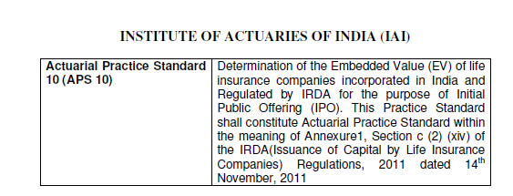
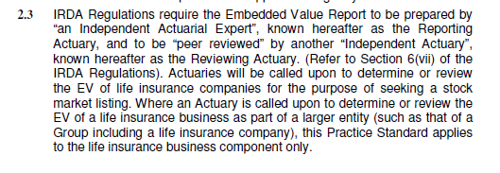
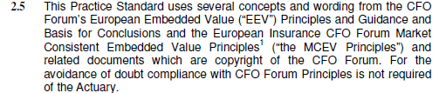
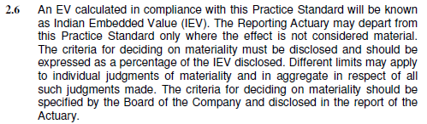
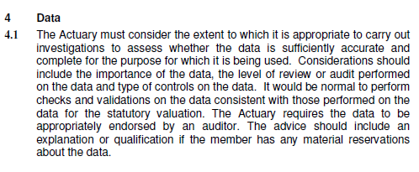

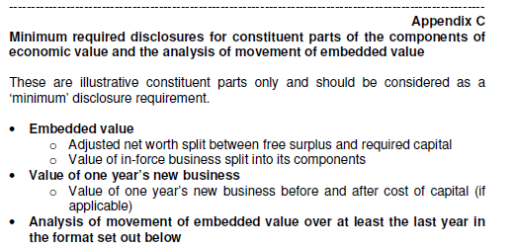
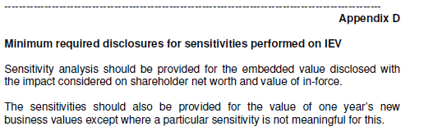
Extracts from APS 10

Slide 18
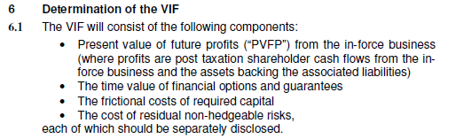
Value-in-Force (1)
Assumptions
Participating Contracts
Differing Views
Economic : Discount rate - based on Reference rates; Inflation - based on Market Data
Non-Economic : based on best estimate of future experience having regard to credible current & past experience with expected changes in the future operating environment
Assumptions about future bonuses & profit allocation between shareholders/policyholders
Future bonus assumption to be consistent with future investment return assumption
Reference Rates
Curve fitting for Risk-Free Yield Curve
Proxy for Risk Free Rate - G-Sec Yield Curve or Swap Yield Curve (in case of deep markets)
Timing for release of participating fund FFA
Release of global reserves

Slide 19
Value-in-Force (2)
TVFOG
Allowance for cost of embedded options & guarantees in the event of adverse market movements
FC
It reflects the taxation and investment management cost of earnings from assets backing the required capital
CRNHR
Requires projection of required capital over the lifetime of the existing book
CRNHR is the present value of the cost of capital charge levied on the projected capital in respect of the identified material non-hedgeable risks
Risks generally include operational, mortality, lapse
Allowance for risks is generally made to the extent that these are not already allowed for in the TVFOG/PVFP
Cost of capital charge have been found to be varying between 3.5-5%
Capital includes investment in subsidiaries as well
Calculations must be based on stochastic techniques
The first step is identification of products consisting of such options/guarantees - includes ULIPs with Capital/NAV guarantee, Par products (to the extent of SA & accrued bonuses), Group fund based
Appropriate allowance for management action in adverse scenario needs to be made (say bonus reduction)

Slide 20

Adjusted Net Worth
Net Worth Adjustment is done as EV principles require all valuation on market values
Under Balance Sheet, Debt is valued at amortized cost, whereas Equity is valued at market value
APS 10 Requires a split of Networth between Free surplus/Required Capital & reconciliation of the same
Differing views
Treatment of market value adjustment on non-par group funds management business
Tax on the unrealised gains / losses on equities in the balance sheet?

Slide 21
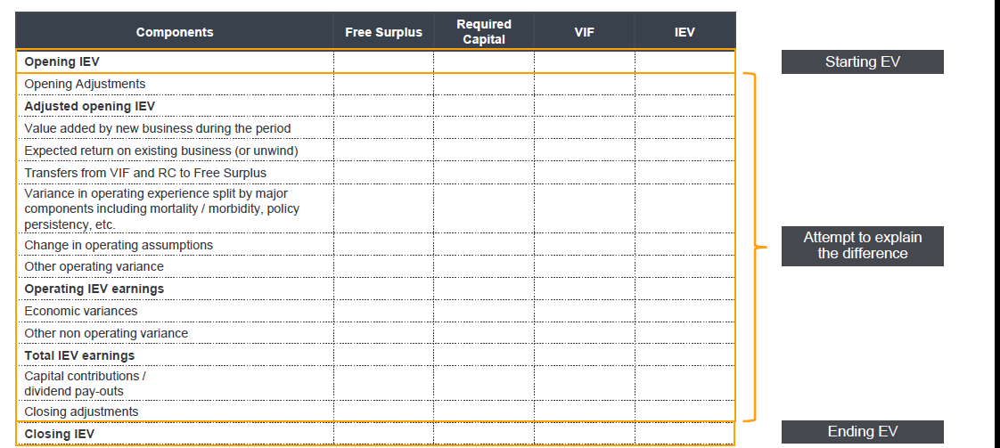
Other APS10 Requirements (1) - AoM

Slide 22
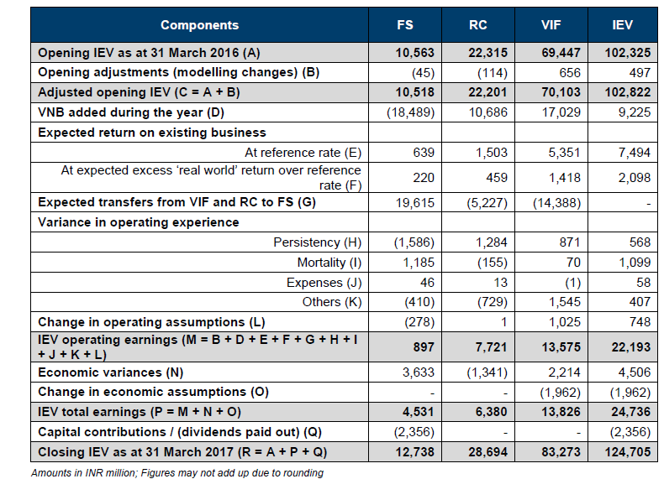
AoM - Live Example
Management’s view of expected returns, generally based on locked-in yields of assets held
+ve variance indicates better Persistency, lower Mortality/Expense than that assumed for calculating EV
EVOP % =
IEV Operating Earning/Opening EV
Source: HDFC Life DRHP

Slide 23
Other APS10 Requirements (2) - Sensitivities
Investment
+/-100/200 bps
Equity shock of 10/20%
Others
+/- 5% (multiplicative) in the mortality / morbidity rates
25% change in equity volatility
Expenses
Persistency
+/-10% in maintenance expenses
+/-10% acquisition expenses
+/- 10/50% change in persistency rates
Mass Lapsation of 25/50% at end of lock-in period
+/- 50% change in surrender rates post lock-in
Required capital set equal to the level of solvency capital
Assumed tax rate increased to match corporation tax rate for other industries
Sensitivities carried out by changing one parameter in isolation
Separate sensitivities required for VNB/EV
Ambiguity whether market value adjustments are applicable in economic sensitivities

Slide 24
Other Listing Requirements
Date of listing to be carefully chosen – financials valid for a 135 day period
Supplementary EV report consisting only of headline EV/VNB number
- applicable where listing is not immediately after financial year-end
Segment-wise Lapse Profits (area mandated by regulators)
Data Audit
Queries raised by Analyst/Investment houses during road-shows, marketing

Slide 25

Questions!!
Because,
“It is not the answer that enlightens, but the question.”

