Slide 1

27th India Fellowship Seminar
Cyber risk and Terrorism risk - Challenges in pricing
Effectiveness of Derivative Products in India to Hedge Investment Guarantees of Life Insurers
Guide: Rajagopalan V.
Presenters: Rakesh Kumar
Ranjan Gupta
Prasham Rambhia
Supervisor:
P.A. Balasubramanian, FIAI
1st June 2017
Mumbai
Indian Actuarial Profession
Serving the Cause of Public Interest

Slide 2
Agenda
Life Insurance in India
Investment Guarantees of Life Insurers in India
Derivatives and their Broad Types
Derivatives: Indian Context
IRDAI Regulations and Guidelines
Interest Rate Swaps
Interest Rate Futures
Use of Derivatives by Overseas Life Insurers
Conclusion

Slide 3
Life Insurance in India
Brief History of the Sector
Nationalization of life insurance sector in 1956, all existing entities merged into a single public sector firm: Life Insurance Corporation of India
Privatization of sector in 2000; establishment of regulatory body (IRDAI)
Currently, 24 life insurers in India (1 in public sector, 23 in private sector)
Categories of Products
Non-participating
Participating
Term insurance policies
Whole life policies
Money back policies
Endowment policies
Child plans
ULIPs
Pension plans

Slide 4
Investment Guarantees of Life Insurers in India
Product Type | Investment Guarantee | Comments
Term insurance | None | Pure insurance product, no investment component
Whole-life / Money-back / Endowment policies Child plans | Returns often guaranteed; hence, insurer bears (mostly interest rate) risk | Insurance-investment hybrid; more risky for non-participating product
ULIPs | None | Investment risk borne by policyholder
Annuity/pension plans | Implied guarantee on interest rates | Extent of risk depends on specific type of annuity
Guarantees are relevant for both non-participating and participating products:
Non-participating products → Guaranteed return
Participating products → Guarantees accumulate with every declared bonus
Also, there is need to meet Policyholders’ Reasonable Expectations
Interest rate risk is the key investment risk factor for life insurers
Other risks might include equity, credit, currency (FX) risks

Slide 5
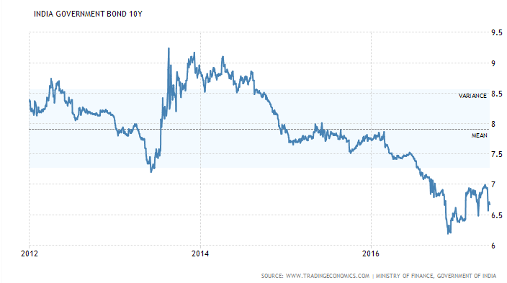
10 Year Indian Government Bond Yield
Falling yield
Risk of not meeting the investment guarantees
Creates the need for derivatives to hedge the interest rate risk

Slide 6
Derivatives and Broad Types
Derivatives = Securities which derive their value from other, more fundamental underlying assets or variables
Common Derivative Types
Futures/Forwards (exchanging cash/asset in future on previously set terms)
Swaps (exchange of series of payments according to pre-decided formula)
Options (right, but no obligation, to enter in a pre-decided transaction in future)
More complex versions (swaptions, compound options, etc)
Derivative Markets
Exchange Traded (standardized, liquid, very little default risk)
Over The Counter (customized/bespoke, flexible, prone to default risk)
Common Underlying Assets/Variables
Equities / Currency (FX) / Interest Rates (IR) / Credit / Commodities

Slide 7
Examples/Types of Derivatives
 | Exchange-traded |  | OTC
 | Futures | Options | Forwards | Options | Swaps
Equities | Index Futures | Index options | Repurchase Agreement | Stock Option | Equity Swap
FX | Currency Future | Option on Currency Future | Currency Forward | Currency Option | Currency Swap
IR | Eurodollar Future | Option on Eurodollar Future | Forward Rate Agreement (FRA) | IR Caps and Floors, Swaption | Interest Rate Swap (IRS)
Credit | Bond Future | Option on Bond Future | Repurchase Agreement | Default Option | Credit Default Swap (CDS)
Commodities | Crude Oil Future | Copper Option | Livestock Forward | Gold Option | Commodity Swap

Slide 8
Derivatives: Indian Context
Relatively Nascent
RBI first permitted IR derivatives (FRA/IRS) in July 1999
Equity index futures launched in June 2000 (Options followed in June 2001)
FX futures trading on NSE went live in August 2008
First credit derivative (CDS) traded in December 2011
Highly Regulated (compared to developed financial markets)
For many derivative types, particularly OTC, there are stringent regulations such as:
Naked positions not allowed / Need to hedge must be demonstrated
Only a few, highly regulated entities can play market-maker
Restrictions on participation of foreign and non-resident players
Underlying Asset Class | Regulator
IR / FX / Credit | Reserve Bank of India (RBI)
Equity / Commodity | Securities Exchange Board of India (SEBI)

Slide 9
Derivatives for Life Insurers in India
Use of derivatives by life insurers is relatively subdued because:
Derivatives market in India is not very deep
Insurers in India have severe regulatory restrictions (imposed, directly or indirectly, by several sources) on their use
Successful adoption would require the following elements:
  specialist expertise
  shared understanding of risks between executives and the Board
  appetite for use of derivatives and relevant governance norms
The key investment risk factor for life insurers is Interest Rates!
Therefore, in practice, the most commonly used derivatives include:
Interest Rate Swaps (IRS)
Interest Rate Futures (IRF)

Slide 10
IRDAI Regulations (Derivatives)
Dealing in financial derivatives Section 11 (IRDAI – Investment Regulations 2000):
Dealing in Financial derivatives is permitted in accordance with the guidelines issued by the Authority from time to time
IRDAI Guidelines (2004):
Permitted use of derivatives with a maximum tenure of 1 year to hedge the interest rate risk on investments and forecasted transactions – which had limited use for life insurers
Circular (11th June 2014) Guidelines on Interest rate derivatives: Guidelines to deal with interest rate derivatives with longer terms
IRDAI (Investment) Regulations, 2016:
Exposure/ Prudential and other investment norms to be complied with while dealing in derivatives

Slide 11
Guidelines on Interest rate derivatives
3 types of Interest rate derivatives are permitted:
  Interest rate swaps (IRS)
  Interest rate future (IRF)
  Forward rate agreements (FRA)
Hedging permitted for forecasted transactions:
  Maturity proceeds of fixed income securities
  Investment income
  Expected premium receivables for underwritten insurance contracts
Can be used for hedging only
Counterparties need to be commercial bank or primary dealer permitted by RBI
Two-way CSA (Credit Support Annex) agreements mandatory to mitigate the counterparty risk
Credit Equivalent Amount of the FRA/IRS to be used for reckoning counter party credit exposure

Slide 12
Guidelines on Interest rate derivatives
Restriction on total exposure specified (notional principal amount equivalent to 100% of the book value of the fixed income investments of the insurer under the policyholder’s fund (excluding ULIP ) and shareholders’ fund taken together)
Pre-approved risk management policy by the board of directors
Board to ensure the suitability and appropriateness of the investments
Efficient corporate governance, where the board and the insurer know the complex products and the risks involved
Quarterly reports to be submitted to IRDAI in the prescribed format
Certificate from the concurrent auditor that systems and procedures are in place
Compliance with RBI, ISDA guidelines & Accounting standards

Slide 13

Accounting Standards Requirement
Fair Value Hedge:
Hedge the fair value of the underlying item.
Any loss/gain from re-measuring the derivative at fair value is recognised in P/L account
Cash Flow Hedge:
Hedge of the exposure to variability in cash flows
Treatment in Balance Sheet : Effective portion is recognized directly in the separate reserve called Hedging Reserve in Reserves and Surplus
Treatment in P/L Account : Ineffective portion of the fair value movement on derivative is recorded
Hedge Effectiveness Test:
should lie between 80% and 125%

Slide 14
Interest Rate Swaps
An Interest Rate Swap (IRS) is a derivative instrument in which two parties agree to exchange interest rate cash flows, based on a specified notional amount from a fixed rate to a floating rate (or vice versa) or from one floating rate to another
IRS was introduced in 1999 to enable market participants to hedge interest rate risk
RBI has only allowed plain vanilla IRS products to be offered
Insurance company
Fixed rate
Investment Bank
Floating rate
Fixed
Floating rate
Liability
Assets

Slide 15
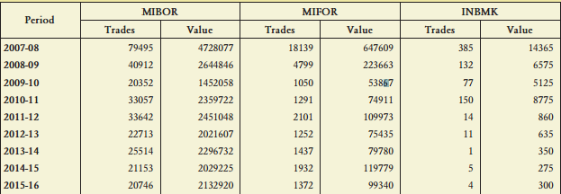
Interest Rate Swaps
RBI has not prescribed use of any particular floating rate benchmark,
Currently three benchmarks are commonly used in IRS:
  MIBOR: daily overnight Mumbai Inter-Bank Outright Rate
  MIFOR: Mumbai Inter-Bank Forward offered Rate which a mix of the London Interbank Offer Rate (LIBOR) and a forward premium derived from Indian forex markets.
  INBMK: Indian government securities benchmark rate
INR in Crores
Source: CCIL’s Rakshitra, April 2017

Slide 16
Advantage and Disadvantage of IRS
Advantage:
Removes uncertainty about interest rate
Customized as per ones requirement
Fairly Liquid market up-to 5 year period
Disadvantages :
Basis risk if the spread between G-sec and MIBOR is wider
Require rebalancing in light of mortality & persistency experience
Illiquidity for longer tenure
Counterparty risk
Volumes declining over last few years
Documentation and compliance cost

Slide 17
Interest Rate Futures
An Interest Rate Futures contract is "an agreement to buy or sell the underlying debt instrument at a specified future date at a price that is fixed today”
Objective: To allow hedge of interest rate risk in a market environment, where long term debt issuance by the government is increasing
Exchange traded interest rate derivatives were introduced in 2003 but failed due to
  prohibition on banks to trade
  complex cash settlement mechanism
Reintroduced in 2009 but failed due to
  physically settlement and illiquidity in the underlying bond
  the bank participation was low due to OTC attractiveness
Introduced for the 3rd time in January 2014
  Allowed cash settlement
  Introduced at 3 exchanges viz. NSE, BSE and MCX-SX
  Daily average turnover in the IRF segment is still very low

Slide 18
Advantages and Disadvantages of IRF
Advantages :
10 Year G-Sec is the underlying – Most Liquid
Hedge against Long duration liabilities
Less Basis Risk
No counterparty default risk
Comparatively less compliance cost
Easier to rebalance in light of mortality & persistency experience
Disadvantages:
Possibility of Rollover risk – Less Liquidity beyond 1 month
Cannot offer a good hedge for all maturities
Volumes yet to gain sufficient traction

Slide 19
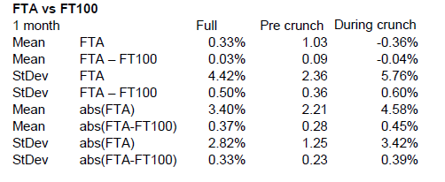
Use of Derivatives by Overseas Life Insurers
Equity Puts & Collars
Used by large number of UK insurers to protect against equity value falls
Options generally based on FTSE 100 as opposed to FTSE all shares, introducing basis risk
Effectiveness could be evaluated in terms of mean and standard deviation of difference in FTSE 100 and FTSE All
Monthly price movement Statistics for 5 years
During Credit Crunch, wider price differences observed
Not perfect hedge (diff of 10% on average)
Fairly effective during the crunch time
All share options reduce basis risk but are more costly and less liquid
Source: SIAS Report of the Risk and Investment Working Party, April 2010

Slide 20
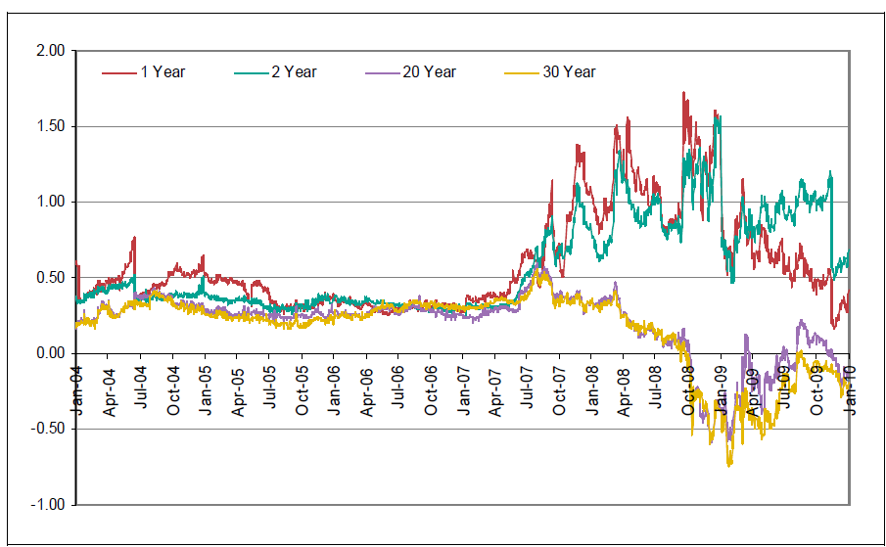
Use of Derivatives by Overseas Life Insurers
Interest Rate Swaps
Used by majority of UK insurers for:
  Matching guaranteed benefits under with-profits contracts
  Immunization from interest rate mismatch
  Duration matching of assets and liabilities
Swap rates are traditionally higher than gilt yields, i.e. swap spreads are traditionally positive
Traditionally, Swap spreads stable (~30 bps)
During credit crunch:
short end swap spread increased
long end swap spread declined, becoming negative
Swap Spreads (%) – Swap Rate minus Gilt Yield

Slide 21
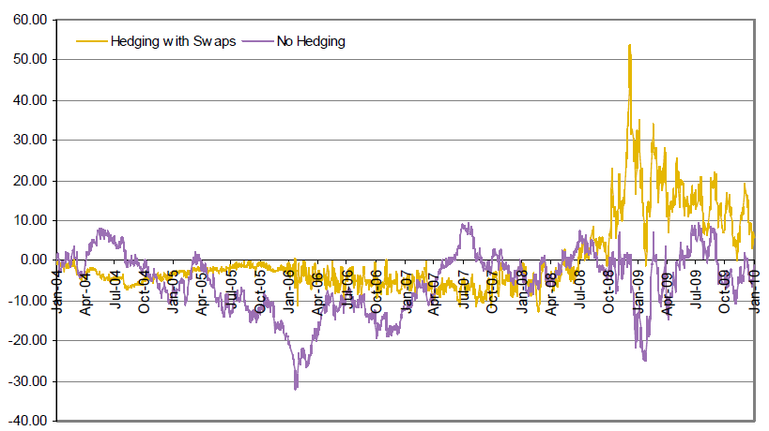
Use of Derivatives by Overseas Life Insurers
Interest Rate Swaps Contd..
Volatility in swap spread flows through Balance Sheet
To illustrate the potential balance sheet impact, let’s consider example of a rolling 30 year liability, valued using the 30 year gilt yield
Two investment strategies considered:
  Liability backed with cash: exposed to movement in 30 year gilt yield
  Liability hedged with 30 year interest rate swap: exposed to 30 year swap spread
Before credit Crunch, noticeable improvement in mean and volatility of net asset position
During credit crunch, hedging increased the risk
Movement in net assets for 30 year Liability

Slide 22
Use of Derivatives by Overseas Life Insurers
Hedging Strategy for Variable Annuities (VA) in US
VA involves number of different types of guarantees: GMDB, GMAB, GMIB, GMWB
Guarantees valuable to policyholders during financial crisis
Hedging adopted by most insurers worked as intended
Hedging saved the industry $40 billion in Sep. and Oct. 2008, offsetting more than 90% of industry’s increased liability over the period
Most insurers reported breakage below 2% before 2008.
In 2008, some insurers experienced double digit breakage (e.g. 30%)
Reasons for hedge breakage include: basis risk, policyholder behavior, counterparty risk, execution risk

Slide 23
Use of Derivatives by Overseas Life Insurers
Lessons Learnt
Analyze hedging strategies in detail to understand basis and other residual risks
Establish appropriate economic capital for basis risks
Reflect in new business pricing the costs associated with basis risks between guarantees offered to customers and available hedging instruments
Review selection of counterparties and their collateral, and other counterparty risk mitigation arrangements
Perform stress tests of hedging strategies and collateral arrangements against extreme events including, but not limited to, a repeat of the financial crisis
Ensure that the issues associated with basis risk are properly communicated to all key stakeholders (e.g. the Board)

Slide 24
Conclusion
Available derivatives in India are helpful in mitigating investment guarantees to a limited extent
Need to develop expertise, understanding and governance structure regarding use of derivatives
Hedging through derivatives can give a competitive advantage
Practical difficulties need to be overcome
Risk management is required for residual risk
Consideration need to be given to the effectiveness in a stressed scenario (e.g. financial market turmoil)

Slide 25
Thank You!

Slide 26
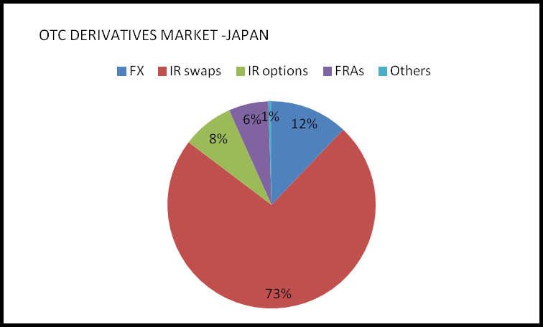
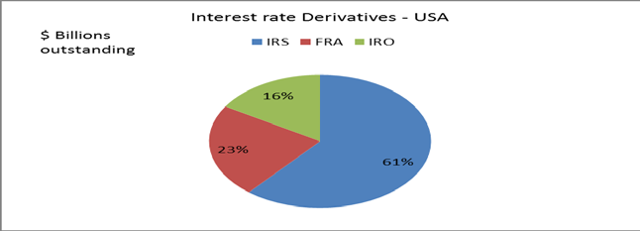
Wide Use of Swaps Worldwide
JAPAN:
The notional amounts outstanding of derivatives transactions by major Japanese financial institutions at end-December 2014 were equivalent to 54.3 trillion U.S. dollars for over-the-counter (OTC) contracts and 4.9 trillion U.S. dollars for exchange-traded contracts.
A breakdown by instrument type shows that IR swaps continued to hold the largest share of OTC contracts, accounting for 73.2 percent
USA:
Forward rate agreements (FRAs), interest rate swaps, and interest rate options averaged $628 billion per day in the United States during April 2013.

Slide 27
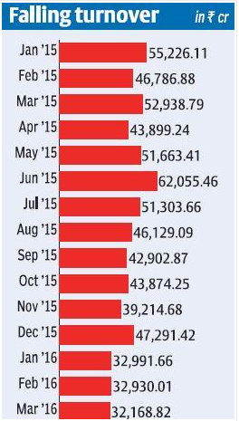
Falling IRF Volumes
IRFs are mainly used by the holders of government bonds.
Government bonds were concentrated in the hands of commercial banks (35 per cent), insurance companies (21 per cent) and provident funds (7.58 per cent.)
These institutions would be selling the instruments before the maturity date and they do not need IRF.
Retail investors rarely hold government bonds directly & Mutual funds hold 1.89 per cent of the government bond issuances
Foreign portfolio investors who hold 3.67 per cent are likely to churn their bond portfolio more often and hence, may need IRFs.
Too many restrictions on the kind of strategies that these investors can adopt while trading.
For instance, the total gross short (sold) position of each FPI in IRF shall not exceed its long position in government securities and in IRFs at any point in time. These rules limit the freedom in implementing trading strategies

Slide 28
Accounting Standards Requirement
Disclosures in the Financial statements:
Description of Participant’s financial risk management objective and policies, in particular its policy for hedging forecasted transactions.
Hedging strategy.
Accounting Policy for Derivatives.
Nature and terms of outstanding Interest Rate derivative contracts.
Quantification of the losses which would be incurred if counter-parties failed to fulfil their obligation under the outstanding Interest Rate derivative contracts.

Slide 29
Interest Rate Swaps:
  MIBOR: reference rate equal to the daily overnight Mumbai Inter-Bank Outright Rate. Calculated everyday by the National Stock Exchange of India (NSEIL) as a weighted average of lending rates of a group of banks. The swaps on overnight MIBOR, i.e. OIS, is the most actively traded instrument. The OIS trades are mainly confined to 1-year tenor, followed by 2-year and 5-year tenors
  MIFOR: rate for a Reset Date will be the Mumbai Inter-Bank Forward offered Rate for a period of the Designated Maturity. MIFOR is a mix of the London Interbank Offer Rate (LIBOR) and a forward premium derived from Indian forex markets.
  INBMK: rate for a Reset Date will be the Indian government securities benchmark rate for a period of the Designated Maturity.

