Slide 1

28th India Fellowship Seminar
Value added benefits in health insurance – an actuarial perspective to the viability and are they worth for the customers
Guide Name: A V Karthikeyan
Presenters Name:
Swati Anil Umre
Mansi Kukreja
Safder Jaffer
Date: 09 November 2017
Mumbai
Indian Actuarial Profession
Serving the Cause of Public Interest

Slide 2
Agenda
Introduction to the Indian Healthcare Industry
Defining Value Added Benefits
Benefits and Limitations: For the Customer
Benefits and Limitations: For the Insurer
Pricing Approaches: Risks & Challenges Associated With Pricing
Conclusions

Slide 3

Health care is one of the most promising sectors of the Indian economy
  Salient features of Indian healthcare industry
  Impressive growth prospects
Indian healthcare sector is expected to grow at a CAGR of 11% during 2015–20 to reach US$176 billion by 2020^
There is significant scope for improving healthcare services availability in India which offers ample opportunity for development of the healthcare industry
  Strong fundamentals
Increasing income levels, ageing population, growing health awareness and changing attitude towards preventive healthcare is expected to boost healthcare services demand in future
Availability of a large pool of well trained medical professionals in the country is expected to provide the necessary support
  Cost advantage
Low cost of medical services has resulted in a rise in the country’s medical tourism, attracting patients from across the world
Medial tourism in India is expected to grow at 20-25%* per annum based on government data
India has emerged as a hub for R&D activities for international players due to its relatively low cost of clinical research
  Policy support vv
Conducive policies encouraging FDI, tax benefits, favourable government policies coupled with promising growth prospects have helped the industry attract private equity, venture capitals and foreign players
Creation of National Health Insurance Mission to provide health benefits to people
  Fifth largest employer
India is expected to rank amongst the top three healthcare markets in terms of incremental growth by 2020*
In 2015, Indian healthcare sector became the fifth largest employer, both in terms of direct as well as indirect employment, with total direct employment of over 47 crores people*
1
2
3
4
5
Source: * IBEF
^ World Health Organization (WHO), BMI

Slide 4





Overview of the Indian health insurance market
IRDAI licensed
health insurance
Self funded
schemes
Group
Retail
      4 public sector, 18 private sector general insurers that can sell health insurance
6 stand-alone health insurers with Aditya Birla as a new entrant in 2016
Few life insurance players* provide health insurance
such as LIC
      Many governmental and public sector institutions, as well as some private corporates (e.g. Unilever, P&G) have self-funded health insurance schemes
      Certain government schemes are self-funded as well
Group health insurance cover (either employer-employee or non employer-employee (like holders of the same credit card, etc.)
Individual or family floater
Tax benefit under section 80D
Government Sponsored
RSBY (Rashtiya Swasthiya Bima Yojana)
Other State sponsored insurance schemes
Players
Indian Health Insurance sector
Segments
Limited Indemnity
Personal Accident*
Agency
Third party
Products
Channels
Reimbursement against the costs of medical expenses
Direct payment to provider as an option, known as cashless
Loss of life due to accident
Permanent and temporary disability
Brokers
Bancassurance
Corporate agents
Web aggregators
Traditional agents
Variable agency model
Overseas Travel*
Critical Illness*
Direct / Telesales
Online/Digital
Overseas Mediclaim insurance
Loss of flight & luggage
Lump sum payment on
diagnosis of one of the specific life threatening illness
Direct sales staff
Call-centre
Website sales
Tablet / mobile app Aggregators
E-commerce tie ups
Add on coverages (e.g. Dental)
* Not a significant portfolio
Category accounts for major share of the segment

Slide 5
Complementing the growth in healthcare industry, health insurance sector has also experienced an impressive CAGR of ~17% between FY 12-16
Health insurance GWP
In INR Bn.
CAGR 18.7%
CAGR: 16.9%
  Key growth drivers for health insurance
  Technology
  New technologies disrupting health insurance
  Insurers launching mobile apps & internet based services
  Regulatory reforms and tax incentives
  Recognition of Health insurance as a standalone class; allowing more opportunities through open architecture
  Increase in tax benefits in 80D from 15K to 25K
  Increased Awareness
  Increasing awareness of health insurance and growing perception of insurance needs among people, evidenced by ~21% growth in the retail health insurance
  High out of pocket expenditure
  62% per cent of the total health care expenditure in the country was borne by households out of their pockets in 2014
  Increasing Healthcare costs
  Healthcare expenditures continue to rise as the government modernizes India’s healthcare system
1
2
3
4
5
Source: WHO Study; IRDA Annual reports
Notes:
Add FY 17 Dec data

Slide 6
Health insurance products falls under two main categories
90%
  Limited indemnity
10%
  Fixed benefit
In-patient cover
Covers hospital treatment that requires a stay of one or more nights
Hospital cash
Pays an assured amount for days spent in hospital irrespective of type and amount of the bill
01
06
Out-patient (OPD)
Covers hospital treatment that doesn’t requires an overnight stay
Surgical cash
  Pays for any in-patient or day surgery, depending on the severity of the operation and typical recovery period
02
Health Insurance Products
05
Health + Savings
Health insurance that rewards you with saving points on adoption of healthy practices
Critical illness
  Provides lump-sum benefit on diagnosis of Critical Illness / Major Medical Illnesses and procedures
03
04
In India, currently 90% of health insurance products are indemnity but fixed benefit products have started gaining traction in recent times

Slide 7




Value Added Benefits in Health Insurance
Maternity benefit
Cover for all the expenses involved in the delivery of a child and/or expenses related to medically necessary and lawful termination of pregnancy.
Dental cover
Reimbursement of medical expenses incurred in connection with treatment of any injury or illness to natural tooth/teeth.
Restoration
Reinstatement of 100% of Sum Insured (once in a policy year) if the claim is not related to the illness for which a claim has been made earlier in the year.
Wellness programs
To promote, incentivise and reward the policyholder for his healthy behaviour through various wellness services.
1
2
3
4

Slide 8
Are Value Added Benefits Worth for the Customers and Insurance Companies?

Slide 9
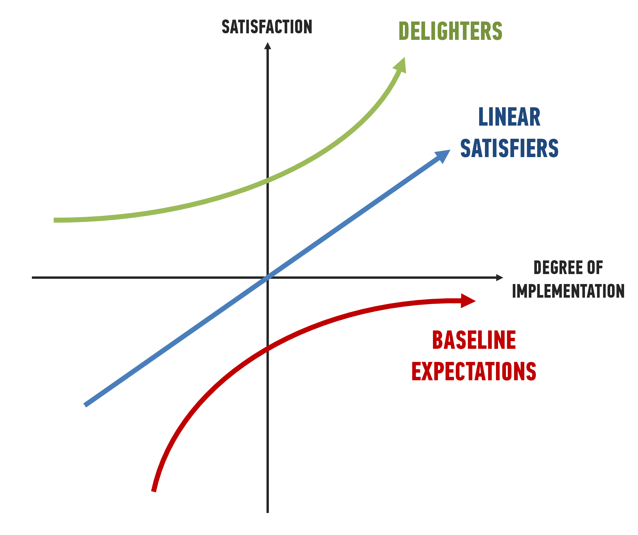
The KANO Analysis
for ever changing customer needs
DELIGHTERS
Wellness Coach
Gym Membership
Health Checkups
Health Reward Points
Air Ambulance
Hospitalization Benefits
Quick Claim settlement
Outpatient Treatment
24 * 7 helpdesk
Road Ambulance
EXPECTATION
Satisfying Basic Needs | Satisfying Performance Needs | Satisfying Excitement Needs
Allows a company to get into the market | Allows a company to sustain and remain competitive | Allows a company to excel and be world class

Slide 10









For the Customer
Perceived Satisfaction: More delighters, higher satisfaction
Motivation to Stay Fit
Lifestyle Disease Management
Access to more Appropriate Care
Low Utilization risk
Onerous T&C - Complexity in Understanding
Data Security and Privacy issues

Slide 11
What does Regulation Says?
Encourages
Wellness and preventive elements as part of product design
How
a) Using health services like
Ensure
Insurers must factor such costs into the product pricing
Outpatient consultations
Pharmaceuticals
Health Check-ups
b) Offer discounts on renewal premiums – based on the fitness and wellness criteria

Slide 12





For the Insurer
Way Forward: Opportunity to create distinctive brand image
Year-round Engagement with the Customer: Higher persistency and higher reviewability
Potential to Increase Profitability
Data Analytics & Better Risk Management
Administration Complexity
Huge Expenses involved in the Setup, Marketing, Sales Training
Anti-Selection Risk
Low Take Up Rate
Pricing Challenges

Slide 13
Pricing Approaches – Considerations & Challenges

Slide 14
Pricing Approaches
Pricing Approaches
  Buildup
  Density
  Tabular
  Stochastic
  Linear
Advanced
Basic
All methods follow the same process:
Evaluate & Normalize to Baseline
Project to Future Expectations
Measure the Past

Slide 15
Pricing Components in Health - Sample Categories
  Non-Maternity
  Hospital
  Physician
  Other
  Inpatient/Outpatient Medical
  Surgery
  Prescription Drugs
  Inpatient/Outpatient Surgical
  Anesthesia
  PDN/Home Health
  Observation
  Wellness Exams
  Ambulance
  Office Visites
  Appliances
  Other
  Diagnostics/Radiology
www.actuariesindia.org
15

Slide 16
Rating Happens Within a Context
The market: competitive and pricing pressure.
Existing products: expectations, rate philosophy, experience.
Distribution : impact on customer behavior
Claims Adjudication Systems (TPA vs In-House).
Regulation: IRDAI, pricing, actuarial standards
Strategic plan and profit goals.

Slide 17
Current Market Pricing Approaches
Very few apply global benchmarks and adjust for local market conditions.
Experience Rating (group) & Projected Loss Ratio Methods (individual).
4
1
3
2
New players rely on competitors rates and secondary research.
Few with credible data use GLM approaches.

Slide 18
Actuarial Pricing Challenges
Lack of data granularity to price from first principles.
Thin experience – new products.
Lack of underwriting data from existing products.
Lack of clinical coding.
Lack of synergy between actuarial and clinical teams.
Market competition – cross subsidy.
Rates rationalisation.
Lack of sufficient longitudinal data for durational impact analysis.
Scarcity of experience resource.
Internal coordination and approvals on benefit design.
Unable to keep pace with the increasing medical costs due to lag in filing & approvals.

Slide 19
Actuarial Pricing Challenges
Understanding medical trends for add-on benefits.
Lack of understanding of adverse selection and selective lapsing.
Quantifying moral hazard from Providers and Policyholders.
Quantifying disease burden from changing lifestyle.

Slide 20
The Underwriter’s Challenge
  No time for deep interrogation of data.
  Limited exposure period.
  Incomplete or inaccurate data.
  IBNR.
Time Pressure
Poor Information
  Conflicts of interest (e.g. Revenue v Profit).
  Poor quality tools & systems.
  Experience & skill shortages.
  Medical inflation
  Catastrophic claims (historic & expected).
  Developing markets (trends are harder to predict).
  Changes in benefits & demographics.
Internal Issues
Risk Volatility
Competitive Market
  Buying business & irrational pricing.
  Churning.
  Forced credibility.

Slide 21
Conclusions
Health care is one of the most promising sector of the Indian Economy.
Customers have high perceived value for such benefits. Hence, huge potential for Insurers.
Limited needs analysis at design stage (appears to be a mimic from other markets).
Lack of market maturity and hence scarcity of data in pricing for these benefits.
Lack of robust IT platforms (actuarial and clinical) in monitoring experience.
Limited interaction with underwriting and claims adjudication teams (lack of clinical and actuarial synergies).
Limited actuarial evidence of customer gains with respect to some add ons (such as wellness programs, gym membership etc).

