Slide 1

27th India Fellowship Seminar
Topic: Offering Products via Digital Media – Is Health Insurance the next big thing after Term Life Insurance: Challenges and Benefits
Guide : Balachandra T Joshi
Presenters: Chandra Shekhar Dwivedi, Ridhi Gupta and Prabhash Anand Chaubey
Cyber risk and Terrorism risk - Challenges in pricing
Supervisor:
P.A. Balasubramanian, FIAI
Date: 1-June-2017
Mumbai: 27 IFS, IAI
Indian Actuarial Profession
Serving the Cause of Public Interest

Slide 2
Agenda
1. Digital World
1.1 Internet Usage
1.2 E-commerce
1.3 Insurance using Digital Platform
2. Health Insurance – Product & Industry overview
2.1 Current Indian Market
2.2 Past sales comparison using online channel
2.3 Product and sales comparison to term Life
3. Health Insurance Products – Future trends
3.1 Insurance Gap
3.2 Future Trends
4. Professional and Ethical Issues

Slide 3
Section 1
1. Digital World
1.1 Internet Usage
1.2 E-commerce
1.3 Insurance using Digital Platform
2. Health Insurance Industry - Product & Industry overview
2.1 Current Indian Market
2.2 Past sales comparison using online channel
2.3 Product and sales comparison to term Life
3. Health Insurance Products – Future trends
3.1 Insurance Gap
3.2 Future Trends
4. Professional and Ethical Issues

Slide 4
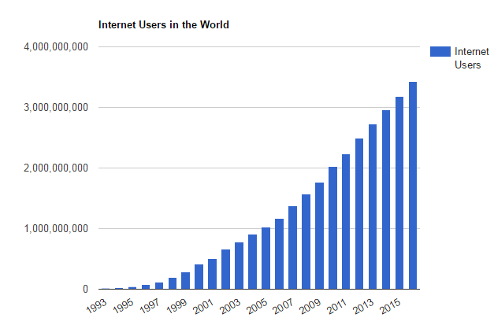
Section 1 – Digital World
Internet usage has increased exponentially over last two decades…
Globally there are 3.4 Billion internet users - population penetration of 46.1%
  Growth in the internet usage during 2015-16 ~ 7.5%
India with 460M internet users is ranked 2nd in term of internet users - population penetration of 34.8%
  Growth in the internet usage during 2015-16 ~ 30.5%.
Source: http://www.internetlivestats.com/internet-users/#trend

Slide 5
Section 1 – Digital World
…high speed network, affordable smartphones driving access further
Factors Driving Growth
Entry of new telecom players
Reduction in data tariff rates
Availability of cheaper smartphones
Government push to digitization
CAGR – 8%
  The number of mobile internet users in India has reached 452 million by 2016, and is on track to reach around 500 million users by 2017
Source – Statista

Slide 6
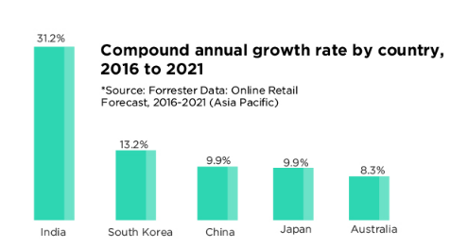
Section 1 – Digital World
India is the fastest growing e-commerce market
In 2016, China was the largest market for e-commerce in online retail sales followed by the US
India was one of the fastest growing retail e-commerce markets in 2015, growing at the rate of 129.5 per cent Y-o-Y.
Indian market is expected to grow at a CAGR of ~ 30%
Source – YourStory and IndiaRetail

Slide 7
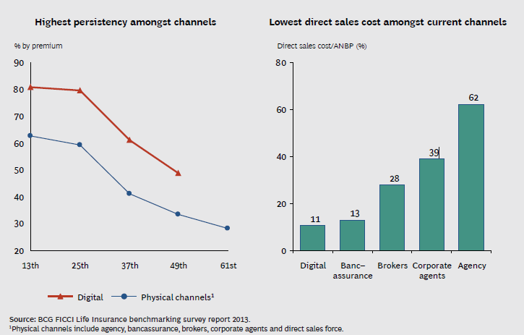
Section 1 – Digital World
Digital channel gave cost and persistency benefits in life insurance

Slide 8
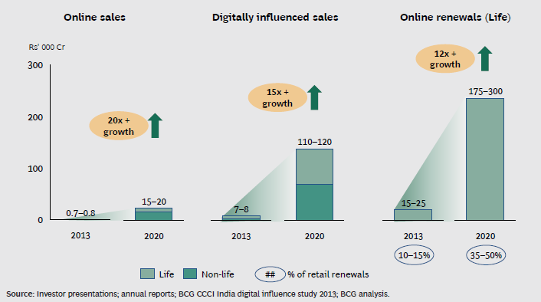
Section 1 – Digital World
Insurance using Digital Platform: Growth by 2020
Online sales is expected to grow ~20x by 2020 compared to 2013,
Digitally influenced sales is expected to grow ~15x during the same period
Digital channel will be significant influencer of financial products sales including insurance

Slide 9
Section 2
1. Digital World
1.1 Internet Usage
1.2 E-commerce
1.3 Insurance using Digital Platform
2. Health Insurance – Product & industry overview
2.1 Current Indian Market
2.2 Past sales comparison using online channel
2.3 Product and sales comparison to Term Life
3. Health Insurance Products – Future trends
3.1 Insurance Gap
3.2 Future Trends
4. Professional and Ethical Issues

Slide 10
Section 2 – Health Insurance Market
India Health insurance industry overview
Health insurance is the most competitive of all insurance segments with 3 distinct categories of players servicing this segment
  Specialist health insurance companies (SPLHI): 6 companies;
  General insurance companies (GIs): 4 government owned companies and 18 private sector owned companies (PVTGIs). 5 more PVTGIs are at various stages of regulatory approvals; and
  Life insurance companies (LI): 24 LIs of which 17 offered health insurance during FY 2015-16
Health insurance is the second largest segment after motor insurance with more than US$ 4.2 billion in gross direct premiums contributing 27% to overall non-life insurance sector premiums.
  PSUGIs generated 60% of the segment premiums followed by PVTGIs (25%) and SPLHIs (15%).
It is one of the faster growing segments with 21% y-o-y growth during FY 2015-16 vs.13% for the industry.
In the FY 2015-16, the direct sales channel contributed to one third of the industry premiums, though less than 2% came from the direct online sales.
Source – IRDAI Annual Report 2015-2016

Slide 11
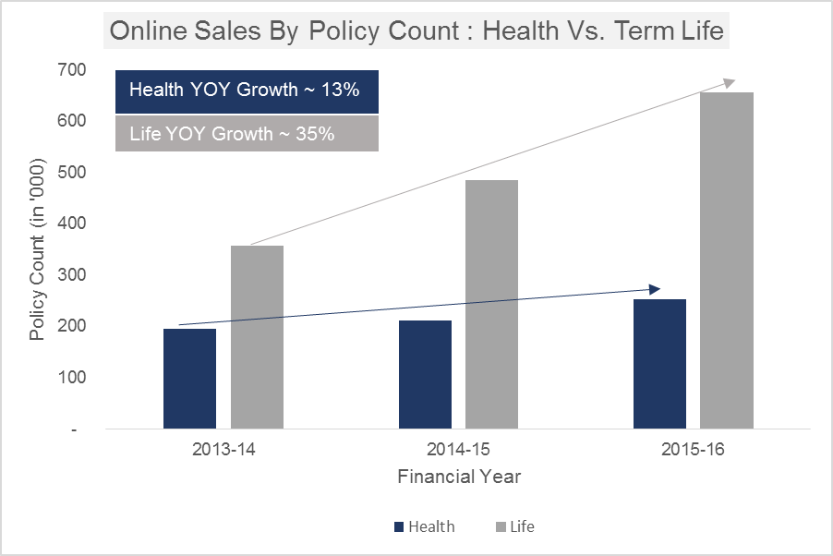
Section 2 – Health Insurance Market
Higher growth in online sales of term life v/s health insurance
Average premium of INR 11,000 was assumed for Life Insurance Policies
Online channel mix for Life Insurance is calculated considering the proportion of other channels in the FY 2013-14 and 2014-15. For 2015-16, the information was available in the IRDAI Annual Reports
Assume all online life insurance sale is for term life product
Source: IRDA Annual reports

Slide 12
Simplicity of term life product makes online sales easier
Section 2 – Health Insurance Market
Challenges
Benefits
Easy to sell & understand
  Difficult to design simple health products at affordable premium
  Health products have exclusions, waiting periods, definitions which make them complex
  Need for pre-policy medical check even for lower SI
  Can be attached to the base life product as a rider
  Digital channel gives access to young educated lives who can understand complex products
  Cashless option in indemnity products
Coverage Scope
  Term life - single claim vs health - multiple claim
  Difficult to predict future morbidity risks - changing disease patterns and advancement in medical
  Increasing awareness and high cost of treatment making health products popular
  Option to cover all family members in one policy

Slide 13
Health Insurance other considerations …
Section 2 – Health Insurance Market
Challenges
Benefits
Cost & Guarantee
  Expensive compared to the term covers
  Premium guarantee not available
  Increasing premiums with age, medical inflation and emerging medical trends
  Ability to load lower margin for adverse deviation
  Lifetime renewability and option to port
  Telematics may allow offering discounts based on activity and condition management
Distribution
  Compete for the same customer every year
  Opportunity to cross sell and up-sell
Claim settlement
  No face to the insurance cover to contact at time of need/emergency
  Claim settlement may be ambiguous leading to dispute and dissatisfaction
  Cashless options: universal dial in details, electronic uploads
  Ability to manage customer’s health

Slide 14
Section 3
1. Digital World
1.1 Internet Usage
1.2 E-commerce
1.3 Insurance using Digital Platform
2. Health Insurance – Product & industry overview
2.1 Current Indian Market
2.2 Past sales comparison using online channel
2.3 Product and sales comparison to Term Life
3. Health Insurance Products – Future trends
3.1 Insurance Gap
3.2 Future Trends
4. Professional and Ethical Issues

Slide 15
Section 3 – Future Trends
India has low health care expenditure – Scope or Challenge ??

Slide 16
External factors impacting online health insurance sale
Section 3 – Future Trends
Challenges
Benefits
Role of government
Free universal healthcare may impact need for private medical insurance
Mandatory insurance (e.g. Dubai) model can increase demand and eliminate impact of anti-selection
Overall thrust on digital India
Digital Payments & Ecommerce Industry
Low internet adoption and prevalence of credit/debit cards
Smartphone, tablets and laptop adoption
Maturity of overall e-commerce, wallets and entry of small banks helping customers get comfortable with online marketplace
Demography and disease trends
Inability to predict risk rates for each risk group and cost of care trends
People believe they will not fall ill
High medical inflation, chronic disease burden changing perception about HI as a discretionary purchase
Younger population literate and tech savvy

Slide 17
Key ecosystem factors impacting online health insurance sale
Section 3 – Future Trends
Challenges
Benefits
Information asymmetry
Lack of access to health status of prospective customers leads to anti-selection and increase in premium
High competition and deployment of technology and innovative solutions to price each risk accurately – e.g. smart watch
Role of web aggregators
Easier to compare premiums leading to price being factor impacting purchase
Low product differentiation putting pressure on margin
Increase in competition allow better options to customers
Overall increase in market size because of increase in marketing spends
Cross-sell
Poor data quality for existing customers – non contactability, missing data
Ready data base of term, motor and travel insurance customers who have experience of online sale

Slide 18
Online health insurance is poised for strong growth
Section 3 – Future Trends
Challenges
Benefits
Customers look for information related to features and price online
Customers prefer to close purchase offline – expect better after sales service, higher trust
Explore hybrid model
Pure online model has lowest lifetime cost of acquisition and servicing
Better persistency
E-KYC, EIA, interactive website reduce traditional barriers of online sale
Big data, IoT to allow personalization of cover
Pure online model
Manage Channel conflict
Difficult to provide differential pricing on online and offline model
Customers expect lower pricing for online product
Design differentiated product offering based on target customer segment and channel reach

Slide 19
Section 4
1. Digital World
1.1 Internet Usage
1.2 E-commerce
1.3 Insurance using Digital Platform
2. Health Insurance Industry
2.1 Current Indian Market
2.2 Past sales comparison using online channel
2.3 Product and sales comparison to Term Life
3. Health Insurance Products – Future trends
3.1 Insurance Gap
3.2 Future Trends
4. Professional and Ethical Issues

Slide 20

Professional & ethical issues of selling insurance digitally
Section 4 – Professional & Ethical Issues
Unlike other industries which provide instant product/service insurance is a long term contract between customer and insurer to honor claim in future
Computer-generated, online applications - poses problems for insurers & consumers seeking to ensure the validity of the insurance transaction – Is the cover effective?
Professional
Ethical

Slide 21
Digital Channel has its advantages & disadvantages
Section 4 – Professional & Ethical Issues
Advantages
Disadvantages
Consumer
Access to customers outside metros
Loss of personal touch and advice
Regulator
Electronic accessibility to regulators
Permit regulators to respond to inquiries or consumer complaints efficiently
Difficult to monitor potentially increasing unlicensed activity.
Impairs ability to provide adequate consumer protections
Insurer
Ability to communicate and transact business electronically could substantially reduce administrative costs
Increase profits and bring more innovative and less expensive services to a wider audience
Challenging to remain compliant while engaging in internet-based sales and services.

Slide 22
Imperative to maintain professional standards to win customer trust
Section 4 – Professional & Ethical Issues
Risk
Mitigation Strategy
  Proper advertising and disclosure to explain product and features
  Ensure data privacy of customer details including transaction details
  Communicate all guarantees/ renewability terms clearly
  Inadequacy of premium to cover claims and expenses
  Inadequate coverage to customers
  Adhere to all norms of Protection of Policyholders Interest
  Strong control of IT systems to avoid data theft and abuse
  Simple to understand product literature, free look period
  Regular reviews of profitability - FCR, reviews with PMC
  Actuarial control cycle to understand improvement areas

Slide 23
Questions??

Slide 24
Thank You

