Slide 1

27th India Fellowship Seminar
Topic: Opportunity and challenges for life reinsurers post regulatory changes and impact on insurance industry
Guide Name: Souvik Jash
Presenters Names:
Kapil Aggarwal and Sumit Ramani
Cyber risk and Terrorism risk - Challenges in pricing
Supervisor:
P.A. Balasubramanian, FIAI
Date: June’17
Mumbai
Indian Actuarial Profession
Serving the Cause of Public Interest

Slide 2
Agenda
Background – (Speaker: Kapil)
Challenges for reinsurers – (Speaker: Kapil)
Opportunities for reinsurers – (Speaker: Sumit)
Impact on (life) insurance industry – (Speaker: Sumit)
Conclusion – (Speaker: Sumit)
Background
Challenges
Opportunities
Impact
Conclusion
Indian Actuarial Profession
Serving the Cause of Public Interest

Slide 3
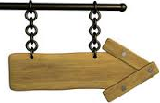




Background – the regulation(s)
Prior
Open Branch
in India
Oct 2015
Background
Challenges
Opportunities
Impact
Conclusion
Jan 2016
Indian Actuarial Profession
Serving the Cause of Public Interest
Notes:
Prior to 2015, Indian insurers were open to reinsure from any reinsurance company subject to condition that foreign reinsurer must have enjoyed a credit rating of at least BBB over a period of the past 5 years
In Oct’2015, IRDA issued a new regulation named “Registration and Operations of Branch Offices of Foreign Reinsurers other than Lloyd’s)”
Later in Jan’16, an amendment of the regulation came to give first right of refusal to the Indian reinsurer i.e. GIC and ITI (probably in future)

Slide 4
Background – the regulation(s)
  Key Highlights of Oct’15 Regulation
  Registration of branch offices
  Different categories of registration
  Order of preference
  Expected Implications
  Retention of business within India
  Developing expertise within India
  Getting money back to India
  Unexpected Implications
  Best Terms
  First Right of Refusal
Background
Challenges
Opportunities
Impact
Conclusion
Indian Actuarial Profession
Serving the Cause of Public Interest
Notes:
In this slide we will talk about the key highlights of the regulation that came in Oct’15 and likely implications of the same.

Slide 5



Background – Best Terms
Best Terms are subjective
Quantitative Measure
Premium rates
Facultative limit etc.
Qualitative Measure
Product design
Underwriting
Meeting TAT etc.
Getting best terms
Registered Branch office
under 4a) Category
Background
Challenges
Opportunities
Impact
Conclusion
Indian Actuarial Profession
Serving the Cause of Public Interest

Slide 6



Background – First Right of Refusal
Offer Best rates for participation
Accepted in full
Rejected in full
Accepted but partial ceding
Background
Challenges
Opportunities
Impact
Conclusion
Offered to other players in market as per ‘Order of Preference’
Indian Actuarial Profession
Serving the Cause of Public Interest
Notes:
Process flow of first right of refusal.

Slide 7

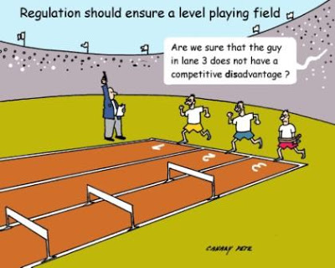

Challenges
Absence of level playing field
Regulatory Uncertainties
Background
Challenges
Opportunities
Impact
Conclusion
Regulatory Restrictions
Indian Actuarial Profession
Serving the Cause of Public Interest
Notes:
On second thoughts, I don’t think there are any challenges for Indian reinsurers (especially GIC)- if they can’t scale up they don’t grow. However, they don’t lose anything. Nothing in short term at least
In this slide we highlighted the challenges of the foreign reinsurers.

Slide 8

Challenges - Absence of level playing field
Priority to Indian Reinsurers for…
Treaty Surplus
Facultative placements
Retro-cessions of reinsurers
Best Terms
First Right of Refusal
Background
Challenges
Opportunities
Impact
Conclusion
Indian Actuarial Profession
Serving the Cause of Public Interest
Notes:
There are two school of thoughts:
While getting the best terms, the insurance company should follow the order of preference as the intention of the regulation is to give priority to Indian reinsurers and 4a) category reinsurers. Whereas some reinsurers think that the interpretation from the regulation is that no order of preference should be followed at the time of asking for best terms.
Give example of a reinsurer which is operating from overseas and would offer such terms which nobody could match and hence business would directly go to them.

Slide 9

Challenges – Regulatory Uncertainties
Considering modifications in existing regulation
and
Exploring alternative tools like ART…..
Background
Challenges
Opportunities
Impact
Conclusion
Indian Actuarial Profession
Serving the Cause of Public Interest
Notes:
IRDAI already considering the changes in the existing regulation as specified in the Jan’16 amendment.
Also The 17-member committee, chaired by M Ramaprasad, a former member of IRDAI, will submit its report by August 2017. It will study international regulatory frameworks and practices relating to reinsurance pools, Alternative Risk Transfer (ART) and such other mechanisms and make appropriate recommendations. “In addition, it will look into the existing guidelines for SEZs and make necessary recommendations in the context of various reinsurance activities,” PJ Joseph, Member-Non-Life, IRDAI, said in a notification

Slide 10
Challenges – Regulatory Restrictions
Regulatory Restrictions
Restrictions on Entry
Ongoing Regulatory Adherence
Impact of Ongoing adherence of regulations
  Loss of capital arbitrage opportunities
  Restrictions on Retro-cessions
  Loss of Investment diversification
Background
Challenges
Opportunities
Impact
Conclusion
Indian Actuarial Profession
Serving the Cause of Public Interest

Slide 11







Opportunities
Foreign reinsurers gung-ho about India
Background
Challenges
Opportunities
Impact
Conclusion
Indian Actuarial Profession
Serving the Cause of Public Interest

Slide 12
Opportunities – Foreign Reinsurers
No new opportunities (post regulations)
However,
  Huge Protection Gap
    92% vs circa 80% in other developing economy
  Conducive Environment
    Focus of the government – PMSBY, PMJJBY
Background
Challenges
Opportunities
Impact
Conclusion
Indian Actuarial Profession
Serving the Cause of Public Interest

Slide 13
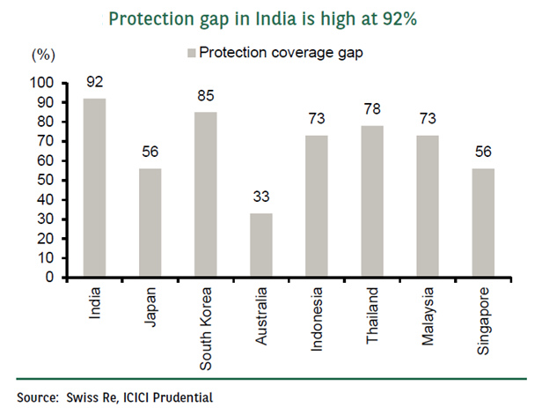
Opportunities – Huge Protection Gap
Translates to USD 9.2 Trillion
Huge working population. From 585m in 2015 to 736m in 2030
High GDP growth – 2.5% (world) vs 8% (India)
Background
Challenges
Opportunities
Impact
Conclusion
Indian Actuarial Profession
Serving the Cause of Public Interest

Slide 14
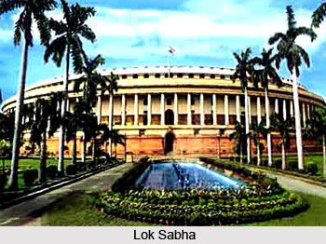

Opportunities – Conducive Environment
Focus of government on insurance
  Insurance bill
  PMSBY, PMJJBY
Active regulator supporting growth
  Several regulations
  Open to suggestions/discussions
Background
Challenges
Opportunities
Impact
Conclusion
Indian Actuarial Profession
Serving the Cause of Public Interest

Slide 15

Opportunities – Indian Reinsurers
Make the most out of the free ride
  Build expertise especially in Life domain
  Find sources of capital – IPO?
  Work towards operational excellence
  Emerge as trusted partner
Background
Challenges
Opportunities
Impact
Conclusion
Make First Right of Refusal redundant!
Indian Actuarial Profession
Serving the Cause of Public Interest

Slide 16


Impact on (life) insurance industry
Insurers getting a “better deal”?
  at the cost of time and resources
  increased time to launch product
  operational challenges
  may not always be a “better deal”
  Redistribution of reinsured business
  GIC getting bigger share
Background
Challenges
Opportunities
Impact
Conclusion
Indian Actuarial Profession
Serving the Cause of Public Interest

Slide 17



Impact on (life) insurance industry
Product Innovation
  Only saving grace for foreign reinsurers
  Mushrooming of Indian Reinsurers
  Improved insurance talent pool
Background
Challenges
Opportunities
Impact
Conclusion
Indian Actuarial Profession
Serving the Cause of Public Interest

Slide 18
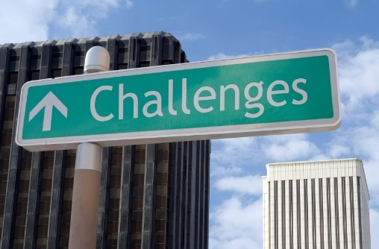


Conclusion
Challenges are galore
  Regulatory and level playing field
Balanced by ample of opportunities
  Protection gap & conducive environment
Resulting in
  Redistribution of reinsured business
  Innovation and competition
Background
Challenges
Opportunities
Impact
Conclusion
Indian Actuarial Profession
Serving the Cause of Public Interest

Slide 19
Q&A
Questions?
And hopefully answers!
Background
Challenges
Opportunities
Impact
Conclusion
Indian Actuarial Profession
Serving the Cause of Public Interest

