Slide 1

28th India Fellowship Seminar
Topic: Commercial Lines Insurance – The nature , cyclicality and road ahead
Guide Name: Adarsh Agarwal
Presenters Name:
1. Amit Gupta
2. Rahul Khetan
3. Anupama Kataria
4. Prateek Kathuria
Date: November 9, 2017
Mumbai
Indian Actuarial Profession
Serving the Cause of Public Interest

Slide 2
AGENDA
Introduction
Nature of Commercial Insurance
Commercial Insurance in India
Technical and Professional Challenges
Road Ahead

Slide 3
Introduction
What is Commercial Insurance?
What type of insurance does a business need?
  Insurance against ones’ property
  Insurance against third party liability
  Insurance against business interruption
Property
Casualty
Engineering
Employer’s
Liability
Liability
Marine
Fire
Notes:
Plain and simply, commercial insurance is insurance that protects businesses. It covers businesses against losses, arising from things like damage to property or injury to employees, and is a term commonly used to label core business insurance covers like public liability and employers’ liability.Coverage for businesses for protection against potential losses through unforeseen circumstances like theft, liability, property damage, and for coverage in the event of an interruption of business or injured employees.
Depends upon business.

Slide 4
Nature of Commercial Insurance
Awareness & Knowledge
Brokers
Low Frequency – High Severity
Large Risks
Higher Average Premium
Non Standard Terms & Conditions
Capital Intensive
Use of Reinsurance
Notes:
Bargaining Power
Adjustment Premium

Slide 5
Commercial Insurance in India
Source : GI Council Segment wise report And GI council Yearbook 2015-16
GDPI: Gross Direct Premium Income
GIC Ratios: Gross Incurred Claim Ratios
Notes:
Commission Ratio around 10-12
Expense Ratio around 23-24%

Slide 6


Technical and Professionalism Challenges
Advice is expected to be based on best judgement whilst paying proper regard to any relevant professional or other guidance (PCS 3.1)
Must not give advice unless be satisfied of personal competence or acting with guidance of someone competent in relevant matters (PCS 3.1)
Each risk is unique
each policy presents different set of risks
Expectations from an Actuary
Actuary vs. Underwriter
vs. Senior Management

Slide 7


Technical and Professionalism Challenges
Incorporating qualitative data
view of the experts
Must consider the extent to which it is appropriate to carry out investigations to assess the accuracy and reasonableness of any data being used (PCS 3.4)
Advice should normally include sufficient information and discussion about each relevant factor (PCS 3.5)
Must indicate the extent to which other sources are available to provide with supplementary information and explanations about scope, data, methods and the findings (PCS 3.5)
Heterogeneity of data
data is a combination of several unique risks

Slide 8

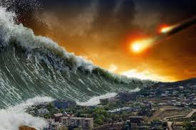
Technical and Professionalism Challenges
Exposure to Large & Catastrophe losses
inherently more volatile
Advice should normally include sufficient information and discussion about each relevant factor (PCS 3.5)
Must indicate the extent to which other sources are available to provide with supplementary information and explanations about scope, data, methods and the findings (PCS 3.5)
Greater chances of accumulation
possible chances of accumulation by industry/ geography

Slide 9
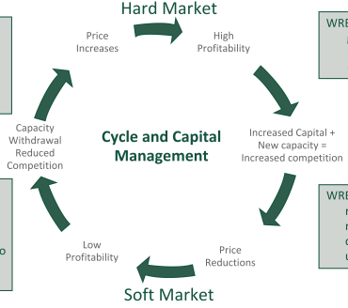
Cyclicality in Commercial Lines
Higher Prices
Claims Trends
CAT losses
High Industry Capitalisation
Investment Income
De-regulation
Lower Prices
Portfolio steering and monitoring
Links to pricing: market pressure vs profitability
Links to the reserving cycle
Managing the risk appetite
Focusing on the core competency
Disciplined underwriting
Notes:
Hurricane Andrew 2012 - $25.6 B
Northridge EQ - $23.9 B
Japan EQ - $38.6 B
Thailand Floods - $13.4 B
Hurricane Sandy $18.8 B

Slide 10



Road Ahead
Risk management to reduce cost of risk and uncertainty will continue to have paramount significance. This will include –
Robust digital technologies
Sophisticated analytics and modeling techniques – experience based and actuarial supported models
Product differentiation and improved price competitiveness
Multiple channel distribution models for small commercial business which have become more aligned with personal lines to cope with increase in market penetration
Focus on sales oriented underwriting, increase bandwidth to strengthen bonds with agents/brokers and customers for medium, large commercial business
Build capabilities around data sciences, artificial intelligence and cloud computing

Slide 11
Road Ahead – the ABC
A
Artificial Intelligence
Machine Learning
C
Cloud
New Markets
Customer- Centricity
B
Big Data
Social Data
Location Data
Sensor Data

Slide 12
Road Ahead – the ABC
Technological advancements (Internet of Things, augmented reality, AI) will help
enhance the efficiency of business operations and processes
reduce various risk exposures e.g. driverless vehicles, smart factories, smart mines
may lead to reduced commercial insurance needs — prompting changes in business strategies
New Data Sources (sensory data, drone images and videos, social media and smart devices) can be leveraged to
mitigate loss and improve underwriting, pricing, product development
Example, insurers writing small commercial policies for restaurants using third-party data from Trip Advisor
anticipate risk exposures and price policies commensurate with exposure
Cloud Computing can help
Reduce IT costs, help build better IT infrastructure
Unify customer data
Drive new business opportunities

