Slide 1


19th Seminar on Current issues in Retirement Benefits
Mumbai, Hotel Sea Princess
21st Sep 2022
The Payment of Gratuity Act, 1972
Ritobrata Sarkar, Hemanshu Jain

Slide 2



Overview
History & Evolution of The Payment of Gratuity Act
Update on Labor codes
Overview of research about gratuity schemes funding
www.actuariesindia.org

Slide 3
1. History and evolution of the Payment of Gratuity Act
www.actuariesindia.org

Slide 4
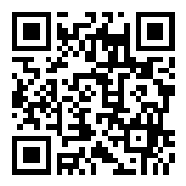
The Payment of Gratuity Act, 1972
Year 2022 marks 75th year of our Independence and 50th year of enactment of The Payment of Gratuity Act, 1972.
Let us look back at some history and evolution of the Act.
We will use Slido for a small quiz to cover. Please go to www.slido.com and use code #CIRB19
www.actuariesindia.org
Notes:
Working Journalists act – is the only central law that provide formal Gratuity to only Journalists

Slide 5
Poll Question 1
Prior to enactment of the Payment of Gratuity, 1972 which central law exists for the purpose of Gratuity?
  The Kerala Industrial Employees Payment of Gratuity Act, 1970
  The Working Journalists and Miscellaneous Provisions Act, 1955
  The West Bengal Employees Payment of Compulsory Gratuity Act, 1971
www.actuariesindia.org
Notes:
Working Journalists act – is the only central law that provide formal Gratuity to only Journalists

Slide 6
The Payment of Gratuity Act, 1972
History of legislations
  The Working Journalists and Miscellaneous Provisions Act, 1955.
  Government of Kerala enacted legislation for payment of Gratuity to workers in 1970.
  On 3rd June 1971, Governor of West Bengal promulgated an Ordinance to enact scheme of Gratuity.
  Other states also were contemplating introduction of similar laws and thus a need for central uniform law arise.
www.actuariesindia.org
Notes:
Working Journalists act – is the only central law that provide formal Gratuity to only Journalists

Slide 7
The Payment of Gratuity Act, 1972
Enactment of new law:
  Proposal for central legislation in Labour Ministry Conference in August 1971.
  Also in Indian Labour Conference in October 1971.
  Agreement to bring central law for uniform gratuity.
  Bill was drafted in lines with the West Bengal Employees Payment of Compulsory Gratuity Act, 1971.
  Bill received assent of President on 21st August 1972.
  Bill come in force on 16th September 1972.
www.actuariesindia.org
Notes:
Some modification in draft was to forfeiture of Gratuity in case of misconduct

Slide 8
Poll Question 2
In the original Payment of Gratuity Act,1972, which of the following is/are not an eligible employee covered under the Act?
  Any person employed in a managerial or administrative capacity
  Any person employed on wages earning more than one thousand rupees per month
  Any person who holds civil post under Central or State Government
  Any person subject to Air Force Act, 1950, the Army Act 1950, or the Navy Act, 1957.
www.actuariesindia.org
Notes:
Working Journalists act – is the only central law that provide formal Gratuity to only Journalists

Slide 9
The Payment of Gratuity Act, 1972
Evolution of law:
  The Payment of Gratuity (Amendment) Act, 1984
  The Payment of Gratuity (Second Amendment) Act, 1984
  The Payment of Gratuity (Amendment) Act, 1987
  The Payment of Gratuity (Amendment) Act, 1994
  The Payment of Gratuity (Amendment) Act, 1997
  The Payment of Gratuity (Amendment) Act, 2009
  The Payment of Gratuity (Amendment) Act, 2010
  The Gazette of India on Gratuity 2018
  Code on Social Security 2020
www.actuariesindia.org
Notes:
1984 amendments – continuity of gratuity for shops if headcount reduce below 10 after crossing 10 once.
1987 amendments – compulsory insurance

Slide 10
Poll Question 3
Which of the following were the prescribed limits on Gratuity payments since the enactment of the Payment of Gratuity Act, 1972?
  INR 50,000
  Ceiling of 20 months wages
  INR 1,00,000
  INR 3,50,000
  INR 2,50,000
www.actuariesindia.org
Notes:
Working Journalists act – is the only central law that provide formal Gratuity to only Journalists

Slide 11
2. Update on labour codes
www.actuariesindia.org

Slide 12
The Four Labour Codes
The Code on Wages | The Code on Social Security | The Industrial Relations code | The Occupational Safety, Health And Working Conditions Code
Definition: Wage cannot be lower than 50% of salary Minimum wage Payment of wage | Provident Fund Gratuity ESI (businesses with 10+ workers) Fixed Term Employees (eligible for equal benefits as permanent employees | Fixed term workers Standing Orders (businesses with 300+ workers) Strikes Layoffs and retrenchment (government permission required for businesses with 300+ workers) Worker's re-skilling fund | Working hours and overtime Leave encashment Contract labor (5-year single license) Inter-state migrant workers (recognition of migrant worker) Welfare provisions

Slide 13
Labour Codes 2020 – Key Impact Areas
Employer
Employee
Design
Design
Salary structures and levels
Review of employment terms and conditions
Impacts on more employees – more categories of employees, additional provisions for “workers” in non manufacturing sectors
Financial
Higher gratuity and leave actuarial liabilities
Financial
Administration
Lower take home salary
Retirement benefit based on higher wage
Payroll process
Additional administration and tracking with respect to overtime and working hours
Compliance
Lower registrations, returns, etc.
Additional welfare provisions
Additional governance due to contractual labour, FTE’s and inter-state migrant workers
Higher penalties

Slide 14


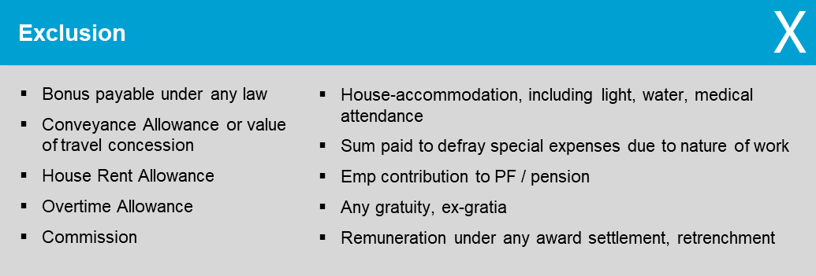

The Code on Wages, 2019: Definition of “Wages”
Definition of Wage - Section 2 (y) states:
All remuneration whether by way of salaries, allowances or otherwise, expressed in terms of money or capable of being so expressed which would, if the terms of employment, express or implied, were fulfilled, be payable to a person employed in respect of his employment or of work done in such employment.”
Inclusion
Basic Pay
Dearness Allowance
Retaining Allowance
    Limit on exclusions: 50% of total remuneration
    Remuneration in kind up to 15% of wages

Slide 15




Almost three in four organisations have taken some action to assess the impact of Labour codes
Almost 1 in 4 organisations are planning to include variable pay in the wage definition
How will your organisation treat each of the following when calculating wages?
Has your organisation taken any action to assess the impact of the Labour Code?
 | Exclude from the definition of wage | Include in the definition of wage | Remuneration in kind
Stock options (and similar plans) | 72% | 6% | 22%
Car leases | 68% | 20% | 12%
Variable pay including bonus | 77% | 23%
Travel concessions | 72% | 28%
All travel related components (clubbed into the Conveyance allowance) | 76% | 24%
Yes
71%
No
29%
Source: WTW - The State of Retirement Benefits in India – 2021
15

Slide 16







1 in 3 organisations will increase the basic pay in response to the new definition of wages
But 1 in 3 organisations are also unsure about what to do
How is your organisation planning to change its compensation structure in response to the new definition of wages?
Increase basic pay
No changes to the compensation structure planned
Increase house rent allowance (HRA) beyond 50%
Increase conveyance allowance
Other
Not sure
Source: WTW - The State of Retirement Benefits in India – 2021
16

Slide 17
Impact on Gratuity
Impact is significant | Average increase from Basic to Wage is in the range of 40-100% Likely to be the case for almost every employer because of the way salaries are generally structured in India - even those companies where the current basic salary is greater than 50% of the remuneration are likely to be impacted.
Impact likely to apply for prior service as well | The basic structure of the gratuity payment formula remains unaltered “Wages” now assumes a broader definition and the last “wage” could be used to reckon for all the years of service. Prima facie, it seems that the impact will extend to prior service as well.
Impact likely to flow through Profit and Loss Account (P/L) | The situation here seems to be a case of a change in the salary “definition” applicable for gratuity calculation - initial view is that this change is likely to be treated as a plan amendment. OCI is meant for actuarial gains and losses because of changes in actuarial assumptions and experience adjustments. Under the current situation, the increase in liabilities is not due to higher salary increases but due to a change in the applicable definition of salary.
Impact not proportionate to increase in wages | Impact not as simple as taking a proportionate increase, i.e. ~ 50%/35%. New wage may be higher than 50% of the remuneration and this could vary across different classes of employees depending on existing salary structures. If the company applies the INR 20L limit, the resulting impact could be lower than the proportionate increase in the wage. In a situation where the company offers a gratuity scheme that is more generous than the statutory provisions – the impact could be based on higher of two plan provisions

Slide 18
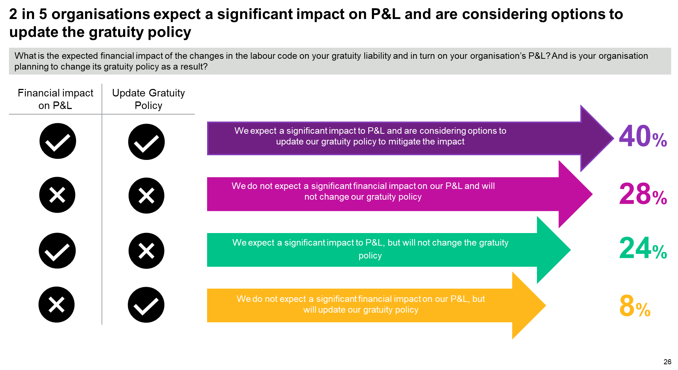
Source: WTW - The State of Retirement Benefits in India – 2021

Slide 19
Key learnings from Social Security Code projects
Wage calculation can be complicated, need to make prudent assumptions that have to be agreed with the client
Data stage becomes cumbersome and complex, where you need to look at every component
Wage can be higher than 50% of CTC
Basic does not need to be increased to 50% of CTC
Impact is not proportional to increase in wage
Benefit design can be more complicated than before – higher of the two situation
Impact can be sensitive to assumptions, especially salary growth and attrition rates
In addition to impact assessment on retirement benefits, opportunity for actuaries to undertake compensation restructuring and benefits redesign projects

Slide 20
3. Overview of research on gratuity funding
www.actuariesindia.org

Slide 21
Background
With introduction of Social Security Code, 2020 (SSC) discussions around funding of Gratuity scheme or Compulsory insurance becomes active.
The Payment of Gratuity Act, 1972 does not mandate funding and present rules of SSC also maintains status quo.
Our research focused on providing recommendations to policymakers, other interested parties for use of actuarial methods for long term funding of Gratuity scheme.
From our research an explanatory paper has been shared with Advisory group for review and next steps.
www.actuariesindia.org
Notes:
1984 amendments – continuity of gratuity for shops if headcount reduce below 10 after crossing 10 once.
1987 amendments – compulsory insurance

Slide 22
Insights
The paper discusses about:
  Employer-employee perspective on Gratuity funding
  Current practices of funding in 100+ Nifty Small & Mid-cap organizations (for period 2019-2020):
    Total Gratuity liability – INR 25,000 cr.
    Total Gratuity fund – INR 21,250 cr.
    70% organizations have 60% or more funding level
    15% organizations have no or poor funding (assets less than 10% of liability)
  Funding framework that could be followed to strengthen funding regime for gratuity.
    Use of accounting liabilities, normal cost and fair value of assets to determine future contribution levels.
    Minimum and Maximum funding regime followed in other mature markets.
www.actuariesindia.org
Notes:
1984 amendments – continuity of gratuity for shops if headcount reduce below 10 after crossing 10 once.
1987 amendments – compulsory insurance

Slide 23
Insights
www.actuariesindia.org
Notes:
1984 amendments – continuity of gratuity for shops if headcount reduce below 10 after crossing 10 once.
1987 amendments – compulsory insurance

Slide 24
Insights
www.actuariesindia.org
Notes:
1984 amendments – continuity of gratuity for shops if headcount reduce below 10 after crossing 10 once.
1987 amendments – compulsory insurance

Slide 25
Team
Members
  Ms. Anjali Rawat
  Mr. Sanchit Aggarwal
  Mr. Rajat Gupta
  Mr. Neelesh Tripathi
Ms. Neha Agarwala - Reviewer and Project Coordinator
Mr. Hemanshu Jain – Peer Reviewer
Mr. Kulin Patel – Guide and mentor for the group
www.actuariesindia.org
Notes:
1984 amendments – continuity of gratuity for shops if headcount reduce below 10 after crossing 10 once.
1987 amendments – compulsory insurance

Slide 26
Thank you
Any questions?
www.actuariesindia.org

