Slide 1

28th India Fellowship Seminar
Topic: Predictive modelling and Artificial intelligence in Insurance – Perspective, areas of uses and emerging risks
Guide Name: Avdhesh Gupta
Presenters Name:
1. Pushp Aggarwala
2. Nitin Agarwal
3. Ashish Hasija
Date: 9th November 2017
Mumbai
Indian Actuarial Profession
Serving the Cause of Public Interest

Slide 2
Agenda
Introduction
Common Predictive Modeling and Artificial Intelligence Methods
Business Applications of Predictive and Artificial Intelligence Modeling
Applications of Predictive Modeling and Artificial Intelligence in Insurance
Predictive Modeling and Artificial Intelligence in Insurance - Emerging Risks
Questions

Slide 3
Agenda
Introduction
Common Predictive Modeling and Artificial Intelligence Methods
Business Applications of Predictive and Artificial Intelligence Modeling
Applications of Predictive Modeling and Artificial Intelligence in Insurance
Predictive Modeling and Artificial Intelligence in Insurance - Emerging Risks
Questions

Slide 4
Predictive Modelling and AI – An Introduction
Predictive modelling is the practice of extracting insights from the existing data set with the help of data mining, statistical modelling and artificial intelligence (AI) / machine learning techniques and using it to predict the future events.
A major focus of artificial intelligence is to automatically learn to recognize complex patterns and make intelligent decisions based on data.
Artificial intelligence can be looked at as a set of tools to create our predictive models
Predictive modelling and artificial intelligence cannot guarantee an outcome but it can help minimize risk and reduce uncertainty.

Slide 5
Agenda
Introduction
Common Predictive Modeling and Artificial Intelligence Methods
Business Applications of Predictive and Artificial Intelligence Modeling
Applications of Predictive Modeling and Artificial Intelligence in Insurance
Predictive Modeling and Artificial Intelligence in Insurance - Emerging Risks
Questions

Slide 6
Common Predictive modelling methods

Slide 7
Predictive modelling methods - Examples
Classification – A bank might use to predict which customer (loan applicant) are risky or which are safe.
Regression - This can be used to predict the future sales of a Company based on the current economic conditions. It also helps to compare the effects of variables measured on different scales , such as the effect of price changes and the number of promotional activities.
Clustering – It is commonly used by big companies for market / customer segmentation of different products and using separate strategies for different segments accordingly
Association rule mining – Association rules are used to assist in cross-selling based on input data such as customer buying bread and mill frequently together, or soda and chips frequently together and so on

Slide 8
Agenda
Introduction
Common Predictive Modeling and Artificial Intelligence Methods
Business Applications of Predictive and Artificial Intelligence Modeling
Applications of Predictive Modeling and Artificial Intelligence in Insurance
Predictive Modeling and Artificial Intelligence in Insurance - Emerging Risks
Questions

Slide 9



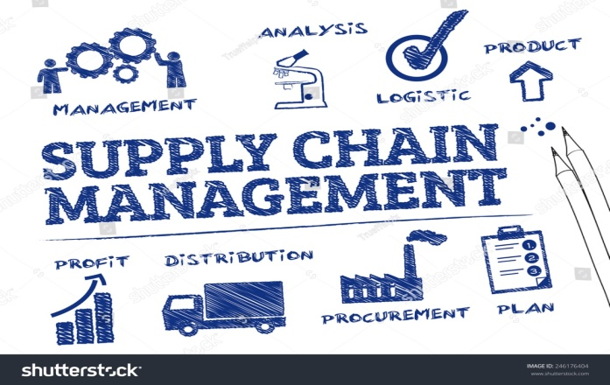



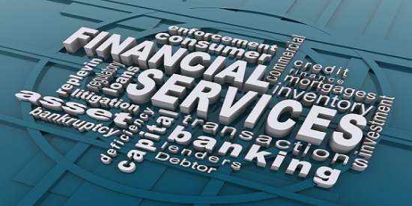
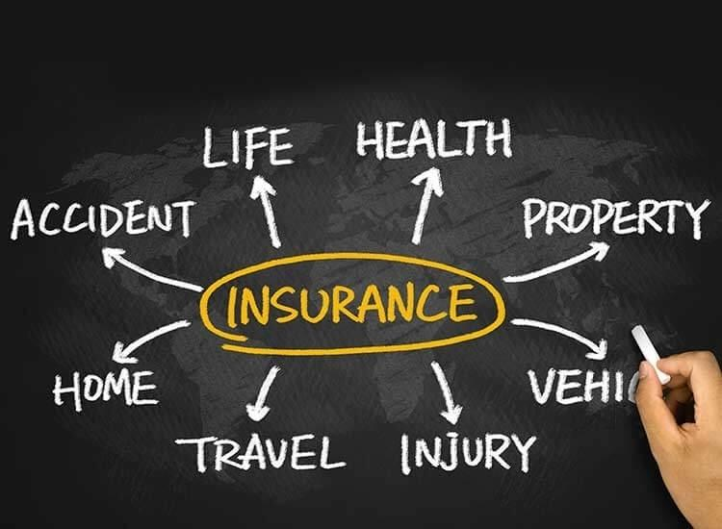
Business Applications of Predictive modelling (I)
E-COMMERCE
Revenue Performance
Customer Profiling
Renewable Energy

Slide 10
Business Applications of Predictive modelling (II)
E-COMMERCE
Identify cross-sell and add on sales opportunities, personalization and churn prediction
FRAUD DETECTION
Detect fraud, criminal activity, false insurance claims, tax evasion and credit card frauds
CUSTOMER PROFILING
Identify high valued customers and retain their loyalty

Slide 11
Agenda
Introduction
Common Predictive Modeling and Artificial Intelligence Methods
Business Applications of Predictive and Artificial Intelligence Modeling
Applications of Predictive Modeling and Artificial Intelligence in Insurance
Predictive Modeling and Artificial Intelligence in Insurance - Emerging Risks
Questions

Slide 12
Applications of Predictive Modeling in Insurance
Analytics and Predictive Modeling – most important business and technology development area in insurance in the last decade
Main areas of application are:
  Actuarial Investigations
  Sales and Marketing or Customer Experience
  Claims Fraud Detection
  Underwriting
  Business planning

Slide 13
Applications of Predictive Modeling in Insurance – Assumption Setting (1)
Traditional Approach
Determine appropriate experience period
Gather data – exposure and deaths
Analytics Approach
Determine the target variables
Initial factor analysis
Select basis
Calculate A / E
By gender
By age group etc
Compare with industry tables / current assumptions
Credibility of data important
Establish variable correlations
Establish the model
Validate the model
Final calibration / smoothing
Implementation

Slide 14
Applications of Predictive Modeling in Insurance – Assumption Setting (2)
Pros and Cons
  allows leveraging much more data
  better insight into interaction of various factors
  isolates the true effect of each factor
  newer factors can be introduced
  more refined assumptions – greater granularity
  lack of expertise
  misinterpretation of models
  can the business build it in?

Slide 15
Applications of Predictive Modeling in Insurance – AI techniques in customer experience
AI Techniques
Sentiment Analysis of social and online / offline interaction data
Applications
Understand / Anticipate customer needs
Call center audio recording
Text mining
Understand customer sentiments
Predict propensity to churn
Customer feedback / reason for call / emotions of caller

Slide 16
Applications of Predictive Modeling in Insurance – Claims Fraud Detection (1)
Importance of identifying fraudulent claims
Increases cost for honest customers
Additional time and scrutiny
Scrutiny at the time of need – loss of reputation and trust
Increases policy turnover

Slide 17
Applications of Predictive Modeling in Insurance – Claims Fraud Detection (2)
Traditional Approach
Area of claim agents
Rely on some facts and intuition
Analytics Approach
Data Collection and Integration
From underwriting, claims, industry
Modeling
Dynamic models – as fraud practices change frequently
Relies on past behaviour and common traits
Based on sampling methods
Works in silos
Helps detect low incidence events
Analyze textual data with the help of text analytics
Notes:
Enterprise wide solutions
Based on multiple (unstructured) data sources

Slide 18
Applications of Predictive Modeling in Insurance – Underwriting
Traditional Approach
Heuristics based rather than statistics based
Based on
Experience
Market knowledge
Intuition
Oral history

Slide 19
Applications of Predictive Modeling in Insurance – Underwriting
AI Techniques
Process mining techniques to automate & improve efficiencies
Applications
Predictive models on risk assessment
Using home and industrial sensor data to operational intelligence on risk drivers that feed into machine learning techniques
Automating of standardised underwriting in auto, home, commercial and life insurance
Understanding the risk drivers
Augmenting of large commercial underwriting & life underwriting by having AI systems highlight key considerations for human decision makers

Slide 20
Applications of Predictive Modeling in Insurance – Underwriting
Pros and Cons
  quantifies risk level compared to similar account
  alignment of price with risk quality in a more granular way
  leveraging price elasticity
  allows harvesting of data in documents
  may not identify finer dimensions of risk
Current status of research
  models are enablers rather than decision takers
  models and underwriters must co-exist
  few underwriting decisions are truly binary

Slide 21
Applications of Predictive Modeling in Insurance – Business planning / sales forecasting
one of the most challenging application of predictive modeling
inaccurate revenue forecasts can potentially jeopardize a company’s share price
Factors impacting future sales:
  level of economic activity and growth
  size of the market and market share of the company
  channel analysis – size, productivity, attrition
  new deals in the pipeline – broker tie-ups / banca partners
  marketing campaigns & conversion rates
  social media activity of the company
  persistency of the existing business
  seasonality of sales
  market penetration
  company opex

Slide 22
Agenda
Introduction
Common Predictive Modeling and Artificial Intelligence Methods
Business Applications of Predictive and Artificial Intelligence Modeling
Applications of Predictive Modeling and Artificial Intelligence in Insurance
Predictive Modeling and Artificial Intelligence in Insurance - Emerging Risks
Questions

Slide 23
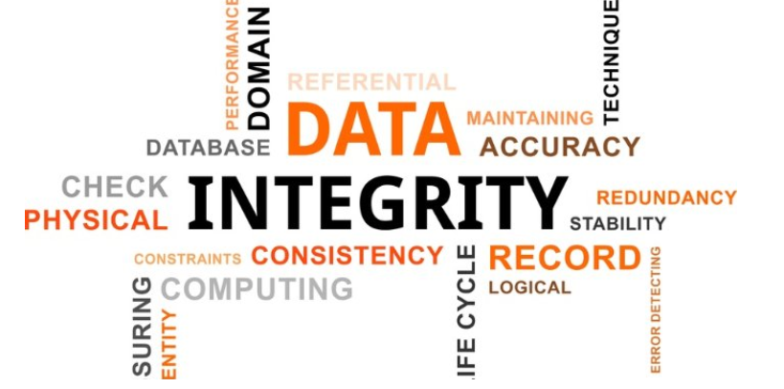
Predictive Modelling and AI in Insurance – Emerging Risks
Accuracy of the Claim Data
Predictive modelling effectiveness is based on the data sources and the quality of the claims data provided.
While predictive modelling may enhance good claim handling, it cannot rectify poor claim handling.

Slide 24
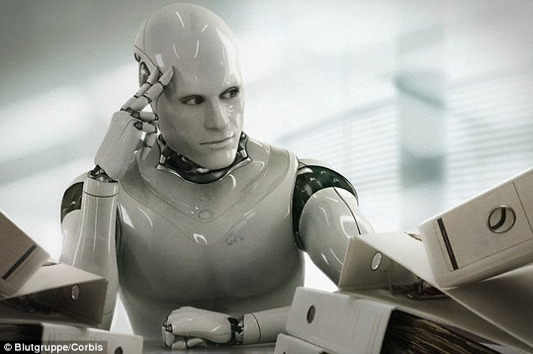
Predictive Modelling and AI in Insurance – Emerging Risks
The Underwriters
Insights from experienced underwriters not incorporated into decision processes.
Need to balance risk quality, emerging exposures, market contexts and competitive strategies.

Slide 25

Predictive Modelling and AI in Insurance – Emerging Risks
Looking Backwards
Backward looking and therefore inadequate for liability, which is long tail.
As environment changes, variables that explain the past may no longer applicable to the future

Slide 26

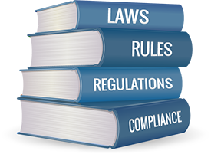
Predictive Modelling and AI in Insurance – Emerging Risks
Privacy Concerns/Regulatory Hurdles
The insurance industry will have to battle data privacy concerns.
Keeping a close watch on the regulatory changes will be a big challenge for insurers.

Slide 27
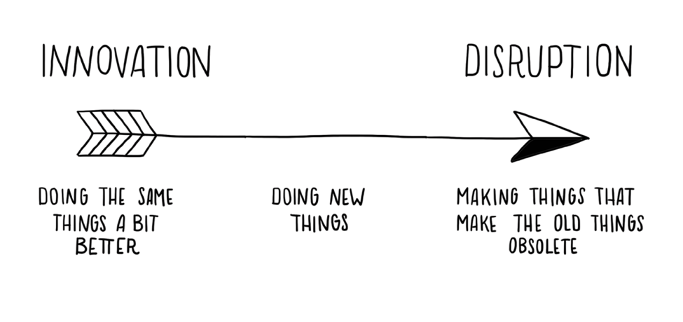
Predictive Modelling and AI in Insurance – Emerging Risks
The Disruption
Risk of their operating model becoming obsolete, due to increasing competition from technology start-ups.
How many of us had imagined digital only insurers?
How many of us have heard LiFi?

Slide 28

Predictive Modelling and AI in Insurance – Emerging Risks
Customer Readiness
Will bots and AI be capable of dealing with emotions, especially during complaints and claims?
Example: Customer calling in a contact centre to escalate the rejected claim.

Slide 29

Predictive Modelling and AI in Insurance – Emerging Risks
The Glitch Risk
AI may also require a significant investment of human time to re-train or re-configure before resuming their work.
How many of us have experienced a glitch in excel/other models when just a restart works.

Slide 30

Questions

