Slide 1

27th India Fellowship Seminar
Standalone critical illness cover
V/s.
Multistage critical illness
Prepared by:
DHARMENDER KUMAR SHRIVASTAVA
K SANDHYA
SEEMA MALI
DNKLNK CHAKRAVARTHI
Reviewed by:
IRVINDER SINGH KOHLI
Date: 1st & 2nd June 2017
Place : Mumbai
Indian Actuarial Profession
Serving the Cause of Public Interest

Slide 2
AGENDA
History of CI
Stand Alone CI(SCI) and Multistage CI(MCI)
Regulation & Taxation
Customer Needs
Variants of MCI
Product Design & Pricing of MCI
Various stakeholders preferences
ConclusionFI
risk and Terrorism risk - Challenges in pricing
Indian Actuarial Profession
Serving the Cause of Public Interest

Slide 3
History of CI
&
IRDAI Regulations
Indian Actuarial Profession
Serving the Cause of Public Interest

Slide 4
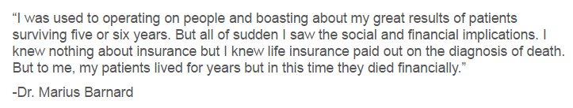
Origin of CI
Concept of CI was introduced by doctor not an insurance company
In 1983, along with the help of a South African insurance company called Crusader Life, Dr. Marius Barnard introduced critical illness insurance to the market
CI included - Cancer, heart attack, stroke and coronary bypass surgery
Provided a way for people to transfer the financial risk of a critical illness from themselves to an insurance company
Indian Actuarial Profession
Serving the Cause of Public Interest

Slide 5
Basics of CI
Provides benefits upon the diagnosis and survival of one of the specific illnesses specified in the policy terms & conditions
Life threatening or lifestyle threatening
Qualifying Conditions –
Perceived to be dangerous
Not rare
Adequate data for pricing
Indian Actuarial Profession
Serving the Cause of Public Interest

Slide 6
Standalone Critical Illness Cover (SCI)
Pays lump sum benefit
Independent of the severity of the illness
Cover terminates on payment of the benefit
Generally no benefit on death
Indian Actuarial Profession
Serving the Cause of Public Interest

Slide 7
Multi-stage Critical Illness Cover (MCI)
Pay benefit multiple times
Benefit pay-out linked to severity of illness/disease
Cover continues until 100% sum insured is paid
Benefit may be payable on death
Indian Actuarial Profession
Serving the Cause of Public Interest

Slide 8
Generally Available List of CI’s
CANCER OF SPECIFIED SEVERITY | END STAGE LIVER FAILURE
MYOCARDIAL INFARCTION (First Heart Attack of specific severity) | END STAGE LUNG FAILURE
OPEN CHEST CABG | COMA OF SPECIFIED SEVERITY
OPEN HEART REPLACEMENT OR REPAIR OF HEART VALVES | MAJOR HEAD TRAUMA
KIDNEY FAILURE REQUIRING REGULAR DIALYSIS | BENIGN BRAIN TUMOR
STROKE RESULTING IN PERMANENT SYMPTOMS | ANGIOPLASTY
MAJOR ORGAN /BONE MARROW TRANSPLANT | MOTOR NEURON DISEASE WITH PERMANENT SYMPTOMS
PERMANENT PARALYSIS OF LIMBS | MULTIPLE SCLEROSIS WITH PERSISTING SYMPTOMS
LOSS OF LIMBS | DEAFNESS
THIRD DEGREE BURNS | LOSS OF SPEECH
BLINDNESS | PRIMARY (IDIOPATHIC) PULMONARY HYPERTENSION
Indian Actuarial Profession
Serving the Cause of Public Interest

Slide 9
Extracts from IRDAI HI Regulations
Section 3
  Both SCI and MCI can be sold by Life, Non-Life or Health Insurers
  The term of cover offered is restricted depending upon type of insurer
  Premiums to remain unchanged for the policy term which can be up to 3years applicable to Non life and Health Insurers
  Life Insurers product to have minimum 5 year term where premiums can be reviewed for every block of 3 years
  Group policies to have one year reviewable term with exception to Group Credit Linked Policies where term can be up to 5 years
Indian Actuarial Profession
Serving the Cause of Public Interest

Slide 10
Extracts from IRDAI HI Regulations
Section 13
  Renewability guaranteed on products sold by Non life and Health Insurers
Section 20 and 21
  Standard Definitions to phrases and terms apply
  Standard Nomenclature and Procedure for CI apply
Indian Actuarial Profession
Serving the Cause of Public Interest

Slide 11
Tax Exemption on Premium- Sec 80D
Health Insurance Policy Premium & Section 80D Tax benefits for AY 2017-18
Scenario | Health Insurance Premium Paid for & Maximum tax deduction limit |  | Tax Deduction under Section 80D
 | Self, Spouse & Dependent Children | Parents (whether dependent or not)
No one in the family has attained 60 years of age | Up to Rs. 25,000 | Up to Rs. 25,000 | Up to Rs. 50,000
The eldest member in the family (self, spouse and dependent children) is less than 60 years & Parents(either mother or father) are above 60 years of age | Up to Rs. 25,000 | Up to Rs. 30,000 | Up to Rs. 55,000
The eldest member in the family (self, spouse and dependent children) has attained 60 years & Parents(either mother or father) are above 60 years of age | Up to Rs. 30.000 | Up to Rs. 30,000 | Up to Rs. 60,000
Indian Actuarial Profession
Serving the Cause of Public Interest

Slide 12
Customer Needs
&
Variants of CI
Indian Actuarial Profession
Serving the Cause of Public Interest

Slide 13
Customer Needs
Cover medical expenses
Repay debt
Provide income & meet misc. expenditure
while the claimant is away from work
Take care of dependents
Recuperative care
Indian Actuarial Profession
Serving the Cause of Public Interest

Slide 14
Customer Expectations
Covers maximum possible illness
Simple and quick application process
An instant decision
Easy to understand
Easy on-going policy administration
Option to adjust the policy if circumstances change
Value-adding services that promote health and wellbeing
Quick and fair claims assessment process
Support at the time of need beyond the financial benefit
Indian Actuarial Profession
Serving the Cause of Public Interest

Slide 15
Customer Needs – SCI vs MCI
Benefit Payout
SCI – Lump sum benefit payout may exceed medical expenses
MCI – Benefit payouts are more close to the financial loss incurred due to illness
Value for money
Conditions to Claim
Key Attraction
Multistage CI premium may be lower than SCI
SCI – Easy to understand compared to MCI
MCI – Not very stringent but the PH could be subject to claim assessment multiple times
SCI – Stringent
MCI – Multiple claims are possible - could lead to increased customer satisfaction and retention – more likely to make claim as compared to SCI
Indian Actuarial Profession
Serving the Cause of Public Interest

Slide 16
Scope for Multi-stage CI
Need for CI remains unchanged even after the first benefit
High awareness for the risk of substantial medical expenses in case of a severe illness
Medical Advancements
Increase in proportion of people opting Health check up
Diagnosis of CI at very early stages
Flip side of SCI
Early CI claims may be denied
Post CI - recovery rates are getting better
Provides poor match to financial needs
Provides little guidance on how to spend to optimise health outcomes
Indian Actuarial Profession
Serving the Cause of Public Interest

Slide 17
Multi-stage CI
Group
Based
Combination of both
Severity Based
Indian Actuarial Profession
Serving the Cause of Public Interest

Slide 18
Variants of CI in other markets
Severity Based Payments -MCI
Address concerns of the product that may not pay for less severe diseases
Additional or partial payment is made depending on the severity of the ill ness
Reinstatements-MCI/SCI
Protect risk of being uninsurable after claiming CI
May include Buy-Back option enabling the policyholder to replace their cover
Multi-pay - MCI
As many CIs are correlated, conditions may be grouped to prevent multiple claims related to similar illness
Ensures assured will continue to have CI cover even after being diagnosed with one of the CI
Health and Well-being services-MCI/SCI
To encourage positive lifestyle choices technology such as wearable devices is used to monitor the PH and reward for healthy behaviour
Indian Actuarial Profession
Serving the Cause of Public Interest

Slide 19
Severity Based CI (Singapore Example)
Early Stage
(25% of SA)
Carcinoma in situ of specified organs
Intermediate Stage
(75% of SA)
Carcinoma in situ of specified organs treated with radical surgery
Catastrophic Stage
(100% SA)
Major Cancers
Early Prostate Cancer
Early Thyroid Cancer
Early Bladder Cancer
Early Chronic Lymphocytic Leukaemia
Early Melanoma
Indian Actuarial Profession
Serving the Cause of Public Interest

Slide 20
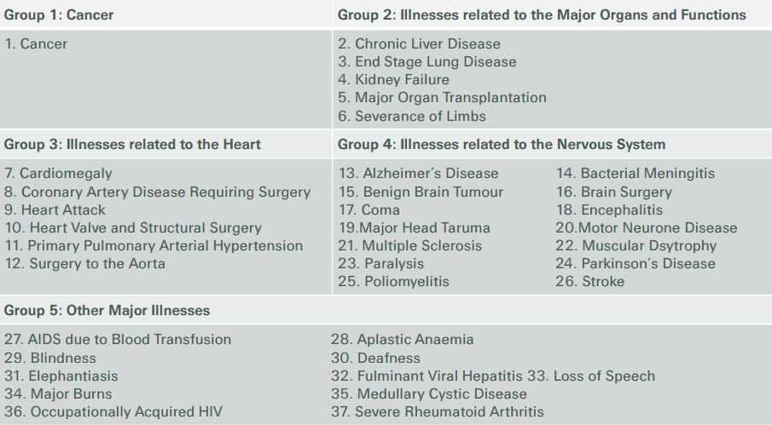
Multi-pay CI (Hong Kong Example)
Indian Actuarial Profession
Serving the Cause of Public Interest

Slide 21
Challenges in
Product Design
&
Pricing
Indian Actuarial Profession
Serving the Cause of Public Interest

Slide 22
Product Design & Pricing
Definitions
    Standard definitions of Critical illness available for SCI
    Stage wise illness categories need to be defined in MCI
      Difficult to derive
      New definitions must be legally and medically objective
      Weak definitions may lead to more claims or claim disputes , if rejected
Indian Actuarial Profession
Serving the Cause of Public Interest

Slide 23
Product Design & Pricing - Data
SCI
CIBT rates ,Reinsurer rates , Own data
MCI
Relatively new concept - absence of Industry data makes it difficult to price
Possible sources Reinsurer rates, Foreign market, PMI data, government health agencies, medical professional
Overlaps between illnesses will further add to the problem
Sufficient claim data at required level of detail may not be available
Required at various stages of illness for multistage
Indian Actuarial Profession
Serving the Cause of Public Interest

Slide 24
Can PMI data be used for pricing MCI?
PMI
Multiple claims
Medium or large sized hospital expenses
MCI
Multiple claims
Compensate financial loss to treat illness – slightly higher than PMI
Lower qualifying criteria
Stringent qualifying criteria
No. of claims higher
No. of claims will be limited to no. of stages/groups allowed
Indian Actuarial Profession
Serving the Cause of Public Interest

Slide 25
Can PMI data be used for pricing MCI?
      Transition rates can be estimated using exposure & claim data of PMI under multiple incidents
      Large time interval (6months) correspond to separate treatment episode for same condition
      Ensure all policyholders joining our PMI dataset are healthy
      The type of claim definitions should be similar between both
      Severity or qualifying criteria should be similar
      Claim paid figures may not contain claims diagnosed but yet to be paid – Development pattern can be used
      Consider whether PMI data can be used for all types of conditions
Indian Actuarial Profession
Serving the Cause of Public Interest

Slide 26
Challenges in Product Design/Pricing Contn’d
Expenses:
  Higher claim management expenses due to multiple claims in MCI
  Sales and administrative staff may require training on MCI increasing training costs
  Greater efforts may be required to sell MCI compared to SCI leading to higher commission subject to regulation.
  Higher advertising expenses as product new to the market
  Overall development cost will be higher for Multistage CI compared to SCI
  Estimation of Business Volume is very Crucial to spread overheads
  Margins:
  Likely to higher in MCI
  Reviewable policy may reduce margins and hence premiums -subject to Regulations and Competition
Indian Actuarial Profession
Serving the Cause of Public Interest

Slide 27
Other Considerations,
Stakeholder Preferences
&
Conclusion
Indian Actuarial Profession
Serving the Cause of Public Interest

Slide 28
Reinsurance/How different for MCI?
Reinsurers play an important role in providing expertise
Product Design (by establishing policy wordings)
Pricing ( by providing data or incidence rates)
Underwriting (Processes/ Manual/Tool)
Claim settlement
System Design
Training
Sharing of risk
Provide experience/data from foreign markets
Greater need for reinsurance in MCI
Indian Actuarial Profession
Serving the Cause of Public Interest

Slide 29
Admin/Systems/Claims – MCI
  Administration more complex in view of multiple claims
  System should be able to keep policy in-force even after a claim is paid in multistage CI which is not the case with SCI
  System should be capable of allowing multiple claims till 100% of SA is exhausted
  Claims can be made for less stringent conditions in MCI therefore may require more scrutiny at outset for propensity to claim
  Windfall claims less likely in MCI reducing anti-selection risk
Indian Actuarial Profession
Serving the Cause of Public Interest

Slide 30
Other considerations
  Others
    Reserves likely to be higher in view of higher margins for the greater uncertainty and higher frequency of claims
    Need to allow for claims spilling through court awards/legal costs for disputed claims for policies already sold if these are significant– Legally and medically objective definitions very important
  Need to allow for post illness mortality, if death benefit paid
Market
    SCI – relatively easily understood by market
    MCI – difficult to explain; greater need to create product awareness
Indian Actuarial Profession
Serving the Cause of Public Interest

Slide 31
Various stakeholders preferences
  From the perspective of various stakeholders preferences
  Customers
    Preference depends on the choice of the benefit and Price
    Sophisticated and informed customers --- Likely MCI because of multiple claims and value for money
    If Lump sum – SCI else If price -- MCI
    Likely to be SCI as MCI less popular and relatively complex
    May prefer ACI also
    Whether price can be reduced in case of MCI , if a claim paid
Indian Actuarial Profession
Serving the Cause of Public Interest

Slide 32
Various stakeholders preferences
Regulator
  Major Objective - Not detrimental to PHs , value for money
  MCI – Relatively new , more complex , more scrutiny may be required unlike SCI
Distributors/Marketing
  MCI- Sold? & SCI – Bought?
  Likely to be SCI in view of the simplicity
  May be MCI if higher reward for higher initial work
Reinsurer
  May take both
  Depends on the risk management approach of the cedant (ex., cedant’s underwriting practice)
Indian Actuarial Profession
Serving the Cause of Public Interest

Slide 33
Various stakeholders preferences
Shareholders
  Prefer higher returns
  Difficult. Likely to be MCI but volume is a significant factor
  However, SCI lower expenses hence profits may be high, other things being equal
Insurer
  May prefer MCI but depends on the target market (ex., sophisticated customers)
  SCI easy to sell
  May also launch variant of MCI with premium reducing after each claim as an Innovative product (Pilot product ) as per regulations to test the market
Indian Actuarial Profession
Serving the Cause of Public Interest

Slide 34
Conclusion
SCI
lump sum payment is more attractive and products is relatively less complex
easy to sell but commission rate higher for MCI for higher sale efforts
MCI
Sold? & SCI - Bought? Mis-selling!!!
May be preferred by sophisticated and informed clients
Customer needs are arguably matched more closely in MCI
Relatively new & more complex, may be subject to more scrutiny by Regulator
Reinsurer/Insurer may be happy to expand CI market and increase premiums amount and volumes and hence profitability by encouraging this product
Indian Actuarial Profession
Serving the Cause of Public Interest

Slide 35
  CI Coverage is “Expensive”
  But,
  contracting CI without Cover is “Catastrophic”
Indian Actuarial Profession
Serving the Cause of Public Interest

Slide 36
  Q & A
  THANK YOU!!
Indian Actuarial Profession
Serving the Cause of Public Interest

