Slide 1

27th India Fellowship Seminar
Topic: Increasing the share of protection business – promise and pitfalls
Guide’s name: Abhishek Saraf
Presenters’ names:
Kashvi Jagnani
Satyavani Cherla
Khalid Ahmad
Date: 1-2 June,2017
Mumbai
Indian Actuarial Profession
1
Serving the Cause of Public Interest

Slide 2
Agenda
Macro-perspective
Protection landscape – watching out for the pitfalls
Proposed solutions – fulfilling the promise
Conclusion
Indian Actuarial Profession
2
Serving the Cause of Public Interest

Slide 3
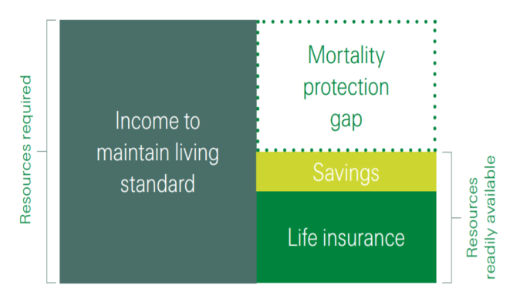
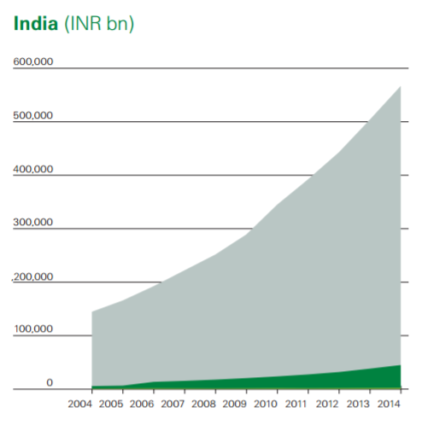
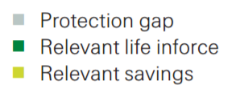
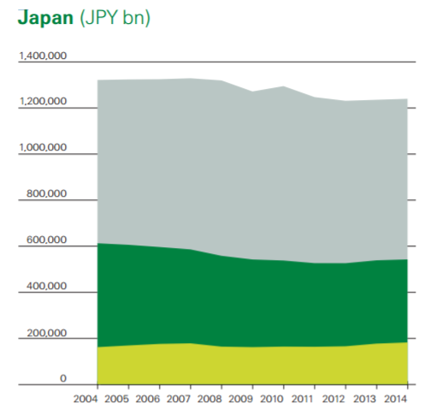
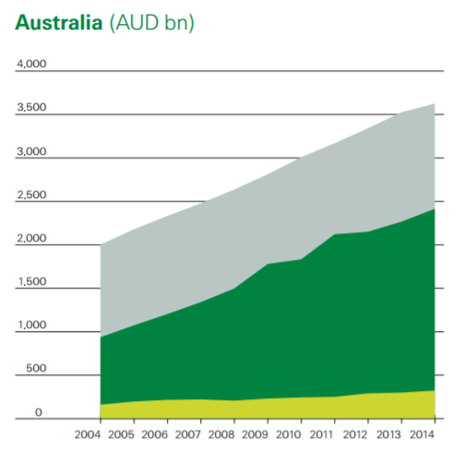
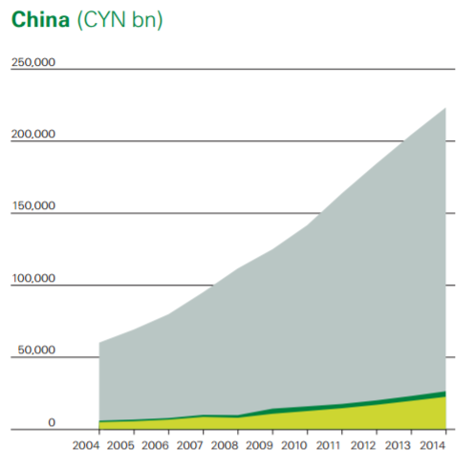
Protection – an unfulfilled promised
CAGR: 11%
Increasing protection gap
Bridging the Gap
Social perspective
Higher purpose
Economic uplift
Financial inclusion
Untapped opportunity
Lack of substitutes
Source : Report on Mortality Protection Gap by Swiss Re
Sum assured to GDP: 55% for India versus 150% to 250% for developed markets
Indian Actuarial Profession
3
Serving the Cause of Public Interest

Slide 4
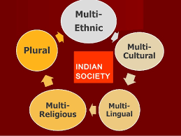



Protection – a macro overview
Demographic dividends
Changing aspirations
Nuclear families
Higher liabilities
Sedentary lifestyles
Social security
Economic development
Financial inclusion
Health care spends
Purpose of insurance
Customer centricity
Social perspective
Untapped opportunity
Lack of substitutes
Neglected category
Life insurance industry
4
Indian Actuarial Profession
Serving the Cause of Public Interest

Slide 5
Agenda
Macro-perspective
Protection landscape – watching out for the pitfalls
  Category view
  Stakeholders say
Proposed solutions – fulfilling the promise
Conclusion
Indian Actuarial Profession
5
Serving the Cause of Public Interest

Slide 6
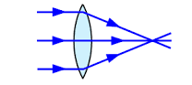




What’s covered under protection?
Focal lens: Pure term
Narrow with heated competitive space
Standard: + Health
High impact with increasing activity
Protection View-finder
Telephoto: + Riders
Incremental value to policyholders & insurers
Wide angle: + Group
Expanding the horizon
Fish eye: + ROP
Scalable model or a distraction?
Indian Actuarial Profession
6
Serving the Cause of Public Interest

Slide 7



Pure term
Non-par protection offers higher margins…. Wait… Really??
Customers – savings or protection?
Impact of competition?
Mortality profits ?
Investment and loading profit?
Lapse Profits ?
So where do the margins really rest?
Distributors – are they interested?
Indian Actuarial Profession
7
Serving the Cause of Public Interest

Slide 8
Health
Where’s the play for life insurers?
Health = Indemnity: ~95% share
Hospital
cash
Is fixed benefit scalable?
Incidence
Vector
based
diseases
Surgi-cash
Competition from GI/ SHI?
Multiple
Critical
Illness
Capabilities on high incidence?
Investments in creating a market?
Disease
specific
Claims management?
Impact
Building scale on a fledgling category?
Indian Actuarial Profession
8
Serving the Cause of Public Interest

Slide 9




Riders
Who sells it anyway?......
Cumbersome onboarding
Caps on sum assured and premium
Distribution interest?
Success stories:
Korea: LEGO – build your protection blocks
Malaysia: High attachment rates
Online: Encouraging recent trends
Classification Singapore example
Need to re-look at regulations and onboarding process
Indian Actuarial Profession
9
Serving the Cause of Public Interest

Slide 10



Group
Making financial sense in group?
Hyper-competition?
Negotiating strength of distribution
Low margins
Higher Statutory profits – scale?
Credit life offers good mortality experience
Restrictive definitions and high solvency
High capital requirements
Indian Actuarial Profession
10
Serving the Cause of Public Interest

Slide 11





Return of premium
Is this protection or not?
Alignment
Customer: Survival benefit
Insurer: Higher ticket size
Distributor: Higher commissions
Is it really protection?
PV of mortality claims cost/ PV of total claims
SA to annual premium ratio
Measure
Indian Actuarial Profession
11
Serving the Cause of Public Interest

Slide 12
Agenda
Macro-perspective
Protection landscape – watching out for the pitfalls
  Category view
  Stakeholders say
Proposed solutions – fulfilling the promise
Conclusion
Indian Actuarial Profession
12
Serving the Cause of Public Interest

Slide 13

Insurers
The insurance market place is…..
….Hugely competitive and facing significant challenges
ULIP profitability impaired due to cap on charges;
Par profitability curtailed due to 90-10 gate
Non-par protection - Higher margins; low interest rate sensitivity; Underwriting profits; Higher EOM limits
Non-par savings - Higher margins, but sensitive to interest rates and ALM risk
Indian Actuarial Profession
13
Serving the Cause of Public Interest

Slide 14




Distribution
Selling protection is too much effort…..
….and the rewards are not enough
High bargaining power
Low earnings
Cumbersome on-boarding
Health:
Medico-legal lingo?
High productivity feasible?
Why take the effort in retail protection?
Indian Actuarial Profession
14
Serving the Cause of Public Interest

Slide 15





Customers
Existing customer segmentation is…..
….Based on life-stage and customer needs
Do not recognize the importance of early savings
Protection for spouse
Securing future for child
Safeguarding against critical illness
Planning for life goals - children (marriage/ higher education etc.)
Generating monthly income to maintain lifestyle
Safeguarding health
Broad-brushing customer segments stifles innovation
Indian Actuarial Profession
15
Serving the Cause of Public Interest

Slide 16
Agenda
Macro-perspective
Protection landscape – watching out for the pitfalls
Proposed solutions – fulfilling the promise
Conclusion
Indian Actuarial Profession
16
Serving the Cause of Public Interest

Slide 17










Value proposition for key stakeholders
So, what it is that the insurer needs to do?
Spreading awareness
Regulatory / Government enablement
Distribution
Personalization
BARRIERS
Low awareness for protection – people don’t see it as the essential product that it is
Savings oriented mindset
We don’t like to talk about dying
Cumbersome onboarding process
Medical underwriting
Creating a digital eco-system
Agility
New business models
Cost and Speed
Connecting and sharing information
Indian Actuarial Profession
17
Serving the Cause of Public Interest

Slide 18


Spreading awareness
Insurance industry/
Intermediaries/
Regulator/ Government
Social media
Technology
Customer engagement
Dedicated desks – retention of business
Agents’ training
Caution against mis-selling
Financial literacy and risk awareness
Tax advantages
Informed decisions
Grievance redressal
Indian Actuarial Profession
18
Serving the Cause of Public Interest

Slide 19

Regulatory / Government enablement
Higher Commissions
Higher EOM
Minimum Death Benefit
E-Commerce guidelines
Other areas
Risk management – mitigating adverse selection and frauds
  Data repository: reducing information asymmetry
  Data analytics support: reports, risk flags
  Accountability for partners: medical network, TPA, distribution
  Legal framework for action against frauds
Separate tax benefits for protection
Reducing service tax rates – GST notwithstanding
Product related relaxations
Use & File for simple protection products
Simplifying terms and conditions for health products, death benefit definition etc.
Re-look at quota share norms
Product regulations
  Riders: removal of caps, re-classification
  Group: pricing flexibility, widening definitions, solvency norms
  PMJJBY: Experience based pricing
Allow innovative products – 80 D utilization, health + savings
Indian Actuarial Profession
19
Serving the Cause of Public Interest

Slide 20



Distribution
Dedicated channels – Protection salesforce
Common service centres / Point of sales
Microinsurance channels – more needs to be done
NGOs / MFI / Self help groups
Leveraging digital sales
Training initiatives for intermediaries
Indian Actuarial Profession
20
Serving the Cause of Public Interest

Slide 21










Personalization
There is a need for….. Focused approach to manage key customer needs
Risk takers
Early adopter of technology
Price sensitive
Don’t know where to begin
Price sensitive
Recognize value of insurance
Least price sensitive
Risk averse
Financially confident
Not thinking about life insurance
Late adopters
Mistrustful of financial instruments
Focused on securing worry free retired life
There is scope for reaching out to….. Specific micro-segments
Daily/Monthly income in absence of bread winner
Key person insurance for business continuity
Avenue to grow household savings
Additional income
Small savings
Protection
Wealth accumulation
Health safeguard
Pure protection
Indian Actuarial Profession
21
Serving the Cause of Public Interest

Slide 22





Creating a digital eco-system
Health insurance products
Care pathway
Education &
Prevention
Screening & Diagnostics
Access
Care management
Payments
Definition
Engage the consumer and create deeper understanding of a consumers’ personal health
Cutting-edge consumer-friendly tools to let a person know if they are becoming unhealthy
Providing consumers with virtual and physical connectivity to credible professionals and drugs
Interactions with medical professionals, prescribed products (drugs) & services, and self-empowered programs to improve a person’s health
Innovations in financial coverage and/or payment programs within healthcare
Indian Actuarial Profession
22
Serving the Cause of Public Interest

Slide 23


Connecting and sharing information
Increased customer engagement through gamification.
Gamification has the ability to activate patients, make them accountable for their health choices, and turn them into consumers.
Main advantages - opportunity for data collection, integration, and analysis; Boosts the reputation, brand awareness, and customer loyalty for market players and establishes the provider as an innovation leader
mySugr is an application for monitoring blood sugar levels to manage diabetes. Through a point collection system, players are enabled to set and reach personal targets. mySugr was shown to improve testing frequency by 10-20%, decreasing blood sugar levels in the blood by 0.4-1.1%.
AIA’s Vitality Program offers 25% upfront discount on policy if health data is shared; Further discounts and rewards (e.g. vouchers and movie tickets) for healthy behavior.
Indian Actuarial Profession
23
Serving the Cause of Public Interest

Slide 24

Agility
Pricing products using innovative analytics to ensure value for money.
Identify risks within policyholders based on publicly available data, instead of just data provided by policyholders.
Then capture interactions between risk factors and
mortality. Open data can be used to determine the
correlation between various factors to the likelihood
of death, which can then be used to help ensure
accuracy in pricing protection products and
maximizing underwriting profits.
There is a merit in micro-segmentation of customers,
even though there is a risk of exclusion.
Pricing in this manner may be curtailed by regulatory
restrictions and lack of data.
Indian Actuarial Profession
24
Serving the Cause of Public Interest

Slide 25




Cost and Speed
Financial advice
Providing cheaper and instant financial advice with minimal human intervention, through robo-advisers. Potentially low overheads.
Mint is a free personal finance and money management platform and therefore has close similarities with automated life insurance advice and guidance. It analyses all the user’s bank transactions to give them a bird’s eye view of their financial situation and how to improve it. Mint has been able to gain significant scale on a shoestring budget. Mint trusted its 36,000 Facebook fans to promote its services.
Underwriting
Cutting underwriting and claim settlement cost and times with Machine Learning. This reduces cost and increases consistency in claim processing; results in improved branding and reputation; better customer interaction
Indian Actuarial Profession
25
Serving the Cause of Public Interest

Slide 26

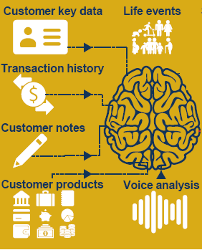
New business models
Improving efficiency of sales staff
Generating real time tailored guidance using voice analytics and customer database. Helps in increasing productivity of sales colleagues. Increased sales through cross sell opportunities and improved customer experience
Digital distribution would allow access to new markets without the need for expensive and difficult to establish branch or agency networks on the ground.
It could be especially important in reaching remote customers.
Kenya’s MPesa, which provides access to payment and deposits via the mobile phone network and now has 15 million customers, more than all of the country’s banks put together
Indian Actuarial Profession
26
Serving the Cause of Public Interest

Slide 27
Agenda
Macro-perspective
Protection landscape – watching out for the pitfalls
Proposed solutions – fulfilling the promise
Conclusion
Indian Actuarial Profession
27
Serving the Cause of Public Interest

Slide 28

Conclusion
There’s a long way to go….. Strong partnership with each stakeholder needed
Government and Regulator
Customers
Insurers
Distribution
Creating a win-win for all stakeholders
Indian Actuarial Profession
28
Serving the Cause of Public Interest

Slide 29
Thank you
Indian Actuarial Profession
29
Serving the Cause of Public Interest

