Slide 1
Future Benefit Reserves
Rajesh Dalmia (Views presented are that of the author and his employer Ernst & Young has no responsibility for the same)

Slide 2
Agenda
Introduction
Comparison of Few Product Features
Literature Review (GR)
Future Benefit Reserving
  Re-current diseases (in claim portfolio)
  Promised benefits triggering in future
  Well-ness benefit
Conclusion

Slide 3
Reserving – principles
Liability – adequate – recognized premiums
Liability adequate – unrecognized premium portion
Liability for future claims/benefits/expenses allowing credit of future premiums
(accounts for any guarantees)
No credit is taken from future new business (except probably contribution towards ongoing maintenance expense levels)
Usually premium and reserving do not talk to each other (?)

Slide 4
Challenges in Health Insurance Reserving
Multiple waiting period for various diseases/PED (different for different products)
Guaranteed renewability – recurrent disease
Different benefits for different variants (maternity, No claim bonus/discounts etc)
Portability – no age limit to any product

Slide 5
Product Features in the market – impact on reserves (?)
Maternity Cover, New-born baby (incl vaccination) , ambulance
OPD cover, Health Check-ups, immunizations, counselling, specialist/second opinion, online facility, ayush, gym discounts
Restoration / Recharge, no claim bonus, deductability
Hospital cash, world-wide cover, co-pay, savings a/c, pre/post variation,
Discounted single premiums, region based co-pay,

Slide 6
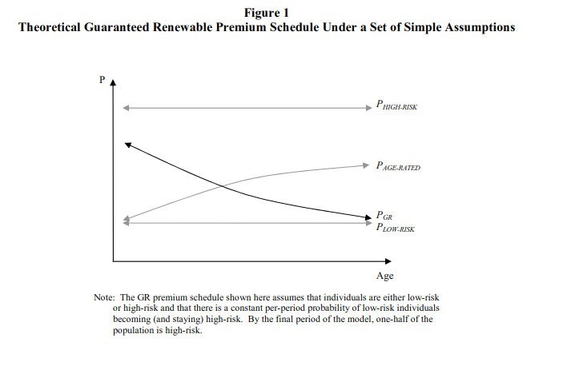
Literature Review (GR)
Pauly, Kunreither and Hirth (1995) showed that in a simple two period model, GR premium should be front loaded.
Notes:
Pauly, M., H. Kunreuther, and R. Hirth, 1995, Guaranteed Renewability in Insurance, Journal
of Risk and Uncertainty 10, 143156.
Frick, K., 1998, Consumer Capital Market Constraints and Guaranteed Renewable Insurance,
Journal of Risk and Uncertainty 16, 271-278.

Slide 7
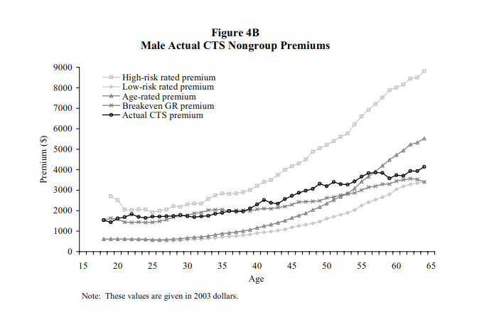
Literature Review (GR)
Pauly and Herring (2006/3) developed a theoretical markov model to estimate the cost of GR and found it to be approximately 20% of risk premium for females and 30% for males (on npv basis).
Notes:
Pauly, M., H. Kunreuther, and R. Hirth, 1995, Guaranteed Renewability in Insurance, Journal
of Risk and Uncertainty 10, 143156.
Frick, K., 1998, Consumer Capital Market Constraints and Guaranteed Renewable Insurance,
Journal of Risk and Uncertainty 16, 271-278.

Slide 8
Literature Review (GR)
Frick (1998) showed that in non-perfect capital markets the front loading would not enable young to undertake the insurance
Pauly and Herring (2006/3) developed a theoretical markov model to estimate the cost of GR and found it to be approximately 20% of risk premium for females and 30% for males (on npv basis).
Feyter (2008) estimated that the cost of selective lapsation for a mature health insurance portfolio is 1-1.5% over the ultimate claim rate for every additional year of claims.
Elikhis surveyed NZ insurer to find out how many keep this reserve and found only one of them do it.
Notes:
Pauly, M., H. Kunreuther, and R. Hirth, 1995, Guaranteed Renewability in Insurance, Journal
of Risk and Uncertainty 10, 143156.
Frick, K., 1998, Consumer Capital Market Constraints and Guaranteed Renewable Insurance,
Journal of Risk and Uncertainty 16, 271-278.

Slide 9
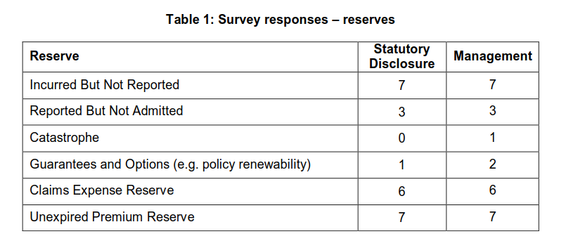
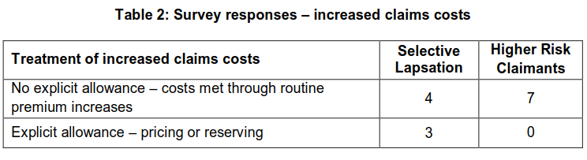
Literature Review (GR)
Notes:
Pauly, M., H. Kunreuther, and R. Hirth, 1995, Guaranteed Renewability in Insurance, Journal
of Risk and Uncertainty 10, 143156.
Frick, K., 1998, Consumer Capital Market Constraints and Guaranteed Renewable Insurance,
Journal of Risk and Uncertainty 16, 271-278.

Slide 10
Premium and Risk patterns
Age band* | Risk Premium | % increase in Risk Premium | Insurer A |  | Insurer B |  | Insurer C | Insurer C
[0-5) | 941
[6-15] | 571 | -39.37%
[16-25] | 1,183 | 107.29% | 3,410 |  | 5,887 |  | 5,060
[26-35] | 1,580 | 33.60% | 3,410 | 0% | 5,887 | 0% | 5,060 | 0%
[36-45] | 2,991 | 89.31% | 4,218 | 24% | 6,662 | 13% | 5,348 | 6%
[46-55] | 3,105 | 3.80% | 9,641 | 129% | 12,321 | 85% | 13,070 | 144%
[56-60] | 6,404 | 106.27% | 11,187 | 16% | 15,907 | 29% | 15,813 | 21%
[61-65] | 8,332 | 30.11% | 17,651 | 58% | 22,089 | 39% | 16,503 | 4%
[66-70] | 10,351 | 24.22% | 24,272 | 38% | N/A | #VALUE! | 23,000 | 39%

Slide 11
FBR / Contract reserving
AAA – required where present value of future benefits exceeds the present value of future premiums (all in-force, only in claim? )
Not required when “rates for a particular block of contracts are determined in such a manner that each year’s premium is intended to cover that year’s cost with no pre-funding of future years’ costs from the current year’s premium” or when contracts which cannot be continued after one year from issue.
Approaches similar to pricing but with margins in the current assumptions is advised by AAA

Slide 12
FBR / Contract reserving
Do nothing approach – Only when company has shown a pattern of increasing rates when future benefit increases
Benefit rider / proportional approach – each year recognize the increase and allow that in the basis
New factor approach – recalcualte the reserves using the current best estimates for future
Loss ratio approach – project target loss ratio based on pricing assumption for a block of business. Use this to develop expected incurred claim amount with margin. Reserve is difference between this and the actual claims.

Slide 13
Conclusions - Reserving
Assumptions between pricing and reserving will differ – due to change in business mix – age / variant / term / zone / floater / options etc
Additionally, there should be some margin for prudence
Actual in claim status – allowing for recurrence and deterioration of portfolio
Claim inflation every year but premium inflation is in steps allowing for regulatory constraints
Rationality assumption for policyholder

Slide 14
Managing Renewability Guarantee
Cross subsidization
Locked in reinsurance rates (?)
Migrating p/hs to different product (portability)
Product closure to new business (PRE, equality)
Health cost management by tie-ups with health service providers
Clumsy/discouraging renewal process (?)
GR reserve invested in positively correlated assets

Slide 15
Thank You
dalmia.rajesh@gmail.com

