Slide 1
Role of control functions in Solvency II: How the 3 lines of defense are organized
ERM Seminar – Institute of Actuaries of India
Mart 2017

Slide 2
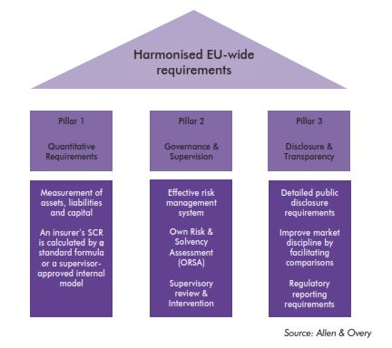
Solvency – II - Framework

Slide 3
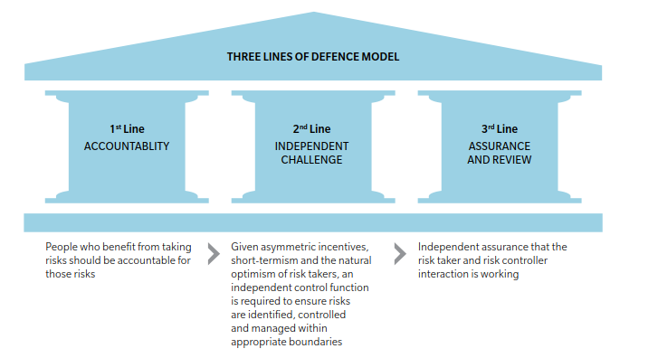
Classical 3 Lines of Defense Model

Slide 4
Solvency II – Lines of defence model
1
2
3
Business operations (Risk ownership)
The business operation units are to measure and manage business performance, implement internal control and risk management framework
Risk and control functions
Risk mgmt function
Facilitate the Risk Management system:
System of governance, ORSA, SCR calculation
Actuarial function
Coordinate calculation of provisions
Contribute to risk management system
Compliance function
Facilitate and evaluate internal control processes
Contribute to risk management system
Internal and external audit
Provide independent and objective assurance over the effectiveness of corporate standards and business compliance, including that the risk management system functions

Slide 5
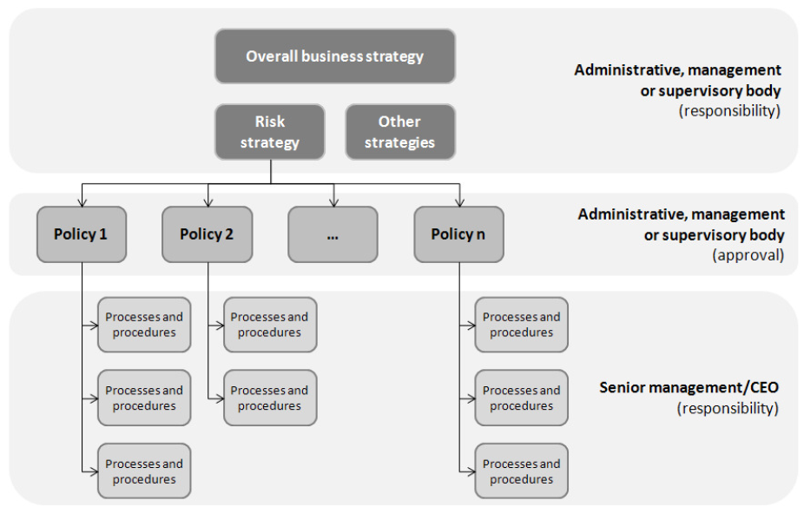
Solvency II – Risk Management – Connect business strategy to risk decisions and operational processes

Slide 6
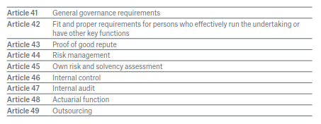
Solvency – II – System of Governance
Source:MunichRE

Slide 7
Role of Risk Function (Article 44)
Structured in such a way to facilitate the implementation of risk management system
Strategies, processes and reporting procedures necessary to continuously identify, measure, monitor, manage and report incurred and potential risks and their interdependencies at an individual and at an aggregated level.
Should cover at least the following areas – risk assumption and reserving, asset liability management, investments especially derivatives, liquidity and concentration risk, management of operational risk, reinsurance and other risk mitigation technique
Thus it should do the following:
Overall coordination and control of the risk­management tasks
Measurement and assessment of the overall risk situation, including early identification of potential future risks
Reporting to the Board

Slide 8
Role of Compliance Function (Article 46)
Structured in such a way to facilitate the compliance with internal control system
Should cover at least the following areas – Administrative and accounting procedures, Internal control framework, Appropriate reporting arrangements at all levels in the company
Thus it should do the following:
Supervision of the internal control system
Risk Control
Early Warning
Provision of advice to management

Slide 9
Role of Internal Audit Function (Article 47)
Responsibilities include - evaluation of the adequacy and effectiveness of the internal control system and other elements of the system of governance
Audit report to be produced at least annually

Slide 10
Role of Actuarial Function (Article 48)
Responsibilities include -Coordination and monitoring of the evaluation of technical provisions (including methodology, assumptions and data), Reporting and Supporting the risk­ management function
The function is not responsible for calculating the technical provisions, but for coordi­nating the calculation process and assessing the methods, tools and data used for the evaluation
Responsibilities include
To understand the individual model components, their interdependencies and the way the model depicts and takes account of the resultant diversification effects
To develop and regularly review the reserving methodology (stochastic simulation, deterministic approach, etc.)
To compare the current assumptions with those for the previous year and those for the previous year with the actual figures to calculate the technical provisions (best­esti­
mate comparison), and identify the reasons for the variances
To express opinion on reserving and underwriting guidelines
To express opiinion on reinsurance cover, adequacy of premiums, main risk factors and their influence on next year profit, appropriatenes of IT system

Slide 11
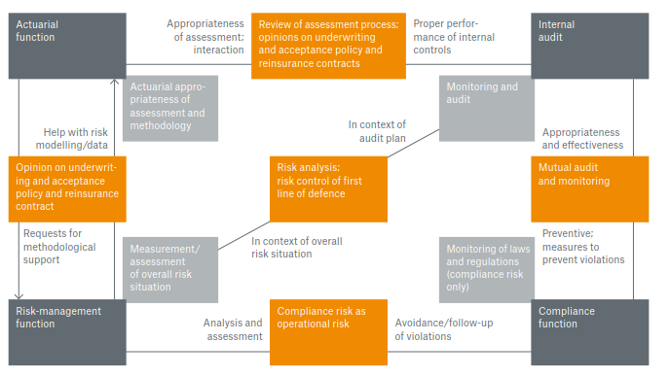
Interfaces between key functions
Source:MunichRE

Slide 12
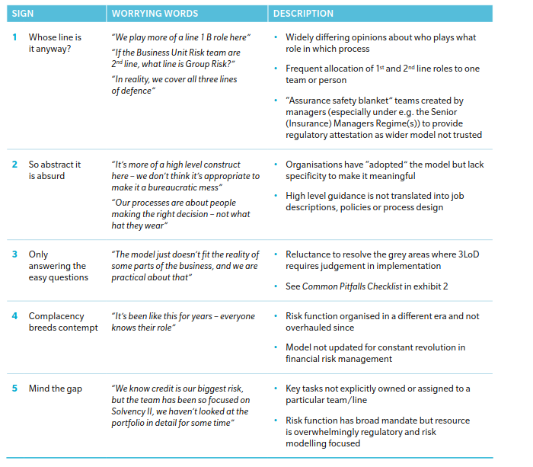
Things going wrong

Slide 13
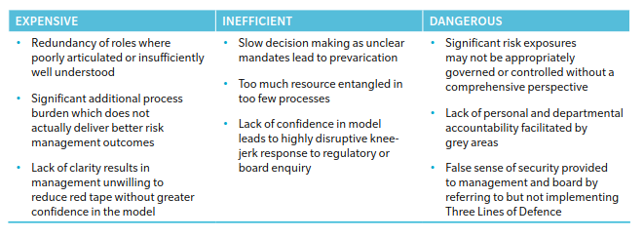
Impact of failure of GRC

Slide 14
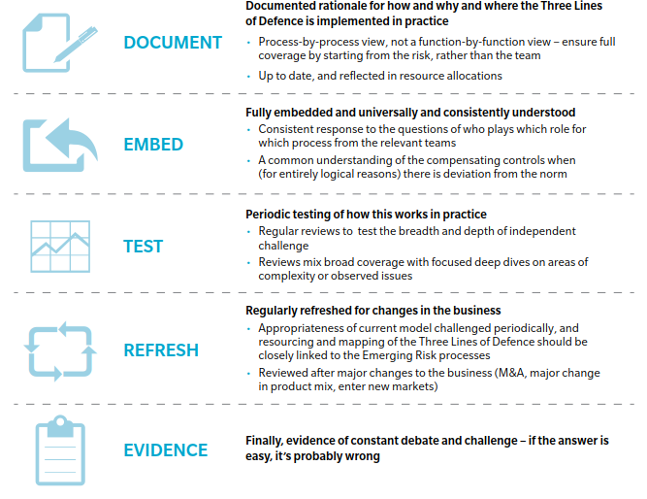
Features of a Good 3 lines of defence

Slide 15
Thank you

