Slide 1
Opportunities for actuaries in the Life, General and Health Insurance Industries
28 October 2017

Slide 2
Overview
Who is an actuary?
What do actuaries do?
Where do actuaries work?
Actuaries of the future

Slide 3
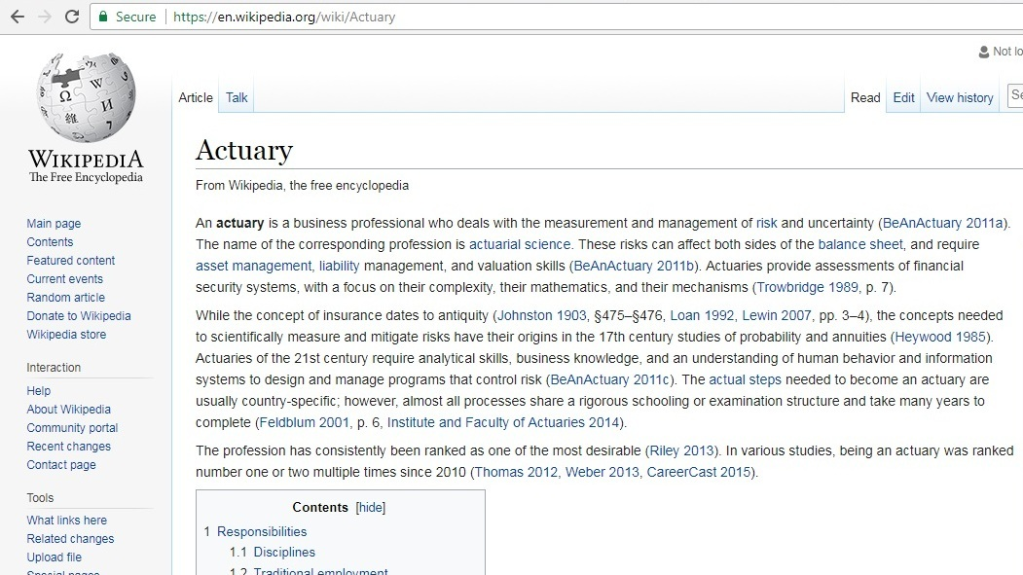
Who is an actuary?

Slide 4





What others think actuaries do?
What my friends think I do
What my mom thinks I do
What society thinks I do
What I think I do
What I really do

Slide 5
What really actuaries do?
Evaluate likelihood of future risk events
Design solutions to mitigate risk/Evaluate effectiveness of these solutions
Likelihood of market related events
e.g. equity fall, interest rate changes
Likelihood of operational risk events
e.g. cyber attack, fraud
Products that meet the need of policyholder (protection against risk of death, sickness, living longer etc)
Catastrophe insurance/home insurance/motor insurance
Likelihood of death, survival and sickness in the future
Likelihood of catastrophes/thefts/accidents
Products with investment guarantees
Reserves/ profitability assessment

Slide 6
How we solve actuarial problems ?
ACTUARIAL CONTROL CYCLE
Identify and specify the problem
Develop and implement the solution
Monitor and respond to experience
External Forces
Professionalism

Slide 7
Where do actuaries work?
- Life insurance company
- General insurance company
- Health insurance company
- Financial consultancy firms
Product development and Pricing
Designing new product solutions to meet the consumer financial needs
Risk management
Calculating capital required to protect against adverse future events
Reserve calculation
Profitability assessment
Calculation of Embedded Value (EV) (fair value of an insurance company; New Business Margins
Experience analysis
Asset liability management
Identify investment strategy to minimize adverse impact of change in market conditions to ensure consumer liabilities are met
Update the assumptions, after monitoring the actual experience
Assess frequency and average amount of claims to estimate premium
Identify, manage and mitigate risks for insurance companies and consumers
To ensure insurance company is able to meet its financial obligations to consumers
Basis experience, set assumptions for above analysis

Slide 8
Actuary of the future
Also, hampers our ability to expand to new areas where we traditionally don’t work
Actuaries need to be more business savvy, risk takers….
Need to embrace new developments and learn rather than resist…….
There is increasing demand for more innovative and dynamic pricing e.g. insuring your car only for the period when it is on the road………
Are we embracing new technology like artificial intelligence, increased computing power, predictive analytics and discussing its implications enough ……
We can’t continue to hide behind ‘prudence’ and thereby potentially miss business opportunities.
Ability to see the ‘big picture’. Not just about calculating something….but implications need to be understood and communicated
“Not many people know what we do because it is complex …” this mentality should go.
Good BUSINESS COMMUNICATION skills are key……….
Bad communication risks our current roles to be taken by other professionals like MBAs, accountants;
Ability to work in cross functional teams need to improve. The bedrock of latest developments like ERM etc is to break away from a ‘silo’ approach to more ‘integrated’ approach.

Slide 9
Disclaimer:
Views expressed here are my personal views and not the views of my employer

