Slide 1

Case Study L6 — Distribution of profits
Archana Anoor, Rahul Khandelwal and Rutika Kumar
Guide: Philip Jackson

Slide 2
Agenda
Introduction
Case study – problem statement
Context and regulatory framework?
Discussion points:
  Financial Impact and Sensitivity analysis
  Practical ways to implement change
  Legal and constitutional issues (including PPFM)
  Policyholder communication & Publicity
  Ethical concerns
  TCF
  Consult for independent views
Discussion & Questions

Slide 3
Case study – problem statement
Current set-up:
Proprietary composite company
Company’s constitution: Any profits arising from par life business – 90:10, any profits arising from non-par – distributed as per company’s discretion
Company’s practice from many years: all profits from the fund – both par and non-par included in the 90:10
All life business written in a single fund (separate revenue account for premiums, expenses, claims but combined investment income)

Slide 4
Case study – problem statement
Issue under consideration:
Increasing pressure from non-life side of business
So Board wishes to exercise its right to restrict 90:10 to par alone
As a WPA, what are PRE concerns and other issues?

Slide 5
Context & Regulatory Framework
Strong Governance Framework:
Advantages
Helps to set PRE
Reduces operational risk
Statute for future decisions
Demonstrates compliances to regulator
Aids consistency between changes in management
Demonstrates compliance with TCF
Disadvantages
Helps to set PRE
Fear of disclosing too much
Introduces Inflexibility
Regulatory intervention
Competition

Slide 6
Context & Regulatory Framework
UK – With-profits Governance Framework prescribed by FSA
With profits fund
With-profits actuary
Actuarial function holder
With-profits committee

Slide 7
Context & Regulatory Framework
Indian Context
With-profits committee
Independent Director
CEO
Appointed Actuary
Independent Actuary

Slide 8
1. Financial Impact and Sensitivity Analysis
Possible Impact on policyholders
Impact on Bonus (RB/TB)
Impact on Estate
Solvency of the Company
Reduced Bonus - Reduced expected Return
Perceived value/ Needs and financial goals NOT met
May discontinue early with a low surrender value (GSV!)
Possibility of increased return due to high bonuses?
Support from Estate to maintain reasonable expectation - affecting TB
Lower investment Freedom – affecting surplus so RB/TB
Higher expenses (per policy and investment expense) – affecting surplus so RB/TB
Par fund deficit after segregation of the life fund
Funding of new business strain after split (closure to NB)

Slide 9
1. Financial Impact and Sensitivity Analysis
Possible impact on shareholders
Additional capital injection to:
Impact on S/H transfers:
Fairness to shareholders:
Support new business strain on capital intense non par business
May reduce from par business
'100% surplus for 100% loss' Vs '10% of surplus for 100% loss'
Maintain the bonus distribution at the current level to met PRE
Help meet regulatory capital requirements
Support possible increase of mathematical reserves
Support the smoothing of bonus
May increase from non-par – entitlement to 100% of surplus
May reduce further from par/non par - lower investment surplus

Slide 10
1. Financial Impact and Sensitivity Analysis
Sensitivity Analysis
Various Sensitivity Analysis Required:
Other dynamic testing (e.g. impact of bonus on surrender, impact of interest rate based on new investment strategy on bonus etc)
Reduced bonus rate series – impact on PRE
Estate building - support that can be drawn from it
Business Volume and business mix - impact on business plan
Surrender Rates - assessing the liquidity risk!
Expenses - may go up due to reduced business volume
Investment strategy - reduced investment freedom and better ALM

Slide 11
2. Practical ways to implement change
Main changes:
Factors to consider:
Bonus rates
Regulation – what is allowed?
Segregation of funds
Magnitude of non-par surplus – past and present
Past communication to policyholders on surplus distribution, PRE (covered under ‘ethical concerns’ section)
Industry practice – if any
Close current product line, launch new products with new ground rules

Slide 12
2. Practical ways to implement change
Bonus rates – various options:
Change in bonus rates
Option 1: Dramatic reduction in Bonus
Option 2: Gradual Reduction in Bonus (refreshed PRE)
Option 3: No reduction in Bonus
New products, new policyholders:
New bonus league for new policyholders
Still a good investment offering for new policyholders?

Slide 13
2. Practical ways to implement change
Segregation of funds:
Important to split fairly and equitably
How?
Asset shares? (TCF is assessed in light of asset share calculations: “Within with-profits contracts, the almost universal method for measuring TCF is via asset share calculations”)
Ensure governance requirements are in place - Role of with-profits actuary gains importance

Slide 14
3. Legal and constitutional issues
Constitutional issues
Changes in MOA, AOA & PPFM for gradual reduction in bonus
Existing PPFM flexible to accommodate changes?
Cannot be too broad or cautious in detail
Changes in MOA, AOA – Special Resolution required
Rigorous examination of changes
Competitive advantage should not be lost
Test modified PPFM against business
Maintain consistency with changes in Prospectus and Advertisements
Consider External legal advice and cost vs benefits

Slide 15
3. Documentation
UK and India
PPFM
UK : Detailed document covering how with-profits business is conducted in various areas
Documentation may cover best practices
Bonus philosophy document
WP committee report appended to AAR
Level of documentation varies from company to company#
India: Not mandatory, best practice
Changes in documentation required
# Source: As per Milliman survey on “Governance framework for participating business” only 40% of companies surveyed had detailed documentation specifying how participating business is managed

Slide 16
4. Policyholder communication & Publicity
Policyholder communication:
Should be clear, unambiguous
All material information clearly communicated e.g. at point of sale
Manage policyholder communication, any complaints carefully
Should not be misleading

Slide 17
4. Policyholder communication & Publicity
Policyholder communication:
Policyholders’ questions:
Am I being treated fairly?
What was promised to me when I bought the policy?
Are my guaranteed benefits intact?
What about the bonuses declared in the past?

Slide 18
5. Ethical concerns
Ethical issues to consider:
Discretionary element in a product – policyholders expect firms to be fair & reasonable in exercising discretion
As an actuary/AA/WPA (later slide)
What PRE has been created? Impact due to change (next slide)
Equity between various stakeholders, generations of policyholders (covered in TCF)
What are policyholders reasonably entitled to? Depends on source of surplus?

Slide 19
5. Ethical concerns
PRE:
IRDA AA regulations 2000, regulation 8(g) viii
Past practice of the company: past bonuses, most recent past practices affect more
Various other communications:
General practice within life industry
Shareprice of the company
Upward trend in the investment market, long term investment return
Broker/agent communication
Advertisement & press releases: Information about company available elsewhere e.g. Accounts, statements made by company in financial press
Past communications (PPFM, sales literature, BI)
Notes:
IRDA AA regulations, regulation 8(g) viii: The duties and obligations of an AA of an insurer include:
in case of insurer carrying on life insurance business, (viii) to ensure that the policyholders’ reasonable expectations have been considered in the matter of valuation of liabilities and distribution of surplus to the participating policyholders who are entitled to a share of surplus;

Slide 20
5. Ethical concerns
As an actuary/AA/WPA:
Act honestly, with highest standards to integrity, competence & care
Any communication – clear, accurate, not misleading (The Actuaries’ Code)
Speak up to clients/Board if believe that a decision/action is unlawful, unethical (The Actuaries’ Code), explain about his/her duty to treat customers fairly
Not allow bias or influence of others to override professional judgment (The Actuaries’ Code)
Any conflict of interests – disclose & manage

Slide 21
6. Treating Customers Fairly
Globally acknowledged best practice
TCF requirements and challenges
Requirement: Use of target ranges for payout of Asset share on maturity or Surrender
Challenge: Should a fair payout satisfy above requirement OR Should it be based on PRE
Requirement: Process for reattribution of the inherited estate
Challenge: Ensuring Equity between with-profit policyholders and shareholders
Future actions:
Independent assessment whether fund compliant with TCF
Disclosure to policyholders

Slide 22
7. Independent Views
Independent views from other professionals:
Members will consider whether advice from other professionals and other specialists is necessary to assure the relevance and quality of their work (The Actuaries Code 2.3)
WPC (Independent Actuary),other independent actuary, actuarial consulting firm
Reviewing actuary (GN 42,UK) but no whistle blowing obligations or protection
Second opinion on bonus reduction implementation plan
Assess impact on policyholder interests
Advise on other areas defined in TOR, Scope

Slide 23
Questions?

Slide 24
Appendix

Slide 25
Role of With-Profits Actuary - UK
Main responsibilities
To produce a publicly available annual report for policyholders
Report must confirm if the firm has properly taken policyholders’ interests into account in exercising its discretion and whether it has treated its customers fairly
Advise management on key aspects of the discretion exercised
Advising/ reporting on areas of discretion including:
communication with policyholders and potential policyholders on the above issues
Bonus rates
Surrender value methodology
Investment strategy & investment fees charged to WP fund…

Slide 26
Role of UK With-Profits Committee
Main responsibilities
Compliance with PPFM
Bonus rates and MVRs
Distribution / retention of surplus
Significant changes to the risk/investment profile of the with‐profits fund
Impact of planned or implemented management actions
Future new business strategy
Firm’s customer communications
Conflicts of interest
Drafting and adherence to distribution, management and run‐off plans and court schemes as
appropriate;
Operational costs
Any other issues the with‐profits policyholders may reasonably expect WPC to scrutinize

Slide 27
UK -Principles and Practices of Management
Sets out how with-profits business is conducted in each of the following areas
Annual bonus policy
Determining payouts to policyholders including methods, approximations used, documentation and procedures for changing methods and assumptions
Terminal Bonus policy
Smoothing policy
Investment strategy
Business risk
Charges and expenses
Achieving equity between policyholders and shareholders
Management of inherited estate
Volume and type of new business
Closure to New business

Slide 28
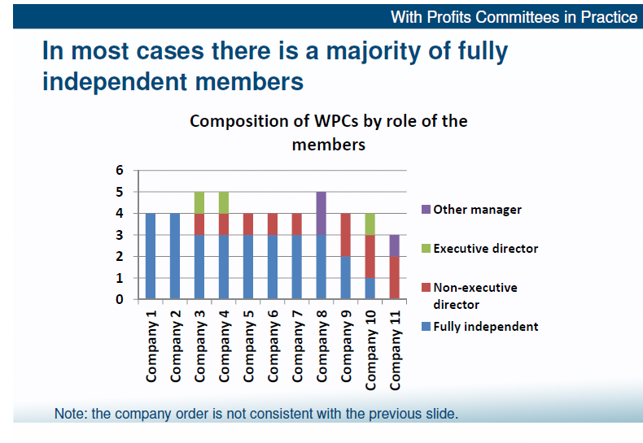
Source: Milliman, Presentation by With-profits business session 1:A UK perspective, Nick Dumbreck, 29 November 2013, 9th CILA

Slide 29
UK -Treating customers fairly
COBS 20.2: Areas where FSA applies
The terms on which new with-profits business should be accepted
Process for reattribution of inherited estate – help firms understand what is appropriate, ensure policyholders are treated fairly
Details required of run-off plans if firms close to new with-profits business
Use of target ranges: Firms must specify target ranges around 100% of unsmoothed asset shares within which 90% of maturity payouts must lie
Circumstances under which bonus distributions or surplus transferred
Description of any profit-sharing arrangements.
It must also cover any other areas that are considered important to the management of the company’s with-profits fund(s) and that may affect with-profits payouts

Slide 30
India – With profit committee structure and responsibilities
With-profits committee
CEO
AA
Independent Actuary
Independent Director
The following shall be approved by WPC
The investment income earned on the fund etc which are represented in the asset share
The expenses allowed for
Detailed working of the asset share
Report appended to AAR

Slide 31
Indian with-profit regulations
Regulation | Contents
IRDA (Non-Linked Insurance products) Regulations 2013 | Specifies rules on product structures, timing of bonus, surrender values and management of with‐profits business •AA ’s responsibility for calculating asset share •Require life insurance companies to calculate asset shares (broadly, the accumulation of policy cash flows, expenses and claims) •The detailed working of the asset share ‐ approved by a WPC •Asset shares calculation – at policy level; fair allocation of expenses and crediting of interest rate •to setup a “With Profits Committee” (“WPC”)

Slide 32
Indian regulations (contd)
Regulation | Contents
IRDA (Distribution of Surplus) Regulations 2002 | Separate funds for par and non-par business. Restricts surplus distributed to shareholders
APS 1 | Allocation of Surplus should be sustainable, compliant with Section 49, equitable and meet Policyholder’s reasonable expectations
Insurance Act 1938 | Section 49: Restricts distribution of surplus as bonuses to policyholders and as dividends to shareholders
 | Section 112: Declaration of Interim Bonus

Slide 33
Indian regulations (contd)
Regulation | Contents
Guidance Notes 6 | Provides guidance on the following: •Segregation and merging of funds •Grouping of policies • Uses of asset shares • Calculation of components of asset shares • Determination of assumption for calculation of asset share • Management of par funds with focus on smoothing, level distribution relative to reserves, surrender values, PRE, riders and non‐par business written in the par fund, expense allocations • Reinsurance • Investment • Cost of guarantees

Slide 34
Indian regulations (contd)
Regulation | Contents
IRDA (Assets, Liabilities and Solvency Margin of Insurers) Regulations | “The gross premium method of valuation shall discount the following future policy cash flows at an appropriate rate of interest: …(iii) bonuses that have already been vested as at the valuation date, (iv) bonuses as a result of the valuation at the valuation date, and (v) future bonuses (one year after valuation date) including terminal bonuses (consistent with the valuation rate of interest……. ……………………. (d) allocation of profit to shareholders, if any, ……………….. Provided that allowance must be made for tax, if any”

Slide 35
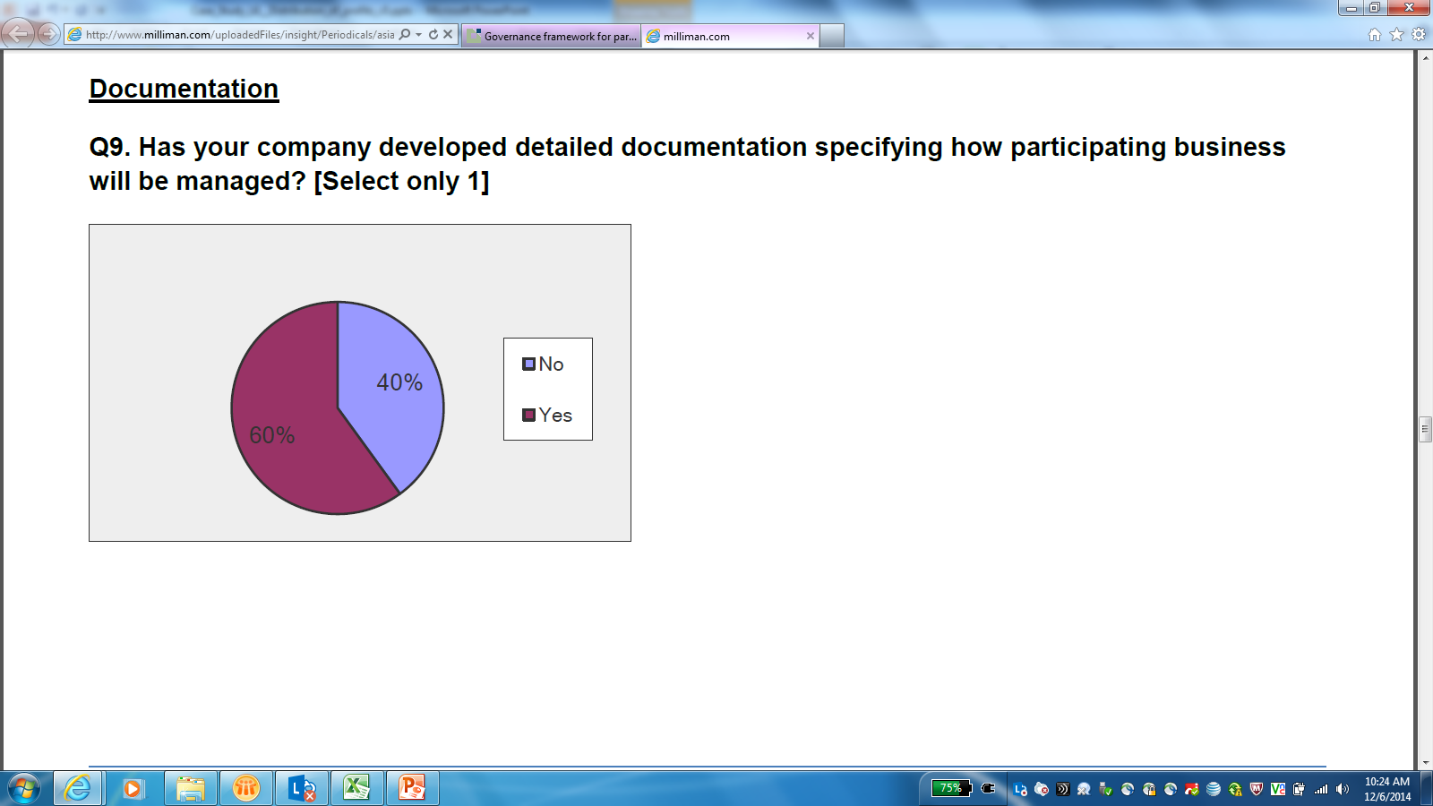
Indian –Status of documentation
Source: As per Milliman survey on “Governance framework for participating business”

