Slide 1


Employee Stock Option Plan
Guide:
Shri K K Wadhwa, FIAI
Consulting Actuary
Kwadhwa.in@gmail.com
Presenter:
Khushwant Pahwa, FIAI, FIA
Founder and Consulting Actuary
KPAC (Actuaries and Consultants)

Slide 2

Agenda
Look at the Reference Material
Black-Scholes Model
Live Example – Listed Company
Practical Challenges – Non Listed Companies
Market Research
Questions

Slide 3
Black-Scholes Formula
The Black –Scholes Formulas
Reference material provided contains necessary reading material for ESOPs:
Ind AS 102: Share Based Payments
GN on Share Based Payments
Ind AS 101: First time Adoption
SEBI Guidelines:
  SEBI (Employee Stock Option Scheme And Employee Stock Purchase Scheme) Guidelines, 1999
  SEBI (Share Based Employee Benefits) Regulations, 2014
CT8 Chapter 12 (The Binomial Model)
CT8 Chapter 13 (The Black-Scholes option pricing formula)
Mayur Ankolekar’s presentation on ESOPs
Let is take a quick overview of each of above

Slide 4
Ind AS 102: Share Based Payments (1/4)
The Black –Scholes Formulas
35 page Standard covering Share Based Payments.
Specifies Recognition, Measurement and Disclosure with regards to share based transactions.
Standard is divided into 3 main parts:
  Main Standard, containing Scope, Recognition, Measurement and Disclosure Requirements.
  Appendix A, giving major definitions
  Appendix B, which provides guidance on application of the standard
Appendices are an integral part of the Standard.
Overview of above parts given in the following slides.

Slide 5
Ind AS 102: Share Based Payments (2/4)
The Black –Scholes Formulas
Main Standard
(16 pages)
Objectives & Scope
(2 pages)
Recognition
(11 pages)
Disclosures
(3 pages)
Description of SBPT
- Para 44, with 45
Equity-Settled SBPT
SBPT with choice of settlement
Cash-Settled SBPT
Description of method / assumption used to estimate fair value of option
- Para 46, with 47 to 49
Financial reporting of all SBPT, whether or not the entity can identify specifically some or all of the goods or services received
Writer
Holder
For each SBPT:
Recognition & Measurement
Treatment of vesting condition (Marketing & Non-Marketing)
Modification of terms & condition
Settlement by group entities
Expense to be recognized in P/L statement
- Para 50, with 51 to 52

Slide 6
Ind AS 102: Share Based Payments (3/4)
The Black –Scholes Formulas
Appendix A
(5 pages)
Appendix A defines following items:
Cash-settled SBPT
Employees and others providing similar services
Equity instrument
Equity instrument granted
Equity-settled SBPT
Fair Value
Grant Date
Intrinsic Value
Market condition
Measurement Date
Performance condition
Reload feature
Reload option
Service condition
Share-based payment arrangement
Share-based payment transaction
Share option
Vest
Vesting condition
Vesting period

Slide 7
Ind AS 102: Share Based Payments (4/4)
The Black –Scholes Formulas
Appendix B
(14 pages)
Estimating fair value of equity instruments
SBPT involving cash-settled payments
Modification to SBPTs
SBPT involving group entities
Shares
Share options
Expected early exercise
Expected volatility
Expected dividend
Risk free rate
Capital structure effects

Slide 8
GN on Share Based Payments (1/2)
The Black –Scholes Formulas
Largely similar to Ind AS 102: Share Based Payments
Para 40 in GN permits Intrinsic Value Method to value the SBPT. Quoted below:
Para 40 – “There is another method known as the ‘Intrinsic Value Method’ for valuation employee share based payment plans. Intrinsic value, in the case of a listed company, is the amount by which the quoted market price of the underlying share exceeds the exercise price of an option.
For example, an option with an exercise price of Rs. 100 on an equity share whose current quoted market price is Rs. 125, has an intrinsic value of Rs. 25 per share on the date of its valuation. If the quoted market price is not available on the grant date then the share price nearest to that date is taken.
In the case of a non- listed company, since the shares are not quoted on a stock exchange, value of its shares is determined on the basis of a valuation report from an independent valuer.
For accounting for employee share-based payment plans, the intrinsic value may be used, mutatis mutandis, in place of the fair value as described in paragraphs 10 to 39.”

Slide 9
GN on Share Based Payments (2/2)
The Black –Scholes Formulas
Runs into about 85 pages, divided into:
  Main regulations (22 pages): Guidance Note on Accounting for Employee Share-based Payments
  Appendix 1 (10 pages): Estimating the Fair Value of Shares or Stock Options Granted
  Appendix 2 (16 pages): Equity-settled Employee Share-based Payment Plans
  Appendix 3 (4 pages): Modification to the Term and Conditions of Equity-settled Employee Share-based Payment Plans
  Appendix 4 (7 pages): Cash-settled Employee Share-based Payment Plans
  Appendix 5 (4 pages): Employee Share-based Payment Plans with Cash Alternatives
  Appendix 6 (4 pages): Graded Vesting
  Appendix 7 (12 pages): Accounting for Employee Share-based Payment Plans Administered Through a Trust
  Appendix 8 (6 pages): Accounting for Employee Share-based Payment Plans Administered Through a Trust

Slide 10
Ind AS 101: First Time Adoption (1/3)
The Black –Scholes Formulas
Ind AS 101 mandates retrospective implementation of standards.
It also provides for certain exceptions and exemptions from first time adoption.
Paras D2 and D3 in Ind AS 101 deal with Share Based Payments. Quoted below:
“D2 A first-time adopter is encouraged, but not required, to apply Ind AS 102 Share-based payment to equity instruments that vested before date of transition to Ind ASs. However, if a first-time adopter elects to apply Ind AS 102 to such equity instruments, it may do so only if the entity has disclosed publicly the fair value of those equity instruments, determined at the measurement date, as defined in Ind AS 102. For all grants of equity instruments to which Ind AS 102 has not been applied (eg, equity instruments vested but not settled before date of transition to Ind ASs, a first time adopter shall nevertheless disclose the information required by paragraphs 44 and 45 of Ind AS 102. If a first-time adopter modifies the terms or conditions of a grant of equity instruments to which Ind AS 102 has not been applied, the entity is not required to apply paragraphs 26–29 of Ind AS 102 if the modification occurred before the date of transition to Ind ASs.
D3 A first-time adopter is encouraged, but not required, to apply Ind AS 102 to liabilities arising from share-based payment transactions that were settled before the date of transition to Ind ASs.”

Slide 11
Managing Transition: Equity Settled SBPT (2/3)
The Black –Scholes Formulas
Equity-Settled Share Based Payment Transactions
Un-Vested options
Require accounting for ESOPs as per Ind AS 102
Vested options but not yet exercised
Options vested and exercised
Not required to apply Ind AS 102
Encouraged but not required to apply Ind AS 102
All expenses recognized. No further adjustment needed.
Need to value options again as at grant date using fair value method
All expenses not yet recognized. Additional expense will be recognized compared to Intrinsic Value Method
No adjustment needed as transaction has been fully settled

Slide 12
Managing Transition: Equity Settled SBPT (3/3)
The Black –Scholes Formulas
Cash-Settled Share Based Payment Transactions
Un-Vested SARs
Require accounting for ESOPs as per Ind AS 102
Vested SARs but not yet settled
SARs vested and settled
Encouraged but not required to apply Ind AS 102
Require accounting for ESOPs as per Ind AS 102
All expenses not yet recognized. Additional expense will be recognized compared to Intrinsic Value Method
All expenses not yet recognized. Additional expense will be recognized compared to Intrinsic Value Method
Need to value options at each previous reporting date from grant date using fair value method until vested.
No adjustment needed as transaction has been fully settled

Slide 13
SEBI Guidelines
The Black –Scholes Formulas
Securities And Exchange Board Of India (Employee Stock Option Scheme And Employee Stock Purchase Scheme) Guidelines, 1999
Issued in 1999 but amended up to 2009. New regulations: SECURITIES AND EXCHANGE BOARD OF INDIA (SHARE BASED EMPLOYEE BENEFITS) REGULATIONS, 2014
Applies to Employee Stock Option Scheme and Employee Stock Purchase Scheme.
Applies to any company whose shares are listed on any recognised stock exchange in India.
Runs into 35 pages, divided into:
  Main regulations (22 pages): Gives requirements to comply with regards to ESPS and ESOPs. Key requirements discussed in further slides.
  Schedule 1 (4 pages): Accounting Policies for ESOS
  Schedule 2 (1 page): Accounting Policies for ESPS
  Schedule 3 (1 page): Fair value of options
  Schedule 4 (2 pages): Disclosure document
  Schedule 5 (4 pages): Information required in statement to be filed with Stock Exchange
  Schedule 6 (1 Page): Format of notification for issue of shares under stock option plans.

Slide 14
SEBI Guidelines – Main Regulations
The Black –Scholes Formulas
PART A: ESOS
Deals with Eligibility to participate in ESOS. Disqualifies the following persons:
  An employee who is a promoter or belongs to the promoter group shall not be eligible to participate in the ESOS.
  A director who either by himself or through his relative or through any body corporate, directly or indirectly holds more than 10% of the outstanding equity shares of the company shall not be eligible to participate in the ESOS.
Requires constitution of Compensation Committee.
  Committee of the Board of directors consisting of a majority of independent directors.
  Compensation Committee shall formulate the detailed terms and conditions of the ESOS
Requires Shareholder Approval for grant of ESOPs.
  Shareholders need to approve ESOS by passing a special resolution in the general meeting.
Lays down procedure for variation of terms of ESOS
  Prohibits variation to the terms of the ESOS in any manner, which may be detrimental to the interests of the employees

Slide 15
SEBI Guidelines – Main Regulations
The Black –Scholes Formulas
PART A: ESOS
Talks about Pricing of ESOPs.
  Gives freedom to determine the exercise price subject to conforming to the accounting policies specified in clause 13.1.
  Requires that in case a company calculates the employee cost using intrinsic value, the difference in cost based on the fair value of the options shall be disclosed in the Directors report and also the impact of this difference on profits and on Earning Per Share of the company shall also be disclosed in the Directors’ report
Disclosure in the Directors' Report
  Various disclosures, largely in line with disclosure requirement in Ind AS 102 on Share Based Payments
  Requires that in case a company calculates the employee cost using intrinsic value, the difference in cost based on the fair value of the options shall be disclosed in the Directors report and also the impact of this difference on profits and on Earning Per Share of the company shall also be disclosed in the Directors’ report.
PART B: ESPS (not discussed in this presentation)

Slide 16
SEBI Guidelines: Schedule 1: Accounting Policies for ESOS
The Black –Scholes Formulas
Permits both intrinsic value and fair value methods of measure.
Intrinsic value approach to become irrelevant as the Companies start reporting on IFRS converged Ind AS basis.
Suggests accounting approach and entries which are in line with requirements of Ind AS 102 and discussed later in the presentation.
Contradicts Ind AS 102 with respect to lapsation of vested options:
“When a vested option lapses on expiry of the exercise period, after the fair value of the option has already been accounted for as employee compensation, this accounting treatment shall be reversed by a credit to employee compensation expense.”
Para 22 of Ind AS 102, which reads as under, does not permit such reversal:
“Having recognised the goods or services received in accordance with paragraphs 10–22, and a corresponding increase in equity, the entity shall make no subsequent adjustment to total equity after vesting date. For example, the entity shall not subsequently reverse the amount recognised for services received from an employee if the vested equity instruments are later forfeited or, in the case of share options, the options are not exercised. However, this requirement does not preclude the entity from recognising a transfer within equity, ie a transfer from one component of equity to another.”

Slide 17
Agenda
Look at the Reference Material
Black-Scholes Model
Live Example – Listed Company
Practical Challenges – Non Listed Companies
Market Research
Questions

Slide 18
Black-Scholes Formula: (Ignoring dividends)
The Black –Scholes Formulas
Price of Call Option (C)
=
S * N (d₁) - K * e ^{r (T - t)} * N (d₂)
Where:
d₁ = [Ln (S₀ / K) + (r + σ² / 2) * (T - t) ] / σ ((T - t)^{0.5})
d₂ = [Ln (S₀ / K) + (r - σ² / 2) * (T - t) ] / σ ((T - t)^{0.5}) = d₁ - σ ((T - t)^{0.5})
S = Stock Price on the date of Valuation
K = Strike Price of Call Option
r = risk free rate of return
T = Expiry Time in years
t = Current Time in years
σ = Annualised volatility of the Stock

Slide 19
Black-Scholes Formula – intuitive explanation
The Black –Scholes Formulas
Price of Call Option (C)
=
S * N (d₁) - K * e ^{r (T - t)} * N (d₂)
RHS of equation =
Cost of replicating portfolio
Cost of setting up hedging portfolio on right side of equation
Seller of call option:
  buys some amount of shares at current price S, and
  goes short on risk free bond that equals to K at expiration if the option finishes in money.
e ^{r (T - t)} is the discount (present valuing) factor
Mysterious N(d1) must be the number of shares of the stock to go long today
Mysterious N(d2) must be probability that option will finish in the money.
Both N(d1) and N(d2) change as the underlying stock price and the time to expiration change. This is why one needs to adjust the hedging portfolio continuously.
The Intuition Behind Option Valuation: A Teaching Note By Thomas Grossman, Haskayne School of Business, University of Calgary. Link: http://www.slu.edu/~chakrab/readings/Valuing_Options.pdf

Slide 20
Black-Scholes Formula – Assumptions
The Black –Scholes Formulas
Assumptions used in Black Scholes formula:
Underlying share price follows Geometric Brownian motion
Market is arbitrage-free
Risk-free rate r is constant and the same for all borrowing and lending
Assets may be bought and sold at any time t > 0
Assets may be held in any amount
There are no taxes or transaction costs
One can criticise quite easily the individual assumptions. Example:
Share prices can jump, invalidating assumption 1 since Geometric Brownian motion has continuous sample paths.
The risk-free rate of interest does vary and in an unpredictable way.
Despite potential flaws in assumptions, analyses of market derivative prices indicate that the Black-Scholes model does give a very good approximation to the market.
In this respect, Black-Scholes model is a good model since it gives prices which are close to observed market prices and because it provides insight into the usefulness of dynamic hedging.
Let us see in context of a listed share in India how close does the Black Scholes Model give the price.

Slide 21
3 things in this section…
The Black –Scholes Formulas
Black Scholes Formula
Finding Theoretical Price of traded option
Comparing Theoretical Price with Market Price
Exploring one online calculator
Black Scholes formula used to calculate Theoretical Price of traded call options.
Using parameters / inputs observed in the market to price the option.
Call options traded in the market are short term (up to 3 months).
Calculations done for INFOSYS LIMITED as on 23 February 2017 for Call Options maturing on 30 March 2017.
ESOPs are Call Options with Longer Term plus Added Complications (e.g. American Call Option, Restriction on sale, etc)
Note: Explaining details and derivation of Black Scholes Formula not the purpose of this presentation.

Slide 22
Lets take a live case – INFOSYS LIMITED
1006.55
1000
Type of Option | Call Option (European)
Valuation Date | 23 Feb 2017
Expiry Date | 30 March 2017
Exercise Price (X) | Rs. 1000.00
Stock Price | Rs. 1006.55
Term to maturity | 0.10 years (approx.)

Slide 23
Now, lets look into what inputs are required
Inputs to the BS Model
Valuation Date | 23 Feb 2017
Exercise Price (X) | Rs. 1000.00
Stock Price as at Grant Date (S) | Rs. 1006.55
Time to expiration ( T – t, in year) | 0.10 years (approx.)
Risk-free rate of return (r) | 6.00%
Dividend Yield | 0.00%
Annualized Volatility (σ) | 23.05%
Points to note:
Annualized Volatility (shown above) has been calculated based on the share price data of past one year (252 trading days) which has been taken from the NSE website.
As per NSE website implied volatility is 21.22%.

Slide 24
Finally the outputs
Output from the BS Model
d1 = ln(S/X) + (r + (σ^2)/2)*(T - t)
σ*√(T - t)
d1 | 20.77%
d2 | 13.64%
N(d1) | 58.23%
N(-d1) | 41.77%
N(d2) | 55.42%
N(-d2) | 44.58%
d2 = d1 - σ*√(T - t)
c = S*N(d1) – N(d2)*K*e^(-r*(T - t))
Price of Call Option | Rs. 35.05
Price of Put Option | Rs. 22.76
p = N(-d2)*K*e^(-r*(T - t)) – S*N(-d1)
Put Call Parity check (Using the calculated assumed volatility) | TRUE
c – S = p - K*e^(-r*(T - t))

Slide 25
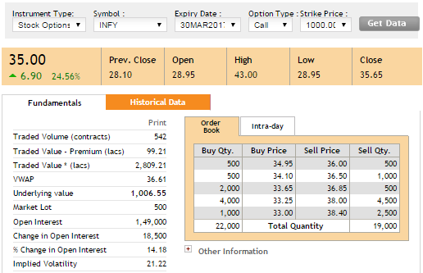
Snapshot: Option Price and Volatility – NSE Website

Slide 26
Now, lets look into few more cases
S. No. | Strike Price | Option Price (as per excel model) | Option Price (NSE)*
1 | 960 | 61.33 | 62.10
2 | 980 | 47.16 | 47.00
3 | 1,000 | 35.05 | 35.00
4 | 1,020 | 25.13 | 26.25
5 | 1,040 | 17.35 | 18.95
*Stock price, Term to maturity, Risk-free rate of interest and Volatility have been kept same with the previous example.

Slide 27
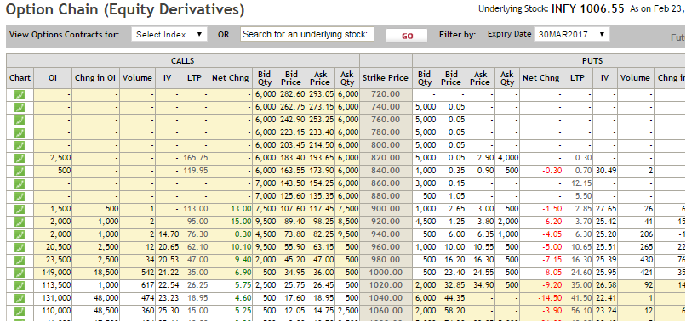
Snapshot: Option Chain – NSE Website
Snapshot 2 (Option prices at different strike prices)

Slide 28
Option prices at different share prices
Intrinsic Value = Share Price – Strike Price
Option Value = Option Price – Intrinsic Value

Slide 29
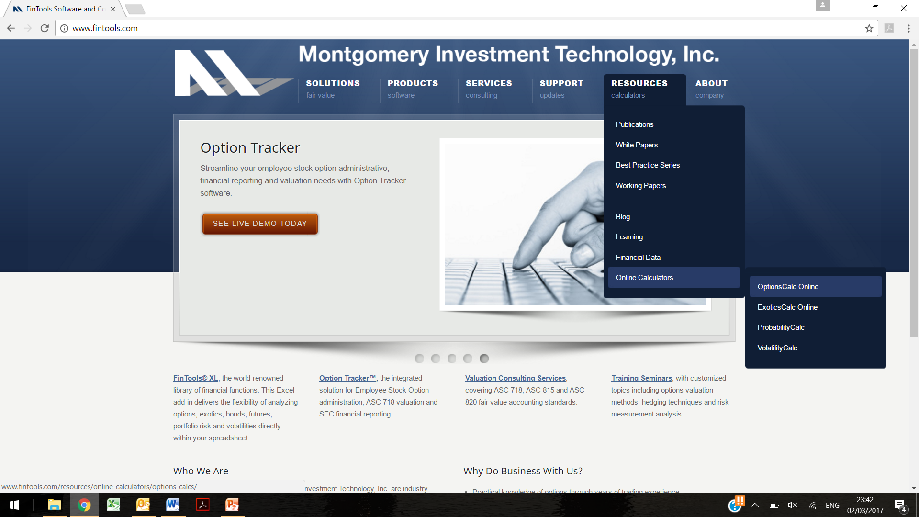
Black-Scholes – Online Model

Slide 30
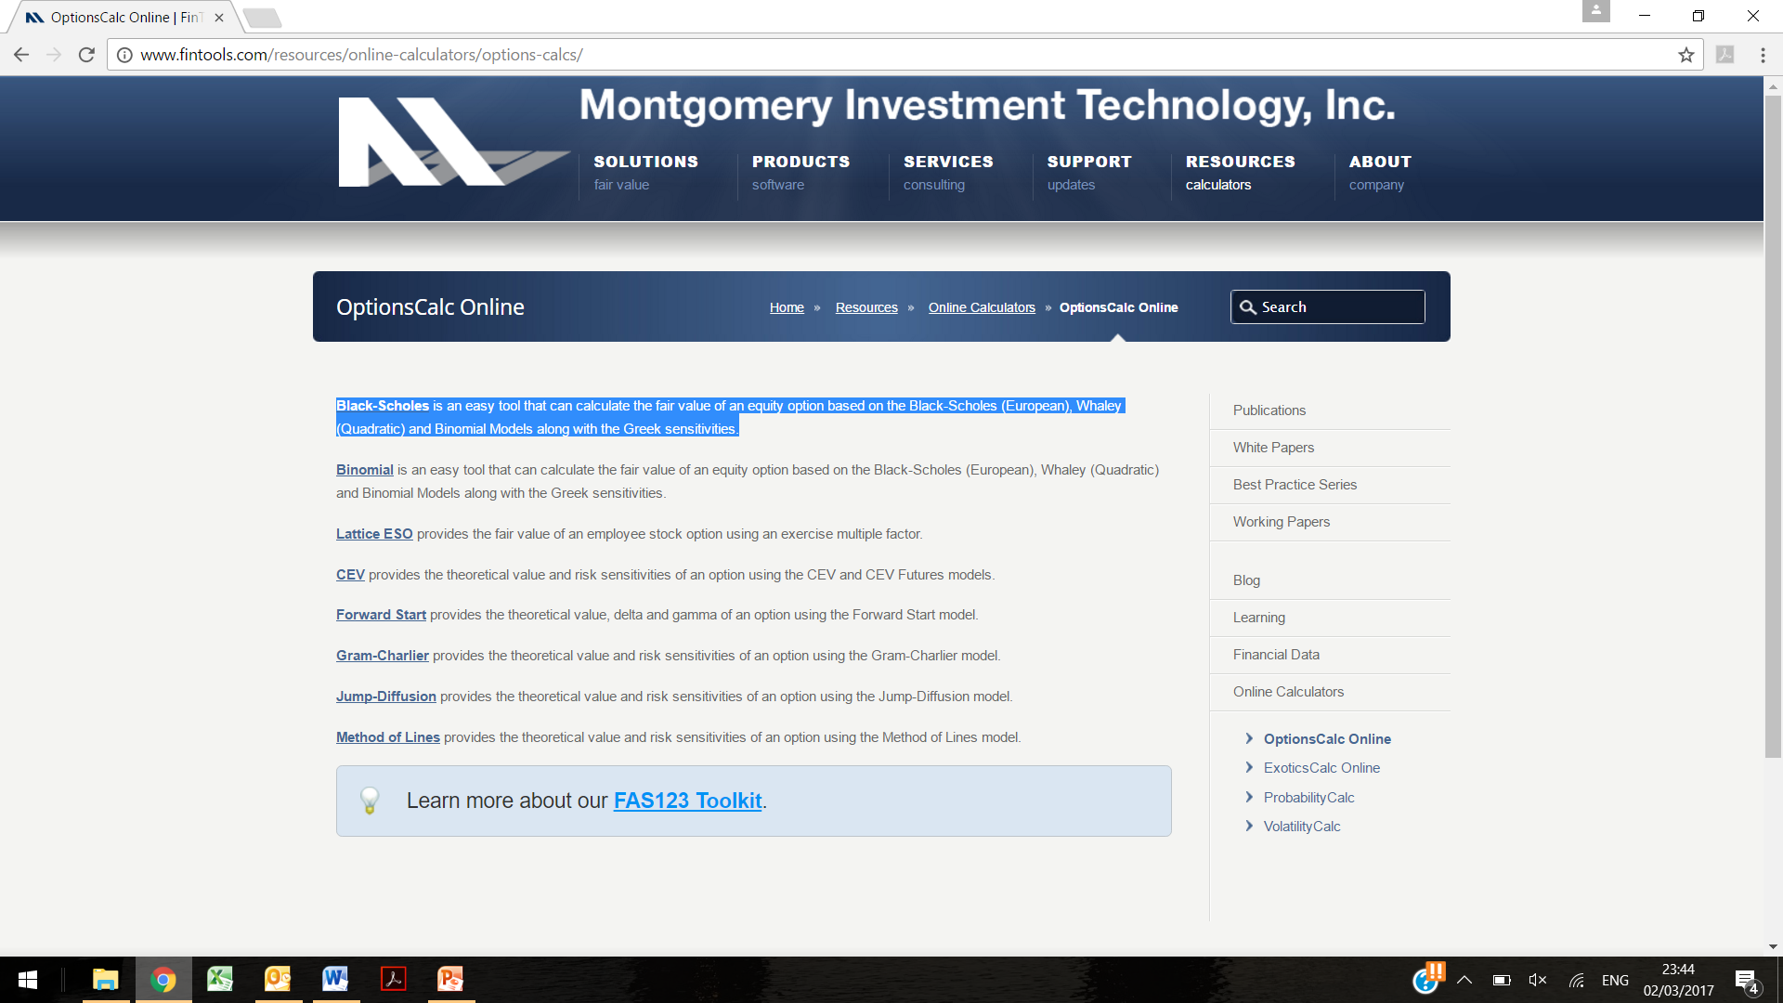
Black-Scholes – Online Model

Slide 31
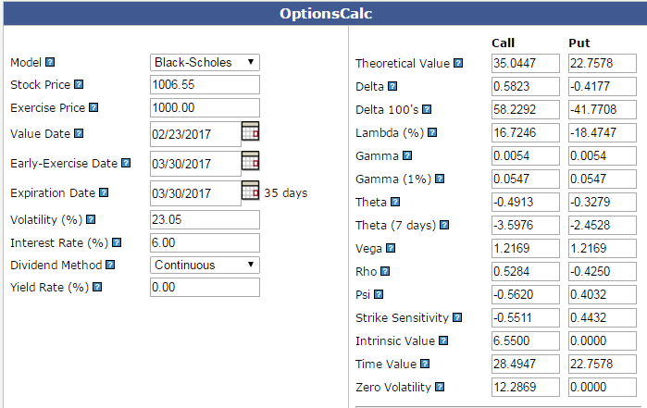
Black-Scholes – Online Model
As BS model is fairly a simple model so instead of creating, one can also use free online models. One such magical website is www.fintools.com.

Slide 32
Agenda
Look at the Reference Material
Black-Scholes Model
Live Example – Listed Company
Practical Challenges – Non Listed Companies
Market Research
Questions

Slide 33
Accounting Treatment: Equity-settled SBPT
For equity-settled SBPT, entity shall measure their value, and corresponding increase in equity, by reference to fair value of the equity instruments granted.
If equity instruments granted vest immediately, recognize the expense and corresponding increase in equity immediately.
If equity instruments granted do not vest until a specified period of service, recognize cost and the corresponding increase in equity over the vesting period.
Measure the fair value of equity instruments granted at the measurement date, taking into account terms and conditions upon which those equity instruments were granted.
Grant of equity instruments may be conditional upon satisfying specified vesting conditions i.e. market and non-market conditions.
  Adjust market condition in determination of Fair Value
  Adjust non market condition in estimate of number of options likely to vest.

Slide 34
Example 1: Equity-settled ESOPS
Grant Date: 1,000 * 100 ESOPS
Strike Price: Rs. 1000
Vesting Date: 3 years
Must be exercised immediately
23 Feb 17
23 Feb 2020
31 Mar 2017
31 Mar 2018
31 Mar 2019
31 Mar 2020
Infosys Ltd grants 1,000 share options (ESOPs 2017) each to its 100 employees on 23 February 2017.
Grant is conditional upon the employee working for the entity over the next three years.
Options are to be immediately exercised after three years.
Strike Price = Rs. 1,000.
On the basis of attrition trend, the entity expects 20% of the employees to leave each year, which will result in the forfeiture of their options.
We need to determine accounting for FY 2016-17, FY2017-18, FY2018-19 and FY2019-20.

Slide 35
Step 1: Determine Fair Value on Grant Date
Grant Date: 1,000 * 100 ESOPS
Strike Price: Rs. 1000
Vesting Date: 3 years
Must be exercised immediately
23 Feb 17
23 Feb 2020
31 Mar 2017
31 Mar 2018
31 Mar 2019
31 Mar 2020
Valuation Date | 23 Feb 2017
Exercise Price (X) | Rs. 1000.00
Stock Price as at Grant Date (S) | Rs. 1006.55
Time to expiration ( T – t, in year) | 3 years
Risk-free rate of return (r) | 6.00%
Dividend Yield | 0.00%
Annualized Volatility (σ) | 23.05%
Price of Call Option | Rs. 246.72
Total Worth of Options Granted | Rs. 24,672,000

Slide 36
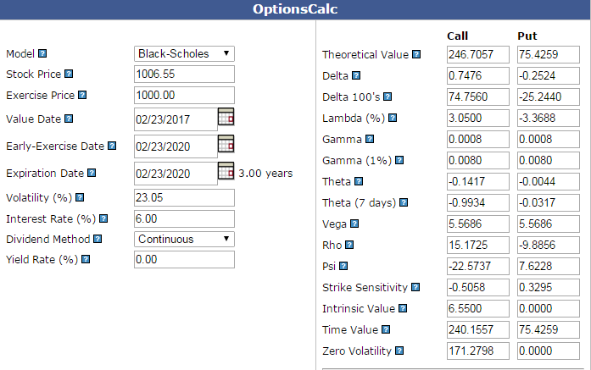
Snapshot – Fair Value of Option as per Online Model

Slide 37
Step 2: Determine options expected to vest
23 Feb 17
23 Feb 18
23 Feb 19
23 Feb 2020
31 Mar 2017
31 Mar 2018
31 Mar 2019
31 Mar 2020
20,000 ESOPs Lapsed
(1,000 * 100 * .20)
16,000 ESOPs Lapsed
(1,000 * 100 * .20^2)
12,800 ESOPs Lapsed
(1,000 * 100 * .20^3)
80,000 ESOPs
64,000 ESOPs
51,200 ESOPs
Options expected to vest as on 23 Feb 2020 | 51,200 Options
Total expected cost to be recognized during the three year period | Rs. 12,632,064 ( 51,200 * 246.72 )

Slide 38
Step 3: Determine expense to be recognized each year
23 Feb 17
23 Feb 18
23 Feb 19
23 Feb 2020
31 Mar 2017
31 Mar 2018
31 Mar 2019
31 Mar 2020
Rs. 412,069
( 12,632,064 * .10 / 3 )
Rs. 4,210,688
( 12,632,064 * 1 / 3 )
Rs. 4,210,688
( 12,632,064 * 1 / 3 )
Rs. 3,789,619
( 12,632,064 * .90 / 3 )
Date | Cumulative Expense (Rs.) | Expense to be recognized during each year (Rs.)
31 March 2017 | 421,069 ( 12,632,064 * .10 / 3 ) | 421,069
31 March 2018 | 4,631,757 ( 12,632,064 * 1.10 / 3 ) | 4,210,688
31 March 2019 | 8,842,445 ( 12,632,064 * 2.10 / 3 ) | 4,210,688
23 Feb 2020 | 12,632,064 ( 12,632,064 * 3 / 3 ) | 3,789,619

Slide 39
Accounting Entries: Assuming actual attrition hold (1/3)
Date | Particulars | Debit (Rs.) | Credit (Rs.)
31 March 2017 | Employee compensation expense account Dr To ESOP outstanding account (Being grant of 100,000 options to employees worth Rs. 246.72 amortized on straight line basis over 3 years) | 421,069 | 421,069
31 March 2017 | Profit and loss account Dr To Employee compensation expense account (Being expenses transferred to P/L account at year end) | 421,069 | 421,069
31 March 2018 | Employee compensation expense account Dr To ESOP outstanding account (Being grant of 100,000 options to employees worth Rs. 246.72 amortized on straight line basis over 3 years) | 4,210,688 | 4,210,688
31 March 2018 | Profit and loss account Dr To Employee compensation expense account (Being expenses transferred to P/L account at year end) | 4,210,688 | 4,210,688

Slide 40
Accounting Entries: Assuming actual attrition hold (2/3)
Date | Particulars | Debit (Rs.) | Credit (Rs.)
31 March 2019 | Employee compensation expense account Dr To ESOP outstanding account (Being grant of 100,000 options to employees worth Rs. 246.72 amortized on straight line basis over 3 years) | 4,210,688 | 4,210,688
31 March 2019 | Profit and loss account Dr To Employee compensation expense account (Being expenses transferred to P/L account at year end) | 4,210,688 | 4,210,688
23 Feb 2020 | Employee compensation expense account Dr To ESOP outstanding account (Being grant of 100,000 options to employees worth Rs. 246.72 amortized on straight line basis over 3 years) | 3,789,619 | 3,789,619
23 Feb 2020 | Profit and loss account Dr To Employee compensation expense account (Being expenses transferred to P/L account at year end) | 3,789,619 | 3,789,619

Slide 41
Accounting Entries: Assuming actual attrition hold (3/3)
Last Entries
(a)
If all vested options get exercised
(b)
If all vested options get lapsed
Date | Particulars | Debit (Rs.) | Credit (Rs.)
23 Feb 2020 (a) | Bank account (51200 * 1000) Dr ESOP outstanding account Dr To Equity Share capital account (51200 * 5) To Share Premium account (Balancing Item) (Being 51,200 employee stock options exercised) | 51,200,000 12,632,064 | 256,000* 63,576,064
23 Feb 2020 (b) | ESOP outstanding account Dr To General reserve account (Being 51,200 employee stock options get lapsed) | 12,632,064 | 12,632,064
*Face value of the shares is Rs. 5. This has been taken from the NSE website.

Slide 42
Disclosures as on 31 March 2017
Description of share – based payment arrangements refer to para 45 (a) of Ind AS 102
Particulars | ESOPs 2017
ESOPs Granted | 100,000
Method of settlement | Equity Settled
Grant Date | 23 Feb 2017
Vesting Requirement | 3 years from grant date
Exercise Price | Rs. 1,000
Share price as at grant date | Rs. 1006.55
Exercise Date | 24 Feb 2020

Slide 43
Disclosures as on 31 March 2017
No. of Options movement during the year refer to para 45 (b) of Ind AS 102
Particulars | 31-03-17 | 31-03-18 | 31-03-19 | 31-03-20
Options O/S at the beginning | 0 | 98,000 | 78,400 | 62,720
Options Granted during the year | 100,000 | 0 | 0 | 0
Options Forfeited during the year | 2,000 | 19,600 | 15,680 | 11,520
Options Exercised during the year | 0 | 0 | 0 | 51,200
Options Expired during the year | 0 | 0 | 0 | 0
Options O/S at the end | 98,000 | 78,400 | 62,720 | 0
Options Exercisable at the end | 0 | 0 | 0 | 0

Slide 44
Disclosures as on 31 March 2017
Weighted-average exercise prices of options
refer to para 45 (b) of Ind AS 102
Particulars | 31-03-17 | 31-03-18 | 31-03-19 | 31-03-20
Weighted average exercise price for the share options outstanding at the end (Rs.) | 1,000 | 1,000 | 1,000 | N/A
Weighted average exercise price for the share options exercised during the period (Rs.) | N/A | N/A | N/A | 1,000
Weighted-average fair values and remaining contractual life of options
refer to para 45 (c) of Ind AS 102
Particulars | 31-03-17 | 31-03-18 | 31-03-19 | 31-03-20
Weighted average share price as at the exercise date (Rs.) | N/A | N/A | N/A | 1,280*
Weighted average contractual life of the share options | 2.9 | 1.9 | 0.9 | -
*For the sake of presentation we have assumed that the share price as at the exercise date will be Rs 1,280.

Slide 45
Disclosures as on 31 March 2017
Description of method / assumptions used to estimate the fair value of option
refer to para 47 (a - i) of Ind AS 102
Particulars | ESOPs 2017
Option Price Model | Black – Scholes Method
Share Price as at grant date (Rs.) | 1,006.55
Exercise Price (Rs.) | 1000.00
Expected Volatility | 23.05%
Exercise Date | 24 Feb 2020
Time to expiration ( T – t, in year) | 3 years
Risk-free rate of return (r) | 6.00%
Dividend Yield | 0.00%
Fair Value of Options as at grant date: Rs. 246.72

Slide 46
Disclosures as on 31 March 2017
Other key information on fair value of options
refer to para 47 (a – ii) of Ind AS 102
The measure of volatility used in option pricing model is the annualized standard deviation of the continuously compounded rates of return on the share over a one year period of time.
Implied volatility as per the NSE website is 21.22%, which has been calculated using all the same inputs (mentioned in previous section) except the term to maturity. Please note that the implied volatility mentioned here is for an option expiring at 30 March 2017. Since the term of the ESOP is longer, the Company has used volatility of share price actually observed over the past term consistent with the term of the ESOPs granted.
Closing price of the Company’s shares on NSE website on the grant date has been considered.
Risk-free rate of return considered is based on yields on Indian government bonds.
Expense to be recognized in P/L statement
refer to para 50 of Ind AS 102
Particulars | 31-03-17 | 31-03-18 | 31-03-19 | 31-03-20
Expense recognized during the period (Rs.) | 421,069 | 4,210,688 | 4,210,688 | 3,789,619

Slide 47
Example 1A: Example 1 + Actual Attrition Varies
Let us assume everything does not go as planned and actual attrition rate assumption does not hold.
During second year, only 10% of the employees leave the organization, hence the entity revise the attrition rate assumption from 20% p.a. to 15% p.a..
Let us discuss the accounting treatment.

Slide 48
Step 2: Determine options expected to vest
23 Feb 17
23 Feb 18
23 Feb 19
23 Feb 2020
31 Mar 2017
31 Mar 2018
31 Mar 2019
31 Mar 2020
20,000 ESOPs Lapsed
(1,000 * 100 * .20)
10,000 ESOPs Lapsed
(1,000 * 100 * .10)
10,500 ESOPs Lapsed
(70,000 * .15)
80,000 ESOPs
70,000 ESOPs
59,500 ESOPs
Options expected to vest as on 23 Feb 2020 | 59,500 Options
Total expected cost to be recognized during the three year period | Rs. 14,679,840 ( 59,500 * 246.72 )

Slide 49
Step 3: Determine expense to be recognized each year
(Already sitting as on 31 March 2019)
23 Feb 17
23 Feb 18
23 Feb 19
23 Feb 2020
31 Mar 2017
31 Mar 2018
31 Mar 2019
31 Mar 2020
Rs. 412,069
( 12,632,064 * .10 / 3 )
Rs. 4,631,757
( 12,632,064 * 1.1 / 3 )
Rs. 10,275,888
( 14,679,840 * 2.1 / 3 )
Rs. 14,679,840
( 14,679,840 * 3 / 3 )
Date | Expense to be recognized during each year (as per plan) | Cumulative Expenses (as per plan) | Actual Expense to be recognized during each year | Actual Cumulative Expense
31 March 2017 | 421,069 | 421,069 | 421,069 | 421,069
31 March 2018 | 4,210,688 | 4,631,757 | 4,210,688 | 4,631,757
31 March 2019 | 4,210,688 | 8,842,445 | 5,644,131 | 10,275,888
23 Feb 2020 | 3,789,619 | 12,632,064 | 4,403,952 | 14,679,840

Slide 50
Accounting Entries: Assuming actual attrition doesn’t hold (1/3)
Date | Particulars | Debit (Rs.) | Credit (Rs.)
31 March 2017 | Employee compensation expense account Dr To ESOP outstanding account (Being grant of 100,000 options to employees worth Rs. 246.72 amortized on straight line basis over 3 years) | 421,069 | 421,069
31 March 2017 | Profit and loss account Dr To Employee compensation expense account (Being expenses transferred to P/L account at year end) | 421,069 | 421,069
31 March 2018 | Employee compensation expense account Dr To ESOP outstanding account (Being grant of 100,000 options to employees worth Rs. 246.72 amortized on straight line basis over 3 years) | 4,210,688 | 4,210,688
31 March 2018 | Profit and loss account Dr To Employee compensation expense account (Being expenses transferred to P/L account at year end) | 4,210,688 | 4,210,688

Slide 51
Accounting Entries: Assuming actual attrition doesn’t hold (2/3)
Date | Particulars | Debit (Rs.) | Credit (Rs.)
31 March 2019 | Employee compensation expense account Dr To ESOP outstanding account (Being grant of 100,000 options to employees worth Rs. 246.72 amortized on straight line basis over 3 years) | 5,644,131 | 5,644,131
31 March 2019 | Profit and loss account Dr To Employee compensation expense account (Being expenses transferred to P/L account at year end) | 5,644,131 | 5,644,131
23 Feb 2020 | Employee compensation expense account Dr To ESOP outstanding account (Being grant of 100,000 options to employees worth Rs. 246.72 amortized on straight line basis over 3 years) | 4,403,952 | 4,403,952
23 Feb 2020 | Profit and loss account Dr To Employee compensation expense account (Being expenses transferred to P/L account at year end) | 4,403,952 | 4,403,952

Slide 52
Accounting Entries: Assuming actual attrition doesn’t hold (3/3)
Last Entries
(a)
If all vested options get exercised
(b)
If all vested options get lapsed
Date | Particulars | Debit (Rs.) | Credit (Rs.)
23 Feb 2020 (a) | Bank account (59500 * 1000) Dr ESOP outstanding account Dr To Equity Share capital account (59500 * 5) To Share Premium account (Balancing Item) (Being 59,500 employee stock options exercised) | 59,500,000 14,679,840 | 297,500 73,882,340
23 Feb 2020 (b) | ESOP outstanding account Dr To General reserve account (Being 59,500 employee stock options get lapsed) | 14,679,840 | 14,679,840
*Face value of the shares is Rs. 5. This has been taken from the NSE website.

Slide 53
Accounting Treatment: Cash-settled SBPT
For cash-settled share-based payment transactions, the entity shall measure the goods or services acquired and the liability incurred at the fair value of the liability.
Until the liability is settled, the entity shall remeasure the fair value of the liability at the end of each reporting period and at the date of settlement, with any changes in fair value recognized in profit or loss for the period.
The entity shall recognize the services received, and a liability to pay for those services, as the employees render service.
In absence of evidence to the contrary, the entity shall presume that the services rendered by the employees in exchange for the share appreciation rights have been received.
If the share appreciation rights do not vest until the employees have completed a specified period of service, the entity shall recognize the services received, and a liability to pay for them, as the employees render service during that period.

Slide 54
Example 2: Cash-settled share based payments
Grant Date: 1,000 * 100 SARs
Strike Price: Rs. 1000
Vesting Date: 3 years
Must be settled immediately
23 Feb 17
23 Feb 2020
31 Mar 2017
31 Mar 2018
31 Mar 2019
31 Mar 2020
Infosys Ltd grants 1,000 share appreciation rights (SARs 2017) each to its 100 employees on 23 February 2017.
Grant is conditional upon the employee working for the entity over the next three years.
SARs are to be immediately settled i.e. paid after three years.
Strike Price = Rs. 1,000.
On the basis of attrition trend, the entity expects 20% of the employees to leave each year, which will result in the forfeiture of their options.
We need to determine accounting for FY 2016-17, FY2017-18, FY2018-19 and FY2019-20.

Slide 55
Step 1: Determine Fair Value of SARs
Grant Date: 1,000 * 100 SARs
Strike Price: Rs. 1000
Vesting Date: 3 years
Must be settled immediately
23 Feb 17
23 Feb 2018
23 Feb 2019
23 Feb 2020
31 Mar 2017
31 Mar 2018
31 Mar 2019
31 Mar 2020
Share Price – Rs. 1050
Option Price – Rs. 275
Payout – Rs. 0
Share Price – Rs. 1150
Option Price – Rs. 296
Payout – Rs. 0
Share Price – Rs. 1250
Option Price – Rs. 314
Payout – Rs. 0
Share Price – Rs. 1280
Option Price – Rs. 280
Payout – Rs. 280
Share price is assumed to be Rs. 1,050, Rs. 1,100, Rs. 1,150 & Rs. 1,200 as on 31 Mar 17, 31 Mar 18, 31 Mar 19 and 23 Feb 20 respectively.
Strike Price, Expected Volatility, Risk-free rate of return and Expected Dividend Yield has been consistent with the previous example
The remaining term to expiry from respective reporting dates has been considered as term to maturity.

Slide 56
Step 2: Determine SARs expected to vest
23 Feb 17
23 Feb 18
23 Feb 19
23 Feb 2020
31 Mar 2017
31 Mar 2018
31 Mar 2019
31 Mar 2020
20,000 SARs Lapsed
(1,000 * 100 * .20)
16,000 SARs Lapsed
(1,000 * 100 * .20^2)
12,800 SARs Lapsed
(1,000 * 100 * .20^3)
80,000 SARs
64,000 SARs
51,200 SARs
SARs expected to vest as on 23 Feb 2020 | 51,200 SARs
Total worth of SARs as on 31 Mar 2017 | Rs. 14,080,000 ( 51,200 * 275 )
Total worth of SARs as on 31 Mar 2018 | Rs. 15,155,200 ( 51,200 * 296 )
Total worth of SARs as on 31 Mar 2019 | Rs. 16,076,800 ( 51,200 * 314 )
Total worth of SARs as on 23 Feb 2020 | Rs. 14,336,000 ( 51,200 * 280 )

Slide 57
Step 3: Determine expense to be recognized each year
Cumulative Expense
23 Feb 17
23 Feb 18
23 Feb 19
23 Feb 2020
31 Mar 2017
31 Mar 2018
31 Mar 2019
31 Mar 2020
Rs. 469,333
( 14,080,000 * .10 / 3 )
Rs. 5,556,907
( 15,155,200 * 1.1 / 3 )
Rs. 11,253,760
( 16,076,800 * 2.1 / 3 )
Rs. 14,336,000
(51,200 * 280)
Date | Cumulative Expense | Expense
31 March 2017 | 469,333 | 469,333
31 March 2018 | 5,556,907 | 5,087,573
31 March 2019 | 11,253,760 | 5,696,853
23 Feb 2020 | 14,336,000 | 3,082,240

Slide 58
Accounting Entries: Assuming actual attrition hold (1/3)
Date | Particulars | Debit (Rs.) | Credit (Rs.)
31 March 2017 | Employee compensation expense account Dr To Provision for SARs A/C (Being worth of 100,000 SARs to employees amortized on straight line basis over 3 years) | 469,333 | 469,333
31 March 2017 | Profit and loss account Dr To Employee compensation expense account (Being expenses transferred to P/L account at year end) | 469,333 | 469,333
31 March 2018 | Employee compensation expense account Dr To Provision for SARs A/C (Being worth of 100,000 SARs to employees amortized on straight line basis over 3 years) | 5,087,573 | 5,087,573
31 March 2018 | Profit and loss account Dr To Employee compensation expense account (Being expenses transferred to P/L account at year end) | 5,087,573 | 5,087,573

Slide 59
Accounting Entries: Assuming actual attrition hold (2/3)
Date | Particulars | Debit (Rs.) | Credit (Rs.)
31 March 2019 | Employee compensation expense account Dr To Provision for SARs A/C (Being worth of 100,000 SARs to employees amortized on straight line basis over 3 years) | 5,696,853 | 5,696,853
31 March 2019 | Profit and loss account Dr To Employee compensation expense account (Being expenses transferred to P/L account at year end) | 5,696,853 | 5,696,853
23 Feb 2020 | Employee compensation expense account Dr To Provision for SARs A/C (Being worth of 100,000 SARs to employees amortized on straight line basis over 3 years) | 3,082,240 | 3,082,240
23 Feb 2020 | Profit and loss account Dr To Employee compensation expense account (Being expenses transferred to P/L account at year end) | 3,082,240 | 3,082,240

Slide 60
Accounting Entries: Assuming actual attrition hold (3/3)
Last Entries
(a)
If all vested SARs get settled
(b)
If all vested SARs get lapsed
Date | Particulars | Debit (Rs.) | Credit (Rs.)
23 Feb 2020 (a) | Provision for SARs A/C Dr To Bank account (51200 * 280) (Being 51,200 SARs get settled) | 14,336,000 | 14,336,000
23 Feb 2020 (b) | Provision for SARs A/C Dr To General reserve account (Being 51,200 SARs get lapsed) | 14,336,000 | 14,336,000

Slide 61
Parameter 1: Expected Volatility
Volatility
Price of Call Options
The measure of volatility used in option pricing models is annualized standard deviation of the continuously compounded rates of return on the share over a period of time.
Factors to consider in estimating expected volatility include:
  Implied volatility from traded share options on the entity’s shares,
  Historical volatility of the share price over the most recent period that is generally commensurate with the expected term of the option
  Length of time an entity’s shares have been publically traded
  Tendency of volatility to revert to its mean and
  Appropriate and regular intervals for price observations.

Slide 62
Parameter 2: Expected Early Exercise
Term since start of contract
Price of Call Options
Expected early exercise taken into account by using an estimate of the option’s expected life, as an input into an option pricing model (eg the Black-Scholes-Merton formula)
Expenses determined based on Fair Value shall, however, continue to be spread over vesting period and not the expected exercise period.
Factors to consider in estimating early exercise include:
  Length of the vesting period,
  Average length of time similar options have remained outstanding in the past,
  Price of the underlying shares,
  Employee’s level within the organisation and,
  Expected volatility of the underlying shares.

Slide 63
Parameter 3: Expected Dividend
Share Dividend
Price of Call Options
Generally, the assumption about expected dividends should be based on publicly available information.
An entity that does not pay dividends and has no plans to do so should assume an expected dividend yield of zero.
However, an emerging entity with no history of paying dividends might expect to begin paying dividends during the expected lives of its employee share options.
Those entities could use an average of their past dividend yield (zero) and the mean dividend yield of an appropriately comparable peer group.

Slide 64
Parameter 4: Risk-free interest rate
Risk-free interest rate
Price of Call Options
Risk-free interest rate is the implied yield currently available on zero-coupon government issues of the country in whose currency the exercise price is expressed,
with a remaining term equal to the expected term of the option being valued (based on the option’s remaining contractual life and taking into account the effects of expected early exercise).

Slide 65
Agenda
Look at the Reference Material
Black-Scholes Model
Live Example – Listed Company
Practical Challenges – Non Listed Companies
Market Research
Questions

Slide 66
Key Issues in Case of Non Listed Entities

Slide 67
Agenda
Look at the Reference Material
Black-Scholes Model
Live Example – Listed Company
Practical Challenges – Non Listed Companies
Market Research
Questions

Slide 68

Size of Potential Opportunity

Slide 69
Agenda
Look at the Reference Material
Black-Scholes Model
Live Example – Listed Company
Practical Challenges – Non Listed Companies
Market Research
Questions

Slide 70

Questions?

Slide 71
Thank you!
Guide:
Shri K K Wadhwa, FIAI
Consulting Actuary
Presenter:
Khushwant Pahwa, FIAI, FIA
Founder and Consulting Actuary
KPAC (Actuaries and Consultants)

