Slide 1

Increasing share of non-participating business in India – systemic risks associated with it
Archana Anoor, Rahul Khandelwal and Rutika Kumar
Guide: Philip Jackson

Slide 2
Agenda
Introduction
Life insurance business evolution in India – changes in business mix
Systemic risk
  Definition & triggers
  Macro-level
  Insurance business (non-par, in particular)
  Mitigation Measures

Slide 3
History of Par and Non- Par in India
Sources: IRDA Journal, BSE Sensex website, RBI website, Research Report of Miliman

Slide 4
History of Par and Non- Par in India
Sources: IRDA Journal, BSE Sensex website, RBI website, Research Report of Miliman

Slide 5
History of Par and Non- Par in India
Sources: IRDA Segment wise data, BSE Sensex website, RBI website

Slide 6
History of Par and Non- Par in India
Sources: IRDA Journal

Slide 7
History of Par and Non- Par in India
From 2013 to Now
Prospective Regulation - ‘0% customer IRR on Par and Illustrated MB of 90% of premiums paid on ULIPs @4%’
Easier to illustrate for ULIPs - less guarantees than par
More obvious for non par savings contracts (not a reg requirement)
Move towards non-par is expected.
Sources: BSE Sensex website, RBI website

Slide 8

Systemic Risk
Image source: http://www.gardalundur.is/g/images/stories/domino-effect.jpg

Slide 9
Systemic risk

Slide 10
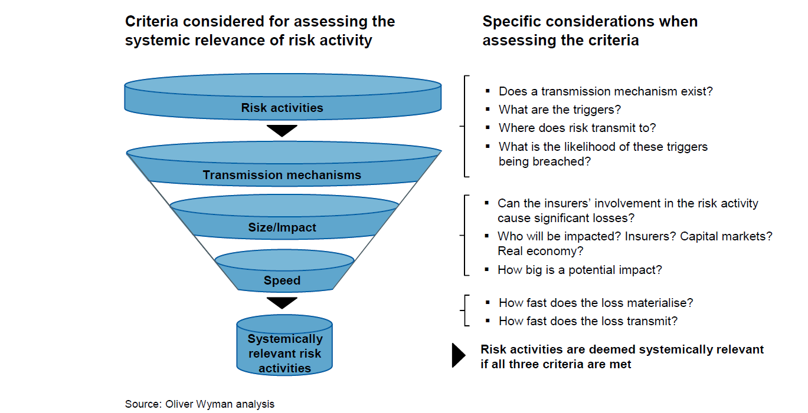
Indicators of systemic Risk

Slide 11
Conclusions of Geneva association Systemic Risk Working Group
Source: FSB, IAIS

Slide 12
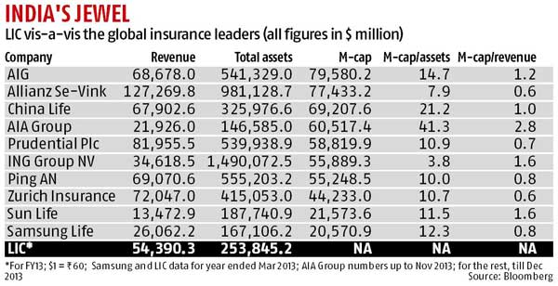
Do the findings apply to Indian insurance industry?
Size: Volume of financial services provided by the individual component of the financial system
If LIC is listed it could be the most valuable Indian company at Rs.4.5 – 5 lakh crore (Business Standard, June 2014)
If above metrics are aggregated for all insurers the impact will be higher

Slide 13
Do the findings apply to Indian insurance industry? (contd)

Slide 14
Do the findings apply to Indian insurance industry? (contd)

Slide 15
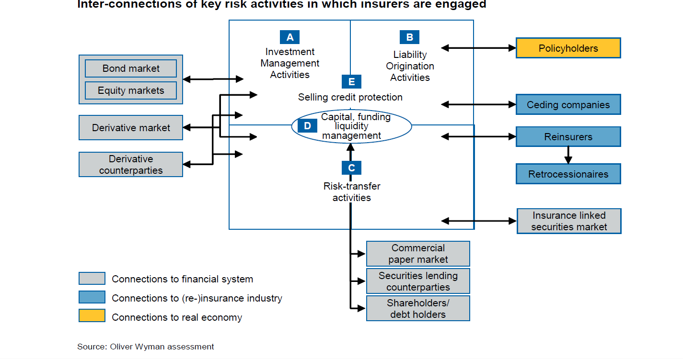
Sources of systemic risk – insurance industry

Slide 16
Systemic risk – insurance industry
* International Financial Services Research, Oct 2009

Slide 17
Systemic risk – insurance industry

Slide 18
Systemic risk – insurance industry

Slide 19
Systemic risk – insurance industry

Slide 20
Systemic risk – insurance industry

Slide 21
Systemic risk – insurance industry

Slide 22
Systemic risk – insurance industry

Slide 23
Systemic Risk – manage/mitigate?

Slide 24
Systemic risk mitigation measures

Slide 25
Questions?

Slide 26
Appendix: Sources/Reference

