Slide 1
November 9, 2017

Slide 2
Cheshire Puss, asked Alice, would you tell me please which way I ought to go from here
That depends a great deal on where you want to go, said the Cat
I don’t much care where, said Alice
Then it doesn’t matter which way you go, said the Cat
Alice’s Adventures in Wonderland – Lewis Caroll

Slide 3
Ethics
    A branch of philosophy that involves systematizing, defending and recommending concepts of right and wrong conduct
    The discipline dealing with what is good and bad and with moral duty and obligation
    The branch of knowledge that deals with moral principles
Moral code, principles, ideals, credo, ethos, dictates of conscience, moral values

Slide 4
Morality
Principles concerning the distinction between right and wrong or good and bad behaviour
A particular system of values and principles of conduct
The extent to which an action is right or wrong
Virtue, principles, honesty, integrity, propriety, justness, fair play, decency

Slide 5
Ethics and Morality
Morality | Ethics
Derived from Latin moralis, coined as a translation of Greek ethikos | Derived from Greek ethikos
Considered as something that’s personal and normative | Standards of good and bad distinguished by a certain community or social setting
Connotes an element of subjective preference | Tends to suggest aspects of universal fairness
Describes one’s particular values | Refers broadly to moral principles, often seen applied to questions of behaviour within a relatively narrow area of activity
Used interchangeably – both deal with distinguishing between “good and bad” or “right and wrong”

Slide 6
Professional
Derived from Middle English profess, from Late Latin professus, meaning “having professed one’s vows”
As people became more and more specialized in their trade, they began to “profess” their skill to others, and “vow” to perform their trade to the highest known standard
A professional is a member of a profession or any person who earns their living from a specified professional activity
Describes a particular social stratum of well-educated workers who enjoy work autonomy and engaged in creative and intellectually challenging work

Slide 7
Professional Ethics
Encompass the personal, and corporate standards of behaviour expected by professionals
Professionals exercise specialist knowledge and skill. How the use of this knowledge should be governed when providing a service is termed professional ethics
Originally applied to vows of a religious order; extended later to divinity, law and medicine
Hippocratic oath is among the earliest example of professional ethics

Slide 8
Ethics enters many of our decisions…
How to live a good life
Our rights and responsibilities
The language of right and wrong
Moral decisions – what is good and bad
Each lapse in ethics affects one’s essence as an individual, an employee, as a person

Slide 9
And the challenge is that…
Ethics doesn’t give right answers
Ethics can give several answers
Ethics is knowing the difference between what you have a right to do and what is right to do

Slide 10
Do different rules apply to business?
There’s no such thing as “business ethics”; there’s just ethics. And ethics makes no concessions for the real or imagined necessities of making a profit
Michael Josephson

Slide 11
Why is ethics important for business?
Integral to overall corporate governance
Provides the foundation for developing trust:
        Customers
        Suppliers
        Employees
        Shareholders
        Creditors
If people like you, they’ll listen to you, but if people trust you, they’ll do business with you

Slide 12
Ethics underpins every element of corporate governance
Honesty
Respect
Responsibility
Pillars of corporate governance
Principles
Integrity
Accountability
Fairness
Transparency
Independence
What lies behind us and what lies before us are small matters compared to what lies within us

Slide 13
Ethics traps
Business targets
Competition
Career progression
Greed
Personal biases and predispositions
Leadership
Relativity applies to physics, not to ethics

Slide 14






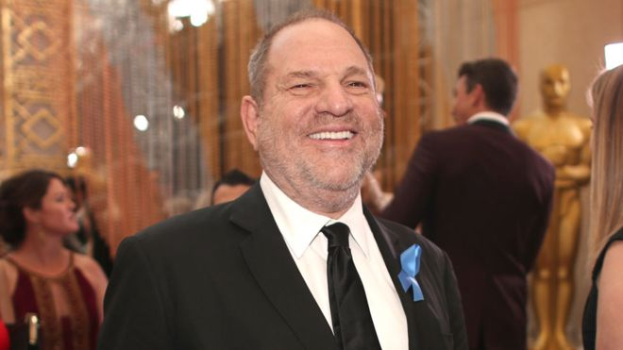


A sampling of some recent ethical dilemmas…
Watson

Slide 15
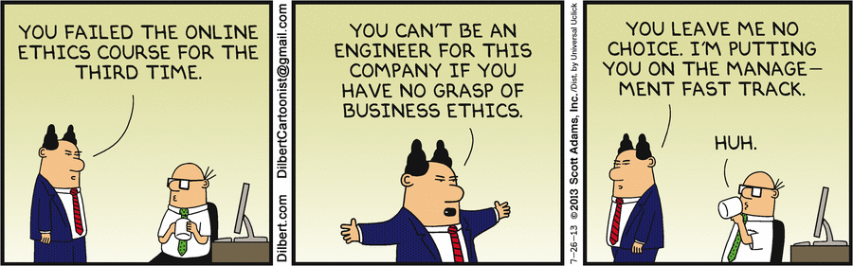

Slide 16




Bobby Parikh Associates

