Slide 1

Current Issues In Health Care Insurance
Aditya Sharma
Head Strategic Initiatives
Bajaj Allianz General Insurance Co. ltd.

Slide 2

HEALTH CARE GROWTH….
US$ 110
2016
US$ 280 billion
2020
Source : India Brand Equity Foundation

Slide 3

The
Indian Health
Scenario
The expenditure on healthcare by the Centre and state governments was 1.3 per cent of the GDP. (2015-16)

Slide 4

Health Insurance Mediums
Govt.
scheme
2
Micro Insurance
Community
Based
Insurers
1
3
Risk Rated & offered by Commercial Organization
Govt. of India launched the Universal Health Insurance and Schemes marketed by Public Insurance CO.
Community Rated & Normally managed by Community / Groups

Slide 5

Health Insurance Industry

Slide 6

Size of Health Insurance Industry

Slide 7
Size of Health Insurance Industry
FY 15-16 Rs Cr. State | Industry
 | Population | GWP | Share
Maharashtra | 12.1 | 8482 | 30.90%
Tamil Nadu | 7.8 | 3153 | 11.50%
Karnataka | 6.1 | 2834 | 10.30%
Delhi | 1.9 | 2406 | 8.80%
Gujarat | 6 | 1639 | 6.00%
West Bengal | 9.1 | 1195 | 4.40%
Haryana | 2.5 | 1154 | 4.20%
Kerala | 3.3 | 921 | 3.40%
Uttar Pradesh | 20 | 836 | 3.00%
Telangana + AP | 12 | 1357 | 4.90%
Total | 80.9 | 23976 | 87.30%

Slide 8

Health Insurance Challenges

Slide 9

Awareness of Health Care
  Awareness
Television
Internet
Low level of awareness among consumers about health insurance products and their benefits
Low level of awareness among consumers about
health insurance products and their benefits
Print Media
Radio
Digital/ Social Media
Who will bell the cat?

Slide 10

Regulatory Challenges
Lack of data availability to analyse products.
Time taken in approval of products .
Regulation on distribution channels of products.

Slide 11

Health Care Delivery Mechanism
Varying treatment costs across providers due to limited bargaining power
Lack of standardization & accreditation in most healthcare facilities leading to difficulty in judging the authenticity of procedures & costs

Slide 12

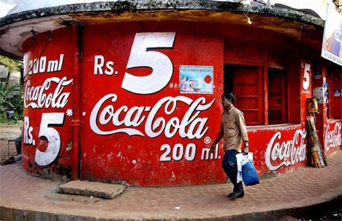
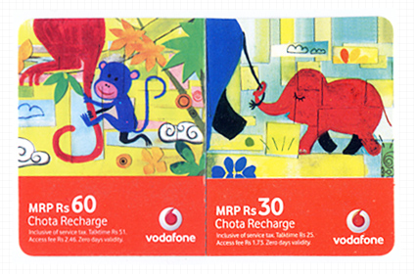
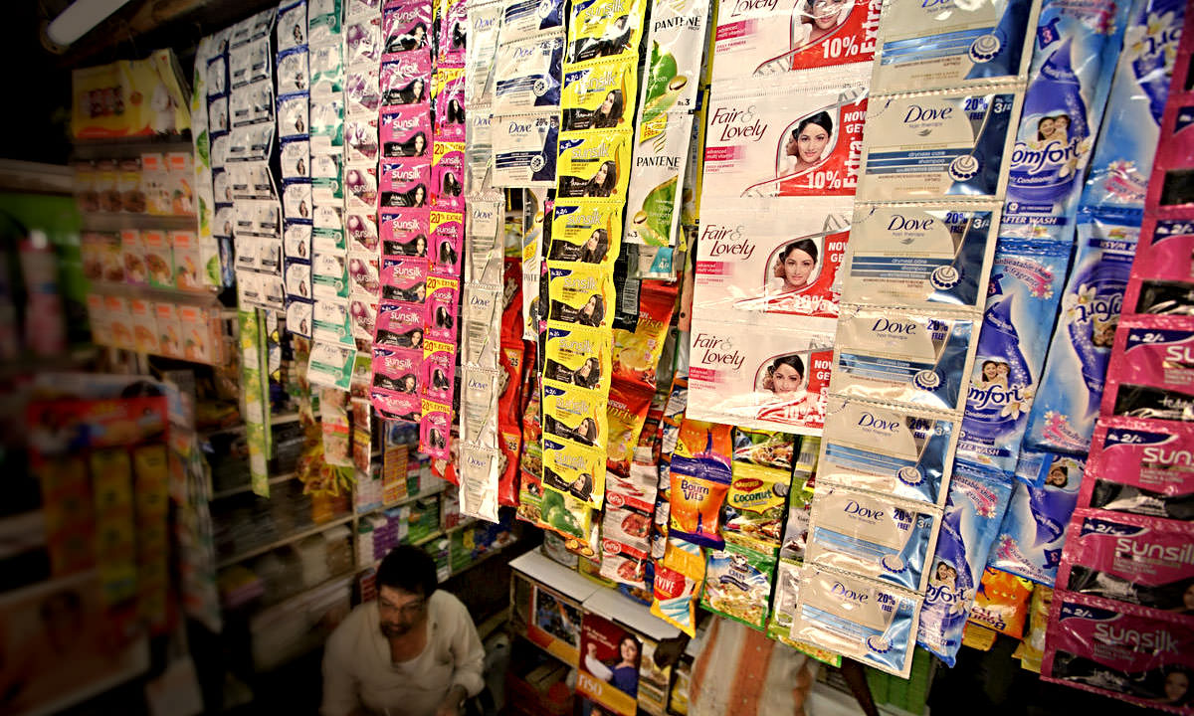
Product Innovation
Product Innovation
Lack of Customize Health Insurance Products
Affordability of Health Insurance Products
Insufficient data on Indian consumers & disease patterns

Slide 13
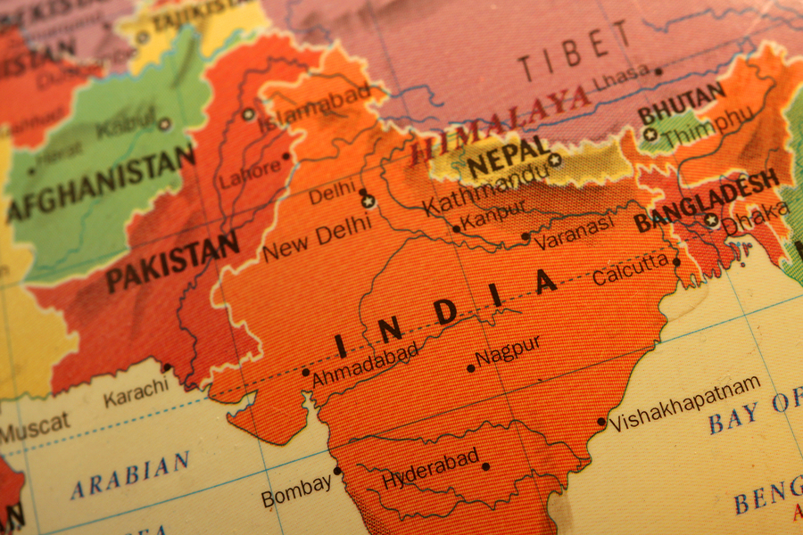
Distribution Network
  Product
  Distribution reach
How can we reach out to maximum ?
Direct Sales including Web
Multiline Agents
POS
Banca
Brokers

Slide 14

Way Forward

Slide 15

Key Drivers of health Insurance In future
Cohesive Health Ecosystem:
Increasing health applications
Tracking health conditions through tools
Cohesive Health Ecosystem
Analytics
&
Digital Revolution
Game changer of Insurance
Helping in understanding customer retention opportunities
loT, big data , block chain etc are bring the change
Analytics
&
Digital Revolution
Accessibility
Accessibility
New Distribution channels will help to capture new territories

Slide 16

Health Insurance – The Future
Straight through Processing (STP) should become the norm
Service communication used by customers on technology
UIDAI project can be leveraged
Process
Digitization
Distribution of Future –Phygital
Products &Pricing
A simpler product offering with easier claim processes
Designing the product keeping in mind the end user
Tailored offerings
Pricing should be derived from Iot, wearable, big analytics.
Emergence of New Distribution channels
It has to develop the capacitates of reaching mass market
Direct Digital Interaction with customers through website, Tele assist based direct sales

Slide 17

Pillars of change and Enablers for growth
Way Forward
Pillars of Change
Consumer Awareness
Standardization of Health care costs and Accreditation norms
Healthcare Infrastructure
Data & Information Exchange
Enablers for Growth
Product & Pricing Innovation
Technology
Channel Innovation
Outcome
Increased Penetration

Slide 18

So, Summary in one go..
Health Insurance to be dynamic and covering end to end customer journey.
Insurance to be customized and relevant to each customer.
Interactions will be phygital – a mix of physical and digital, though increasingly becoming more and more digital.
Insurance to partner with multiple service providers to offer end to end service meeting customer needs and not just products.
There is a need to reinforce a conviction for improvements in all areas – especially services and redress of grievance regarding policies.

Slide 19

It depends on the mind set of
Government, Regulator, Insurers and Distributors
to
create an ecosystem for
providing adequate coverage
and
better services to
each and every citizen.
THANK
YOU

