Slide 1

Institute of Actuaries of India
Capital infusion – Is the business appealing enough to attract investors?
Vichitra Malhotra
Gopal Kumar
Ishwar Gopashetti
Guide: Mayur Ankolekar
Indian Actuarial Profession
Serving the Cause of Public Interest

Slide 2
Agenda
Introduction
Industry Analysis
General Insurance
Life Insurance
E-Commerce
Summary
Questions
2

Slide 3

Introduction - Appeal to Investors
What makes a business appealing for Investors?
From purely economic view point, business which earns
highest risk adjusted return
compared to other investment opportunities (opportunity cost)
is most appealing to investors.
3

Slide 4
Introduction – Appeal to investors
Business Appealing also depends on investors’
RISK APPETITE & VALUE
Business Appealing
or Not ?
SURPLUS CAPITAL & OPPORTUNITY COST
INVESTMENT TIME HORIZON & PAST EXPERIENCE

Slide 5
Introduction – Industry attractiveness
Determining if the option at hand is the best depends on various factors:
Factor | Potential/Attractive | Challenge/Unattractive
Market Characteristics
Market Size | Large potential | Small disparate market
Market growth rate | Growing and will continue to grow | Growing slowly, flat or declining
Pricing trends | Holding steady and moving with inflation | Prices falling and becoming more competitive
Profitability trends | Changes in cost passed on to customer, profitability maintained | Margins sinking and pressure to squeeze out cost
Direct Industry Forces
Intensity of direct competition | Fragmented with no competitor | Market dominated by few players with high market share
Customer purchasing power | Plenty of customers and low dependency on any one customer | Few dominant customers with long term supply contracts
Product Innovation | Potential for Innovation, Intellectual Property (IP) rights protection | Standardized Products

Slide 6
Introduction – Industry attractiveness
Factor | Potential/Attractive | Challenge/Unattractive
Other Forces
Intensity of direct competition from substitution | No significant or viable alternatives | Plenty of alternative ways to deliver the product or service benefit
Barriers to entry | High barriers to entry deterring new entrants | Low barriers to entry
Supplier / distributor dominance | Plenty of suppliers with over supply and few of them have significant marker share | Few suppliers
Regulatory environment | Collaborative environment between Regulator and Industry members | Restrictive environment Uncertainty of the future

Slide 7
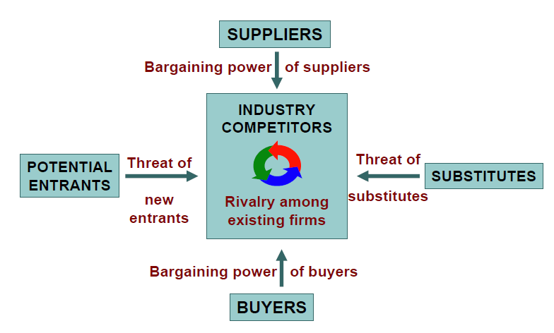
Introduction – Industry attractiveness
Alternative analysis

Slide 8
Introduction – Industry valuation
Perpetuity Valuation Actual cash flow for return capitalisation Actual profit for return capitalisaiton Net asset value Net assets Liquidation value | Discounted cash flows Future cash flows Future Profit Future dividend payments
Performance Multiples EBITDA multiple Earnings multiple Cash flow multiple Revenue multiple Net asset value Book value – multiple | P/E – growth multiples
Independent Measure
(Basis: return expectation of Buyer
Problems: Appropriate return
On which to make A valuation
Comparative Measure
(Basis: comparable
Data of market / industry
Problems:
Availability of Comparable data
)
Current Value Measure
Problem
Buying the future and not the past
Future Oriented Measure
Problem
Forecast accuracy

Slide 9
GI Industry – Growth & Market Size
Significant top line growth – EXPECTED TO CONTINUE IN FUTURE
From a Rs 12,000 crore top-line industry in 2001–02, today it is worth 70,000 crore, clocking an annual growth rate of 17% over the last decade.
The industry today provides a cover of Rs 1,000 lakh crore.
GI penetration still on the lower side.
GI Industry, with low startup capital, is projected to grow at 16% in medium to long term mainly on account of economic growth, socio economic drivers and greater penetration.
16%
Source: KPMG Analysis, IRDA Annual Report 2012
9

Slide 10
GI Industry – Profitability (low and fluctuating)
Profitability low – driven by intense competition and regulated Motor TP prices.
De-tariffication has resulted in prices being cut significantly.

Slide 11
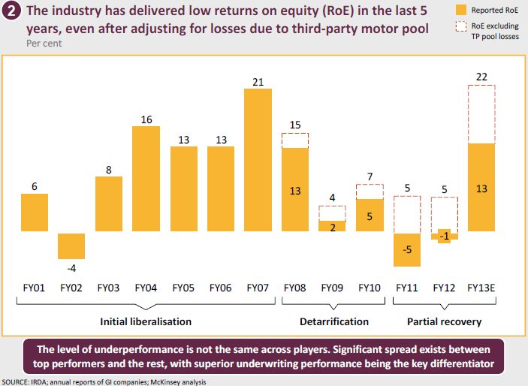
GI Industry – Profitability (low and fluctuating)

Slide 12
GI Industry – Regulatory update
Creation of Indian Motor Third Party Insurance Pool
Introduction of declined risk pool, TP premium rates increase
New health insurance guidelines introduced
Key Regulatory Changes
Merger and Acquisition Guidelines
Price Detariffication
2007
2011
2012
2013
Mechanism to equitably share CVTP losses
Enabled consolidations, inorganic transactions in the industry
Improvement in overall profitability of the CV segment
Streamlining of products
Change in Industry
Significant change in premium rates for commercial lines
12

Slide 13
GI Industry - Challenges
Product Innovation
Existing products mainly standardized
Some innovation seen in terms of add on benefits and customized products to some segments
Lack of proper customer segmentation with products for complete customer life cycle
Nature of Competition
Many new entrants seen since 2007
Focus on growth and competition only on price
Third Party Premium Rates
Limited or no increase in TP premium rates
Third Part liability caps under Motor Vehicles Act
Liability generally decided through court orders; high claim ratios
13

Slide 14
GI Industry - Challenges
Distribution Models
Mainly Agents & Brokers (60% of industry premium)
Agents: High churn out, low productivity and low customer connect
Brokers: Fragmented, unable to offer full range of services to customers
Bancassurance potential not utilized fully
Pricing Challenges
Potential for using risk based pricing, capturing data through new technologies (big data etc.) not exploited enough.
Need for having separate pricing approach for each line
14

Slide 15
GI Industry - Future prospects
Industry has huge potential; but initiatives needed to exploit full potential and grow irrespective of economic environment
Competition of Product Differentiation versus Price Differentiation
Better customer segmentation to meet needs across life cycle; Product innovation need of hour.
Invest in building best in class claims management
Strengthen pricing mechanisms; Talent development
Strengthen distribution model to maximise reach; Power of E-distribution and shared services should be leveraged
15

Slide 16
The Life Insurance Industry - evolution
Birla Sun Life | Bajaj Allianz | Aviva |  | Sahara Life | Shriram Life | Bharti AXA | IDBI Federal | Aegon Religare | India First |  | Edelweiss Tokio
HDFC Life | Exide Life |  |  |  |  |  | Future Generali | Canara HSBC OBC
ICICI Prudential | Kotak Life |  |  |  |  |  |  | DHFL Pramerica
Max Life | PNB MetLife |  |  |  |  |  |  | Star Union Dai-chi
 | Reliance Life
 | SBI Life
 | Tata AIA
CAGR: 2.5%
Total Premium
INR 3,13,000 Cr*
CAGR: 22%
Total Premium
INR 35,000 Cr
CAGR: 25%
Wave 1
Wave 2
Wave 1 | Bank-led: ICICI Prudential, HDFC Life, Kotak Life, Exide life, SBI Life, PNB MetLife Non bank-led: Birla Sunlife, Max Life, Bajaj Allianz, Reliance Life, Tata AIA, Aviva, Sahara Life, Shriram Life
Wave 2 | Bank-led: IDBI Federal, Canara HSBC OBC, Star union Dai-chi Life, India First Non bank-led: Bharti AXA, Future Generali, Aegon Religare, DHFL Pramerica, Edelweiss Tokio
Source: IRDA

Slide 17
The regulatory changes overview
Key guidelines a
ULIP regulations (FY11)
Increased lock-in period for ULIPs from 3 years to 5 years,
Age based minimum mortality cover at ~ 10 times premium
Caps on surrender charges
Cap on reduction in yield basis policy term
Pension to offer a minimum 4.5% p.a. guarantee
Guidelines on pension products (FY12)
Scrapped the 4.5% guaranteed annual return clause on ULIP pension
However, all pension products to have a guarantee of a non-zero rate of return
Company that contracts the original deferred pension policy is required to provide the annuity product to the policyholder
Linked and Non-linked products regulations (FY13)
Minimum death benefit specifications for single and regular premium products
Minimum premium payment term of 5 years for non-single premium policies
Cap on commission basis premium payment term
Reduction in commission
Reduction in margin and loadings leading to downsizing of Agency
No Pension products available for sale for a long time. Hence, decline in new business.
Re-pricing of products
Reduced commission – reduced new business
Industry-wide impact

Slide 18
Appraisal Value
Embedded Value
What are the drivers?
    Structural Value –
        Business Mix
        Future / Expected Profit Margin
        Future Growth Rate
        Risk Discount Rate
    Actual Expenses
    Persistency
    Miscellaneous
– Acquisition Expense Overrun
AV
Structural Value

Slide 19
Value Creation Framework
Business Value = VNB * Multiplier + EV
VNB = FYP X VNB Margins
First Year Premium
VNB Margins
Multiplier
Future Growth
Loyalty / Trust
Embedded Value
Expense Management
Distribution Network
Product
Brand
Product Innovation
Product Mix
Risk Management Practices
Mortality / Morbidity
Investments
Brand and Marketing
Pricing Power
Distributors
Customer / Referral/Cross Sell
Diversification
Product
Distribution
Continued excellence
Corporate Governance
Compliance
Quality and Scalability
Loyal employee
Claims Management
Investment Performance
Risk management
Persistency management
Policy
Premium
Withdrawals
Product Mix

Slide 20
Life Insurance: Industry Analysis
MACRO ANALYSIS
Industry Attractiveness
Market Characteristics
- Market Size
- Market Growth rate
- Pricing trends
- Profitability Trends
Direct Forces
- Intensity of competition
- Customer purchasing power
Others
- Regulatory reforms
- Political and economic environment
Limiting Forces
- Substitute products
- Barriers to entry
- Distributor dominance
- Regulatory restriction

Slide 21
Future Outlook
Potential
- Market Size - $ 1 trillion by 2020,
Market Growth rate – 12 % to 15% pa
Reason
Favorable demographics – Insurable population – 75 Crores lives, Average Age 27,
Increased consumer awareness
Insurance premium % of Domestic savings – 35% by 2020 from 26% in 2010
Leveraging Digital Platform to tap into the target market
Challenges
- Stable regulatory environment
Cost effective distribution channel
Untapped potential – Digital space
Product innovation

Slide 22
Industry Analysis
RATIO ANALYSIS
Industry Attractiveness
Liquidity test
- Quick Liquidity (Cash + ST Investment) to total investments,
Current Liquidity – Current Assets to total liabilities,
Operating performance / Profitability
- Benefits paid to premium written
- Commission and expenses to Premium
- Return on invested assets
- NBAP Margin
-
Balance sheet strength
- Net Worth,
- Solvency ratio,
- Total capital and surplus to total liabilities
Business Profile
- Spread of risk
- Revenue composition
- Competitive market position
- Management
- Insurance market risk
Risk Management
Corporate Governance

Slide 23
Industry Trend: Private Players vs. LIC
Expense Ratio =
OPEX / Premium Income
Other measures also followed – ex. OPEX to FYP
Adjusted Opex Ratio =
OPEX / (Premium Income + Investment Income - Increase Reserve)
OPEX Ratio
China – 8.3%
UK – 4.8%
Singapore – 6.9%

Slide 24
NBAP Margins
Participating
products
ULIPs
Term insurance
10-12%
6-9%
15-20%
4-8%
40-60%
40-60%*
New Business margins
2-4%
1-3%
3-5%
0.5-2%
12-15%
12-15%*
Profit
margins
New Business Margin = PV of Distributable earnings / Annualised First year premium
Profit Margin = PV of distributable earnings /PV of premiums
*For non-online term policies
Based on analysis & industry discussions

Slide 25
Comparative Statistics: Transactions & public Disclosures
Category/Company | HDFC Life | Max Life | Reliance Life | Aviva Life | Exide Life
Basis | MCEV | EEV | TEV | TEV | TEV
Year | Mar-13 | Mar-12 | Mar-11 | Dec-13 | Mar-13
EV- Before Overrun | 6,020 | 3,786 | 2,730 | 1,800 | 844
Net Worth | 1,690 | 1,711 | 439 | 697 | 339
VIF | 4,330 | 2,075 | 2,291 | 1,103 | 505
Overruns | 150 | 102 | NA | NA | NA
EV - after overrun | 5,870 | 3,684 | 2,730 | 1,800 | 844
NB-Profits | 584 | 168 | 340 | 60 | 89
NB Margins | 17.80% | 17.80% | 12.80% | 14.00% | 14.00%
AV | 13,000 | 10,504 | 11,500 | 5,000 | 1,100
Good will | 7,130 | 6,820 | 8,770 | 3,200 | 256
NBM | 12 | 41 | 26 | 53 | 3
AV/EV | 2.21 | 2.85 | 4.21 | 2.78 | 1.3
Capital Infused | 2,160 | 2,127 | 3,094 | 2,005 | 1,465
The numbers of Max Life, Reliance Life and Exide Life are as per the transactions
HDFC Life numbers (EV) are published as a part of the Investor Presentation. AV is based on bankers publication
The numbers of Aviva Life are as per the article published in the Economic Times
The details of capital infused and net worth are obtained from the financials disclosed in the public disclosures for each of the companies.

Slide 26
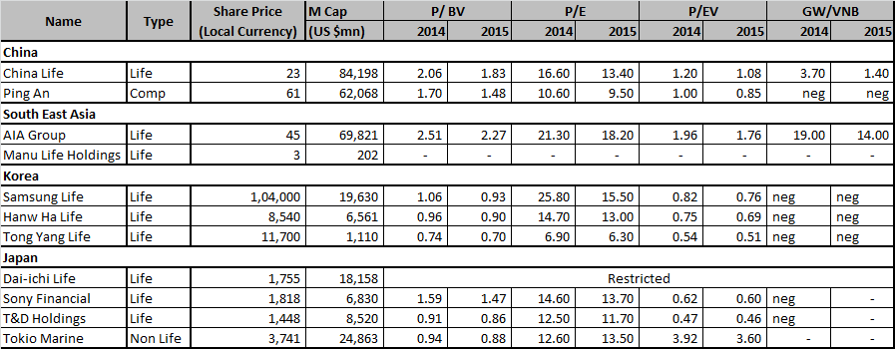
PE Multiple Comparison for Life Companies
GW – Good Will (Market Value less EV)
EV – Does not include the expense overrun l

Slide 27
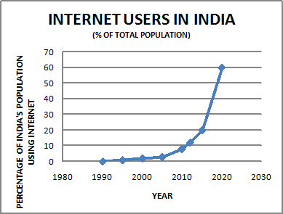
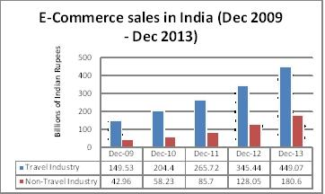
E-commerce Industry: Introduction
E-commerce Industry on a roller coaster ride over the last five years
Picked up in 2011 and continued thereafter
Internet penetration in India has been increasing exponentially – 21 million in 2006 to 243 million users by June 2014.
Number of active mobile internet users grown to 185 million.
India’s ecommerce market at $10-16 billion last year, annual increase of 88% and by 2020 it could be 60-80 billion.

Slide 28


Investment Opportunity or Bubble?
Opportunity: Growing sector in India; Emerging sector, in long term at least 10 per cent of Indian retail will move to online.
Bubble: High gestation period, difficult to sustain losses, only top-line driven, bottom line not in sight.
If you have a long term view and if you are cash surplus, then you can jump in and others who are not cash surplus and don't take a long term view, it probably will look like a bubble.

Slide 29
Capital Infusion: Investor’s Rationale
Sector to reach $32 billion (Rs 1.9 lakh crore) in 2020
Investors pumped in over $1.6 billion (Rs 9,700 crore) across 24 deals so far in 2014 vs $553 million (over Rs 3,300 crore) in 2013 across 36 deals.
PE funds typically value companies on profitability and cash flow, while VCs value companies on multiple of sales
E-Commerce in India cam a long way when eBay started its operations in India in 2004 by acquiring Baazee.com.

Slide 30
Top Capital Infusions in the Sector
Amazon - $2 billion investment in India
Flipkart - raised $1 billion from Tiger Global Management and Naspers.
Snapdeal - SoftBank Internet and Media, committed $627 million
Myntra- $50 million by Premji & others
Bigbasket - $33 million from Helion Ventures and others
Jabong - secured $27.5 million from British development finance institution
Urbanladder - $21 million from Steadview Capital and others
Firstcry - $15 million funding from Vertex Venture Management

Slide 31

Valuation Game
Valuation is subjective
Valuations depends on many qualitative and quantitative parameters.
At this stage less of quantitative and more of qualitative parameters
Depends on perception of potential and share of success in past (Softbank – Alibaba)
Investors feel not investing in e-commerce may prove to be a lost opportunity

Slide 32
Summary
 | Life Insurance | General Insurance | E commerce
Market Characteristics
Market Size | Large Potential | Large Potential | Large Potential
Market growth rate | Growing slowly, flat or declining | Growing at steady rate | Exponential Growth
Pricing trends | Prices falling and becoming more competitive | Competitive | Competitive
Profitability trends | Margins sinking and pressure to squeeze out cost | Pressure to squeeze cost | Potential profits
Direct Forces
Intensity of direct competition | Market dominated by few players with high market share | Market dominated by few players with high market share | High competition
Customer purchasing power | Plenty of customers with high purchasing power | Plenty of customers with high purchasing power | Plenty of customers with high purchasing power
Product/Services Innovation | Potential for Innovation | Potential for innovation | Potential for Innovation
32

Slide 33
Summary
 | Life Insurance | General Insurance | E commerce
Limiting forces
Intensity of direct competition from substitution | Medium to High | Medium | High
New competitors and Barriers to entry | High barriers to entry | Medium | Low
Supplier / distributor dominance | Plenty of distributors | Plenty of distributors | Plenty of distributors
Regulatory restriction | Highly regulated | Highly regulated | No regulation Untested rules and regulations – Taxation Industry lobby
33

