Slide 1



Organizer
19th Global
Conference of Actuaries
30th – 31st January, 2018 | Mumbai, India
Shilpi Jain
FIAI
Ritu Kotnala
FIA, AIAI
Mayur Ankolekar
FIAI, FIA, FCA

Slide 2



19th Global
Conference of Actuaries
30th – 31st January, 2018 | Mumbai, India
Developing the Indian Actuarial Climate Index
31st January, 2018 from 1600 -1700
Understanding the criticality of climate change, discussion of the work of other organizations including actuarial associations, and laying out a path for structuring a climate index for actuarial practice in India.

Slide 3
Agenda
Overview of climate change
Need for a climate change index
Potential users of the index
International backdrop
Proposed design for the Indian Actuarial Climate Index (IACI)
Further actions

Slide 4

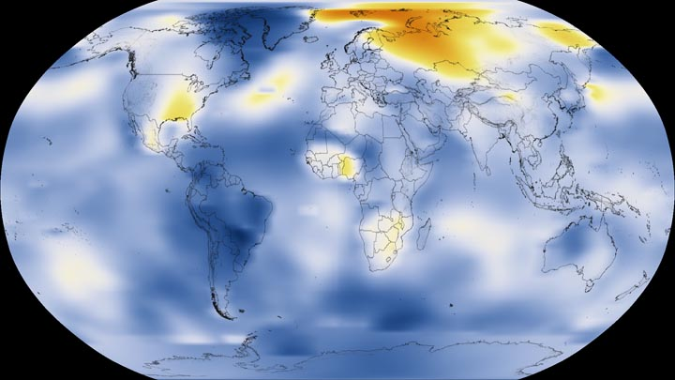
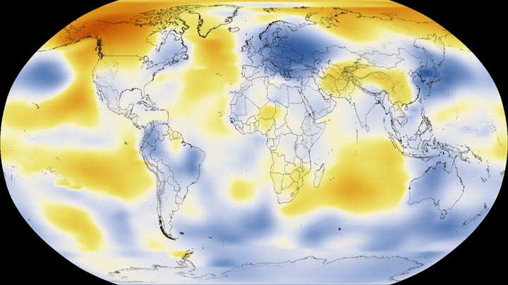
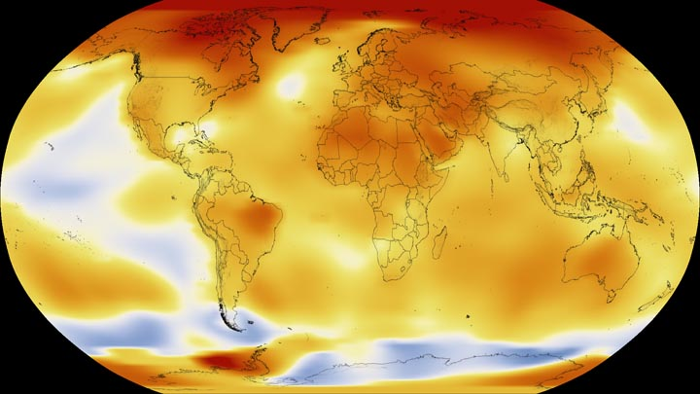
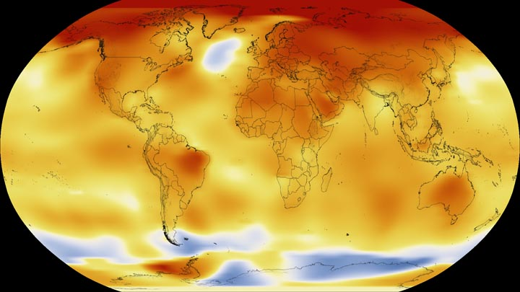
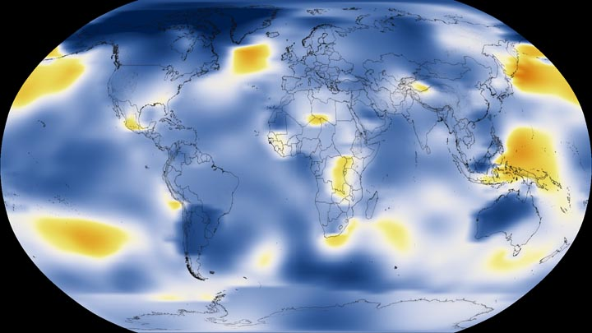
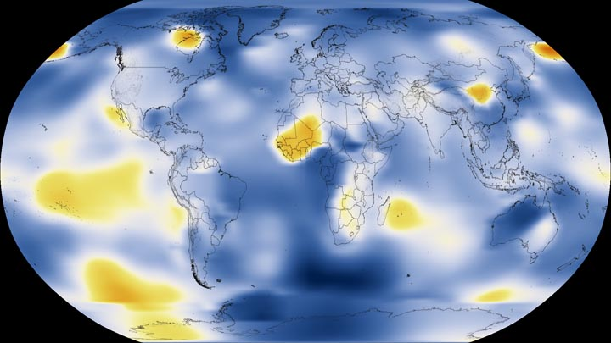
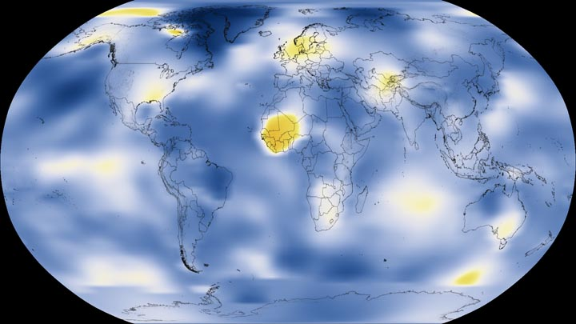
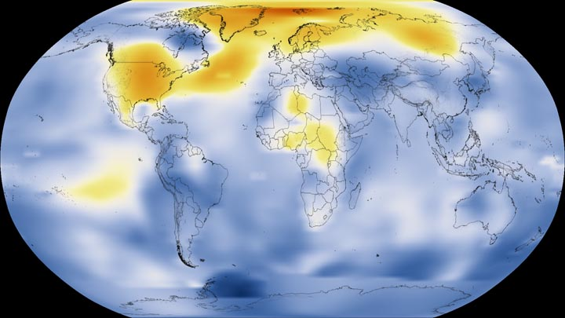
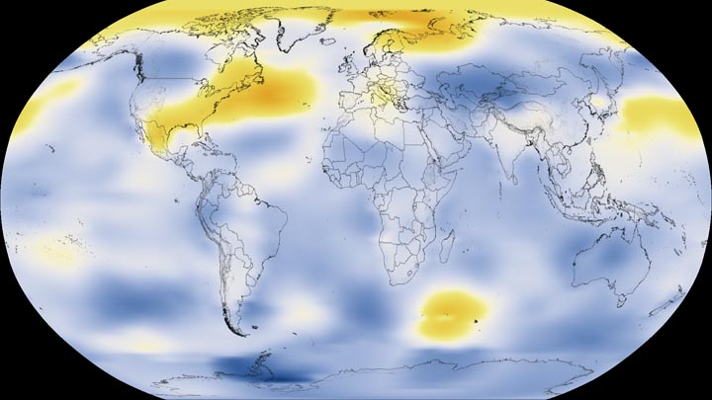
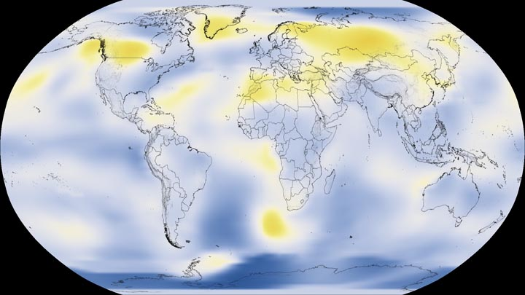
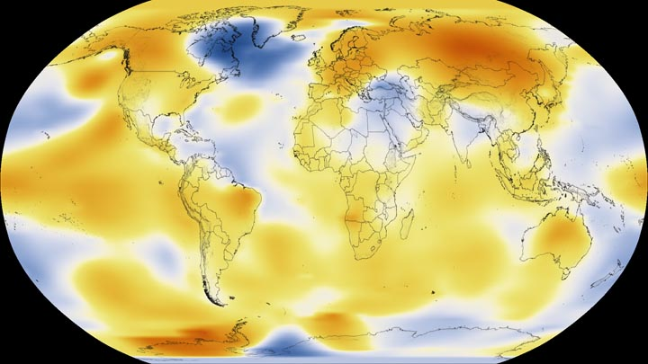
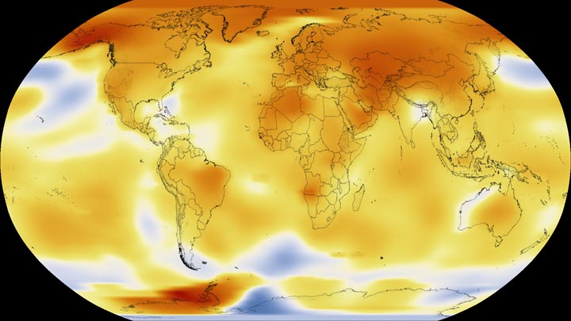
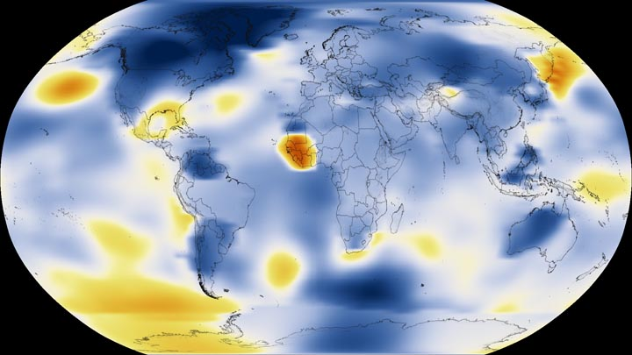
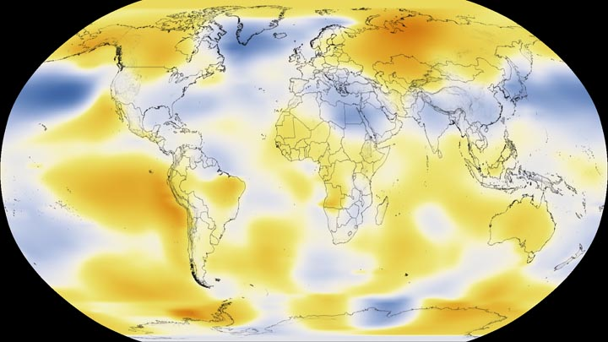
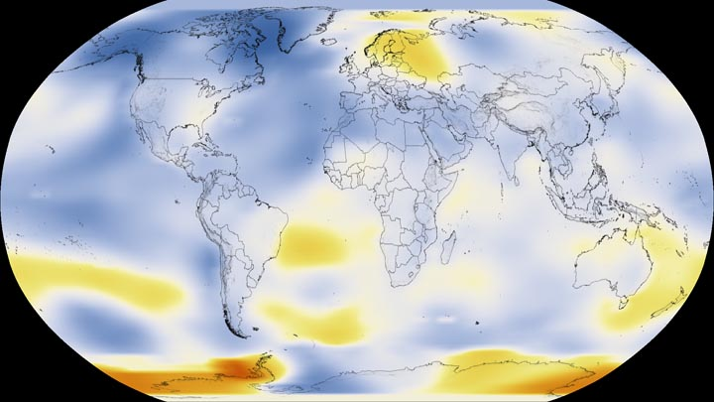
1924
1944
2014
1884
1984
2016
1974
1894
1904
1914
1934
1954
1964
1994
2004
Source: NASA (n.d.)
Notes:
The change is relative to 1951-1980 averages.
Global temperatures have increased from 0.65°C to 1.06°C during 1880 to 2012
Impact of two degree rise in temperature since pre-industrial levels:
On land, water deficit would double and lead to a drop in wheat and maize harvests
Glacier melting and corresponding sea-level rise can destroy homes and cities
About 40% of the world population lives within 100 kms of the coast
About 80% of global coastlines could experience a rise in sea levels of 6 feet
Extreme temperatures can also reduce productivity amongst workers
Recently a series of scientific papers have come out and stated that we have a 5 percent chance of limiting warming to 2°C, and only one chance in a hundred of keeping man-made global warming to 1.5°C, the aspirational goal of the 2015 Paris United Nations Framework
One trillion tons – a maximum global carbon budget of one trillion tons burned is necessary to keep global warming under two degrees Celsius above preindustrial levels; and 2020 – the year global CO2 emissions must peak in order to burn less than one trillion tons of carbon (the world has already burned more than half of that to date).

Slide 5
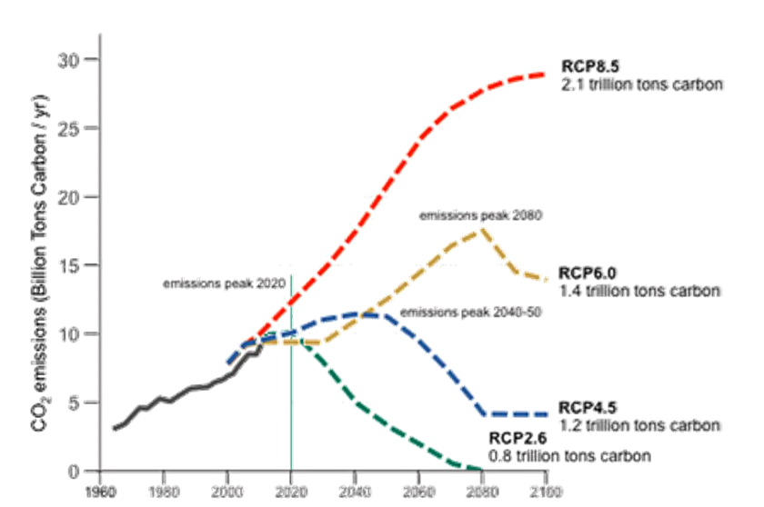
Projected Carbon Emissions under different Scenarios
Source: Architecture 2030 (2013)
Notes:
Positive radiative forcing means that earth receives more energy than it radiates back. This net gain will cause warming.
RCP – Representative Concentration Pathways
The projections are for the end of the 21st century
The years 1986-2005 have been taken as a base

Slide 6
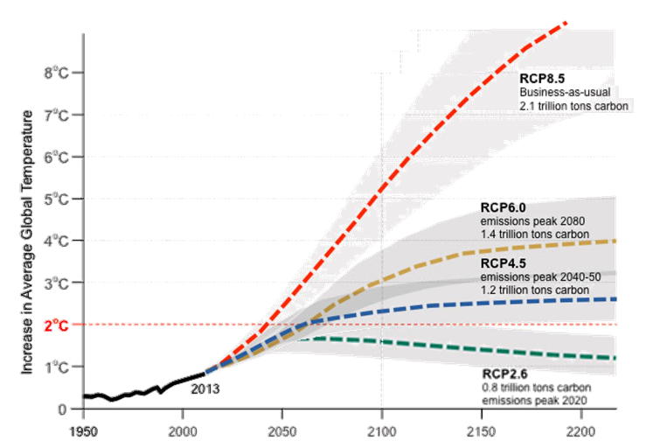
Projected Global Temperature Change
Source: Architecture 2030 (2013)
Notes:
The increase is global mean surface temperature is likely to be between 0.3°C and 1.7°C for RCP 2.6 and between 2.6°C and 4.8°C under RCP 8.5 scenario

Slide 7
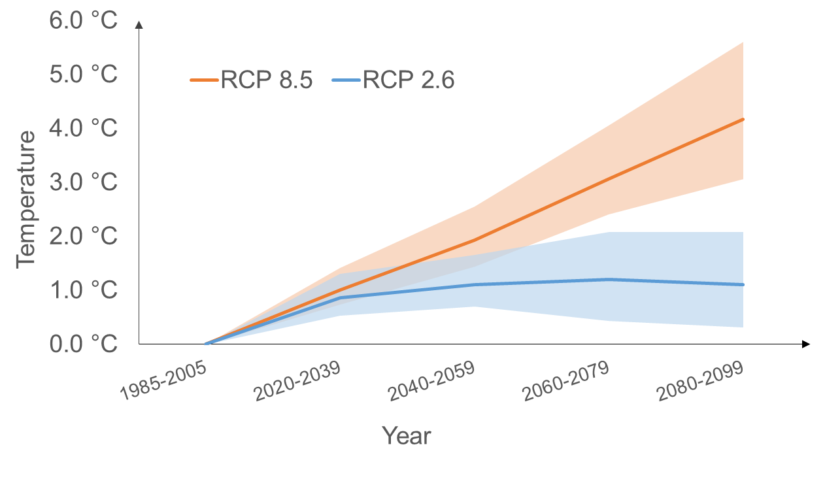
Projected Temperature Change for India
Data Source: Climate Change Knowledge Portal (2017)
Notes:
It is likely to be between 0.3°C and 2.1°C under RCP 2.6 scenario and between 3.1°C and 5.6°C under RCP 8.5 scenario.

Slide 8
Projected Precipitation Change for India
Precipitation to increase
All models and all scenarios project an increase in both the mean and extreme precipitation in the Indian summer monsoon.
Extreme events to increase
Extreme precipitation events are expected to become more intense and more frequent.
Changes not to
be uniform
Projections show varying trends across different regions and different seasons.
Change projected to
be the largest
Percentage change ratios of monsoon are the largest and model agreement is highest among all monsoon regions across the world.
Notes:
Under RCP 2.6 precipitation change can be between -6.0 mm and +3.8 mm
Under RCP 8.5 precipitation change can be between -7.7 mm and +10.9 mm

Slide 9
Projected Global Sea Level Change
Sea level expected to rise
Under all RCP scenarios, the rate of sea level rise will very likely to exceed the observed increase of 2 mm/yr during 1971-2010.
Rise in sea level can be very high
Under RCP8.5 scenario, during 2081–2100 sea level is projected to rise at the rate of 8 to 16 mm/yr.
India to see similar changes
About 70% of the coastlines worldwide are projected to experience a sea level change within ±20% of the global mean.
IPCC projections may be conservative
Many experts believe that IPCC projections are too conservative and sea level rise will exceed the IPCC projections.
Notes:
From 1901 to 1990, the average global sea levels rose about 1.2 mm/yr, but from 1993 to 2010, the levels rose about 3 mm/yr, meaning the rate of rise more than doubled, according to a 2015 report in the journal Nature.
The IPCC AR5 projections: This is more than 50 percent higher than the old projections (18-59 cm) [in its last assessment in 2007- AR4]
According to the best case scenario (humans take very aggressive action to reduce greenhouse gases), the experts think sea level rise will likely be about 0.4–0.6 meters (1.3–2.0 feet) by 2100 and 0.6–1.0 meters (2.0–3.3 feet) by 2300. According to the more likely higher emission scenario, the results are 0.7–1.2 meters (2.3–3.9 feet) by 2100 and 2.0–3.0 meters (6.5–9.8 feet) by 2300. These are significantly larger than the predictions set forth in the recently published IPCC AR5 report. This study was done with 90 experts from 18 countries.
<https://www.theguardian.com/environment/climate-consensus-97-per-cent/2013/dec/04/experts-ipcc-underestimated-sea-level-rise>

Slide 10
Agenda
Overview of climate change
Need for a climate change index
Potential users of the index
International backdrop
Proposed design for the Indian Actuarial Climate Index (IACI)
Further actions

Slide 11




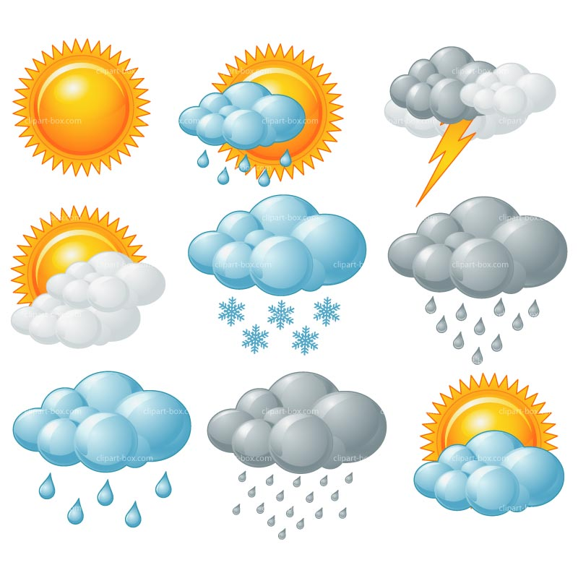



Pricing and valuation of climate risks
Tracking changes in long run
Need for a comprehensive index
Better comparability across the globe
Why
a Climate
Index?
Measuring
tail risk
Increase awareness about climate change

Slide 12
Agenda
Overview of climate change
Need for a climate change index
Potential users of the index
International backdrop
Proposed design for the Indian Actuarial Climate Index (IACI)
Further actions

Slide 13
Potential Users of the Index - Insurers and Reinsurers
Developing new insurance products
Parametric insurance products for climate risks can be developed with benefits linked to the value of this index.
Better pricing of existing products
Pricing of existing crop insurance and other weather based insurance products can allow for climate risks better.
Improved modelling
of tail risk
The index can identify tail risks better and hence be used for better modelling of catastrophe risks.

Slide 14
Potential Users of the Index - Businesses and Financial Institutions
Developing new financial instruments
Index linked securities can be developed with pay-outs linked to the value of this index.
Pricing of climate linked instruments
Securities that are based on climate risks or natural disasters can be priced better using this index.
Assessing own exposure
Businesses can use this index to better judge their own exposure to climate risks. This can also lead to better shareholder disclosures.

Slide 15
Potential Users of the Index - Government
Better preparation
for disasters
Understanding climate extremes better that could help the Government in planning better for disaster risk reduction and management.
Better budgeting
for disasters
Change in index value will signal the government that a change in disaster budgeting is required.
Monitoring climate change control targets
The 2015 Paris Agreement targets warming ‘well below 2 ºC’. This index can be used to regularly monitor meeting these targets.

Slide 16
Potential Users of the Index - Others
Regulators can use the index to create and implement various climate risk controlling policies.
Regulators
Changing climatic patterns will affect agriculture. The index can enable agricultural planning at regional and national level.
Agricultural Planners
The index can result in more awareness amongst the general public about climate change and its implications.
General Public

Slide 17
Agenda
Overview of climate change
Need for a climate change index
Potential users of the index
International backdrop
Proposed design for the Indian Actuarial Climate Index (IACI)
Further actions

Slide 18
International Climate Indices
WHO
CALCULATES IT?
WHAT IS IT?
Analyses to what extent countries have been affected by the impacts of weather-related loss events.
Published annually by Germanwatch, an independent German NGO.
Global Climate Risk Index
As per GCRI 2017, India is the 4th worst affected country in 2015 and 14th worst affected in the period 1996-2015.
It is calculated by taking into account number of deaths and amount of losses.
WHAT ABOUT
INDIA?
HOW?

Slide 19
International Climate Indices
…contd.
WHO
CALCULATES IT?
WHAT IS IT?
It tracks countries’ efforts in combating climate change.
Published annually by Germanwatch, an independent German NGO.
Climate Change Performance Index
India is ranked 20th according to CCPI 2017.
80% of the evaluation is based on objective indicators and remaining 20% on climate policy assessments by experts.
WHAT ABOUT
INDIA?
HOW?

Slide 20
International Climate Indices
…contd.
WHO
CALCULATES IT?
WHAT IS IT?
The USCEI quantifies observed changes in climate for highest and lowest 10% of extremes of five climate indicators. .
It is calculated for eight seasons for the contiguous US by NOAA's National Centers for Environmental _________ Information.
U.S. Climate Extremes Index
It is not calculated
for India.
_______ The index has indicators based on __ temperature, precipitation, and wind intensity. Final index is a arithmetic average of its indicators.
WHAT ABOUT
INDIA?
HOW?

Slide 21
International Climate Indices
…contd.
WHO
CALCULATES IT?
WHAT IS IT?
The ETCCDI Indices are based on the European Climate Assessment indices to analyze trends for second half of the 20th _________ century. .
The ETCCDI indices have been computed for a number of global climate models participating in the CMIP3 _________ and CMIP5, and __________ for reanalysis.
ETCCDI Indices
Separate index values could not be found for India.
ETCCDI has defined 27 core indices, which chiefly depend on temperature and precipitation.
WHAT ABOUT
INDIA?
HOW?
Notes:
ETCCDI - Expert Team (ET) on Climate Change Detection and Indices
CMIP3 - Coupled Model Intercomparison Project – used for IPCC AR4
CMIP – used for IPCC AR5

Slide 22
Climate Indices in India
Standardised Precipitation Index
It is a probabilistic index recommended by the World Meteorological Organization to monitor drought. It was developed by McKee et al .in 1993.
It considers precipitation to measure drought but can
also be used to determine periods of anomalously
wet events.
The India Meteorological Department (IMD) calculates
SPI every week for a cumulative four week period at a
district level. The base period used for this is 1901-2000.

Slide 23
Climate Indices in India … contd.
Aridity Anomaly Index
This index was was developed by the Indian
Meteorological Department (IMD)
It is a is a near real-time drought index based
on temperature, wind and solar radiation.
The IMD calculates this index for weekly or two-weekly periods.

Slide 24
Climate Indices in India … contd.
UV Index
This index was standardised by WHO, UNEP, and the
WMO in 1994. Based on this, Ministry of Earth Sciences (MoES) developed a UV Index for India.
It is a measurement of the amount of skin damaging UV radiation expected to reach the earth's surface at the time when the sun is highest in the sky.
It is calculated by System of Air Quality and Weather Forecasting and Research (SAFAR), a Government
of India initiative.

Slide 25
Climate Indices in India … contd.
Air Quality Index
It was developed by IIT Kanpur
It measures the quality of air based on concentration of various air pollutants and their likely health impacts.
It is calculated by the Central Pollution Control Board along with State Pollution Control Boards. They operate the National Air Monitoring Program which covers 240 cities of the country and has more than 342 monitoring stations.

Slide 26
Climate Indices in India … contd.
Heat Index
It was developed by George Winterling in 1978.
It is a summer index based on actual temperatures and relative humidity levels. It is a measure of stress that humans face due to rise in temperature as well as moisture levels.
IMD calculates this index across all weather stations
of India. It is updated every three hours during the
months of April, May and June.

Slide 27
Work done by other
Actuarial Bodies
Region and Actuarial Body | Work Done
United States and Canada (The Climate Change Committee formed by four North American actuarial organizations) | They developed the Actuarial Climate Index (ACI) in 2016 and are in the process of developing the Actuarial Climate Risk Index (ACRI).
UK and Europe (The Institute and Faculty of Actuaries, UK ) | A feasibility study conducted in 2015 concluded that it would be technically feasible to extend the ACI to UK and Europe. The main challenge would be the selection of optimal datasets.
Australia (The Actuaries Institute) | In January 2016, Climate Change Working Group was formed. They also conducted a feasibility study for implementing ACI for Australia.
Notes:
the Canadian Institute of Actuaries, the Society of Actuaries, the Casualty Actuarial Society, and the American Academy of Actuaries
This committee developed the Actuaries Climate Index (ACI) in 2016, with the following goals:
▪ Create an objective index that measures changes in climate over recent decades
▪ Educate the insurance industry and the general public on the impact of climate change
▪ The index should be easy to understand, but not simplistic
▪ Promote the actuarial profession

Slide 28
Agenda
Overview of climate change
Need for a climate change index
Potential users of the index
International backdrop
Proposed design for the Indian Actuarial Climate Index (IACI)
Further actions

Slide 29
Working of the
IACI
Components

Slide 30
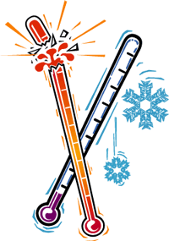

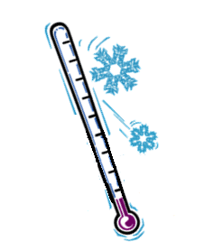
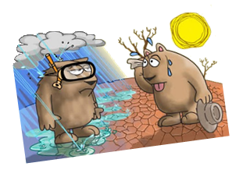
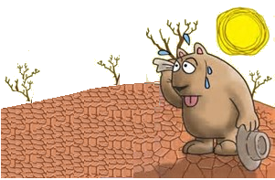
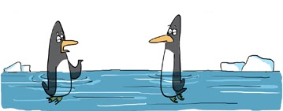
Components of ACI
Extremely Cold
Temperature
Extreme
Wind Speeds
Extremely Hot
Temperature
Change in
Sea-level
Extremely Low
Rainfall
Extremely High
Rainfall
Notes:
India has a large coastline.
Length of the coastline of India including the coastlines of Andaman and Nicobar Islands in the Bay of Bengal and Laksha dweep Islands in the Arabian Sea is 7517 km.
Therefore sea level rise is a major risk

Slide 31
Components of ACI
Component | Definition
Extremely Cold Temperature | Frequency of temperatures below the 10th percentile
Extremely Hot Temperature | Frequency of temperatures above the 90th percentile
Change in Sea-level | Change in sea-level for costal areas
Extremely Low Rainfall | Annual maximum consecutive days when precipitation is less than 1mm
Extremely High Rainfall | Maximum rainfall per month in five consecutive days
Extreme Wind Speeds | Frequency of wind speed above the 90th percentile
BACK

Slide 32
Calculation
Working of the
IACI
Components

Slide 33
Method of Calculation
Selecting the reference period
  Defining the components
  Calculating reference period μ and σ
  Calculating standardized anomalies
  Calculating the final index value
BACK

Slide 34
Climatic zones
Frequency of update
Calculation
Working of the
IACI
Components

Slide 35
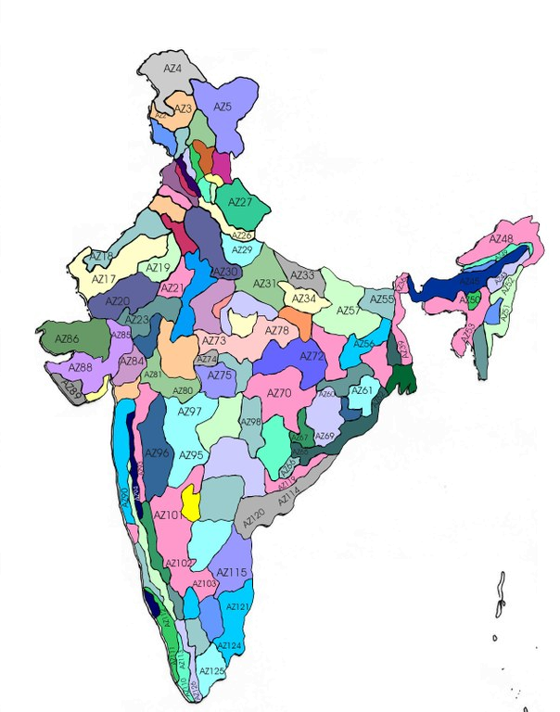
Climatic Zones
of India
India has 127 climatic zones as per the National Agricultural Research Project
Same zoning classification
is used by the India Meteorological Department
BACK

Slide 36
Climatic zones
Frequency of update
Source of data
Calculation
Working of the
IACI
Components
Publisher

Slide 37
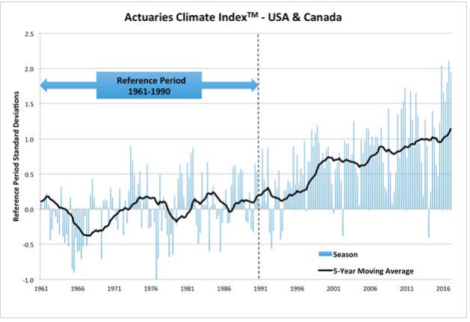
What will the Index look like?
Source: http://actuariesclimateindex.org

Slide 38
Agenda
Overview of climate change
Need for a climate change index
Potential users of the index
International backdrop
Proposed design for the Indian Actuarial Climate Index (IACI)
Further actions

Slide 39
Going forward
Finer grouping of climatic zones
With sufficient data available in the long run the separate indices can be calculated for a finer climatic zone classification.
Index can be more frequently updated
To enable stakeholders to respond more quickly to the changing climate, it can be more frequently updated.
More weightage to rainfall
Of all the components rainfall is most significant for India. We should perhaps give it a higher weightage.
Better allowance for seasonality
Publishing different indices for different seasons will perhaps significantly increase utility of the index for crop insurers.

Slide 40
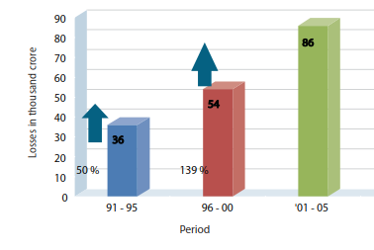
Developing a Climate Risk Index
Source: Ministry of Home Affairs of Government of India (2011)
Notes:
The Centre for Research on the Epidemiology of Disasters (CRED), a World Health Organization (WHO) collaboration centre, published a report named The Human Cost of Weather related disasters. According to this report, between 1995 and 2015, 805 million people were affected by weather-related disasters; one of the highest in the world. The countries hit by the highest number of disasters are the United States (472), China (441) and India (288).
It shows that economic loss is accounted for 2% of the GDP due to disasters as per the study of the World Bank

Slide 41
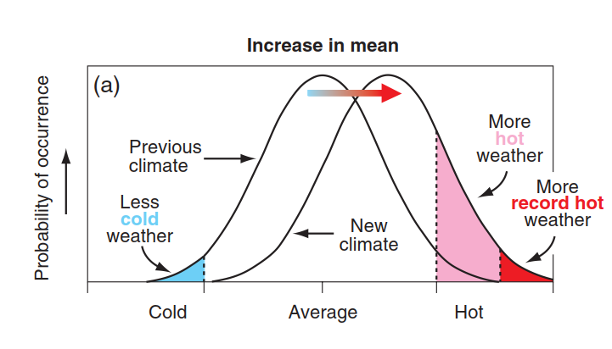
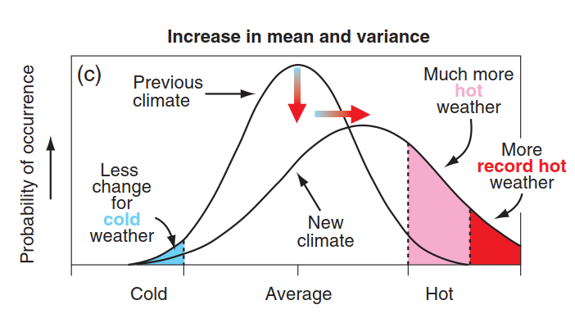
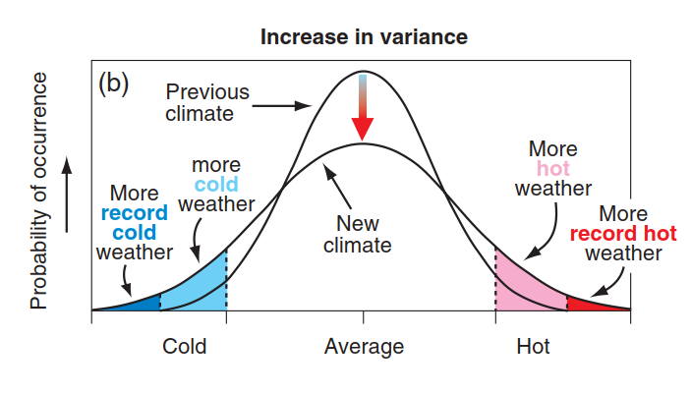
Developing a Climate Volatility Index
Source: IPCC (2001)
Notes:
Ecological studies suggest that changes in variance may have disproportionately greater effects on species’ performance than the impact of mean change in temperature.
Vasseur et all, 2014

Slide 42
Organizer
19th Global
Conference of Actuaries
30th – 31st January, 2018 | Mumbai, India
Thank You
Contact details-
Shilpi Jain: shilpi_jain@rocketmail.com
Ritu Kotnala: kotnalaritu@gmail.com

