Slide 1
Health Insurance Product Design for
Low Income Women Centred Groups
Arman Oza
4th Capacity Building Seminar in Health Care Insurance
Feb. 16, 2017
Mumbai, India

Slide 2
Objectives of Product Development
Client Value & Utilization
Scale and Sustainability

Slide 3
What Is Client Value?
Customers don’t
buy products –
they buy solutions
Client Value in Microinsurance
Reduced Vulnerability
Welfare
Notes:
A push strategy and not a pull strategy.
Explaining the concept of insurance
Claims is the real test of the insurer, the product and above all the intermediary.

Slide 4
Intrinsic Value
Perceived Value
Will he
pay my
claim?
Benefits
Features
Cost
Flexible
Communication
Marketing
Education

Slide 5
Why People Don’t Buy Insurance?
Loss Aversion
Pain of losing is twice the pleasure of gaining.
Status Quo Bias
When in doubt, stay where you are.
Narrow Framing
Buyer’s remorse
Availability Bias
Ignorance of low probabilities
Cognitive Dissonance
Risk averse on gains and risk takers on losses
Wandering around the reference point.
Visualization of loss-producing events.
Absence of a futuristic outlook.
Avoiding the big picture
Costlier the product, higher is the remorse.

Slide 6
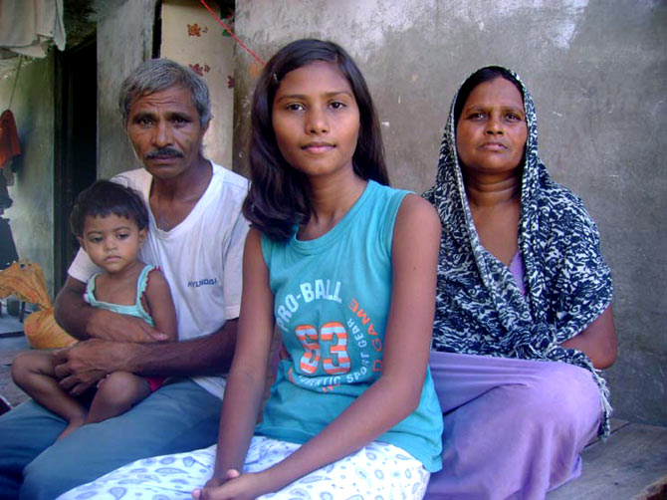
Who is a Low Income Consumer
Modest Earnings
No Savings
Financially Excluded
Fatalist Thinking
Short –term Outlook
Adverse health behaviour

Slide 7
Salability
Frequent enough
to be credible
High enough
to be threatening
RISK
Frequency
Severity
Rare enough
to keep loadings
within limits
Low enough to
be absorbed by
small contributions by many
Insurability

Slide 8
The PACE Framework
Product
Coverage
Access
Choice
Experience
Quality
Cost
Affordable
Flexibility
Simplicity
Value Added Services
Information
Proximity
Structure
Benefit
Processes
Facilitation
Courtesy: PACE Framework, Microinsurance Innovation Facility

Slide 9
Profiling Health Risks
Health Risks | Frequency | Severity | Financial Impact
Primary Healthcare (Visits to Family Physician for common ailments like cough, cold, fever, etc. | Medium / High | Low | Low / Medium
Secondary Healthcare Hospitalisation for typhoid, dehydration, etc. | Low | Medium to High | High
Tertiary Healthcare Major ailments and surgeries like cancer, heart attacks, kidney transplant, etc. | Low | High | High

Slide 10
Why Women Centric?
Research has proved that
  Women are more sensitive to the well-being of the family
  They have a better futuristic vision
  More open to new ideas
  More likely to adopt financial planning
  Can take the entire family long.

Slide 11
Health Insurance Product Design for Low Income Segment
Features
Cover frequent risks
Simple wordings
Minimum exclusions
Pricing
Uniform Pricing
Flexible premium payment
Incentives for preventive health actions
Product Development
j
Value Added Services
Discounted services
Preventive health interventions

Slide 12
THANKS

