Slide 1
Digital risks for insurance and FIs in India
5th Seminar on Enterprise Risk Management (ERM)
10th March, 2017 | Mumbai

Slide 2

Marsh - Global Fortune 500 professional services firm
Leader in Risk and Insurance Services
  50% of the world’s top 1,000 banks incl. 6 of Top 10 in Asia
32 banks in India incl.
  Banking Regulator,
  Largest Public & Pvt. Bank
  4 of the top 5 MNC banks
  Largest Public & Pvt. General Insurer
proprietary approach to risk & insurance
100% cases inappropriate levels of cyber insurance by FIs in Asia – Risk financing optimization reviews by our analytics team
86% FIs in Asia choose to purchase cyber insurance
subsequent to analyses

Slide 3


Cyber = internet
Any business that uses;
# computer network
# confidential information

Slide 4
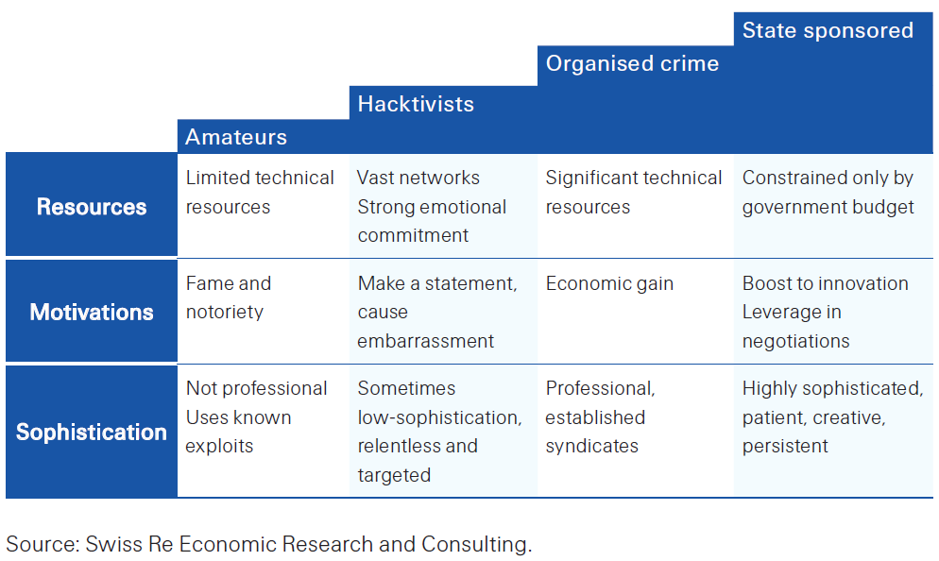
What’s driving change?

Slide 5


Slide 6
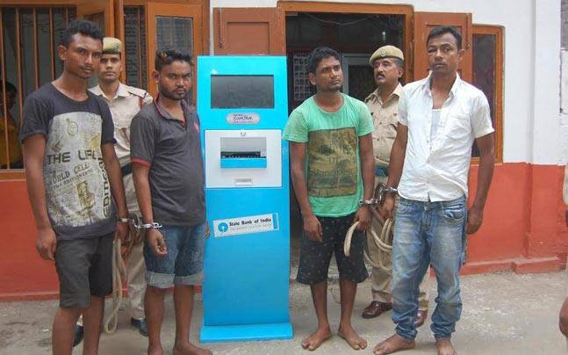
but levels of sophistication still vary!

Slide 7




MORE THAN HALF THE WORLD POPULATION IS NOT SAFE!
DATA RECORDS LOST OR STOLEN SINCE 2013
5 | , | 8 | 8 | 0 | , | 7 | 6 | 7 | , | 0 | 8 | 6
EVERYDAY
EVERY HOUR
EVERY MINUTE
EVERY SECOND
4,075,653
169,527
2,830
47

Slide 8
CYBER CRIMES: 3rd Largest Risk for Organizations in 2016
USD 500 BB
est. cost of cybercrime to global economy - 2016
107% CAGR
Rate at which Cyber-crimes are growing in India, having touched 300,000 in 2015
#1 cause - hackers
32% - insider involvement
$ 674,000 – avg. insured loss
30% - lower than uninsured entity
Allianz risk barometer report 2016

Slide 9
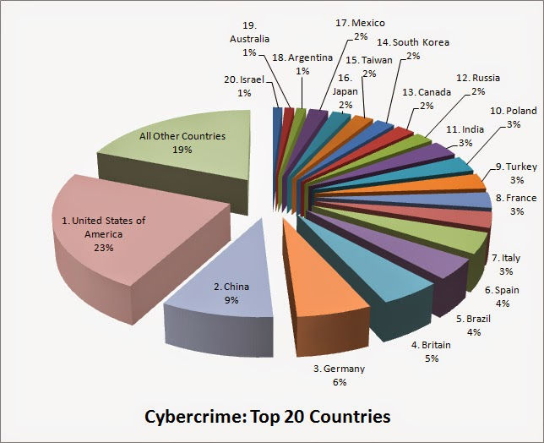
CYBER BY NUMBERS - INDIA
$5
Billion
Global share in cost of cyber crime
2nd
Source of malicious codes
3rd
Target for phishing frauds
3rd
Target for ransomware attacks

Slide 10
CYBER ATTACK
UNDERSTANDING THE ORGANIZATIONAL IMPACT
5,544
Per capita cost for Financial Institutions
5.6%
Customer churn rate post breach for FIs

Slide 11
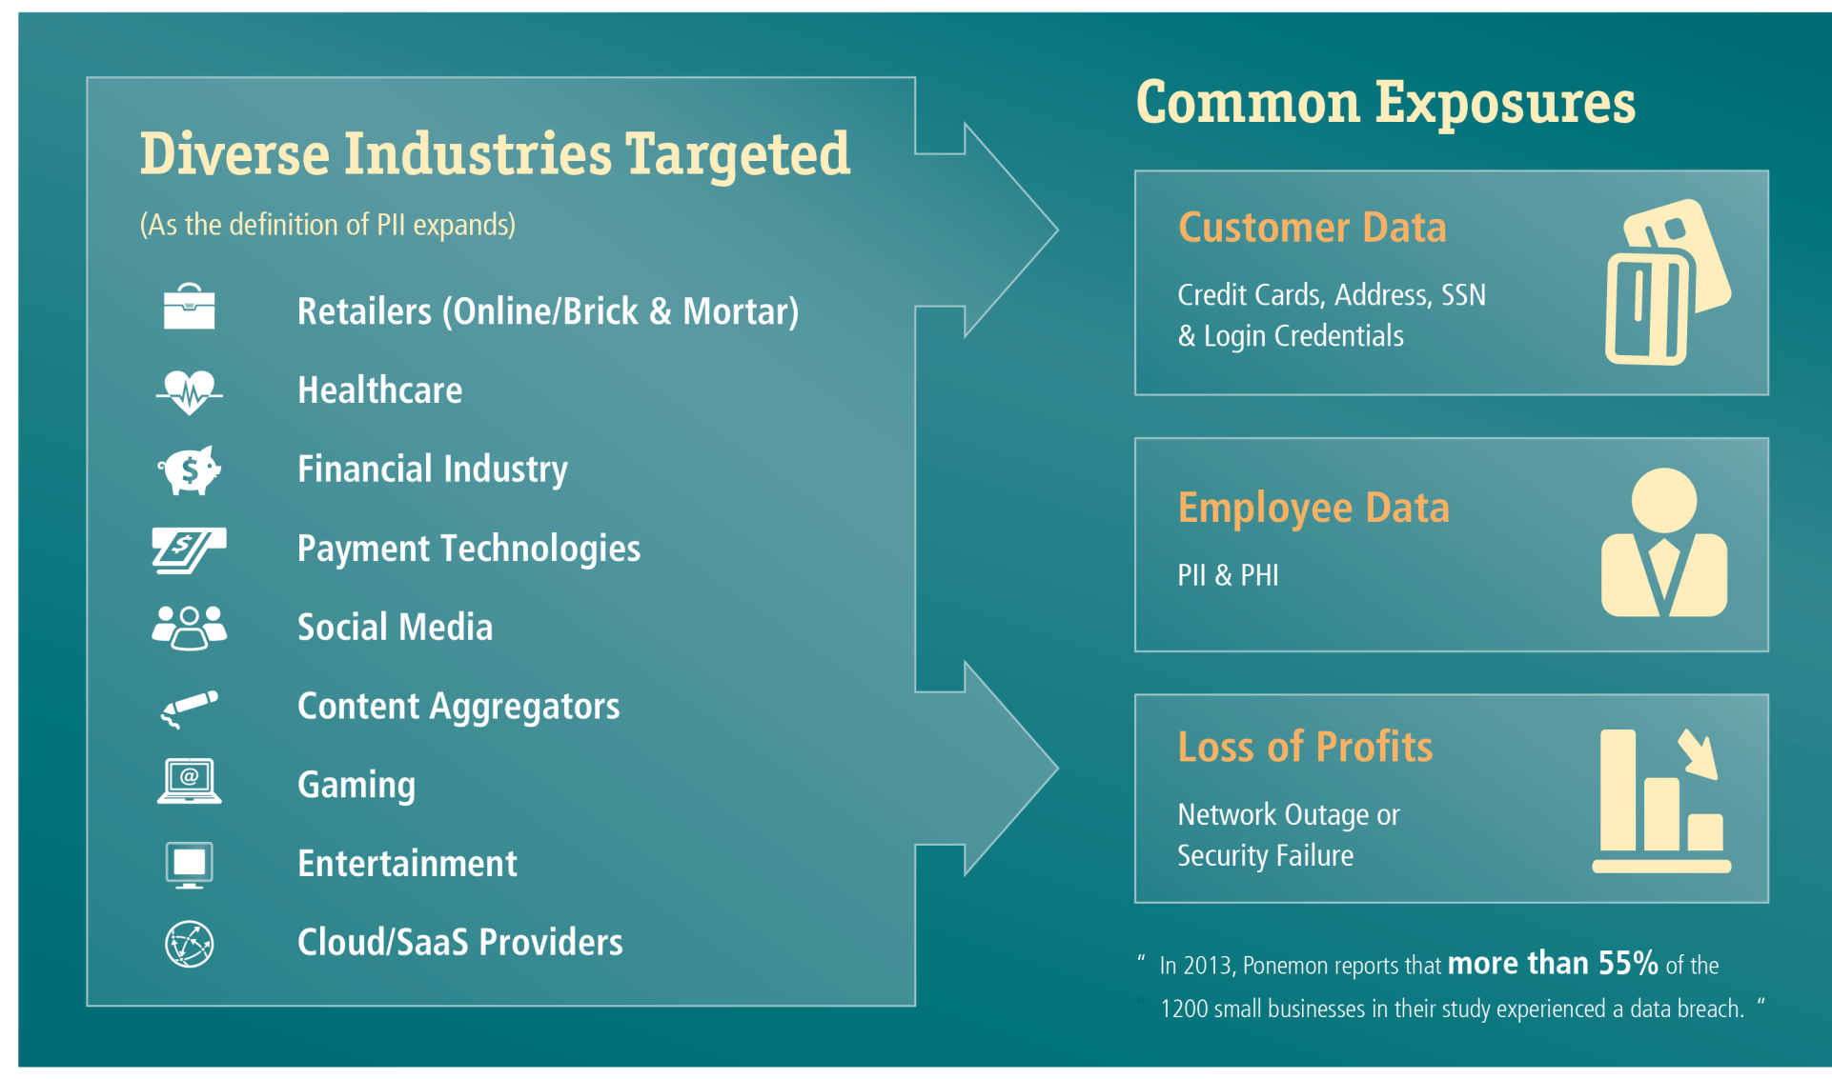
CYBER EXPOSURES – WHAT’S @ RISK?

Slide 12



CYBER EXPOSUREs – SOME COMMON MISCONCEPTIONS
We use a third party data/payment processor, so we have transferred the exposure”
  A data breach can occur while customers data is in transit
  You are still responsible under law, no matter where it happens
  Even if it’s processors’ fault, they have limited liability
We don’t store any credit cards or PII on our network
Hackers can intercept data real time, “skimming” credit card, data, password and other sensitive information
We have upgraded our security, transferring our data to a cloud provider
Major providers may have higher security, but nothing is foolproof
It may not be true for smaller outsource partners like TPAs
Aggregation of data is an attractive target for hi-tech criminals

Slide 13
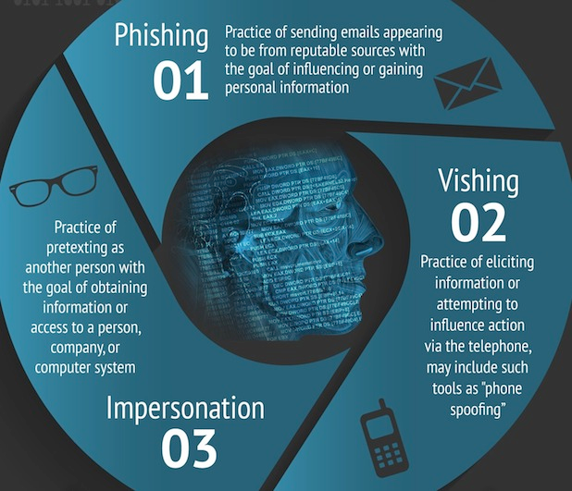
Social
Engineering

Slide 14
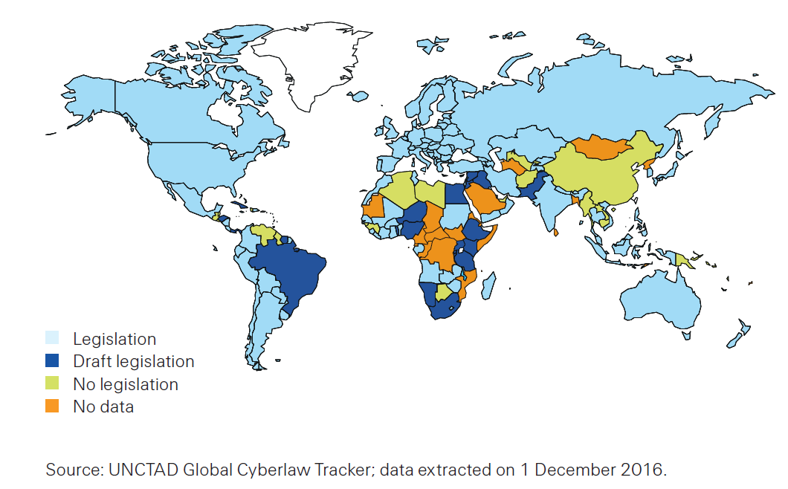
REGULATORY CHANGES DRIVING RISK

Slide 15




US Securities Exchange Commission on Security Breaches
Disclosure in the likely event of a breach
Laws like HIPPA for date protection/ privacy
Penalties for a breach upto USD 1.5 million
New EU General Data Protection Regulation (GDPR)
Fines of EUR 20 M or 4% of global annual turnover
Extra-territorial scope
Notification to authorities within 72 hrs
Notifications to data subjects immediately
Data Privacy Rules for Indian Companies – IT Act 2000
Unauthorized access to a computer, computer system, or computer network - compensation of up to INR 10 million.
Punishment for disclosure of information in breach of a lawful contract – 3 year imprisonment and/or a fine of INR 500,000.
Clear data protection guidelines per circular – June 2016
Separate Cyber security policy, to be submitted by Sept.
Directs banks to have Cyber Incidence Response Plan, Crisis Management Plan, Reputation Management plan, and Forensic Analysis plan in place

Slide 16




LIVING WITH CYBER RISKS
Cyber Risk is a permanent entry on the enterprise risk register
Cyber risk can be managed, but cannot be eliminated.
Firms usually apply classical risk management & actuarial approach.
Cyber is technical in nature, but should be managed economically.
Managing cyber risk engages the entire enterprise, not just IT.
Risk Management Options
Avoidance Mitigation Transfer Acceptance

Slide 17

  You probably already have…
  Firewalls, anti virus
  WAF, IPS, DAM, DLP, DRM
  Every other 3 letter acronym
  3rd party audits / ethical hacking
  Information security policies
  Compliance programs
  User awareness trainings
  Management reporting
WHY SHOULD
EVERY INDIAN BANK
BE WORRIED?

Slide 18
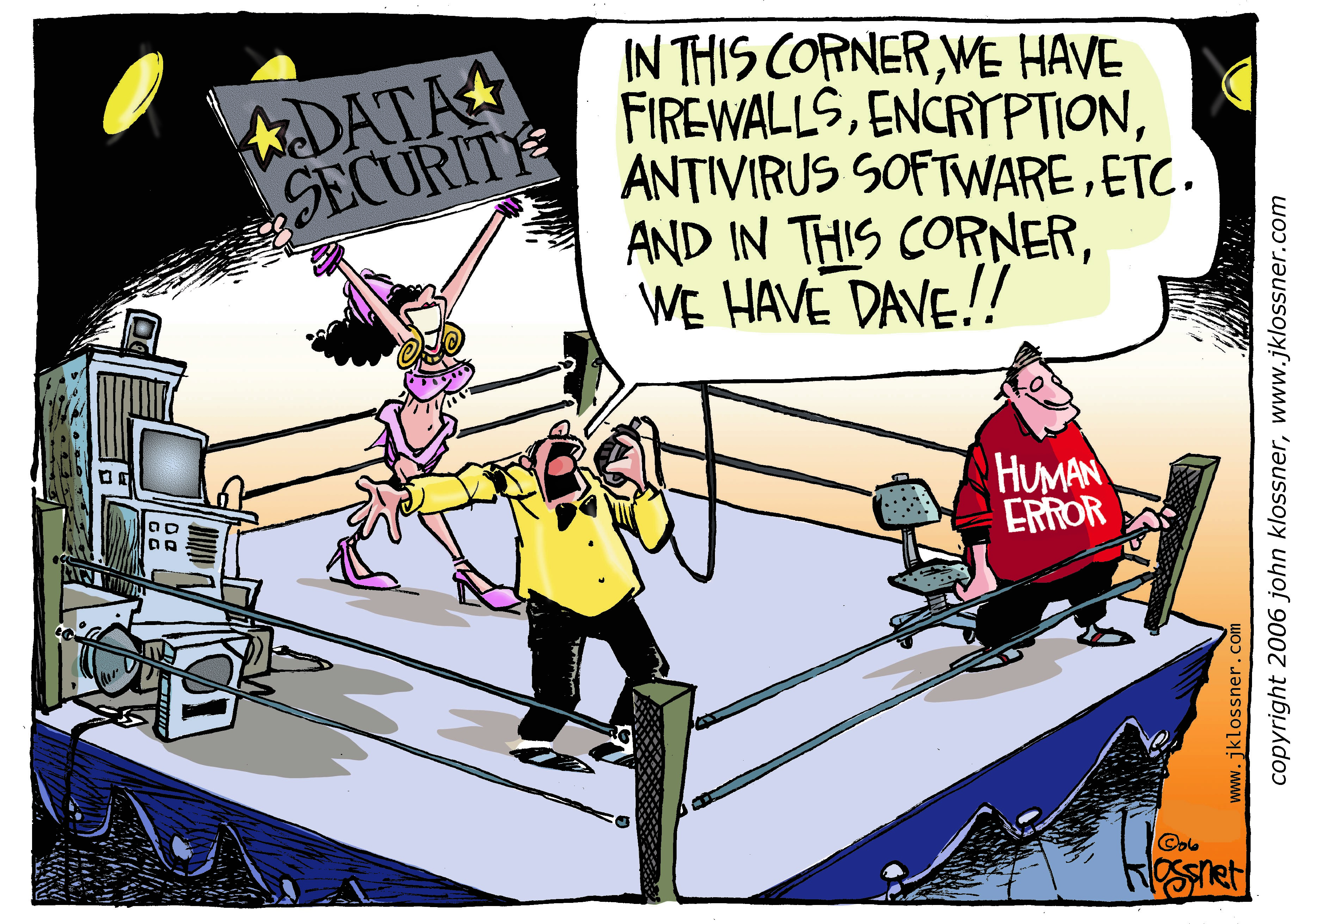

Slide 19

In short, the cyber threat cannot be eliminated; rather, cyber risk must be managed.
Director of National Intelligence James R. Clapper
Worldwide Cyber Threats Testimony, Sep. 10, 2015

Slide 20

MITIGATION THROUGH INSURANCE SOLUTIONS

Slide 21

MAJOR CYBER CLAIMS – FINANCIAL INSTITUTIONS
Identity Theft
$100
Million
Theft of PII viz. personal information, accounting information, confidential business information etc.
Large US Bank
Money Theft
Fraudulent withdrawal of money by accessing credentials
mobile apps
Phishing frauds
$80
Million
Bangladesh Bank
Cyber Extortion
INR5
Crores
Ransomware
Criminal in possession of critical PII
Large Indian Conglomerate

Slide 22
MAJOR CYBER CLAIMS – FINANCIAL INSTITUTIONS
System
Failure
$100
Million
Interruption in business due to network downtime caused by DDoS
Large UK Bank
Data Breach
$$$
Million
Breach of PII including Social Security Nos. of 78mn people
Anthem Health Insurer
Card Frauds
Multi
Crores
Skimming
Counterfeiting
Compromise at outsourcer end
Multiple Indian Banks

Slide 23
CYBER POLICY COVERS IN DETAIL
Cover for Personally identifiable information
Cover for Corporate confidential information
Cover for Outsourcer
Multimedia liability
Network liability, etc.
1
Privacy and data liability
Fund transfer frauds
E-theft loss
E-communication loss
Cyber extortion
2
Cyber-theft
3
Cover for loss of profit
Cover for increased expenses
Business Interruption
Forensic analysis expenses
IT audit expenses
Crisis management expenses
Credit monitoring expenses
PR expenses
4
First Party expenses
A FULL FLEDGED CYBER POLICY HAS ABOUT 30+ COVERS; INDICATIVE COVERS MENTIONED ABOVE

Slide 24
Note: All insurance coverage is subject to the terms, conditions, and exclusions of the applicable individual policies. Marsh cannot provide any assurance that insurance can be obtained for any particular client or for any particular risk.
GAPS IN TRADITIONAL POLICIES
 | Not covered |  | Covered | See notes | Dependent upon specifics of claims, may not be covered
Privacy & Cyber Perils | Property | General Liability | Traditional Fidelity Bond | Computer Crime | E&O | Special Risk | Broad Privacy & Cyber Policy
Destruction, corruption or theft of your electronic information assets/data due to failure of computer or network |  |  |  |  |  |  | Information asset protection
Theft of your computer systems resources |  |  |  |  |  |  | Information asset protection
Business Interruption due to a material interruption in an element of your computer system due to failure of computer or network security (including extra expense and forensic expenses) |  |  |  |  |  |  | Network Business Interruption
Business interruption due to your service provider suffering an outage as a result of a failure of its computer or network security |  |  |  |  |  |  | Network Business Interruption (sublimitted or expanded based upon risk profile)
Indemnification of your notification costs, including credit monitoring services |  |  |  |  |  |  | Privacy Liability (sub-limited)
Defense of regulatory action due to a breach of privacy regulation |  |  |  |  |  |  | Privacy Liability (sub-limited)
Coverage for Fines and Penalties due to a breach of privacy regulation |  |  |  |  |  |  | Privacy Liability
Threats or extortion relating to release of confidential information or breach of computer security |  |  |  |  |  |  | Cyber Extortion
Liability resulting from disclosure of electronic information & electronic information assets |  |  |  |  |  |  | Network Operations Security
Liability from disclosure confidential commercial &/or personal information (i.e. breach of privacy) |  |  |  |  |  |  | Privacy Liability
Liability for economic harmed suffered by others from a failure of your computer or network security (including written policies & procedures designed to prevent such occurrences) |  |  |  |  |  |  | Network Operations Security

Slide 25
UNDERWRTING FACTORS
Industry – FIs are the largest buyers of Cyber insurance
Size of Company
Type and volume of Data
Risk Management
  People : proper security budget and vigilance
  Process : ISO, HIPAA/HITECH ready, breach response plan
  Technology : firewalls, intrusion detection software, encryption of PII
Cyber Security policies
Past claims

Slide 26
CURRENT HOT BUTTONS FOR INSURERS
Data/Confidential Info – Types/How much?/location
Encryption (Safe harbor) – At rest, in motion, backup, mobile devices
POS Systems & Software – Patches/updates/controls
Use of cloud vendors – who and what services (payroll, payments, services, etc.)
Vendor Controls – Due Diligence/ Contracts/Data shared/Access control
Network Access – How and who accesses your network remotely?
Subsidiary acquisitions – Due diligence, conversion process
Compensating controls – What else are you doing?

Slide 27
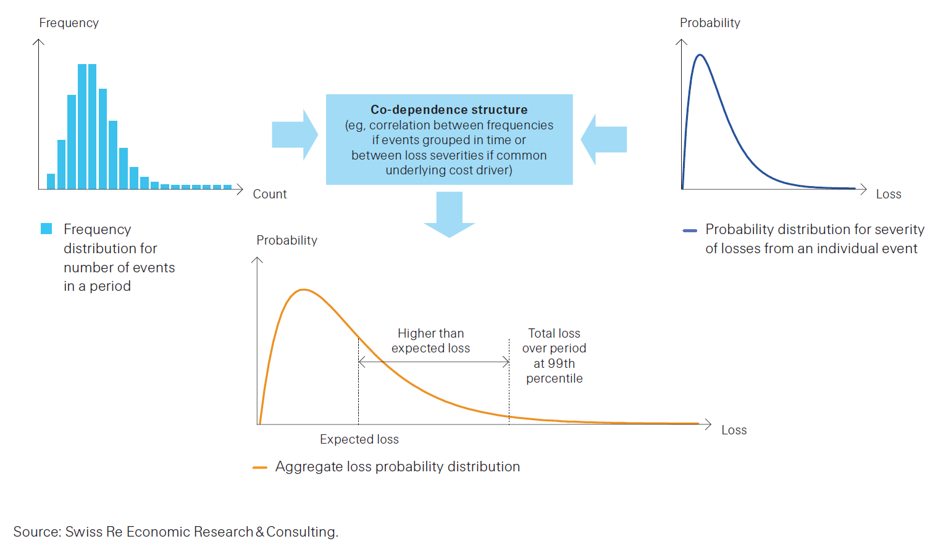
Traditional actuarial approach to risk quantification

Slide 28
New tools to Assess & Analyze
A client’s risk is considered to be comprised of 3 parts: threat, vulnerability, and impact.
Impact
Cyber Risk
Vulnerability
Threat
[Cyence]
[Self-Assessment]
[IDEAL]
Marsh has analytical tools to help clients assess and understand their risk. Consider that the client’s risk is comprised of three parts:
What is the threat environment facing my firm?
How significant are the vulnerabilities in my controls?
How much financial exposure do I face?

Slide 29
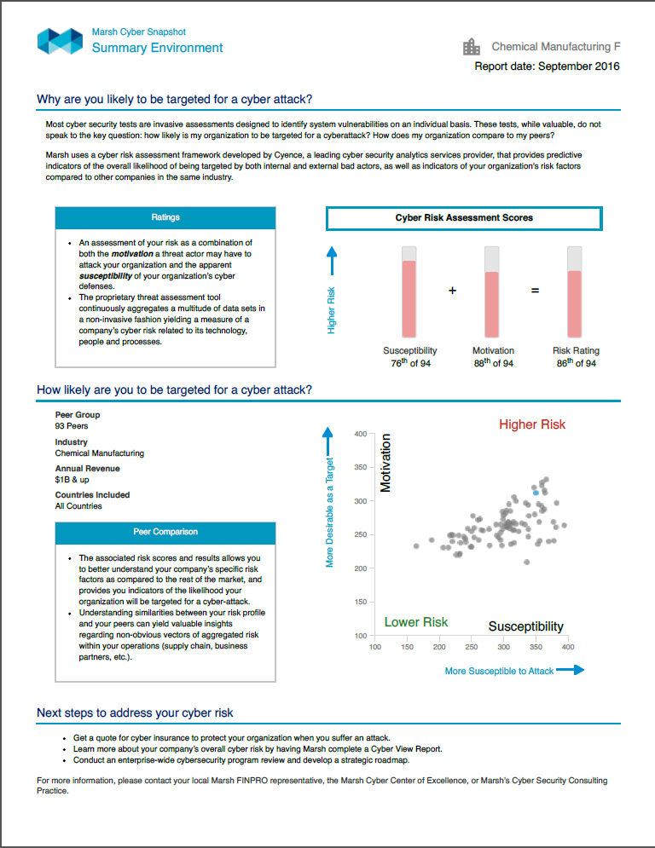
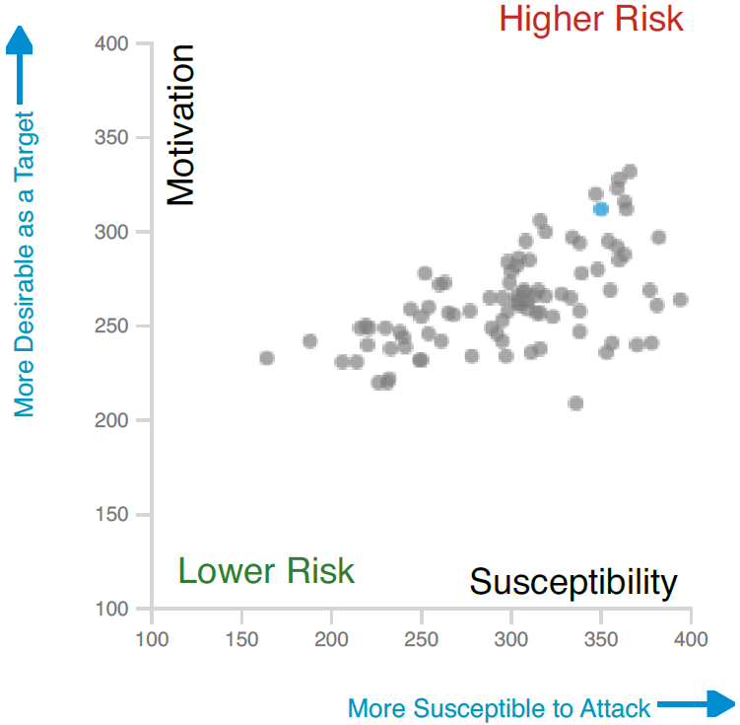
Cyber Threat Analytics
Quantified Threat Analysis
Impact
Cyber Risk
Vulnerability
Threat

Slide 30
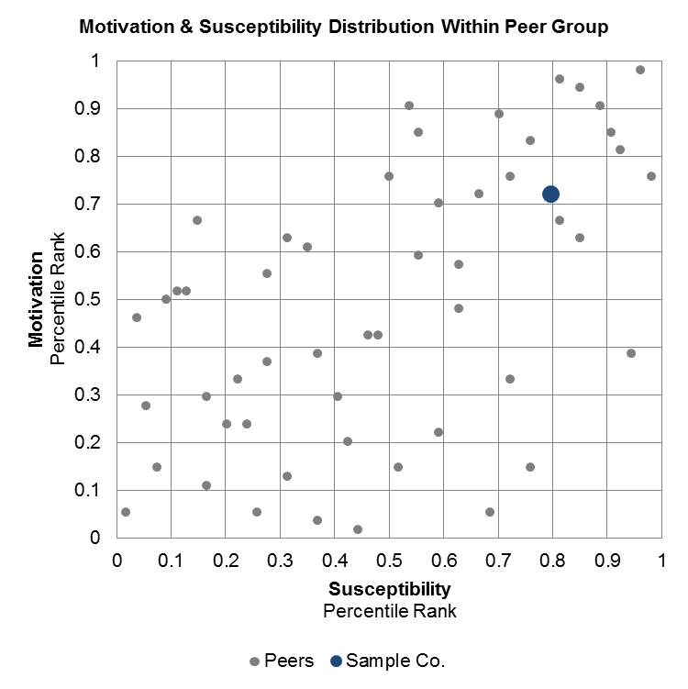
Cyber Threat Analytics
Quantified Threat Analysis
Impact
Cyber Risk
Vulnerability
Threat

Slide 31


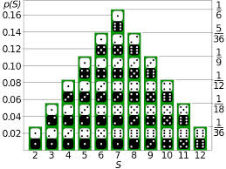
MARSH CYBER IDEAL:
MONTE CARLO SIMULATION FOR DATA LIABILITY COSTS
Impact
Cyber Risk
Vulnerability
Threat
The model performs breach analysis using Monte Carlo Simulation software.
It mathematically and objectively computes and tracks many different possible future breach scenarios, then tells the probabilities and costs associated with each different one.
Monte Carlo Simulation
Random Sampling
The name comes from the resemblance of the technique to the act of playing and recording your results in a real gambling casino.
Simulated 10,000 Trials
of the Rolling of 2 Dice

Slide 32
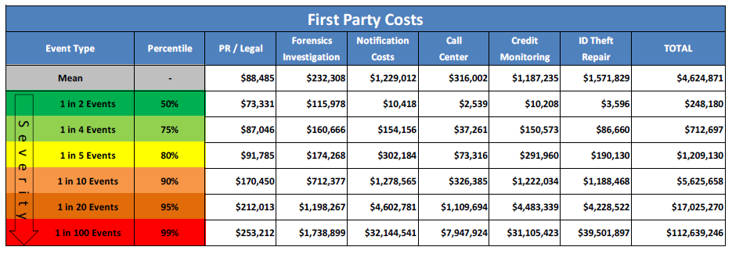
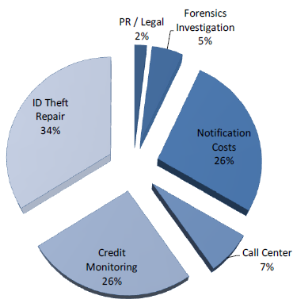
CYBER IDEAL:
FIRST PARTY COSTS
Impact
Cyber Risk
Vulnerability
Threat
Note: Costs do not include Business Interruption and/or costs to recreate the data.

Slide 33
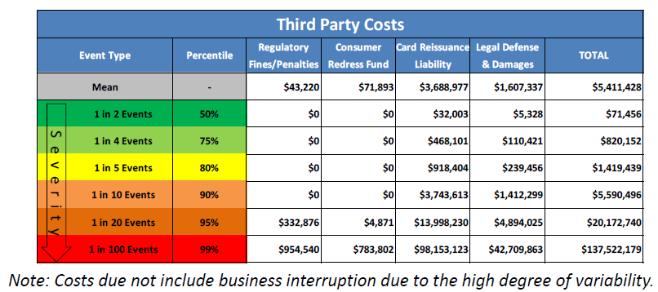
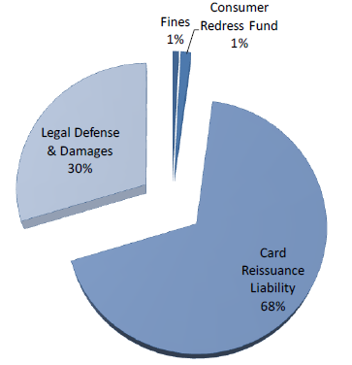
CYBER IDEAL:
THIRD PARTY COSTS
Impact
Cyber Risk
Vulnerability
Threat
Note: Card Reissuance Liability will only be displayed with PCI and PHI as the Record Type

Slide 34
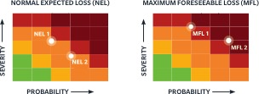
MARSH CYBER BUSINESS INTERRUPTION QUANTIFICATION (CBIQ)
Impact
Cyber Risk
Vulnerability
Threat
Marsh’s Cyber Business Interruption Quantification (CBIQ) service provides you with a detailed financial loss quantification based on key cyber threats your organization faces. CBIQ delivers:
Tailored scenarios to support insurance program design.
Justification for remediation and mitigation strategies/efforts.
Incident response and risk management decision support data.
Who It’s For:
Organizations that want to understand their cyber risk weaknesses and the impact a breach or failure could
have on operations.
What You Get:
The amount of insurance required given your cyber risks.
A prioritized listing of risk retention and transfer options.
An inventory of business interruption costs
based on scenarios.
An evaluation of the effectiveness of incident
response capabilities.
A listing of recovery requirements and a roadmap to restore pre-incident operational status.
Why Marsh?
Only Marsh provides clients with award-winning and industry-leading expertise expertise in: technical cybersecurity, forensic accounting, and economic modeling and analytics.
CBIQ THREE-STEP PROCESS
1
EXAMINE AND DISCOVER
critical organizational elements.
2
IDENTIFY AND DOCUMENT key cyber event scenarios for in-depth analysis.
3
ANALYZE AND REPORT cyber
event scenarios that are both
quantitative and qualitative.
NORMAL EXPECTED AND
ANTICIPATED MAXIMUM LOSS
Each cyber event scenario identifies a Normal Expected Loss (NEL) and Maximum Foreseeable Loss (MFL). This data is presented within heat maps and can be used to support informed decision making regarding cybersecurity risk retention, transfer, mitigation, and management.

Slide 35
Cyber risks growing exponentially
Cannot be eliminated. Have to be managed economically.
Value chains becoming complex
Outsourcing work & risk is not a perfect solution.
What it means?
Risk quantification difficult
People are the weak link. Actuarial tools not perfect.
Cyber Insurance
Healthy uptake with FIs in India, but no standard solution.
Notes:
© Copyright Showeet.com

Slide 36

Marsh is one of the Marsh & McLennan Companies, together with Guy Carpenter, Mercer and Oliver Wyman. This document is not intended to be taken as advice regarding any individual situation and should not be relied upon as such. The information contained herein is based on sources we believe reliable, but we make no representation or warranty as to its accuracy. Marsh shall have no obligation to update this publication and shall have no liability to you or any other party arising out of this publication or any matter contained herein. Any statements concerning actuarial, tax, accounting or legal matters are based solely on our experience as insurance brokers and risk consultants and are not to be relied upon as actuarial, tax, accounting or legal advice, for which you should consult your own professional advisors. Any modeling, analytics, or projections are subject to inherent uncertainty, and the Marsh Analysis could be materially affected if any underlying assumptions, conditions, information, or factors are inaccurate or incomplete or should change. Marsh makes no representation or warranty concerning the application of policy wording or the financial condition or solvency of insurers or re-insurers. Marsh makes no assurances regarding the availability, cost, or terms of insurance coverage. Although Marsh may provide advice and recommendations, all decisions regarding the amount, type or terms of coverage are the sole responsibility of the insurance purchaser, who must decide on the specific coverage that is appropriate to its particular circumstances and financial position.
Marsh India Insurance Brokers Pvt. Ltd. having corporate and the registered office at 1201-02, Tower 2, One Indiabulls Centre, Jupiter Mills Compound, Senapati Bapat Marg, Elphinstone Road (W), Mumbai 400 013 is registered as composite broker with Insurance and Regulatory Development Authority of India (IRDAI). It’s license no. is 120 and is valid from 03/03/20125 to 02/03/2018. CIN U66010MH2002PTC138276
Copyright © 2015 Marsh India.

