Slide 1

Antimicrobial Resistance:
“Bad Bugs, Few Drugs”
Dr Sheetal Salgaonkar MD
March 10,2017

Slide 2
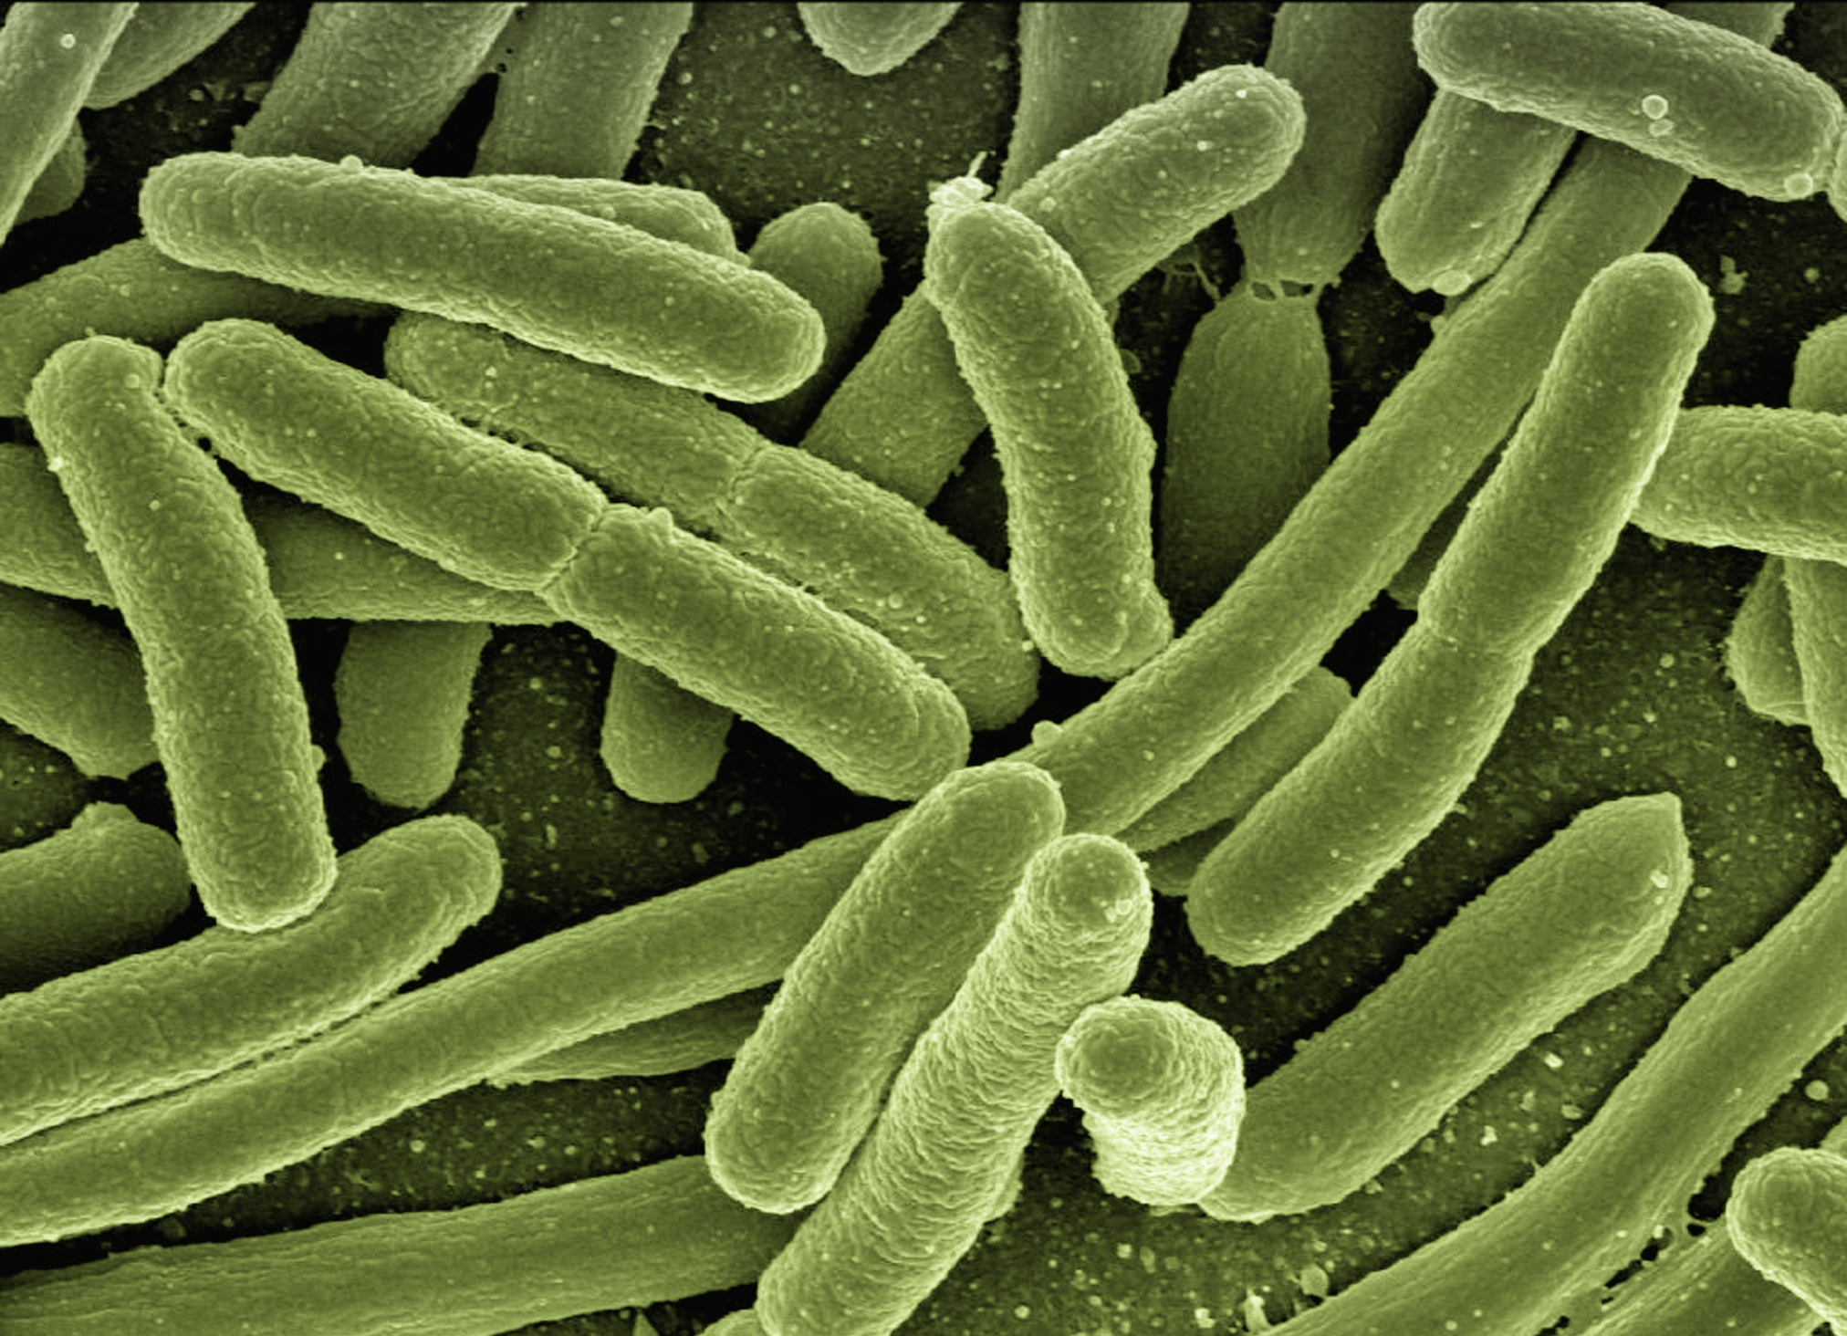
Agenda
Antimicrobial resistance
Causative factors
Global Threat
Drug Resistant TB
The Way Forward

Slide 3
Terminology
Antimicrobials
Antivirals
Antifungals
Antibacterials
Antiparasitic
Antibiotics

Slide 4
Gram Staining
Gram Positive
Gram Negative
Thick peptidoglycan wall
No outer membrane
Easier to kill
Develops resistance slowly
Thin Peptidoglycan wall
Has an outer membrane
Difficult to kill
Develops resistance quickly

Slide 5
The Story So Far……

Slide 6

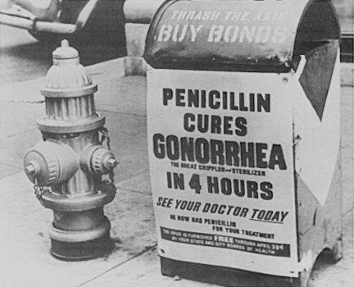
A Medical Miracle……..
Gonorrhea treatment advertisement from 1944, when penicillin became widely available due to mass production. National Institutes of Health

Slide 7
As Good as it Gets!
Infectious Disease mortality in the United States
1900: 797 deaths per 100,000
1980: 36 deaths per 100,000
Mortality decrease of 8.2% per year between 1938-1952
Armstrong, G. L. et al. JAMA 1999;281(1): 61–66.
Notes:
Armstrong, G. et al. Trends in infectious disease mortality in the United States during the 20th century. JAMA 1999;281(1): 61–66.

Slide 8
The WARNING …………….
“The greatest possibility of evil in self-medication is the use of too small doses so that instead of clearing up infection, the microbes are educated to resist penicillin and a host of penicillin-fast organisms is bred out which can be passed to other individuals and from them to others until they reach someone who gets a septicemia or a pneumonia which penicillin cannot save”
---- Alexander Fleming
The New York Times 1945

Slide 9
The Result – Antimicrobial Resistance
Not just for penicillin but for each new antibiotic subsequently developed!!
Resistance to previously sensitive antimicrobial
Usually irreversible
Drug resistant
  Single
  Multiple

Slide 10
Resistance develops rapidly
Inevitable, continuous and slow
Inherent [Natural]
Acquired - mutation in the existing DNA
v
v
v
Antibiotic
Susceptible Resistant

Slide 11
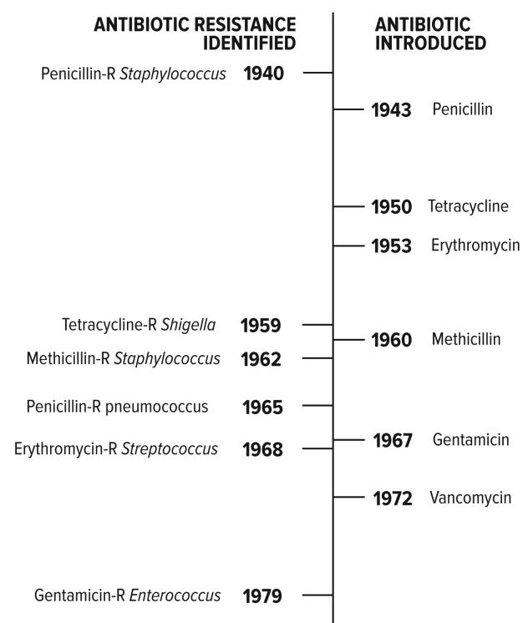
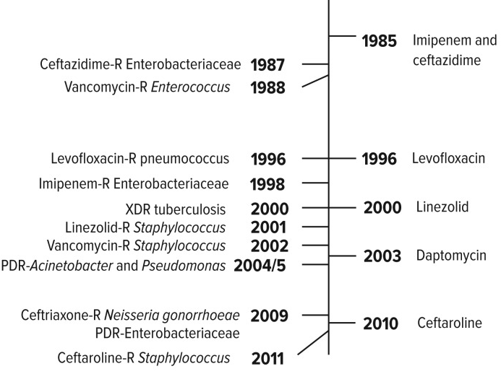
Events in Time
Centers for Disease Control and Prevention, Office of Infectious Disease Antibiotic resistance threats in the United States, 2013. Apr, 2013. Available at: http://www.cdc.gov/drugresistance/threat-report-2013

Slide 12
Causes of AMR

Slide 13
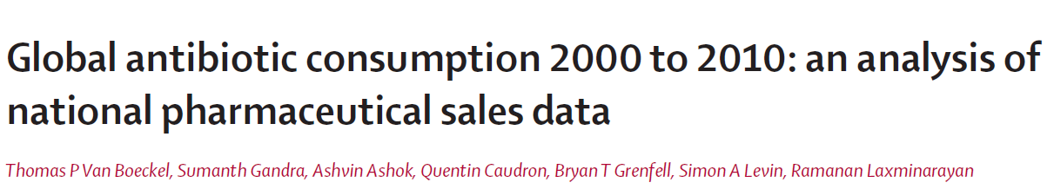
Antibiotic consumption is major driver
Global consumption increased by 36%
Brazil, Russia, India, China, and South Africa [BRICS] accounted for 76%
Last resort antibiotics – carbepenems and polymixin
Van Boeckel, T.P. et al. Lancet Infect Dis 2014;4:742–50.
Notes:
Van Boeckel, T.P. et al. Global antibiotic consumption 2000 to 2010: an analysis of national pharmaceutical sales data Lancet Infect Dis 2014.14:742–50.

Slide 14
Inappropriate Antibiotic Use
Human + Animal Use
No health benefit
Suboptimal use
  low dose, short duration, low potency
Self medication
Non compliance to treatment
Possible Reasons
Desire to meet customer needs.
Lack of appropriate knowledge
Lack of microbiology facilities
Incentives for pharmacists
Public’s lack of antibiotic use

Slide 15
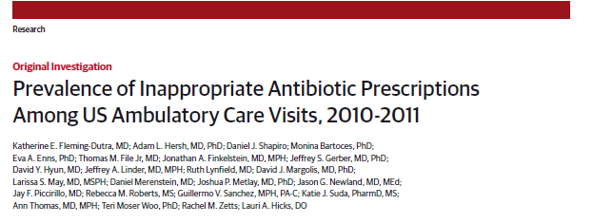
Inappropriate Antibiotic Prescriptions
356 out of 506/1000 appropriate
30% of outpatient, oral antibiotic prescriptions inappropriate
44% acute respiratory conditions
No Antibiotics Needed
Viral URTI
NS middle ear infections
Influenza
Viral pneumonia
Fleming-Dutra, K et al. JAMA. 2016.315(17):1864-1873.
Notes:
Fleming-Dutra, K et al. Prevalence of Inappropriate Antibiotic Prescriptions Among US Ambulatory Care Visits, 2010-2011 JAMA. 2016.315(17):1864-1873.

Slide 16
How many of you have taken an antibiotic without a prescription?

Slide 17
Frequency of non-prescription use of antimicrobials in the general population
Country* | Frequency (%)
Bangladesh | 86
Brazil | 46
China | 36
Eastern Europe | 30
Honduras | 26
Indonesia | 17
India | 18
Jordan | 40
Mexico | 18
Nigeria | 100
Northern Europe | 3
Sudan | 100
Half of rural and urban pharmacists dispensed antibiotics without a doctor’s prescription to people who presented with clinical symptoms to pharmacies**.
*Morgan DJ, et al. The Lancet infectious diseases. 2011;11(9):692-701.
**Rathnakar UP et al. Journal of Clinical and Diagnostic research 2012; August ,6:951-954.
Notes:
Morgan DJ, et al. Non-prescription antimicrobial use worldwide: a systematic review. The Lancet infectious diseases. 2011;11(9):692-701. doi:10.1016/S1473-3099(11)70054-8.
Rathnakar UP et al. Journal of Clinical and Diagnostic research 2012; August ,6:951-954
Ratnakar – amoxicillin was the major drug sold OTC

Slide 18
Drying Antibiotic Pipeline
Time Period | New Antibiotics
1983 -1987 | 16
1988-1992 | 14
1993-1997 | 10
1998-2002 | 7
2003 -2007 | 5
2008 -2012 | 2
Boucher, H.W. et al. Clin Infect Dis 2013 Jun;56(12):1685-94
Notes:
Boucher, H.W. et al. 10 x '20 Progress--development of new drugs active against gram-negative bacilli: an update from the Infectious Diseases Society of America Clin Infect Dis 2013 Jun;56(12):1685-94. doi: 10.1093/cid/cit152. Epub 2013 Apr 17.
Clin Infect Dis. 2013 Jun;56(12):1685-94. doi: 10.1093/cid/cit152. Epub 2013 Apr 17.
10 x '20 Progress--development of new drugs active against gram-negative bacilli: an update from the Infectious Diseases Society of America.
Boucher HW ^{et} al
Producing new antibiotics in the 21st century has been a daunting task. In the very successful era of the mid-20th century, antibiotic discovery typically consisted of screening cultures of soil-derived organisms such as streptomyces for activity against other microorganisms. This approach produced a plethora of “hits” between 1940 and 1960, from which multiple new antibiotics with expanded activity and potency were developed. However, by the 1970s, this golden era of antibiotic discovery started to fade, with the repeated identification of the same compounds. By the 1990s, with antibiotic resistance increasing, several antibiotic-discovery programs were launched that used genomics, high-tech chemical approaches, and high-throughput screening, but these proved expensive and inefficient. For example, the high-throughput screening approach of GlaxoSmithKline required 14 runs to discover one lead, at a cost of $1 million per campaign,3 and not one compound advanced to the final stage of clinical development; this has also been the experience of other pharmaceutical companies. As a result, and because of the poor economic return on investment of antibiotics,2 many companies halted their antibiotic research and development programs to focus on more economically favorable areas.

Slide 19
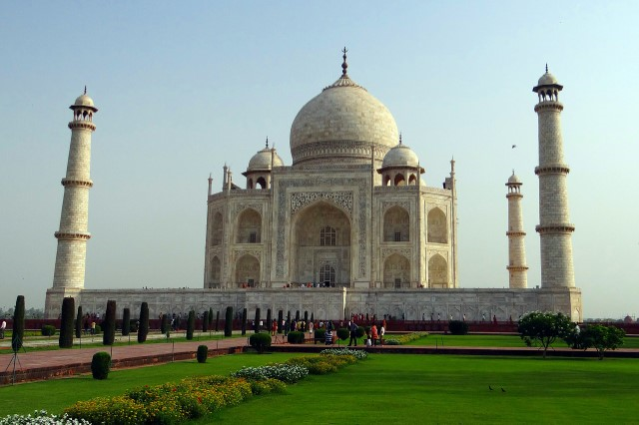
India in a storm………
High background infectious rates
Largest antibiotic consumer
Inappropriate antibiotic use
Over the counter medications
Weak surveillance and regulatory system
70% of health care is dispensed through private sector

Slide 20
The Advent of SuperBugs

Slide 21
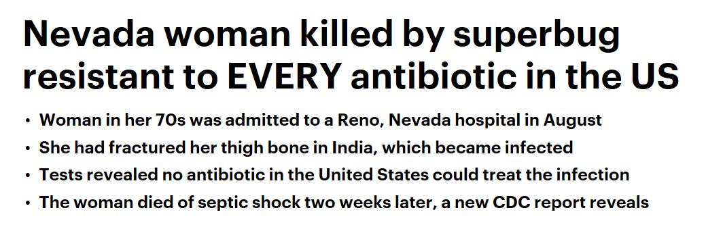
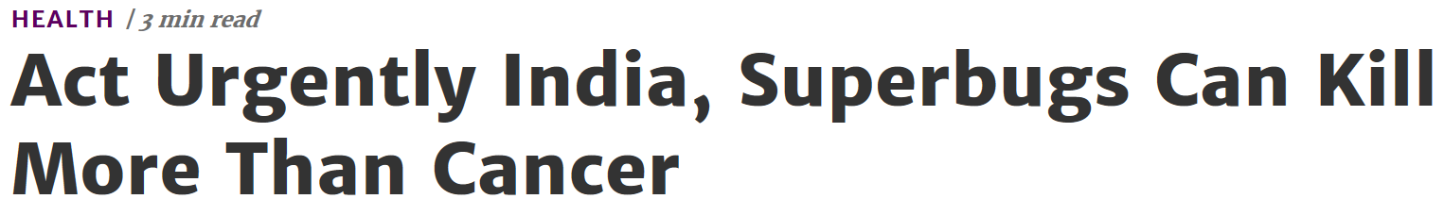
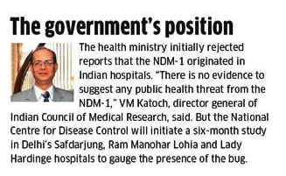

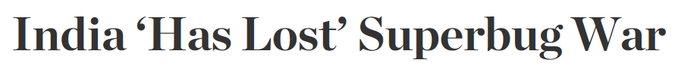
New Delhi Metallo Beta Lactamase 1 – NDM -1
Carbapenem-resistant Enterobacteriaceae (CRE)
Plasmid resistance gene transfer
Resistant to 26 antibiotics
Pan resistant

Slide 22
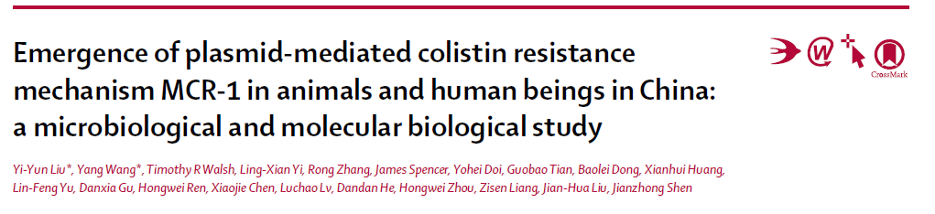
“Super Bugs – The Nightmare Bacteria ”
Nonspecific term
  Refers to microorganisms resistant to multiple drugs
  E.g.Colistin last line of defence against drug resistant Gm negative
  First plasmid bearing Colistin resistance gene – mcr -1
  Easily passed to other bacteria such as :
    Ecoli,
    Pseudomonas
    Klebsiella
The New Threat (2016)
Liu, Y.Y. et al. The Lancet Infectious Diseases. 2016;16(2):161-168

Slide 23
Global Priority Pathogen List
Priority: Critical
1. Acinetobacter baumannii, carbapenem-resistance
2. Pseudomonas aeruginosa, carbapenem-resistant
3. Enterobacteriaceae, carbapenem-resistant, ESBL-producing
Priority: High
4. Enterococcus faecium, vancomycin-resistant
5. Staphylococcus aureas, methicillin-resistant, vancomycin-intermediate, and resistant
6. Helicobacter pylori, clarithromycin-resistant
7. Campylobacter spp, fluoroquinolone-resistant
8. Salmonellae, fluoroquinolone-resistant
9. Neisseria gonorrhoeae, cephalosporin-resistant, fluoroquinolone-resistant
Priority: Medium
10. Streptococcus pneumoniae, penicillin-nonsusceptible
11. Haemophilus influenzae, ampicillin-resistant
12. Shigella spp, fluoroquinolone-resistant
WHO Global Priority List of antibiotic Resistant Bacteria

Slide 24
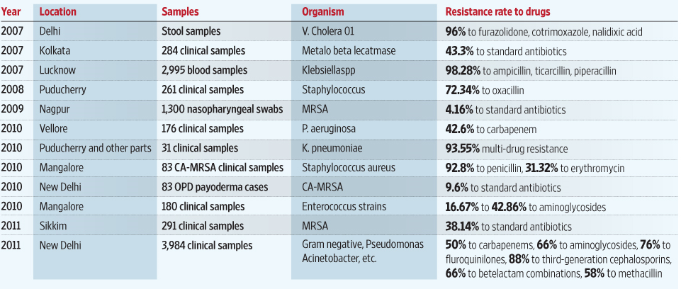
Indian Scenario……..
High Rate of Resistance to most standard antibiotics
Increased resistance seen in wider community
Kumar SG, et al. Journal of Natural Science, Biology, and Medicine. 2013;4(2):286-291. doi:10.4103/0976-9668.116970.
Notes:
Kumar SG, Adithan C, Harish BN, Sujatha S, Roy G, Malini A. Antimicrobial resistance in India: A review. Journal of Natural Science, Biology, and Medicine. 2013;4(2):286-291. doi:10.4103/0976-9668.116970.

Slide 25
Magnitude of the Problem

Slide 26
Global Concerns of AMR
Mortality and Morbidity
Increases health care costs
Jeopardizes health care gains to society
Hampers the control of infectious diseases
Threatens health security, and damage trade and economies
WHO Antimicrobial Resistance 2013

Slide 27
AMR Kills
Organism | Resistant to | Relative Risk of Death
E coli | 3rd gen cephalosporins | 2.02 (1.41-2.90)
Klebsiella pneumoniae | 3rd gen cephalosporins | 1.93 (1.13-3.31)
 | Carbapenems | 1.98 (0.61-6.43)
Staphylcoccus aureus | Methicillin (MRSA) | 1.64 (1.43-1.87)
Antimicrobial Resistance Global Report on Surveillance 2014 WHO

Slide 28
Impact of Inadequate Initial antimicrobial therapy
Mortality ~9% if effective therapy started within 24 hours
Mortality ~11% if effective therapy started within 48 hours
If longer than 5 days to start effective therapy, mortality ~16%
Hyle EP et al . Arch Intern Med. 2005;165(12):1375-1380.
Notes:
Hyle EP et al . Impact of Inadequate Initial Antimicrobial Therapy on Mortality in Infections Due to Extended-Spectrum β-Lactamase–Producing Enterobacteriaceae Variability by Site of Infection Arch Intern Med. 2005;165(12):1375-1380

Slide 29
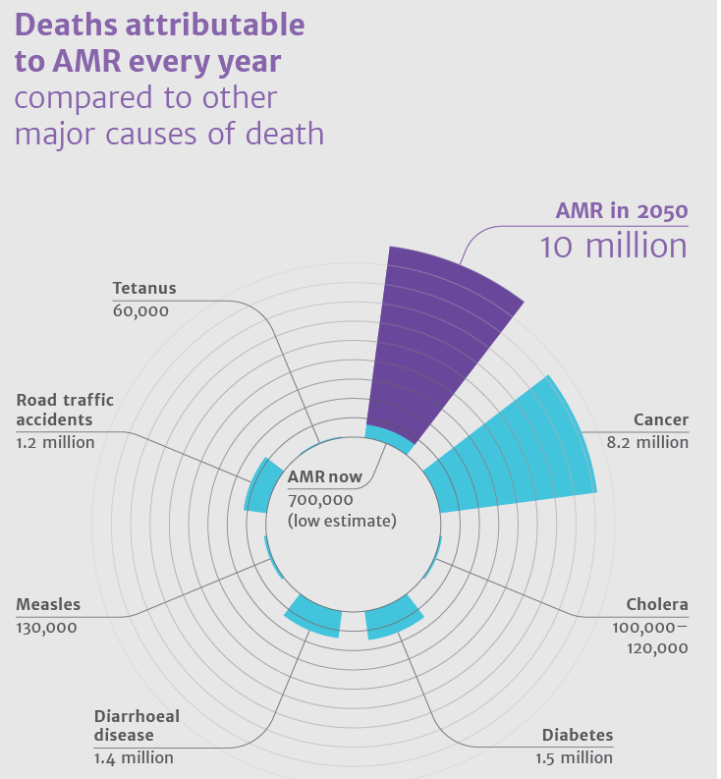
AMR Kills
If no action taken by 2050
One person dying every 3 secs
Loss of global production cost =100 trillion USD
> 30% of those in BRIC
Review on Antimicrobial Resistance. Antimicrobial Resistance: Tackling a Crisis for the Health and Wealth of Nations. 2014.’

Slide 30
Cost of antibiotic resistant infections
Financial costs:
  Medical cost per person ~$18,500 - $29000
Hospital stay duration:
  Increased by ~6 to 13 days
Death rate:
  2 fold higher than without ARIs
The Alliance for the Prudent Use of Antibiotics (APUA)

Slide 31
The Case of Drug Resistant TB

Slide 32
Drug Resistant TB
Cure Rates - 50-60%
Iatrogenic
Types :
  Multidrug Resistant TB [MDR ]
    Resistant to isoniazid + rifampicin
  Extensively drug-resistant tuberculosis [XDR]
    MDR TB + any fluoroquinolones + 1/3 injectable 2nd line drugs
Burden of TB is high in India

Slide 33
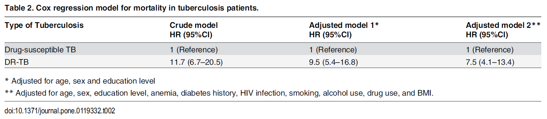
High Mortality in Drug Resistant TB
Chung-Delgado K, et al. PLOS ONE 2015 10(3): e0119332. doi:10.1371/journal.pone.0119332
Notes:
Chung-Delgado K, Guillen-Bravo S, Revilla-Montag A, Bernabe-Ortiz A. Mortality among MDR-TB Cases: Comparison with Drug-Susceptible Tuberculosis and Associated Factors. PLOS ONE 2015; 10(3): e0119332. doi:10.1371/journal.pone.0119332
http://journals.plos.org/plosone/article?id=10.1371/journal.pone.0119332

Slide 34
Cost of MDR TB – Out of Reach
Cost 50 to 200 times more than drug susceptible TB
3 times longer to cure [18- 24months]
More side effects
Drug Price
  Bedaquiline – 2 lakh x 6months
  Delamanid – 18-25 lakh x 6 months
Type of TB | Treatment Cost
Pulm MDR TB | 4 lakh
Pulm XDR TB | 5.3 lakh
Udwadia, Z et al. European Respiratory Journal Sep 2016, 48 (suppl 60) PA1536; DOI: 10.1183/13993003.congress-2016.PA1536
Notes:
Udwadia, Z et al. Jai Mullerpattan. The health economics of treating MDR-TB in the Indian private sector European Respiratory Journal Sep 2016, 48 (suppl 60) PA1536; DOI: 10.1183/13993003.congress-2016.PA1536

Slide 35
The Way Forward

Slide 36
Antimicrobial Stewardship – Global Solution
Appropriate selection ,dosing ,route and duration of antimicrobial therapy
GOALS*
Chennai Declaration**
Primary
  Optimize clinical outcomes
  Minimise unintended consequences of antimicrobial uses
Secondary :
  Reduction of health care costs
  No adverse impact on quality of care
  Updated Cochrane Review :
  1.Reduced duration from 11 to 9.1 days
  2.More hosp patients receive appropriate treatment
  3.Hosp stay decreased 11.8days[12.9days]
  4.No increase in mortality
Over the counter sale of antibiotics to be regulated
Antibiotic usage in hospitals monitored
Develop microbiology laboratory facilities
National antimicrobial resistance surveillance
Ministry of Health published National Antibiotic Guidelines in 2014
CDSCO 2014 : 24 antibiotics [11 Anti TB drugs ] H1 category
Updated Cochrane Review Feb 2017***
1.Reduced duration from 11 to 9.1 days
2.More hosp patients receive appropriate treatment
3.Hosp stay decreased 11.8days[12.9days]
4.No increase in mortality
*IDSA Practice Guidelines 2017
** Chennai Declaration 2015
***Davey P et al.Cochrane Database of Systematic Reviews 2017;2. Art. No. CD003543. DOI: 10.1002/14651858.CD003543.pub4.
Notes:
Davey P, Marwick CA, Scott CL, Charani E, McNeil K, Brown E, Gould IM, Ramsay CR, Michie S. Interventions to improve antibiotic prescribing practices for hospital inpatients. Cochrane Database of Systematic Reviews 2017, Issue 2. Art. No.: CD003543. DOI: 10.1002/14651858.CD003543.pub4

Slide 37
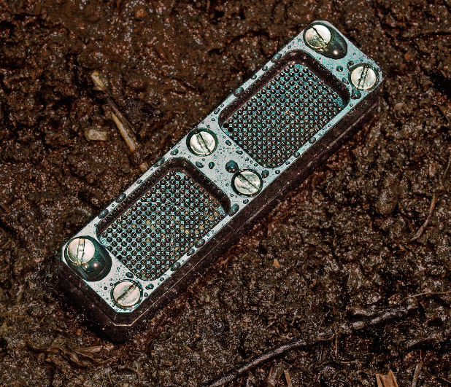
Teixobactin - Digging in the dirt
Unexplored bacterial diversity
Device: Ichip
Bacterium: Eleftheria Terrae
Antibiotic: Teixobactin
Targets Lipids
Effective against
  Gm positive bacteria
  M.tuberculosis
Ling LL, et al. Nature 2015;517:455-459
Notes:
Ling LL, Schneider T, Peoples AJ, et al. A new antibiotic kills pathogens without detectable resistance. Nature 2015;517:455-459

Slide 38
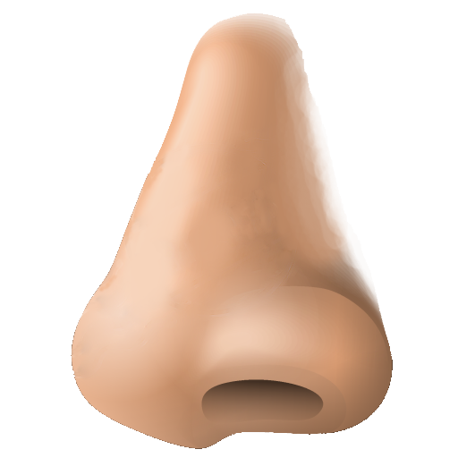
Lugdunin – Right under our nose
Bacterium: Staphylococcus lugdunensis
Antibiotic: Lugdunin
Effective against
  MRSA
Zipperer, A. et al. Nature 2016. doi: 10.1038/nature18634
Notes:
Zipperer A, Konnerth MC, Laux C et al. Human commensals producing a novel antibiotic impair pathogen colonization. Nature 2016. doi: 10.1038/nature18634

Slide 39
The Future…………..
19 alternatives to antibiotics approaches for consideration
Probiotics
Therapeutic
Antibodies
Peptide
Polymers
Alternatives
Vaccines
Bacteria -phages
Lysins
Immuno-modulators

Slide 40
Bacteriophage Therapy
Bacteria specific viruses
Effective against MDR pseudomonas
Binds to cell membrane
Changes efflux
Increased antibiotic sensitivity
Chan, B. K. et al. Sci. Rep. 2016;6:26717 doi: 10.1038/srep26717
Notes:
Chan, B. K. et al. Phage selection restores antibiotic sensitivity in MDR Pseudomonas aeruginosa. Sci. Rep. 6, 26717; doi: 10.1038/srep26717 (2016).

Slide 41
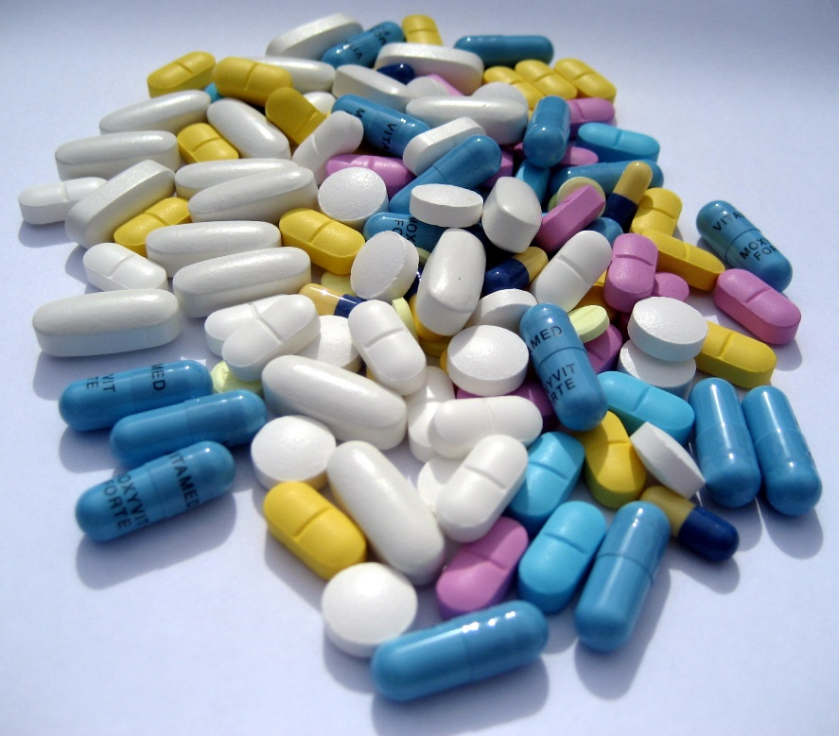
Final Takeaways …….
Next Global Health crisis
Mortality, morbidity and health care costs
Reign of superbugs
Inappropriate use of antibiotics
Few antibiotics in pipeline
Antimicrobial stewardship
Innovative Non antibiotic Approaches

Slide 42
“You can fool all the microbes for sometime,
You can fool some of the microbes all the time,
But you cannot fool all the microbes all the time”
------Dr Rajeev Soman
Editorial “Antibiotic Resistance” Supplement to JAPI, Dec 2010;58:6.

Slide 43
Thank you for your attention
ssalgaonkar@rgare.com

Slide 44
©2017 RGA. All rights reserved.
No part of this publication may be reproduced in any form without the prior permission of RGA.
The information in this publication is for the exclusive, internal use of the recipient and may not be relied upon by any other party other than the recipient and its affiliates, or published, quoted or disseminated to any party other than the recipient without the prior written consent of RGA.

