Slide 1


Current Issues in Retirement Benefits
Date : 11 September 2020
Time: 1700 - 1830
Pensions and Long Term Employee Benefits in a reducing interest rate environment

Slide 2








Housekeeping Points
Mute
Q&A
IAI support
C
P
D
Recording
Feedback
www.actuariesindia.org
www.actuariesindia.org

Slide 3



Speaker’s Profile
Moderator Profile
Preeti Chandrashekhar
Wealth Leader at Mercer Consulting India
Preeti has about 30 years of experience as a consultant in Pensions and other employee benefits and is a consulting actuary for employee benefit plans in India.
She also has been the subject matter expert in implementation of large technology programs
across the life insurance and pension industry globally.
She is a regular speaker at client and industry events of financial and actuarial issues and has been quoted in media.
Preeti holds an M.Phil in Statistics from University of Delhi and is a Fellow Member of the
Institute of Actuaries of India.

Slide 4


Programme Schedule
11th September 2020; Friday, 5.00 PM – 6:30 PM India Time Pensions and Long Term Employee Benefits in a reducing interest rate environment
No | Time | Sessions | Speaker
1 | 05-00 PM to 05-05 PM | Opening Remarks | Preeti Chandrashekhar, Member AGPEBSS
2 | 05-05 PM to 05-35 PM | Long term institutional investing in low and negative interest rate environment – trends in India and impacts | Satish Betadpur, CFA Managing Director, Head of Investments State Street Global Advisors
3 | 05-35 PM to 06-05 PM | Actuarial implications of a low / negative interest rate on the work of actuaries and their clients | Gopal Kumar FIAI, MBE, Radgo & Company Actuaries and Consultants
4 | 06-05 PM to 06-25 PM | Q&A Session | Moderated by Preeti Chandrashekhar, Member AGPEBSS
5 | 06-25 to 06-30 PM | Vote of Thanks | Jenil Shah, Member AGPEBSS
www.actuariesindia.org

Slide 5



Speaker Profile
Satish Betadpur, CFA
Managing Director, Head of Investments
State Street Global Advisors
Satish Betadpur, CFA is the Managing Director, Head of Investments – India of State Street Global Advisors. Satish provides leadership to the Investment Research and other investment related function. Satish is a member of the Senior Leadership Team at State Street Global Advisors.
Satish has over 25 years of investment industry experience working in the United States, United Kingdom and India. Satish worked at TIAA Investment Management for over 15 years in New York and San Francisco in various portfolio management roles covering both fixed income and equities in emerging markets, Japan, Europe and later as their head of global technology research. After his tenure at TIAA, Satish set up and managed research, advisory and investment management firms in US, UK & India.
Satish has dual masters in Computer Science and Mechanical Engineering specializing in Robotics, AI & Pattern Recognition and a MBA in Finance from the University of Illinois, Urbana-Champaign. Satish also holds the Chartered Financial Analyst® designation.

Slide 6


Speaker Profile
Gopal Kumar MBE, FIAI
Radgo & Company Actuaries and Consultants
Gopal V Kumar is a practicing actuary and management consultant.
He is a Fellow member of the Institute of Actuaries of India and Post graduate in Finance and Econometrics from University of Delhi.
Gopal has a professional experience for more than 24 years in the areas of actuarial consulting, liability valuation, actuarial audit, risk management, investments, business journalism, academics and economic research. He has authored a book, Actuarial Aspects of Product Development, part of the core curriculum, published by Insurance Institute of India. He has been a visiting faculty at Insurance Institute of India, National Insurance Academy and other management institutes giving lectures on Finance & related subjects.
He has been quoted on banking, insurance and economic issues in the print media like The Times of India, The Economic Times, The Indian Express, The Financial Express, The Mint and on television programmes in Zee Business, News 18, and CNBC.

Slide 7
17th Current Issues in Retirement Benefits
3rd Webinar on Pensions
Date : 11 September 2020
Pensions in a low to very low interest rate environment
Satish Betadpur, CFA

Slide 8

How is low interest rate environment a problem for pension funds and insurance companies
We are in a ‘low for long’ interest rate environment
We have a fundamental mismatch: the duration of liabilities is greater than that of assets.
This –ve duration gap causes the value of liabilities to be higher than that of assets

Slide 9
What can pension funds/insurers do?
Tools to address the risk of persistently low interest rates
Increase the duration of assets in order to ensure a better duration match between assets and liabilities
Insurers can alter the terms of new policies (lowering guaranteed rates), thus progressively lowering liabilities
Renegotiate or unilaterally adjust existing contracts, if allowed

Slide 10
Hunt for yield
Government bonds are at –ve yields (A quarter of the bonds issued by governments and companies worldwide are currently trading at negative yields — which means that $14tn of outstanding debt is being paid for by creditors in a bizarre reversal of normal practice)
Intensifying search for yield means buying higher-risk products, including some that may have limited liquidity and transparency
Cause asset price bubbles (causing severe dislocations in investment flows and asset prices. The herd-like behavior often observed)
Seek to hedge interest-rate risk (engaging in derivative transactions), creating further downward pressure on bond yields.
Modern Monetary theory

Slide 11
Is financial stability at risk?
Higher yield, higher risk
Hedging – higher risk
Higher risk – financial stability?

Slide 12
What to do?
ALM
Diversify
No single asset class can stand out as an all-time outperformer
Time horizon

Slide 13
17th Current Issues in Retirement Benefits
3rd Webinar on Pensions
Date : 11 September 2020
Interest Rates & Impact on Actuarial Assumptions
Gopal V Kumar
Consulting Actuary
Radgo & Company, Actuaries & Consultants

Slide 14
Agenda
Interest Rate – Economic Aspects
Interest Rate – Impact on Actuarial Assumptions
Overall impact – Integrated view
Forecasting method
Conclusion
www.actuariesindia.org

Slide 15
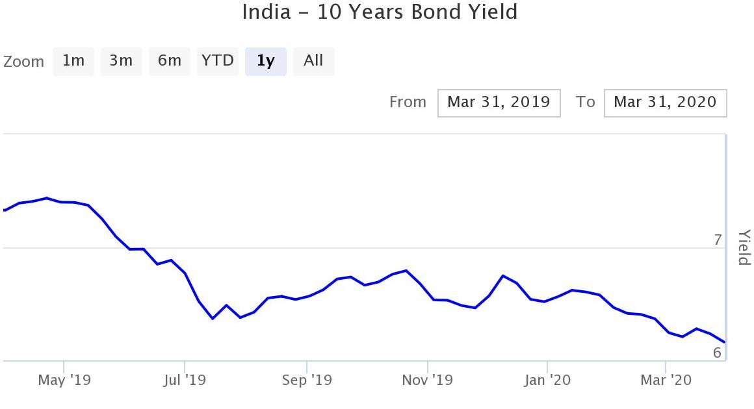
Interest Rate and Trends
Interest Rate – Economic Aspects,
Interest Rate – Impact on Actuarial Assumptions
Overall impact – Integrated view
Forecasting method
Conclusion
In simple terms, an interest rate is rate charged by a lender of money or credit to a borrower. Although there is no single rate of interest in an economy- depends on term, purpose, creditworthiness of the borrower and probability of ‘default’.
www.actuariesindia.org

Slide 16
Impact of High Interest Rates
Interest Rate – Economic Aspects, Interest Rate – Impact on Actuarial Assumptions
Overall impact – Integrated view
Forecasting method
Conclusion
Loans more expensive.
Lesser Borrowings: Fewer people and businesses can afford to borrow.
That lowers the amount of credit available to fund purchases, slowing consumer demand, interest payout increases
More savings: It encourages more people to save because they receive more on their savings rate. Reduce disposable income
Less Capital, Less Demand: High-interest rates also reduce the capital available to expand businesses, strangling supply.
Slowdown of Economy: This reduction in liquidity slows the economy
www.actuariesindia.org

Slide 17
Poll Question 1
Interest Rate – Economic Aspects, Reality
Interest Rate – Impact on Actuarial Assumptions
Overall impact – Integrated view
Forecasting method
Conclusion
In the current low interest rate scenario, which is your preferred investment option?
1. Equities: high risk, higher return
2. Bank Fixed Deposit: Very low returns
3. Spending the money instead of saving/investing
4. Keep liquid cash and invest later
5. Buy your dream house
www.actuariesindia.org

Slide 18
Impact of Low Interest Rates
Interest Rate – Economic Aspects, Reality
Interest Rate – Impact on Actuarial Assumptions
Overall impact – Integrated view
Forecasting method
Conclusion
Low-interest rates have the opposite effect on the economy.
Low interest rates have the effect of stimulating demand
Savings rates fall: When savers find they get less interest on their deposits, they might decide to spend more.
They might also put their money into slightly riskier but more profitable investments.
That action drives up stock prices.- may be due to low Cost of capital
Inflation: If there is too much liquidity, then the demand outstrips supply and prices rise. That's just one of the causes of inflation
www.actuariesindia.org

Slide 19
Trend Low Interest Rate Not Converting into Growth
Interest Rate – Economic Aspects, Reality
Interest Rate – Impact on Actuarial Assumptions
Overall impact – Integrated view
Forecasting method
Conclusion
In the new era, what is now being known as the ‘new normal’, this rule does not apply. A look around the world tells us that low and near-zero interest rate and free flow of money through quantitative easing has failed to induce growth.
Many countries negative interest rates, but even then there are no consumers at the stores. Not only consumers, even corporate houses are unwilling to add new capacities, despite almost zero interest rates.
Growth will now have to happen before credit growth. Unless banks get the confidence to lend, there is no way the economy will get the benefit of low interest rates, if at all.
Liquidity trap – lower interest rates didn’t boost spending. Growth remained negative or weak
www.actuariesindia.org

Slide 20
Actuarial Assumptions
Interest Rate – Economic Aspects, Reality
Interest Rate – Impact on Actuarial Assumptions
Overall impact – Integrated view
Forecasting method
Conclusion
Para 72 of Ind AS 19 says Actuarial assumptions shall be unbiased and mutually compatible. -
An unbiased statistic is a sample estimate of a population parameter whose sampling distribution has a mean that is equal to the parameter being estimated.
IND AS says: Actuarial assumptions are unbiased if they are neither imprudent nor excessively conservative.
By definition, compatibility means a state in which two things are able to exist or occur together without problems or conflict.
Actuarial assumptions are mutually compatible if they reflect the economic relationships between factors such as inflation, rates of salary increase, the return on plan assets and discount rates
www.actuariesindia.org

Slide 21
Poll Question 2
Interest Rate – Economic Aspects, Reality
Interest Rate – Impact on Actuarial Assumptions
Overall impact – Integrated view
Forecasting method
Conclusion
What in your opinion will be the impact of low interest rate on value of assets?
1. Depends on Asset Mix
2. Depends on Duration of assets
3. Both 1 & 2
www.actuariesindia.org

Slide 22
Impact of Interest Rate on Net Liabilities Position
Interest Rate – Economic Aspects, Reality
Interest Rate – Impact on Actuarial Assumptions
Overall impact – Integrated view
Forecasting method
Conclusion
Discount Rate | Plan is funded | Plan is Unfunded
Low interest rate –discount rate will be down | Generally we see the impact on liabilities Low interest rate – price of bonds will increase An increase in liabilities is offset by an increase in asset value So impact on valuation of assets will depend on investment mix and the duration of the assets The net liability position will be influenced by the increase in liabilities and the corresponding increase in assets | The impact is an increase in liabilities; all other assumptions remaining the same The increase being influenced by the change in discount rate from Previous valuation to the Current valuation
www.actuariesindia.org

Slide 23
Impact on Attrition Rate
Interest Rate – Economic Aspects, Reality
Interest Rate – Impact on Actuarial Assumptions
Overall impact – Integrated view
Forecasting method
Conclusion
Impact of attrition on liability will depend on other factors such as relationship between salary growth rate and discount rate and also maturity profile of employees
Low interest rate
Cost of capital down
Capital formation high
More job opportunities
Attrition high
www.actuariesindia.org

Slide 24
Impact on Salary Growth Rate
Interest Rate – Economic Aspects, Reality
Interest Rate – Impact on Actuarial Assumptions
Overall impact – Integrated view
Forecasting method
Conclusion
Low interest rate
Reduce cost - borrowing
Credit offtake
Capital formation
Demand will rise and so salary
Liquidity trap – lower interest rates didn’t boost spending. Growth remained negative or weak
www.actuariesindia.org

Slide 25
Overall impact – Integrated View
Interest Rate – Economic Aspects, Reality
Interest Rate – Impact on Actuarial Assumptions
Overall impact – Integrated view
Forecasting method
Conclusion
We should have consistent and integrated view
Economic sense of interest rate versus Actuarial Sense
Can we create parametric model to see the relationship
Can we forecast: Salary Growth rate and attrition as a function of interest rate
www.actuariesindia.org

Slide 26
Regression Analysis
Interest Rate – Economic Aspects, Reality
Interest Rate – Impact on Actuarial Assumptions
Overall impact – Integrated view
Forecasting method
Conclusion
Regression analysis: a procedure commonly used by economists to estimate economic parameters with available data
Two types of regression:
  cross-sectional: analyze several variables for a single period of time
  time series data: analyze a single variable over multiple periods of time
www.actuariesindia.org

Slide 27
Regression Analysis
Interest Rate – Economic Aspects, Reality
Interest Rate – Impact on Actuarial Assumptions
Overall impact – Integrated view
Forecasting method
Conclusion
Regression equation: linear, additive
e.g.: Y = a + b₁X₁ + b₂X₂ + b₃X₃ + b₄X₄
  Y: Attrition rate or Salary growth rate
  a: constant value, y-intercept
  X_{n}: age band, industry, past service etc.- independent variables, used to explain Y
  b_{n}: regression coefficients (measure impact of
  independent variables)
www.actuariesindia.org

Slide 28
Regression Analysis
Interest Rate – Economic Aspects, Reality
Interest Rate – Impact on Actuarial Assumptions
Overall impact – Integrated view
Forecasting method
Conclusion
Interpreting the regression results:
Coefficients:
  negative coefficient shows that as the independent variable (X_{n}) changes, the variable (Y) changes in the opposite direction
  positive coefficient shows that as the independent variable (X_{n}) changes, the dependent variable (Y) changes in the same direction
  magnitude of regression coefficients is a measure of elasticity of each variable
www.actuariesindia.org

Slide 29
Challenges
Interest Rate – Economic Aspects, Reality
Interest Rate – Impact on Actuarial Assumptions
Overall impact – Integrated view
Forecasting method
Conclusion
Multicollinearity problem: two or more independent variables are highly correlated, thus it is difficult to separate the effect each has on the dependent variable
Solution: a standard remedy is to drop one of the closely related independent variables from the regression\
Autocorrelation - When the error term in one time period is positively correlated with the error term in the previous time period. This is common in time-series analysis
Solution: One method to correct positive first-order autocorrelation involves first regressing Y on its value lagged one period
www.actuariesindia.org

Slide 30
Conclusion
Interest Rate – Economic Aspects, Reality
Interest Rate – Impact on Actuarial Assumptions
Overall impact – Integrated view
Forecasting method
Conclusion
Actuarial assumptions should be mutually compatible if they reflect the economic relationships between factors such as inflation, rates of salary increase, the return on plan assets and discount rates
www.actuariesindia.org

Slide 31
Questions
THANK YOU
www.actuariesindia.org

Slide 32

Upcoming Webinars
S.No | Webinar | Date | CPD
1 | Tech Talk | 12 September, 2020 | No CPD
2 | 3rd Webinar on Health Care Insurance | 23 September, 2020 | 1.5 hrs in Health Care Insurance
3 | 6th Webinar on Data Science & Analytics | 3 October, 2020 | 1.5 hrs in Any Area of practice
4 | Tech Talk | 10 October, 2020 | No CPD

