Slide 1


Seminar Name: 6th Webinar on IFRS17
Date: 19th August, 2022
Implementation Experience: Roadmap and Challenges
Saigeeta Bhargava, Director, PwC
Rajiv Mukherjee, SVP, ICICI prudential

Slide 2


End-to-End Implementation Journey
Design
Operate, review and deployment
Detailed design
Key Decision
Data gaps
Functional and technical design specification
High level design
Vendor Data Model, Deployment strategy
Design e2e target reporting architecture
Identify system capabilities to acquire
Transition decision
Strategy
and assess
Business as usual
Ensure continuity and flexibility in the quarterly disclosure
Construct and implement
Construct
Data tools
Cashflow Model – RA, FCF, Profitability
Grouping
Actual Data – allocate, aggregate, ETL, data warehouse
CSM engine – deploy, build
Development and Integration of CoA with GL
Transition
Establish opening balance sheet of the comparative period disclosed
Project Mobilisation
Establish high level project plan, budget
Governance and working team
Training
Strategy and architecture
Define technical interpretation of the standard
GAP analysis.
Vendor Selection – define objectives and POC
Test
Simulation of the P&L, OCI and balance sheet as if IFRS17 is already in effect
2

Slide 3
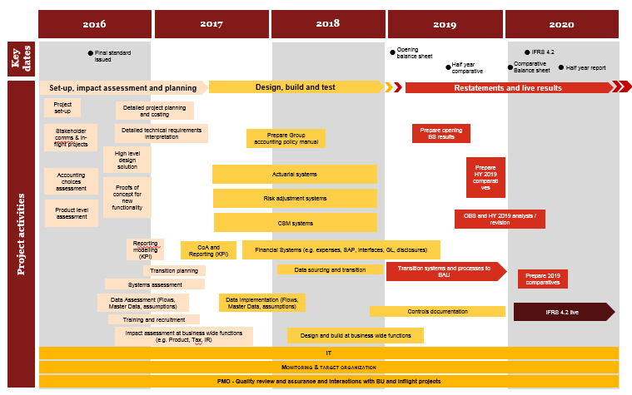
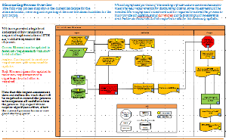
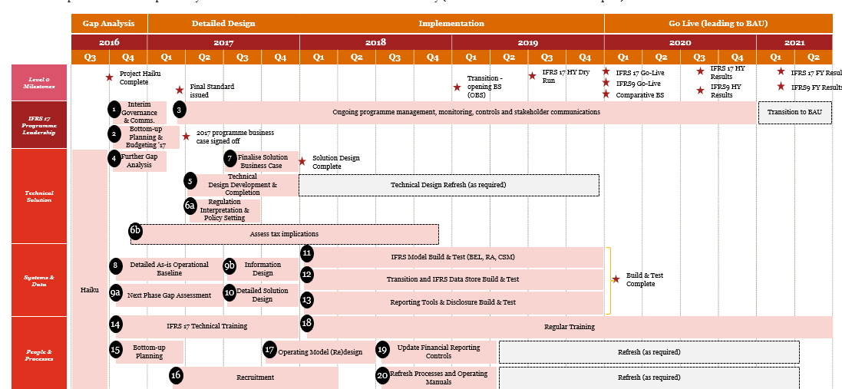

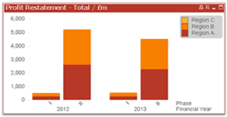
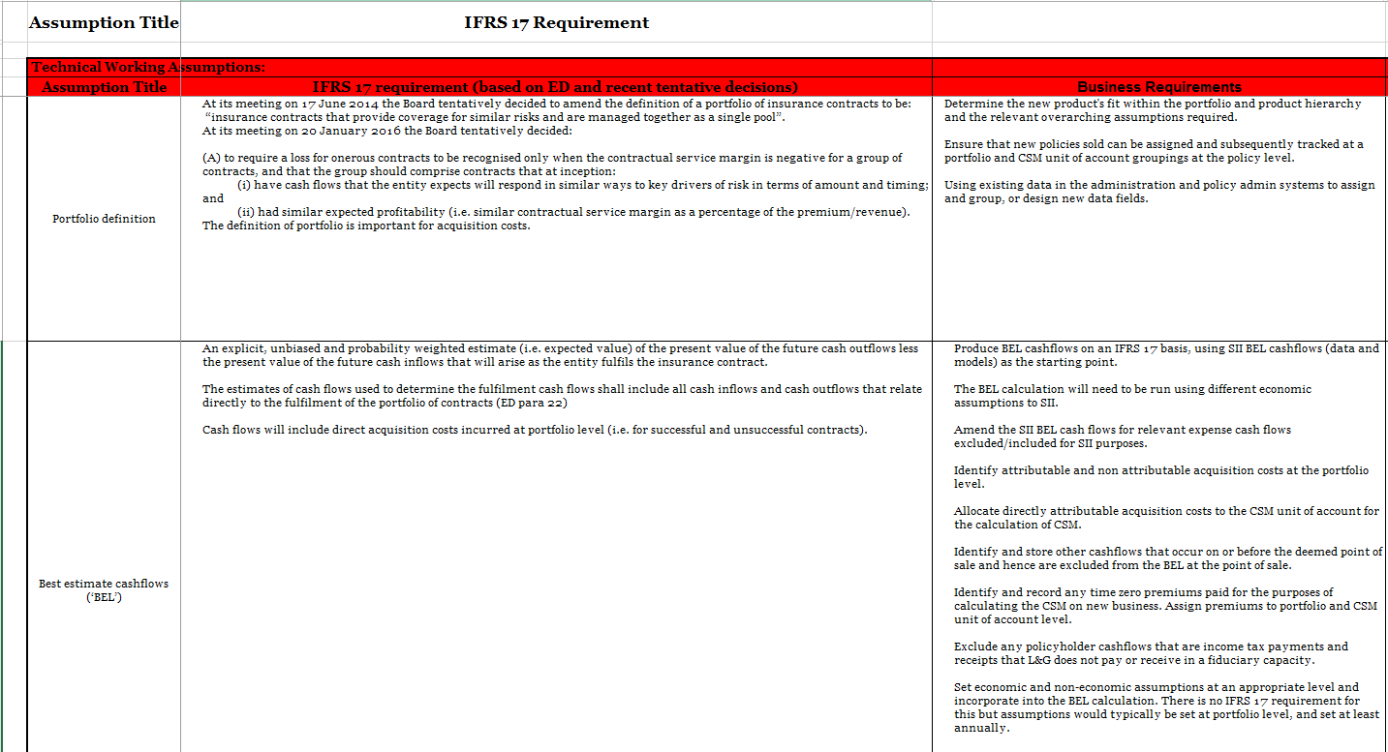
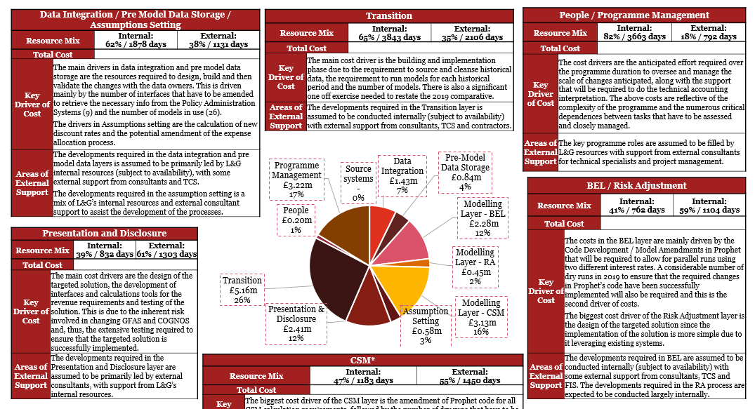
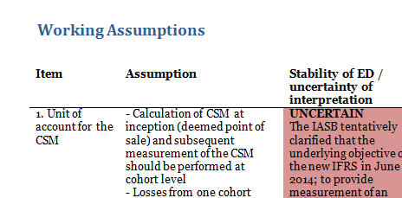
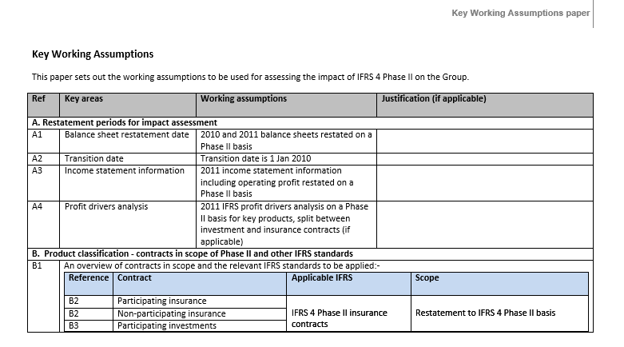

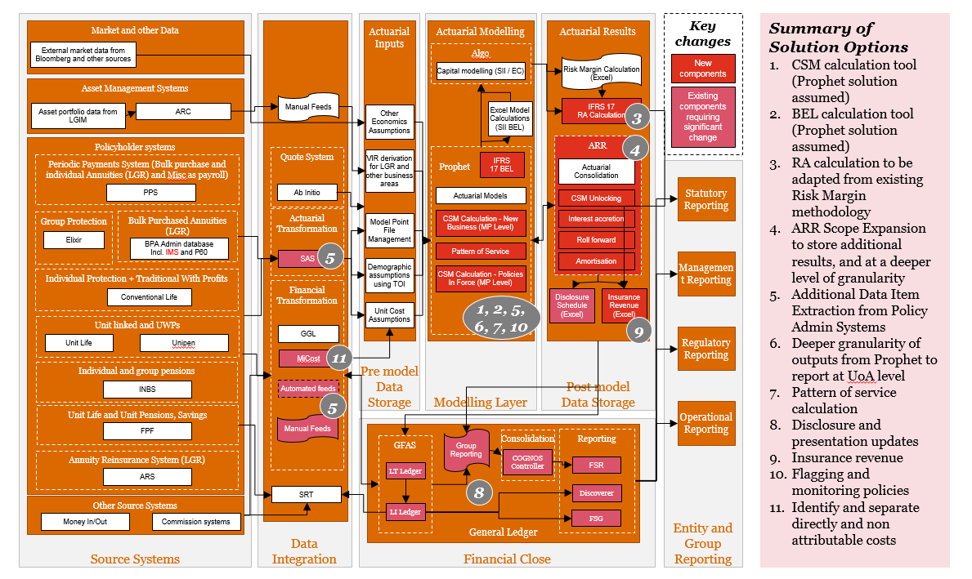
Implementation Challenges
Disclosures
Creation of IFRS17 financials and disclosures and specific aspects around Group Reporting
Technical Considerations
IFRS 17 is principle based with a number decision on aspects that have direct impact on opening balance sheet, profitability and implementation complexity
Disclosures
Technical Consideration
Data Reconciliation
Data reconciliation with financials and with aggregated model points
Data Reconciliation
Project Governance
Project Governance
IFRS 17 involves inputs from multiple stakeholders and hence need of strong governance
Implementation Challenges
Prophet Modelling
Knowledge and upskilling
Prophet Model related changes
Prophet models will have to modified in line with the standard requirements.
Data Requirements
IT systems architecture & CSM engine
Knowledge and Upskilling
Training to ensure all stakeholders have adequate knowledge
IT Systems architecture
IFRS 17 new requirements and data processing requirement
Data Requirements
The level of granularity at which data is required for IFRS 17 is very different from the current process
3

Slide 4

Technical Considerations
01
Transition
What methodology and implication. Complexity in implementation due to past data & model requirements
Technical decisions can vary in transition and BAU
Transition roll forward, sequential in nature and iterative implication of decision makes it difficult
02
Model Point Grouping
Grouping based on similar risk, managed together, issue year & profitability
Design considerations related to grouping should thought through at the very beginning
Further bifurcations leads to complications in the future
Sub grouping was used for alignment of correct reinsurance and can be used to leverage for output visualization.
03
  Risk Adjustment
No defined methodology by the standard.
Decision needs to be made whether it will be done on a stochastic or deterministic basis, what factor aligns with the required CI etc
01
02
04
Reporting requirements, Communication with stakeholders, Comparison with other standards
Local reporting and Group reporting requirements may be different.
Calendar Year vs Financial Year, Coverage Unit, Year to Date vs Locked in
Communication to internal stakeholders & market analysts as IFRS17
Explaining results
03
05
05
Discounting
Derivation methodology – Bottom up vs Top down
Segregation between lines of business
Application between VFA and GMM – Locked in vs Prevailing
04

Slide 5
Data Requirements
Based on group of model points rather than individual model points – Alignment from Prophet cashflows, PAS, Data Warehouse, Renova, CAMS, etc. Mapping between individual and grouped model points
01
Granularity - Asset Share allocation, Expenses, Actual Data
Asset share data for each group needs to be defined. FV changes impacts CSM. Policies impacted by different transition methodologies will need to be take care of
Expense allocation was done at a line of business level using certain drivers which had to be further aligned at a UoA level.
Consistency between group logic on actual transaction with expected.
Logic for this join varies for system and product. Policy Number, Master policy number and product code has to be validated and complete. Discrepancies needed to be solved for
01
02
02
  Separating Investment Component & Policyholder Loans
Changes in PAS maybe required to capture the actual surrender value at the time of claim and outstanding claim amount
05
03
03
Prophet & DCS/SQL
Model changes to ensure cashflows are in line with IFRS17 – specifically with respect to Risk Adjustment, Reinsurance, Discount rates, Grouping of cashflows.
Model, tables and MPF’s alignment for the transition years of FRA
Operational aspects around multiple inputs and outputs, errors while setting up runs, ensuring proper checks are put in place
04
04
Dependency on GL Codes
Cashflow in Accounting system are designed as GL codes in most of the source system.
All the cashflow decisions on which GL codes to be considered needs to be aligned with the accounting team.
Large volume and very dynamic makes tricky for transition and BaU.
05
Materiality
Separating Investment Components
Policyholder Loans
Projected new business for reinsurance expected to written under each treaty
Segregation of LIC between Paid and Non Paid

Slide 6
Other Considerations
Data Reconciliation
Data from multiple sources is directly used in calculating company P&L and balance sheet, the data recon is most important
Recon strategies:
Recon with Financials and source systems
Recon with the aggregated model point numbers
Server Capacity
Server Capacity
IFRS17 is data intensive and has multiple processes that are required to be run – Tagging, Grouping, Profitability Assessment, Mapping of cashflows, it requires a sophisticated server to perform all these calculations.
Run time issue, data storage issues due to the volume of data and processes involved – cashflows from 100 years needs to be fed
Hence, serves should be equipped with adequate memory, ram, cores, etc to ensure smooth process.
Data Recon
CSM Engine
CSM Engine
Understanding the system input requirements and data format
Understanding the various aspects and functionalities within system ensure that the data inputs are aligned with the intended calculations
Manual Entries
Manual & Provisional Entries
Manual interventions are usually there in the data reported in financials.
Example: :
· Provisional entries for premium, commission and claims data
· GST reversals
· Audit entries
· Other miscellaneous / adjustment manual entries
· Reversal of provisional entries

