Slide 1


2nd Webinar on Health Insurance
Date: 27th August, 2020
Time: 1500 to 1630 (IST)
Declined Lives Pool in USA
And
Changing face of Claims Emergence, Experience & Investigation under Covid-19

Slide 2








Housekeeping Points
Mute
Q&A
IAI support
C
P
D
Recording
Feedback
www.actuariesindia.org

Slide 3
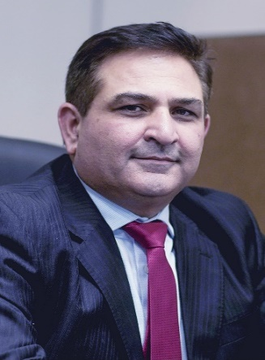
Presidential Address
Mr. Sunil Sharma,
President, IAI
Mr. Sunil Sharma is President of the Institute of Actuaries of India. Sunil is a Fellow member of Institute of Actuaries of India (FIAI) and Fellow member of Institute and Faculty of Actuaries, UK (FIA). He is also the Council member of International Actuarial Association (IAA) and is part of various Committees of IAA.
Sunil is currently the Appointed Actuary and the Chief Risk Officer for Kotak Mahindra Life Insurance Company India Ltd. Prior to joining Kotak Life, he has worked in various positions with ICICI Prudential Life, Swiss Re, GE Financial Assurance Holdings, Inc. and Life Insurance Corporation of India.
He endeavor to grow the profession beyond the traditional areas, increase rapport and forge stronger connect with Actuarial profession globally and better coordination with Insurance, Pension and Market regulators.
www.actuariesindia.org

Slide 4
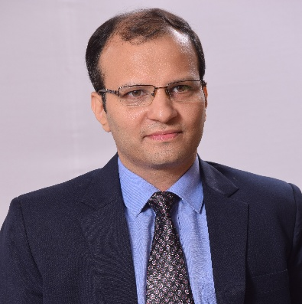
Welcome Address
Vishwanath Mahendra, Chairperson, Advisory Group for Health Insurance, IAI
Vishwanath has 25 years of rich experience in analytics, actuarial and finance in some of the reputed organisations in India.
He current working with Max Bupa Health Insurance Company Limited as Director and Chief Actuary and is a key member of the Executive Leadership team. In his previous stint he has worked with Apollo Munich Health Insurance Company Limited for almost 12 years and was holding position of Chief Actuary and Chief Risk Officer at the time of exit as part of the key leadership team.
He is a Fellow Member of The Institute of Cost Accountants of India (erstwhile ICWAI), Associate Member of Institute and Faculty of Actuaries, UK and Fellow Member of Institute of Actuaries of India (IAI) with specialisation in Health and Care Insurance. He is Chairman of Advisory Group on Health Care Insurance of IAI.
www.actuariesindia.org

Slide 5
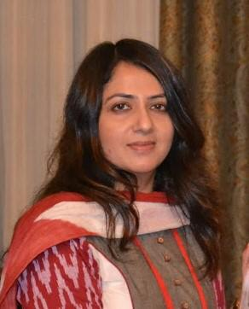
Moderator
Raunak Jha, Secretary, Health Care Insurance Advisory Group, IAI
Raunak Jha is a qualified Actuary from Institute of Actuaries of India with more than 15 years of work experience in Actuarial and Risk Management domains. Having worked in Senior level roles with companies like Reliance , Magma HDI, Cigna TTK and IFFCO TOKIO, she holds strong industry knowledge and has played critical role in setting up initial teams and systems in place in these organizations. She is a regular speaker in Industry forums and has co-authored research papers on technical subjects in General and Health Insurance fields. She actively participates in Indian Industry forums and is also a part of Health Insurance advisory Board of Institute of Actuaries of UK.
www.actuariesindia.org

Slide 6
Programme Schedule
When | What | Who
15:00 – 15:05 | Welcome Address | Vishwanath Mahendra, Chairperson, Advisory Group on Health Insurance
15:05 – 15:10 | Keynote Address | Sunil Sharma, President, IAI
15:10 – 15:15 | Context setting | Raunak Jha, Secretary, Advisory Group on Health Insurance
15:15 – 15:45 | High Risk Pools | Dr. Yan Yang, FSA, PHD, GM, Health Greater China, Munich Re
15:45 – 16:15 | Changing face of Claims Emergence, Experience & Investigation under Covid-19 | Mr. Sanjiv Kumar Dwivedi, SVP, Investigation and Loss Mitigation, BAJIC
16:15 – 16:28 | Q&A and CPD Assessment
16:28 – 16:30 | Vote of Thanks | Raunak Jha, Secretary, Advisory Group on Health Insurance
www.actuariesindia.org

Slide 7
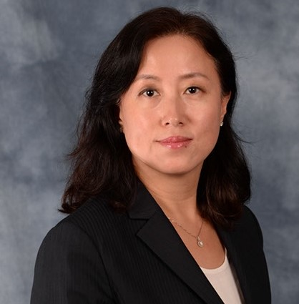
Speaker
Dr. Yan Yang, GM, Health Greater China, Munich Reinsurance
Dr. Yan Yang joined the Munich Reinsurance Beijing office in 2018 as General Manager of Health Greater China. Before she joined Munich Re, Dr. Yan Yang had over 18 years of working experience in U.S. Health insurance industry, with the roles of Director of Actuary for Senior Health Markets and Commercial Insurance in Blue Cross and Blue Shield of Michigan.
While responsible for Pricing, Valuations, Financial Forecast and Capital Planning, she also worked as the Group Actuarial Partner to market segment CEOs by performing strategic planning and providing decision support on business strategies, such as product development, sales and marketing, provider contracting and care management initiative analysis. Dr. Yan Yang had her Ph.D. from Case Western Reserve University, and MS from Renmin University of China. She is a fellow of the Society of Actuaries and member of the American Academy of Actuaries
www.actuariesindia.org

Slide 8
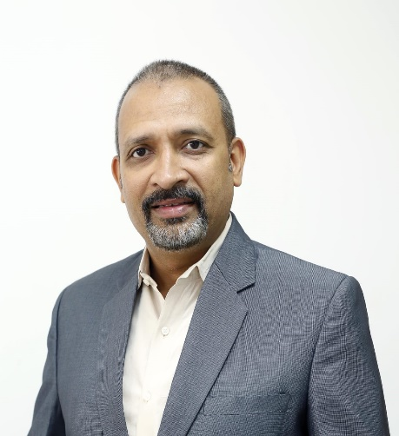
Speaker
Sanjiv Kumar Dwivedi, SVP, Investigation and Loss Mitigation, Bajaj Allianz General Insurance Company Limited
Sanjiv Kumar Dwivedi has been associated with Bajaj Allianz General Insurance since August 2013. He joined Bajaj Allianz as Head of Department - Investigation & Loss Mitigation team. In his 6 years with the company, he has been the founder of Anti - Fraud function for the company. Along with setting up of team of Doctors, engineers, lawyers, Forensic experts, data scientists, Investigators, and recovery officers he has been instrumental in developing the Fraud Management Framework / System for identification of real time irregularities in claims. This has helped the company in efficient handling of potential fraud claims. Sanjiv and his team coherently prepare, analyze, and interpret data to help senior management draw conclusions on the business risks that the company might face through risk management strategies.
Sanjiv has been recently honored with “Group Leadership award” from Bajaj Finserv. Apart from this he has been recognized with several awards for his performance.
With an overall experience of 20 years, Sanjiv has worked in Telecom, Banking and Insurance sector into Investigations, Debt Recoveries, Customer Service and Sales.
He has a varied professional experience of working with companies like ICICI LOMBARD, GE Capital Business Process Management Services Pvt. Ltd., Bharti Cellular Limited, ICICI Bank Limited, to name a few.
www.actuariesindia.org

Slide 9
2nd Webinar on Health Insurance
August 27, 2020
High Risk Pools in USA
Yan Yang
FSA, Ph.D., GM, Health Greater China, Munich Re

Slide 10
Agenda
History
Impact
Funding
Member Eligibility and Benefits
Administration
10

Slide 11


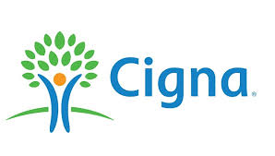

US Health Insurance Market Overview
55% Government Business (Federal and States)
Source: Centers for Medicare & Medicaid Services

Slide 12
High Risk Pool Evolvement
1993 National Association of State Comprehensive Health Insurance Plans (NASCHIP)
2014 Accountable Care Act (ACA)
1976 first high risk pool
Traditional High-Risk Pools:
Historically provided coverage to uninsurable individuals
State sponsored programs
Federal PCIP (Pre-existing Condition Insurance Program
Reinsurance Solutions under guaranteed issue protections:
Parameter Based
Condition Based (Invisible High-Risk Pool)

Slide 13
Impact on the Health Care System
A high-risk pool is an insurance program to address the problems of uninsurable individuals
1
  Accessibility
Only available option to reach the subset of the uninsured population who have serious health conditions
2
  Economic Benefits
Properly managed care—reduced overall health care expenses;
Direct payment of medical providers—reduced the cost shifting from uncompensated care

Slide 14


High Risk Pool Funding
Premiums
  Age, gender, geographical location
  Other rate variables (smoking status, income, length of time in the pool, prior continuous coverage…)
  Rate caps: from 125% to 200% of the standard risk rate
Additional Funding Mechanisms
  Assessment of health insurers
  Service charge on hospitals and surgical centers
  Appropriation of general revenue

Slide 15
Member Eligibility and Benefits
Eligibility
Benefits
E
B
Rejection for health insurance by one (or sometimes two) insurer(s);
Restrictive rider or pre-existing condition limitation;
Coverage at a rate exceeding the pool premium
Consistent with available comprehensive coverage
Based on a list of benefits and exclusions listed in statute
Generally offer 3 to 5 different plan designs
Deductible, copay/coinsurance, annual maximum and lifetime benefit maximium

Slide 16
Operations and Administration
Supervision
A board of directors Representations from the various stakeholders, including: Insurance carriers Insurance brokers The commissioner Healthcare providers Business owners State legislators High ranking government officials and, Pool members
Administration
A competitive bidding process to select an experienced, efficient, competitively priced and financially strong plan administrator The duties of the plan administrator typically include: Determination of eligibility Payment of claims Premium billing Etc.
Cost Control
Strengthening eligibility rules Setting the premium rates at the highest level allowed by law Negotiating provider reimbursement rates or using a provider network Increasing benefit cost sharing Limiting the amount of annual claim payment Etc.

Slide 17
Considerations
Negative consumer perception with program
High Risk vs. High Cost
Expense to administer
Shared risk, incentive for issuers to keep costs down
Volatility in evaluation of program risk and funding
17

Slide 18

Thank you for your participation!

Slide 19
Impact of Covid-19 on Health insurance- Webinar
27 August 2020
Changing face of Claims Emergence, Experience & Investigation under Covid-19
Mr. Sanjiv Kumar Dwivedi, SVP, Investigation and Loss Mitigation.
Bajaj Allianz General Insurance Company Ltd.

Slide 20
Agenda
General Insurance Industry growth
Covid-19 Impact on Health Insurance
New Trends in health claims fraud
Modern techniques for investigation
Final Thoughts
Q&A
www.actuariesindia.org

Slide 21
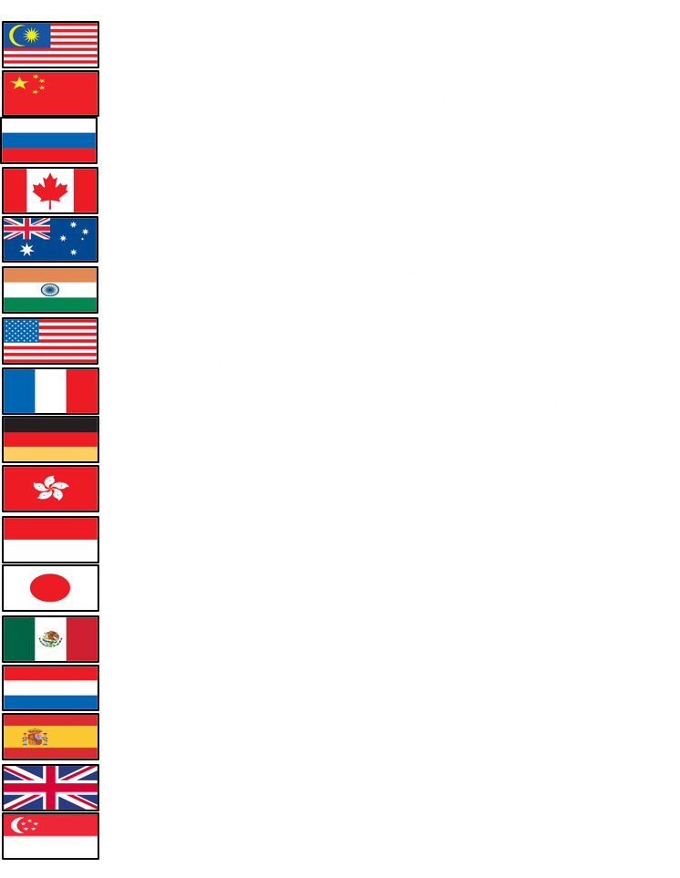
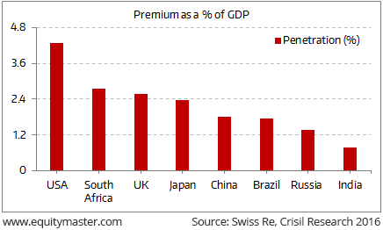
Insurance industry- Global
Country Clusters (# Non-Life Companies*)
India (34)
China (84)
Germany (253)
USA (3,432)
Indonesia (82)
Singapore (225)
Japan (52)
India very likely to see many folds growth in GI companies
Australia (86)
Canada (84)
Mexico (66)
Malaysia (59)
Russia (399)
France (381)
Spain (111)
UK (176)
Netherlands (101)
www.actuariesindia.org

Slide 22
Insurance industry- India
130 New Health products introduced
Market Share
  Health: 2.3%
  Fire : 4.1%
  Motor: 8.3%
Covid-19 claims 18,100 no’s (280 Cr)
Average claim size
  Urban areas - 2-2.5 lakh
  Semi Urban/Rural 50,000-75,000
Strict lockdown guidelines have been lifted in the month of June - Downfall expected in Q2 and Q3
Total cases
31,02,692
Recovered
23,30,153
Active
7,14,919
As of 23rd August 2020 as per Times of India
www.actuariesindia.org

Slide 23
Health Insurance- India
Segment | Health-Retail | Health-Group | Health-Govt schemes | Overseas Medical | Health Total | Growth % | Market %
General Insurers (CY) | 3596.27 | 9208.65 | 882.61 | 46.96 | 13734.49 | 6% | 75%
General Insurers (PY) | 3071.21 | 8263.36 | 1318.25 | 312.20 | 12965.02
% Growth | 17.10% | 11.44% | -33.05% | -84.96% | 5.93%
Stand-alone (CY) | 3825.01 | 848.20 | 0.00 | 7.80 | 4681.01 | 26% | 25%
Stand-alone (PY) | 2596.06 | 835.01 | 223.41 | 55.21 | 3709.69
% Growth | 47.34% | 1.58% | -100.00% | -85.87% | 26.18%
Overall Industry (CY) | 7421.28 | 10056.85 | 882.61 | 54.76 | 18415.50 | 10% | 100%
Overall Industry (PY) | 5667.27 | 9098.37 | 1541.66 | 367.41 | 16674.71
% Growth | 30.95% | 10.53% | -42.75% | -85.10% | 10.44%
% Mkt Share (CY) | 40.30% | 54.61% | 4.79% | 0.30% | 100.00%
% Mkt Share (PY) | 33.99% | 54.56% | 9.25% | 2.20% | 100.00%
Growth%
Health overall: 5.9%
Standalone health:26%
Retail Health:47%
(SAHI)
Note: Comparison same period CY vs PY up to July 20
Note: Compiled by GI Council on the basis of data submitted by the Insurance companies
www.actuariesindia.org

Slide 24
Current trends observed
The demand for health insurance has witnessed a significant rise :
Demand for health insurance plans picks up during epidemics / pandemic.
Rise in queries for pandemic covers (50% more queries from customer asking for cover)
Increase In Demand Of Health Plans With Higher Sum Insured:
Earlier, < 5% people buying health plans between Rs. 20 L to Rs. 1 Cr sum insured,
however, the share has now increased to 50 per cent over the last 2 -3 months.
Demand increased for comprehensive health insurance policy with super top up option:
A Basic Cover wont work for such situation.
Rise In Number Of Senior Citizens Buying Health Insurance:
In the past 2 - 3 months, number of senior citizens covering themselves increased drastically..
There has been a drastic dip in non-COVID related claims : The number of claims has gone down dramatically.
Health insurance prices are set to rise : Given the increase in the number diseases covered
www.actuariesindia.org

Slide 25

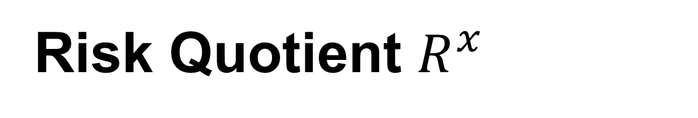
Risk Quotient $R^{x}$
Insurance is about underwriting risks. However there are risks which are not underwritten but get attached due to fraudulent practices and where the cardinal principle of ‘Utmost good faith’ is sacrificed these can hit a company in various forms from various entities.
Preliminary estimate puts fraud claims at 6% of the total number in India but Insurance fraud levels are rated between 10% to 15% globally.
India Insurance Co’s would be losing between Rs.2,500-3,500 crore approx. in a year.
Line of Business
Investigated
Hit Rate
Over All
Motor
Health
Commercial
2.58%
3.21%
0.52%
42%
46%
61%
1.08%
1.48%
0.31%
Value Savings: ₹ 250 Crores; Impact on Loss ratio 4.3%
www.actuariesindia.org

Slide 26
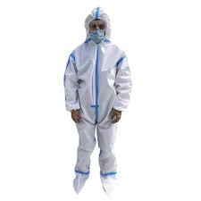


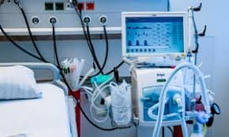
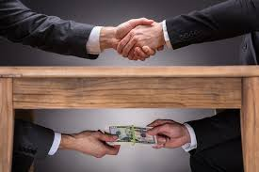
Impact on health claims
In April 2020, 14 % increase in claims linked to providers with suspicious billing practices.
Extra ordinary inflated bills observed from hospitals.
Unlisted lab tests: As there was no specific code available
Hands-on therapy charges: Telemedicine misused
Unnecessary DME (Durable medical equipment):
Elective surgeries during lock down
Unlisted vaccinations
Cyber-security remains a massive challenge for :
Identity Theft Malicious Mails Fake Plans/Schemes
81%
(PPE Kits related)
62%
(Black market)
55%
(faulty equipment's)
46%
(Ventilators)
22%
(Bribe
Did any of the above scenario – lead to suspected Death?
Whistle blow suppression
Possible fraud Involving Test Kit
Immediate fraud prevention strategy required
PPE KIT, Ventilators
Embezzlement of financial support
www.actuariesindia.org

Slide 27
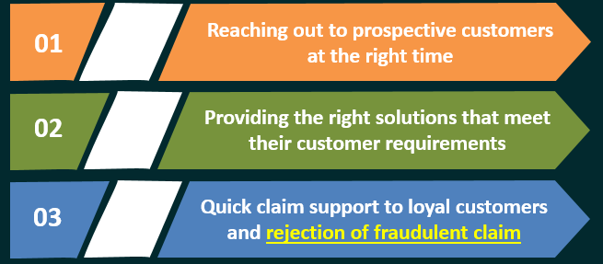
Major Challenges
Insurance companies, as on today, face 3 major challenges:
74%
Of the Customer would Like to interact with modern technology and appreciate the computer generated system of Insurance advice
Providing the right solutions that meet their customer requirements
So Companies who have been early to adopt automation of some aspect of their claims process can experience significant fall in Processing time, Cost & Good Increase in service quality
www.actuariesindia.org

Slide 28
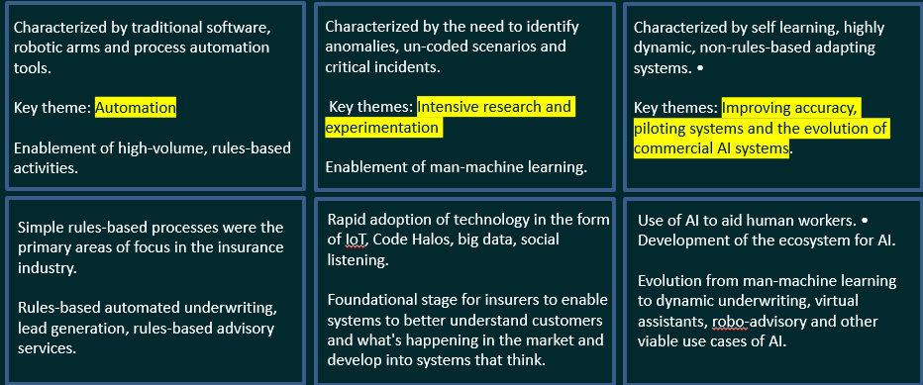
Finding risk area
SYSTEMS THAT DO
SYSTEMS THAT THINK
SYSTEMS THAT LEARN
www.actuariesindia.org

Slide 29

Evolution of Analytics
Due to the absence of standard medical protocols, large number of frauds occurring health insurance.
It is estimated that India’s health insurance sector is losing around INR 300 crs on fraud & abuse :
Concealing (PED) / chronic ailment
Manipulating pre-policy health check-up findings
Fabricated documents to meet policy terms conditions
Duplicate and inflated bills, impersonation
Participating in fraud rings, purchasing multiple policies
Billing for services not provided & Inflated billing
Unwanted Investigation, Expensive medicine
Over utilisation, extended length of stay
Fudging records, patient history
Non existing hospital / provider
Staged Losses / accidents
It would be difficult for a customer to file a fraudulent claim without connivance of doctor or hospital
www.actuariesindia.org

Slide 30



Layer of fraud détection
Claims Fraud Detection
Identify claims which are suspicious in nature
Assign suspicious score
Reasoning for alert
Data Driven OPI*
Evidence Requirement Decisioning
Entity Fraud Detection
Continuous monitoring and identification of entities with suspicious / illicit behaviour
Reasoning of alerts for entities
Enhancing Claim Fraud Detection by incorporating learnings from entity behaviour
Identification of claims to be studied in the audit
Collusion/Network Detection
Identify collusion between and across different parties
Enhancing Claim Fraud Detection by incorporating learnings from network behaviour
Identify scenarios, fraud rings, structural anomalies
Enhance OPI by learning from investigation behaviour
OPI – Operational & Performance indicators
www.actuariesindia.org

Slide 31
How to Combat fraud?
Analytical Tool – 3 Way approach
Rule Engine
Virtual Investigation
Advance Data Analytics
Works Mostly on internal data
Rules & Triggers
Claim Scoring
Assessment Questionnaire
Works on internal + External
Rule engine
External APIs
Robotics automation
Auto decision making
Works on internal + External
Predictive Analytics
Supervised / Unsupervised
Network Analytics
Voice analytics
Artificial Intelligence
Machine learning
Right People, Process & Technology in Place
Data is more enriched & Structured
Integrated with External Sources Like – Police, RTO, Health record, Personal, Block Chain
IOT Based Data to analyze
www.actuariesindia.org

Slide 32
Virtual Investigation
Undertake structured, repeatable and computer based tasks
Perform complex decisions based on algorithms
Access more than one system to complete the process
Do information search, collation or Updating
Use workflow enabled interaction with people
Resource optimization & Cost reduction during investigation
Features
Data Mart: All LOB Claims / Policy data – Search Engine
Rule Engine - Triggers
External data integration & News Repository
Robotics investigation
Voice & Image Intelligence, Optical character recognition
Digital body language (BaaS)
Machine Learning & Artificial Intelligence
Dependency on respondent
Operational Efficiency
          Cost Efficiency
Productivity enhancement
Reduced Turn around time

Slide 33
According to McKinsey Global Institute
French AI company tested fraud detection model with cognitive AI & ML which have processed over 77 million claims with 75% accuracy.
Insurers are discovering the AI chatbots to provide convenient and frictionless customer service and risk assessment that can address common inquiries and transactions which will frees up human reps to handle the more complicated situation.
AI Maya a policy issuance and Claim scrutiny model can issue a policy in just 90 seconds with no paperwork and takes a flat fee of a customer’s premium while setting aside the rest to pay claims and purchase reinsurance.
AI Jim, another chatbot, reviews claims and runs them through 18 anti-fraud algorithms. Simple ones are approved and paid out in seconds, more complicated claims are handed over to the company’s human team for review.
One of the largest insurers in Turkey employed a team of 50 people to manually check each claim for fraud based on loose rules. They purchased a predictive analytics software, and they saw 210% ROI within one year of using the software.
www.actuariesindia.org

Slide 34
Thanks
www.actuariesindia.org

Slide 35


Slide 36
Upcoming Webinars
S.No | Webinar | Date | CPD
1 | 2nd Webinar on Banking, Finance & Investment | 5 September, 2020 | 1.5 hrs in Banking, Finance & Investment
2 | 3rd Webinar on Pension, Employee Benefits and Social Security - 17th CIRB Module 3 - Latest trends and impacts on ESOP design and valuations | 10 September, 2020 | 1.5 hrs in Pension, Employee Benefits and Social Security
3 | 3rd Webinar on Pension, Employee Benefits and Social Security - 17th CIRB Module 4 - Pensions in a low to very low interest rate environment | 11 September, 2020 | 1.5 hrs in Pension, Employee Benefits and Social Security
4 | Tech Talk | 12 September, 2020 | No CPD
5 | 3rd Webinar on Health Care Insurance | 23 September, 2020 | 1.5 hrs in Health Care Insurance
6 | 6th Webinar on Data Science & Analytics | 3 October, 2020 | 1.5 hrs in Any Area of practice
7 | Tech Talk | 10 October, 2020 | No CPD

