Slide 1


Seminar Name: 6th webinar on General Insurance
Analytics in General Insurance
Date: 29th October, 2021
AI in Motor claims
Varun Jain,
VP, Lead Actuarial and AI/ML Lab, HDFC ERGO
Devina Nikam,
Manager, AI/ML Lab, HDFC ERGO

Slide 2



Flow of the presentation
2
4
Model Results
Building the model
Resources
Model results
360 degree view
Model pipeline
Process followed for model development
Theoretical Knowledge
Technical resources
Data overview
Project Learnings
Number of images used
Data preparation
Data augmentation
1
3
5
www.actuariesindia.org

Slide 3
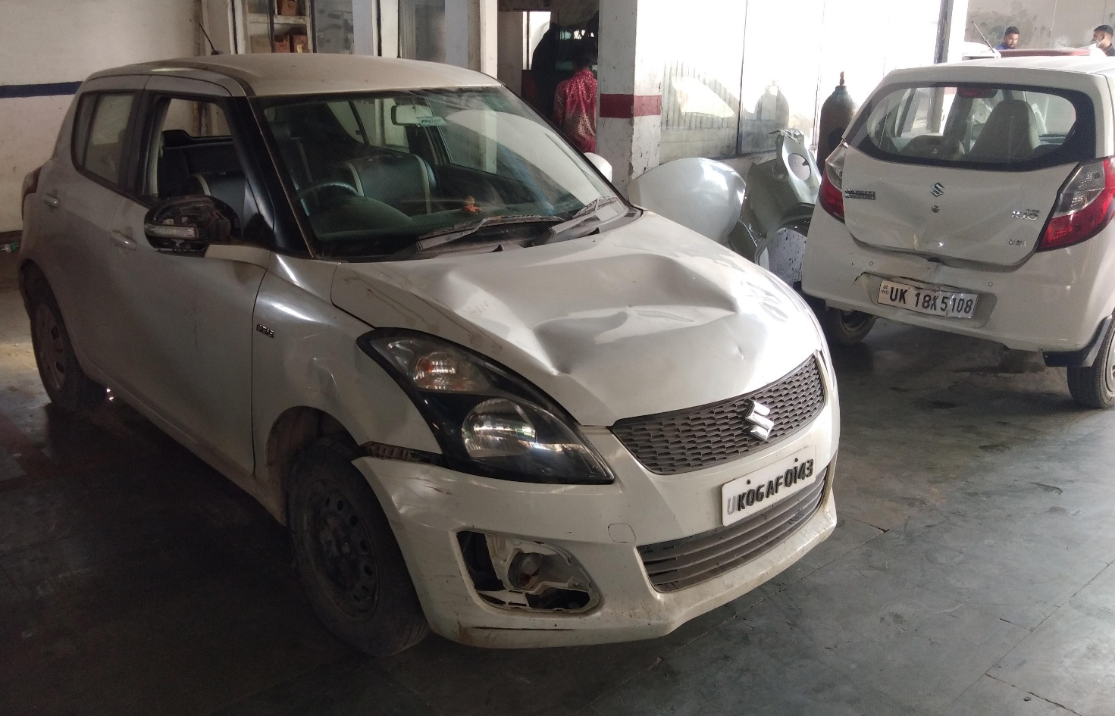
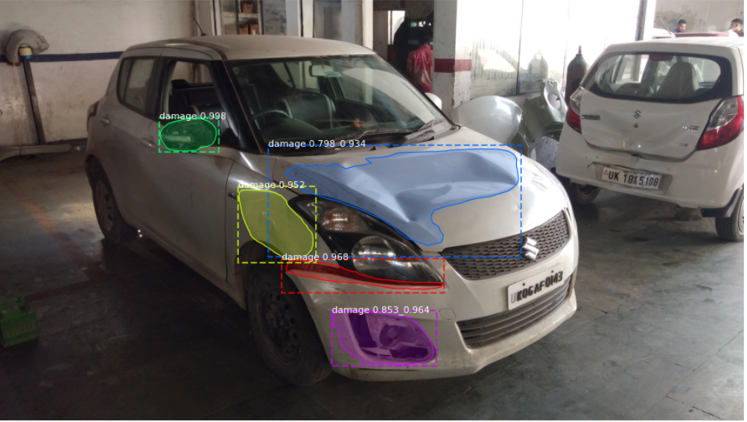
Damage Detection
www.actuariesindia.org

Slide 4
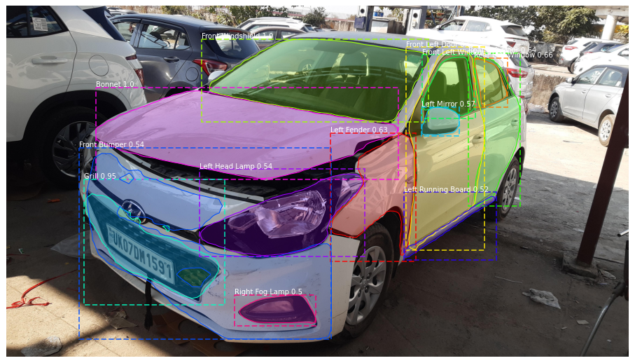
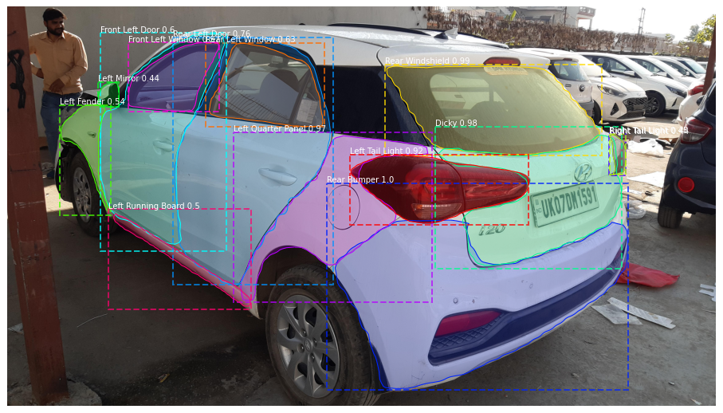
Parts Detection
www.actuariesindia.org

Slide 5
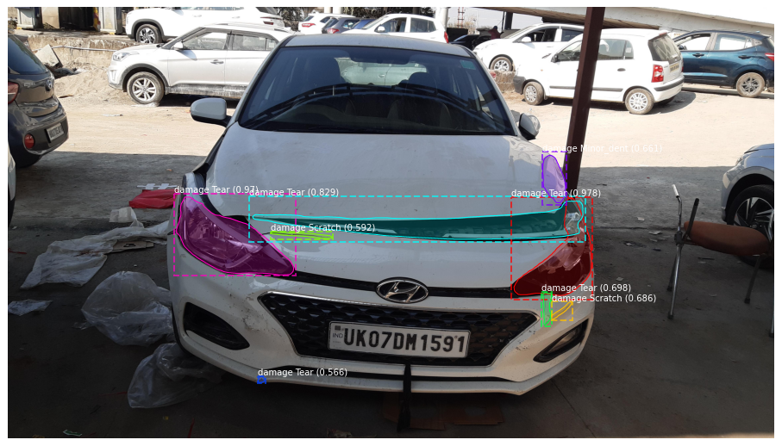
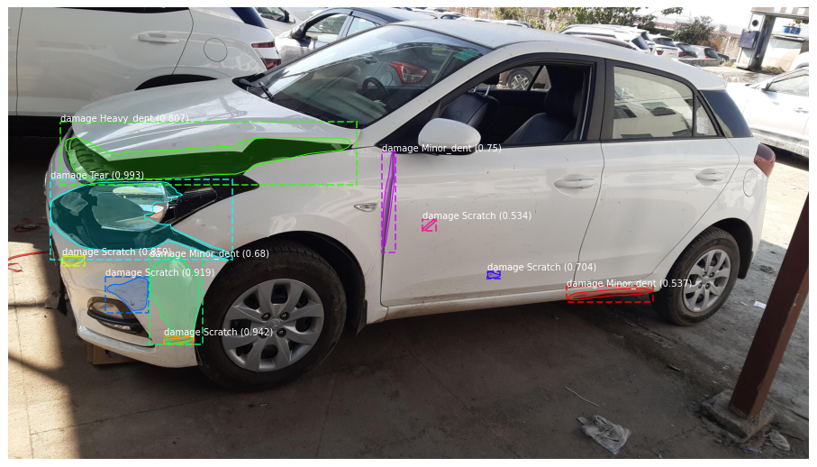
Damage Detection
www.actuariesindia.org

Slide 6
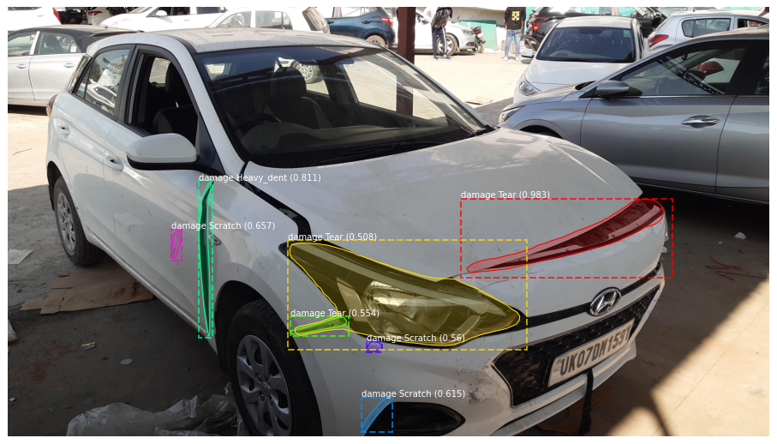
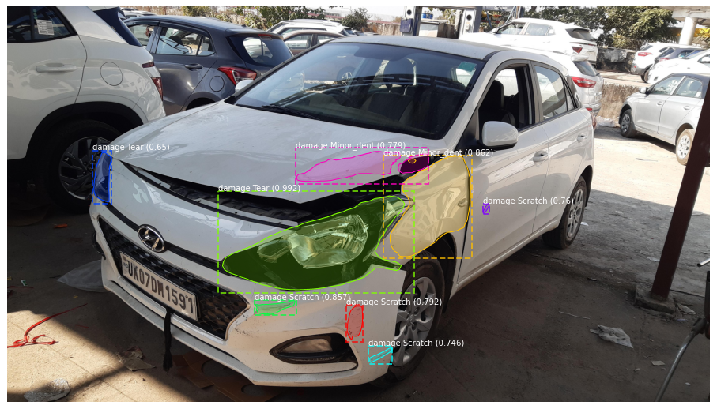
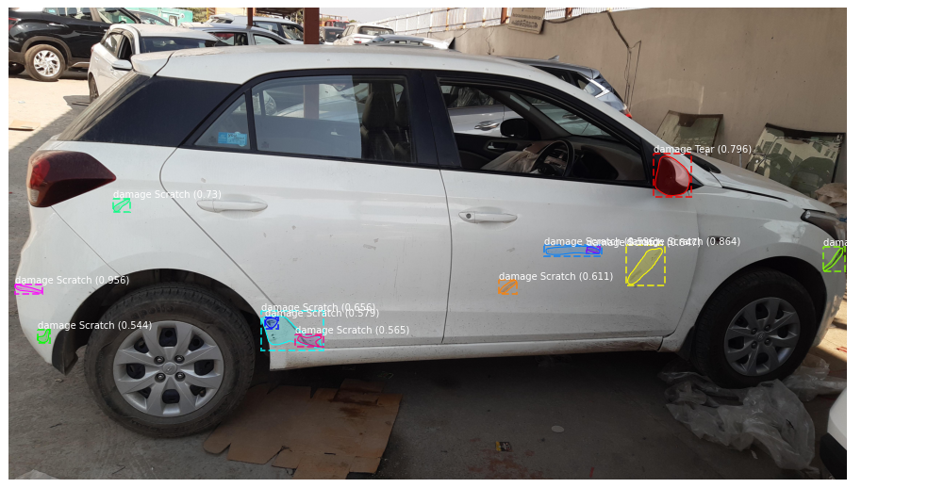
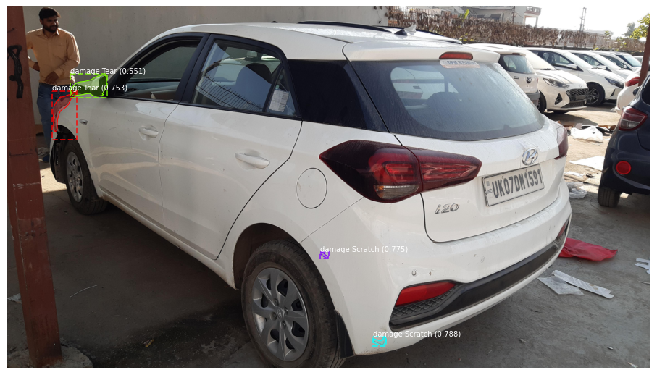
Model output – 360 degree view
www.actuariesindia.org

Slide 7
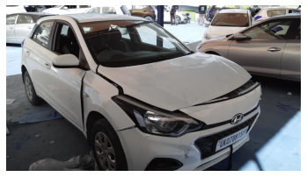
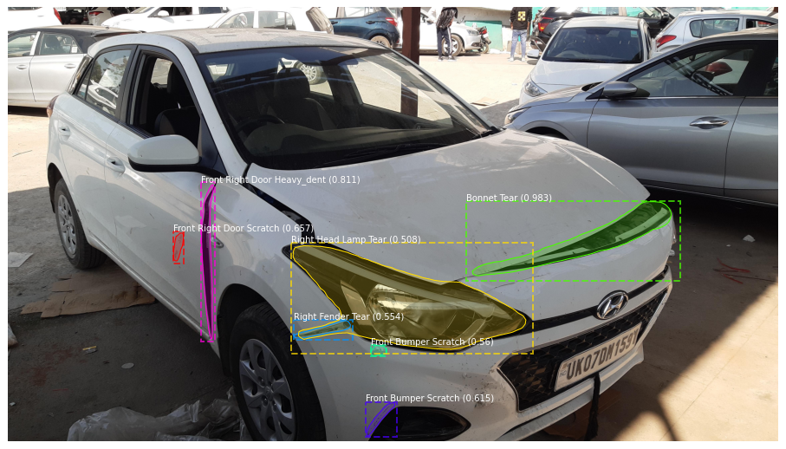
Model Pipeline
Final Output
Damage Detection Model
Relative overlap >= thresh
Input Images of a claim
Final Output :
Part + Damage + Damage Severity + License Plate Number
Part Detection Model
View Identifier
Front View?
Yes
License Plate Extraction
www.actuariesindia.org

Slide 8
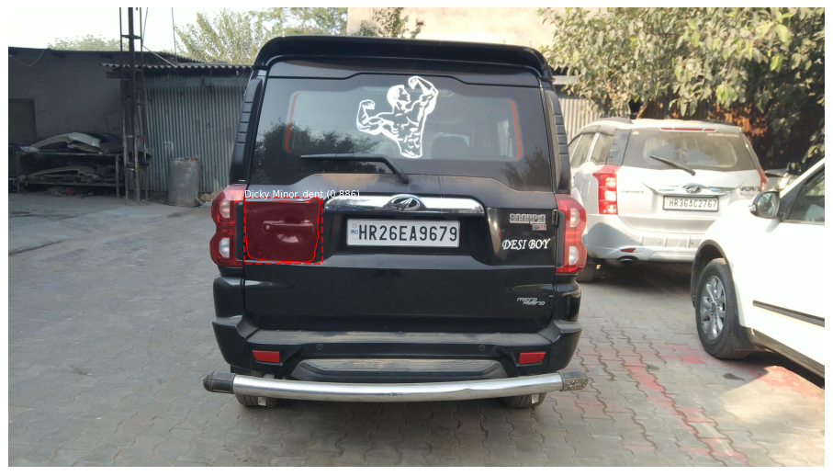
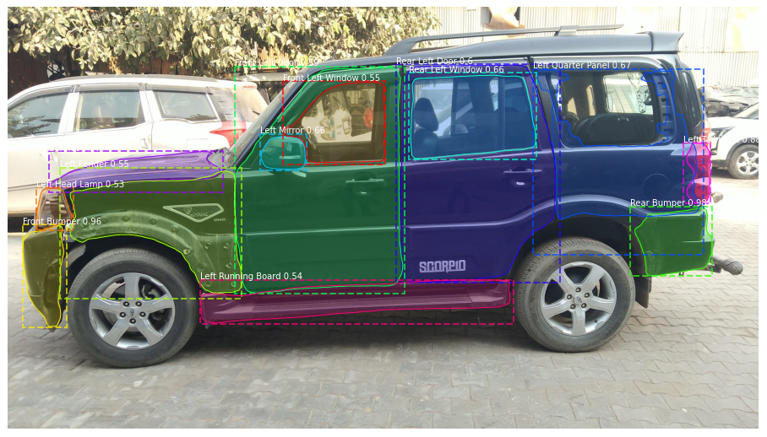
Example of Model’s Limitation
Model can see it is not quarter panel but doesn’t know what else it could be.
Vary few cars have dicky with door handle. Model is interpreting it as dent
www.actuariesindia.org

Slide 9
Poll 1
Which one of the following is an example of an unstructured data?
Excel table
SQL database
Image
Likert scale output
www.actuariesindia.org

Slide 10



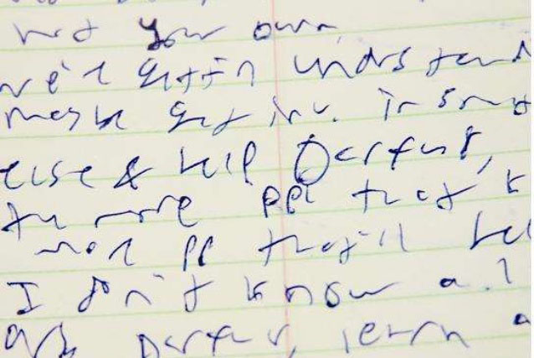
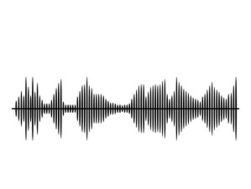
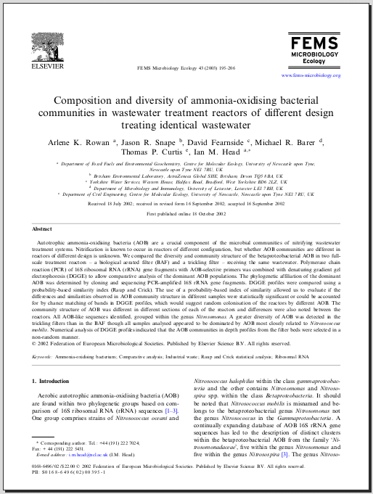
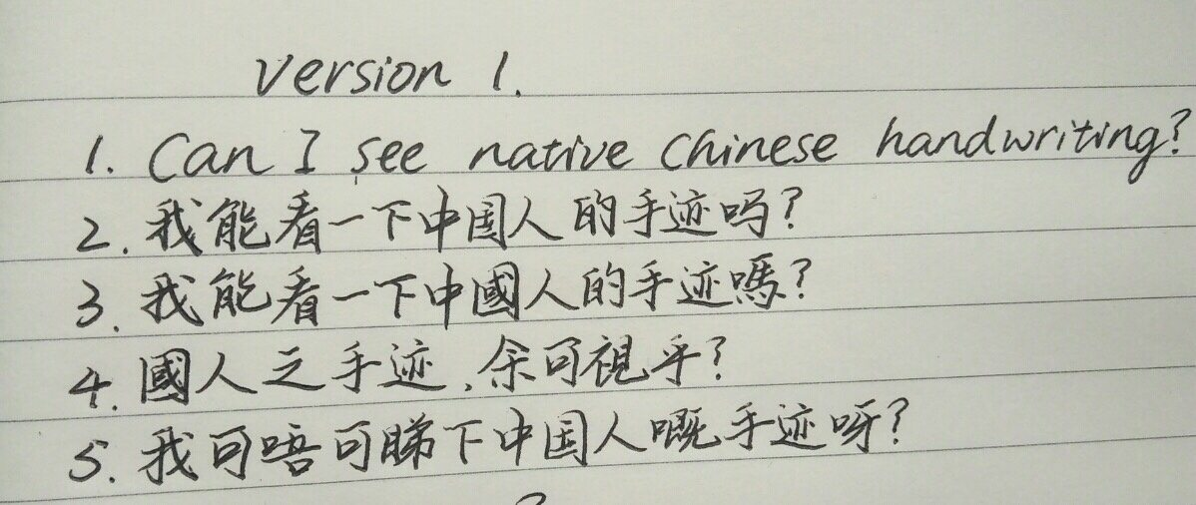

Examples of unstructured data
www.actuariesindia.org

Slide 11
Steps of building a model
Supervised learning
Define:
  Y – Dependent variable
  X – Independent variables
Data cleaning
Initial insight gathering steps
Building a preliminary model
Adjusting or tuning variables/factors
Understanding errors and fixing them
X
Y
Claim frequency | Fuel | Make | Location
25% | Diesel | Hyundai | Delhi
10% | Petrol | Maruti | Mumbai
www.actuariesindia.org

Slide 12
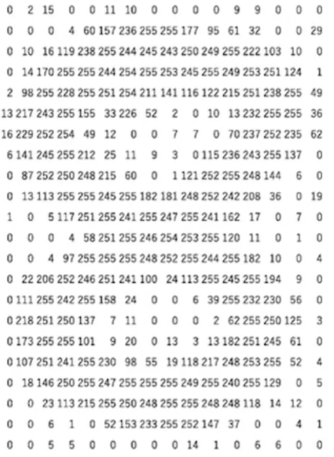
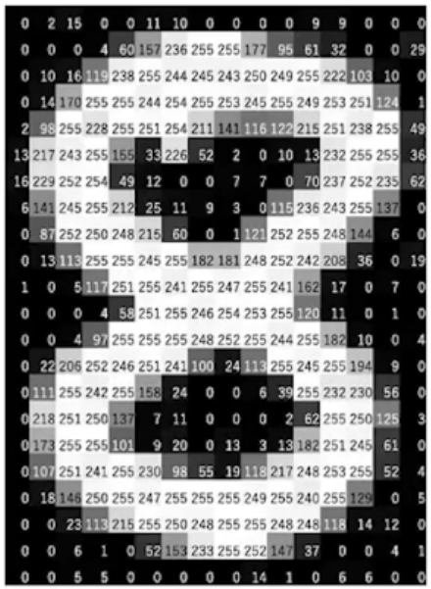


Understanding images
16
How to build a model on images:
Each image has a number of pixels
Each pixel can be represented with a numeric value
An image can be converted into a matrix of numbers
21
For one image in the dataset
Matrix X dimension = (21 x 16)
www.actuariesindia.org

Slide 13
Defining X
n
0
2
15
0
0
11
10
0
0
0
0
9
9
0
0
0
0
0
0
4
6
0
157
.
.
.
.
0
How to build a model on images:
Each image has a number of pixels
Each pixel can be represented with a numeric value
An image can be converted into a matrix of numbers
0 | 173 | 232 | 156 | . | . | . | 157
2 | 203 | 143 | 216 | . | . | . | 133
15 | 169 | 140 | 215 | . | . | . | 117
0 | 3 | 19 | 99 | . | . | . | 78
0 | 131 | 3 | 204 | . | . | . | 211
11 | 180 | 234 | 75 | . | . | . | 12
10 | 148 | 223 | 25 | . | . | . | 13
0 | 247 | 231 | 148 | . | . | . | 205
0 | 156 | 112 | 105 | . | . | . | 192
0 | 178 | 47 | 251 | . | . | . | 114
0 | 18 | 110 | 105 | . | . | . | 254
9 | 58 | 129 | 223 | . | . | . | 160
9 | 190 | 167 | 67 | . | . | . | 182
0 | 205 | 85 | 30 | . | . | . | 252
0 | 251 | 59 | 177 | . | . | . | 51
0 | 35 | 240 | 205 | . | . | . | 122
0 | 179 | 119 | 115 | . | . | . | 20
0 | 93 | 83 | 38 | . | . | . | 100
0 | 191 | 167 | 178 | . | . | . | 105
4 | 159 | 96 | 173 | . | . | . | 45
6 | 81 | 89 | 84 | . | . | . | 168
0 | 229 | 175 | 97 | . | . | . | 189
157 | 45 | 204 | 80 | . | . | . | 161
. | . | . | . | . | . | . | .
. | . | . | . | . | . | . | .
. | . | . | . | . | . | . | .
. | . | . | . | . | . | . | .
0 | 24 | 54 | 47 | . | . | . | 48
336
336
For one image in the dataset
Matrix X dimension = (21 x 16)
= (336 x 1)
For n images in the dataset
Matrix X dimension = (336 x n)
www.actuariesindia.org

Slide 14
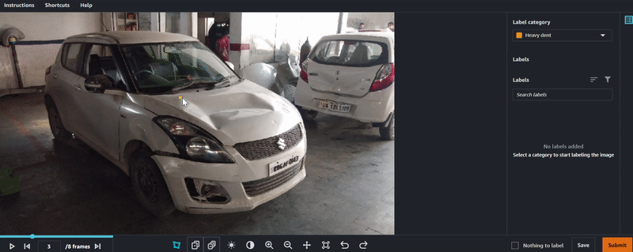
Defining Y
We are interested in identifying damage
Where in the image is the damage
How much area does it cover
What is the intensity of it
Damage area coordinates
{"x":2112,"y":993},
{"x":2394,"y":956},
{"x":2865,"y":899},
{"x":3168,"y":1003},
{"x":3283,"y":1234},
{"x":2870,"y":1296},
{"x":2582,"y":1411},
{"x":2284,"y":1275},
{"x":2018,"y":1192}
Annotation
Y =
2112
993
2394
956
2865
899
.
.
.
3
Intensity = Heavy Dent
www.actuariesindia.org

Slide 15
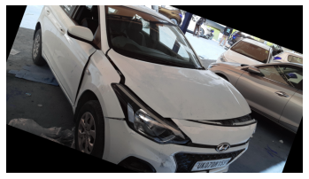
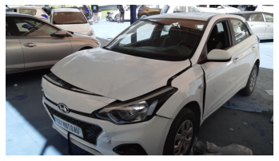
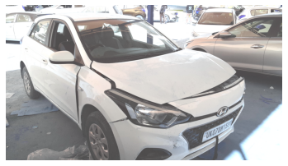
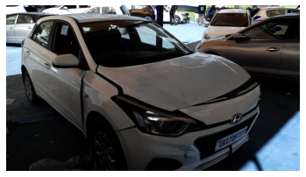
Data augmentation
Rotated
Original Image
Horizontal flip
Brightened
Augmentation helps by increasing data volume
Contrasted
www.actuariesindia.org

Slide 16
Neural Networks
Poll 2
What is the layer between the input and output layer of a neural network called?
Hidden layer
Open layer
Neural layer
www.actuariesindia.org

Slide 17

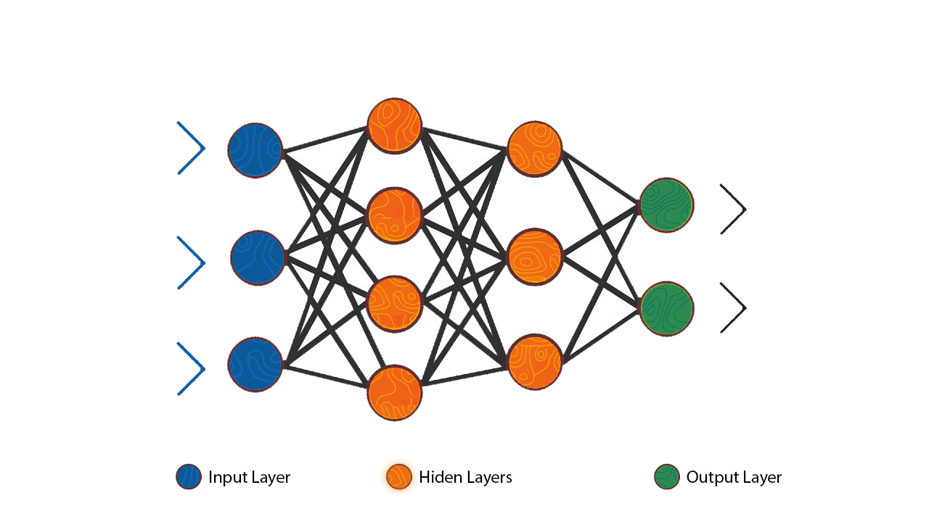
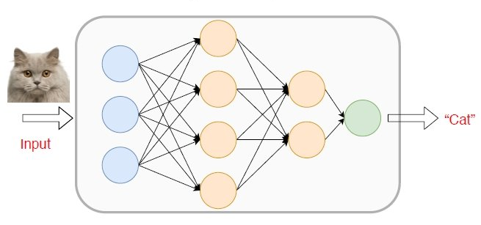


Neural Networks
Artificial NN
Convolutional
NN
Recurrent NN
www.actuariesindia.org

Slide 18
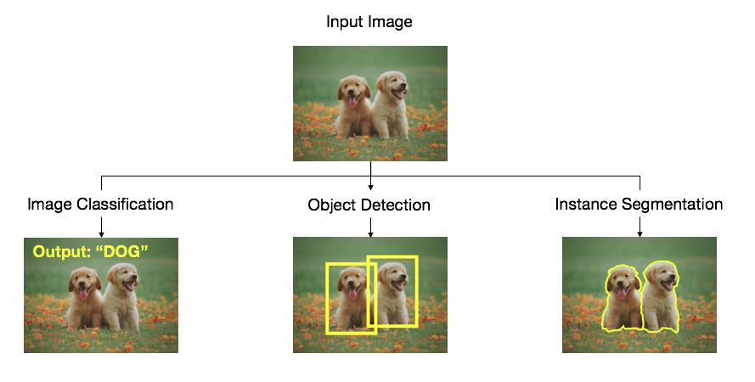

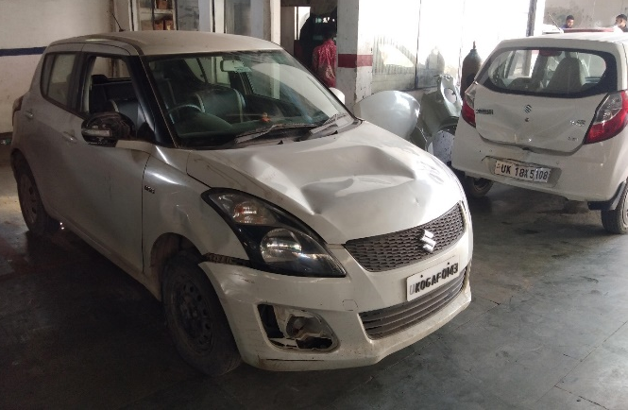

Convolutional neural network output types
Damage = Yes
www.actuariesindia.org

Slide 19



Convolutional Neural Network
Convolution
Edge
There is an edge present in the middle
10 | 10 | 0
10 | 10 | 0
10 | 10 | 0
1 | 0 | -1
1 | 0 | -1
1 | 0 | -1
10 | 10 | 10
10 | 10 | 10
10 | 10 | 10
*
= 10x1 + 10x0 + 0x(-1) +
10x1 + 10x0 + 0x(-1) +
10x1 + 10x0 + 0x(-1)
= 30
= 10x1 + 10x0 + 10x(-1) +
10x1 + 10x0 + 10x(-1) +
10x1 + 10x0 + 10x(-1)
= 0
Vertical edge detector
10 | 10 | 10 | 0 | 0 | 0
10 | 10 | 10 | 0 | 0 | 0
10 | 10 | 10 | 0 | 0 | 0
10 | 10 | 10 | 0 | 0 | 0
10 | 10 | 10 | 0 | 0 | 0
10 | 10 | 10 | 0 | 0 | 0
0 | 30 | 30 | 0
0 | 30 | 30 | 0
0 | 30 | 30 | 0
0 | 30 | 30 | 0
1 | 0 | -1
1 | 0 | -1
1 | 0 | -1
*
=
Convolution
www.actuariesindia.org

Slide 20

Convolutional Neural Network
Convolution
Edge
There is an edge present in the middle
Vertical edge detector
0 | 0 | 0 | 10 | 10 | 10
0 | 0 | 0 | 10 | 10 | 10
0 | 0 | 0 | 10 | 10 | 10
0 | 0 | 0 | 10 | 10 | 10
0 | 0 | 0 | 10 | 10 | 10
0 | 0 | 0 | 10 | 10 | 10
0 | -30 | -30 | 0
0 | -30 | -30 | 0
0 | -30 | -30 | 0
0 | -30 | -30 | 0
1 | 0 | -1
1 | 0 | -1
1 | 0 | -1
*
=
Convolution
www.actuariesindia.org

Slide 21
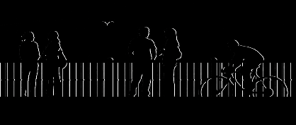
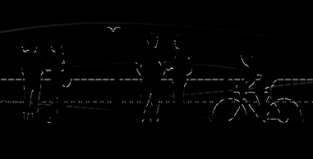
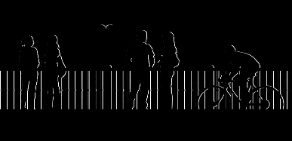

Convolutional Neural Network
vertical edges
Final output layer
horizontal edges
www.actuariesindia.org

Slide 22
Convolutional Neural Network
Poll 3
How many parameters are there in a typical convolutional neural network?
As many as the number of images
As many as the number of pixels
Tens of million
Can’t say
www.actuariesindia.org

Slide 23
Convolutional Neural Network
Final output layer
Pre Trained model
Transfer learning
Final output layer
Pre Trained model
Trained on our data
www.actuariesindia.org

Slide 24
Data overview
No of claims used for training | 1,705
No of images used for training | 10,150
No of claims used for validation | 171
No of images used for validation | 926
Damages per image | Frequency
1 | 2,960
2 | 2,233
3 | 1,528
4 | 1,061
5 | 765
>5 | 1,603
Total | 10,150
67%
Over sampling to fix class imbalance
www.actuariesindia.org

Slide 25
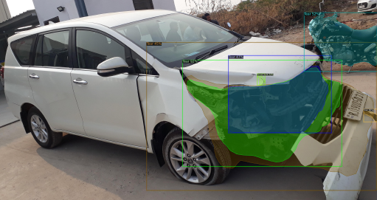
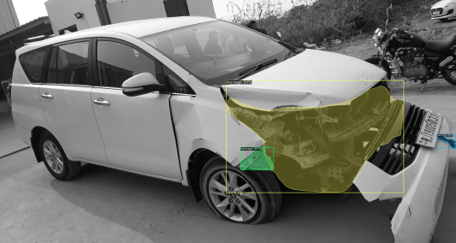
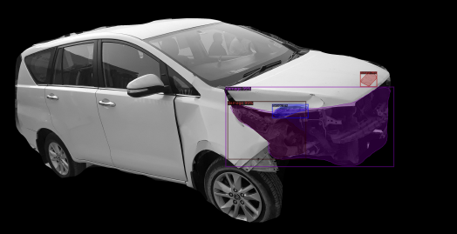
Iterations on the model
Damage localisation + severity classification
Define the problem
Develop Solutions
Monitor Results
Damage localisation with grey scale
Best among all 3 options | Accuracy 30%
Damage localisation + background subtraction
www.actuariesindia.org

Slide 26
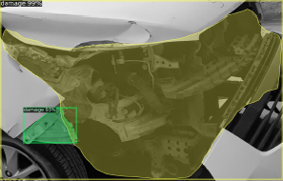
Iteration on our model
02
Iteration
MASK RCNN
>90
Final Damage localisation
Accuracy 50%
Damage localisation
03
MASK RCNN on cropped images
Iteration
>90
Final Damage localisation
Accuracy 65%
Damage localisation
www.actuariesindia.org

Slide 27
Iteration on our model
04
Unet on cropped images
Negative examples
Iteration
>90
Final Damage localisation
Accuracy 80%
Damage localisation
Negative examples
+
Rule Engine
04
Unet on cropped images
Iteration
>90
Final Damage localisation
Accuracy +90%
Damage localisation
www.actuariesindia.org

Slide 28
How to handle bias vs Variance
high bias
“just right”
high variance
High Bias
Train bigger model
Train longer/better optimization algorithms
NN architecture/hyperparameters search
High Variance
More data
Regularization-L2, Dropout, Augmentation
NN architecture/hyperparameters search
www.actuariesindia.org

Slide 29













Resources
Programming Packages- Open Source
Knowledge resources
Foundation
Models-Open Source
U-Net
Faster RCNN
Yolo
Mask RCNN
Model Training Platform
www.actuariesindia.org

Slide 30
Questions?
www.actuariesindia.org

