Slide 1


Analytics in General Insurance
29 Oct 2021
Advanced Analytics in
General Insurance – Use Case - IFRS 17 Consequences
Stefan De Lombaert
SAS – Global Leader Risk & Finance Insurance Solutions

Slide 2
























SAS and IFRS 17
70 insurers worldwide already use the SAS solution for IFRS 17/LDTI
24 in APAC
3 large pan-asian life insurance groups in Hong Kong and 1 international insurer in Greater China
1 large life insurance group in South Korea
6 large insurance groups in Malaysia
5
1
5
1
2
1
3
3
1
6
2
1
1
1
1
27 in EMEA
Several international primary insurance groups, based in Germany, Switzerland, the Netherlands, France, Spain, UK, Slovakia, Slovenia, Turkey, Greece, Croatia, Portugal, ….
3 large international insurance groups (incl. 1 reinsurer) based in France
2 international insurance groups (incl. 1 credit insurer) based in Spain
2 regional insurers based in South Africa
8
18 in Americas
1 subsidiary of an international insurance group in Mexico
5 large regional insurance groups in Canada
2 US insurers addressing IFRS 17 and 1 addressing LDTI
5 insurers in Brazil
2
6
2
5
2
This Photo by Unknown Author is licensed under CC BY-SA

Slide 3



IFRS 17 will force business change
IFRS 17 has fundamentally changed the way the financial reporting is done going forward;
Insurers will, as bankers already do, recognize profit as coverage is evolving (accrual principle), so a lot of profit is put on the BS.
Loss is taken immediately, so it remains in the IS.
Furthermore, we will now clearly see the different contributors to the result, with a split between underwriting & financial results
New KPI’s
Different way of Budgeting/Planning the future

Slide 4
IFRS 17 : New KPI’s
Other
Business (Future)
Business (Future)
Risk
Other
Profitability (Current)
Sensitivity
Sensitivity analysis by scenarios
Measures run-off by scenarios
Changes in OCI reserve
Business reserve and growth
AoC Monitoring
CSM run-off projection (vs premium and capital requirement)
Profitability (Current)
Risk
Business profits and ROE
Growth of insurance business
Loss ratio & A/E Analysis
Combined Ratio
Component analysis
IFRS 17 ROE
Volatility and onerousity flip
LC & RA waterfall
LC & RA run-off projection
LC & RA portfolio distribution

Slide 5
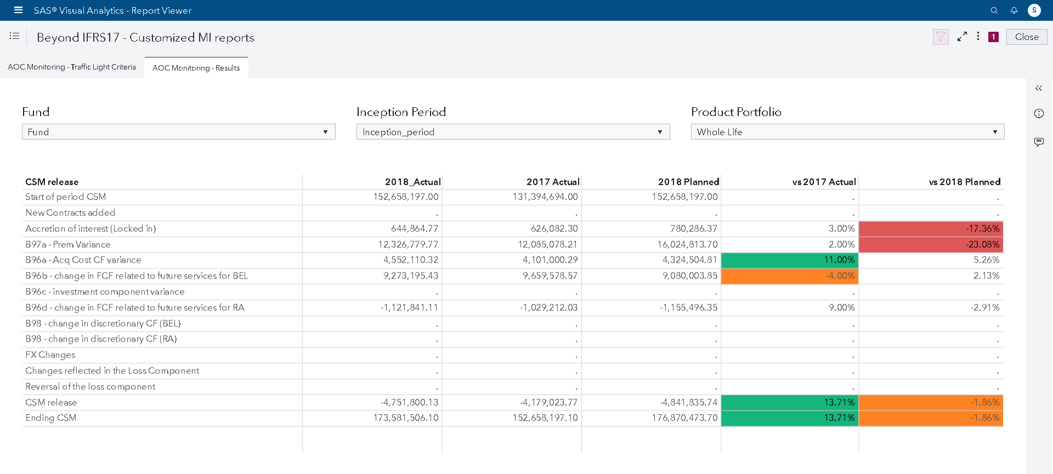
Analysis of Changes (AoC) Monitoring

Slide 6
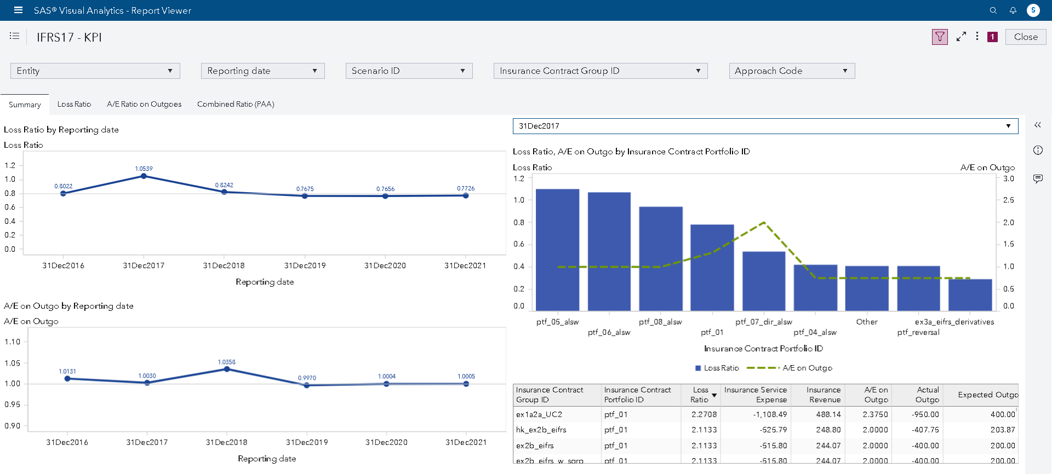
Loss Ratio, Act/Exp & Combined Ratios

Slide 7
Planning and budgeting – why again?
Capital requirement regimes, accounting standards – introduce new approaches to measurement, new CoA, finally – new KPIs to view the financial position of insurance company. This always leads to the task of adjusting the existing planning activities to new measures, views, scenarios.
Solvency II
Pillar II – ORSA, Capital Planning
Recent situation of declining profits, climbing cost of capital and volatility resulting from introducing IFRS17 enforces the need of scenario-based projections and managing the capital even more efficiently
Financial Condition Testing
(Canada)
Forecast of financial position under several scenarios
Dynamic Solvency
Test (Mexico)
Capital projection under several scenarios
IFRS 17
Planning and forecasting adjusted to new CoA
Stress testing,
especially after pandemic
Scenario based projections;
Latest EU stress test require two versions of BS – without and with guided reactive management actions included

Slide 8
Poll Question 3
How are you currently involved in budgeting/planning?
Part of data analytics team/projects in my company
Working on business modelling in my company
Currently training on budgeting/planning
No involvement yet

Slide 9
Poll Question 4
Which timeline does your company consider for budgeting/planning?
1 to 3 years in the future
1 to 5 years in the future
Another timeline (Which one ?)

Slide 10
Poll Question 5
Which timestep does your company consider for budgeting/planning?
Monthly
Quarterly
Semi-annual
Annual
Other (e.g. first Monthly for Y1, then Quarterly for Y2-3, then Yearly)

Slide 11




Possible approaches
history
projected periods
t₀
t₁
t₂
t₃
1
Detailed calculations
For each future reporting period the system obtains the same input data as for the last reporting period (t₀).
The system performs the calculations for each of the future periods using the same approach as for t₀.
2
Projection of inputs
projection
projection
projection
Based on inputs (exp cashflows, actual cashflows) at t₀, the system generates (using a predefined logic) the inputs for the next reporting periods.
The system performs the calculations for each of the future periods using the same approach as for t₀.
3
Projection of results
Based on BS and SCI at t₀, the system generates (using a predefined logic) the values of accounts of BS and SCI for each future period.
projection
projection
projection
Notes:
Grey inout data are the ones provided by the Customer, yellow ones are generated by the system

Slide 12
Possible approaches
history
projected periods
t₀
t₁
t₂
t₃
1
Detailed calculations
For each future reporting period the system obtains the same input data as for the last reporting period (t₀).
The system performs the calculations for each of the future periods using the same approach as for t₀.
2
Projection of inputs
projection
projection
projection
Based on inputs (exp cashflows, actual cashflows) at t₀, the system generates (using a predefined logic) the inputs for the next reporting periods.
The system performs the calculations for each of the future periods using the same approach as for t₀.
projection
projection
projection
projection
3
Projection of results
Based on BS and SCI at t₀, the system generates (using a predefined logic) the values of accounts of BS and SCI for each future period.
projection
projection
projection
projection
projection
projection
projection
Notes:
… amd in fact the task looks this way, because projections need to be made under several scenarios

Slide 13



Initial analysis of the market
Need
Model for IS, BS and capital projection and finally capital planning; it is part of Own Risk and Solvency Assessment (ORSA); generic model for non-life is prepared; to be adjusted to local requirements; platform: SAS IPS
CP A3
IFRS 17 A2
  Projection of IFRS17 IS and BS, where the input data are projected and full IFRS17 calculations are performed for each future period and each scenario; set of KPIs and reports included; platform: SAS Stratum
IFRS 17 A3
Simplified model of non-life projections for PAA; including set of reports;
Platform: SAS IPS
OPlanning
Operational planning and budgeting;
Platform: SAS IPS
Notes:
Furthe on, only the first two will be discussed

Slide 14


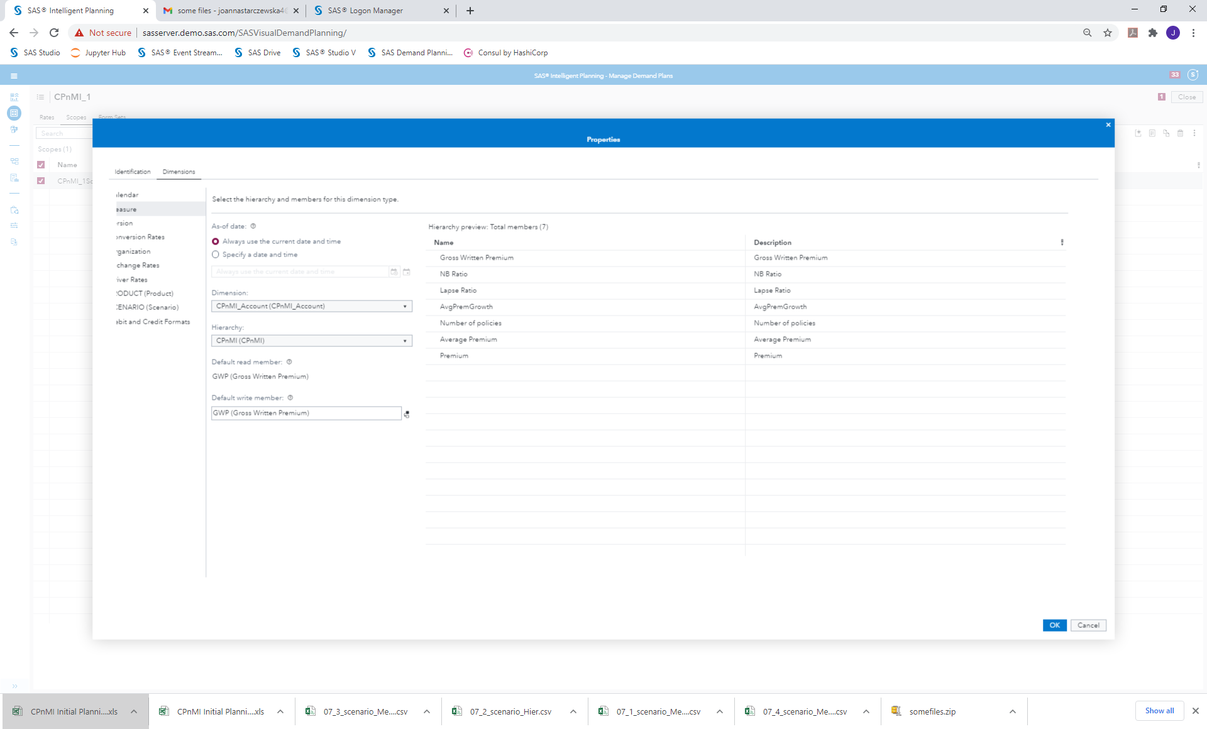
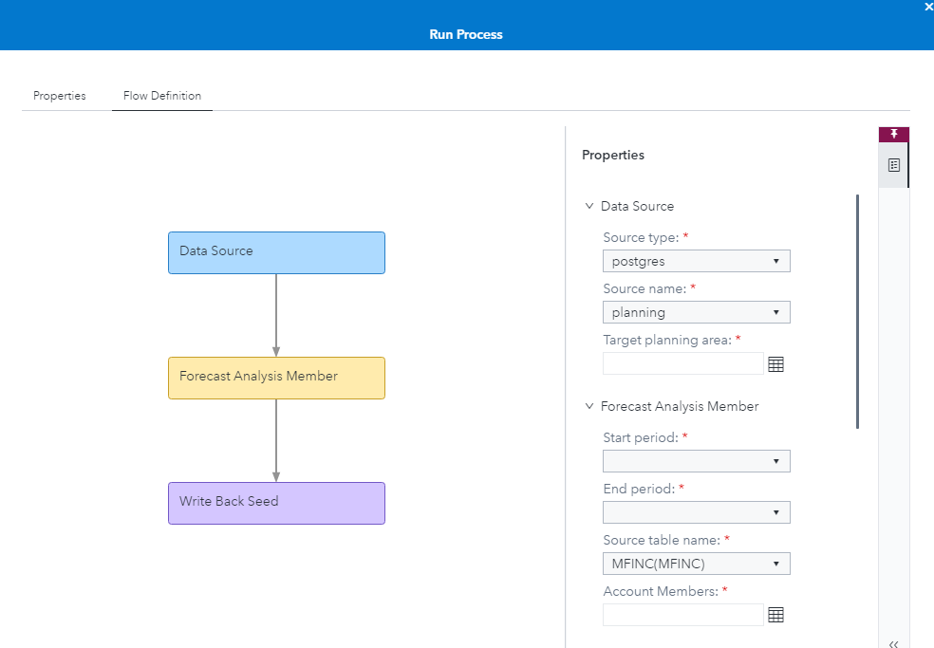
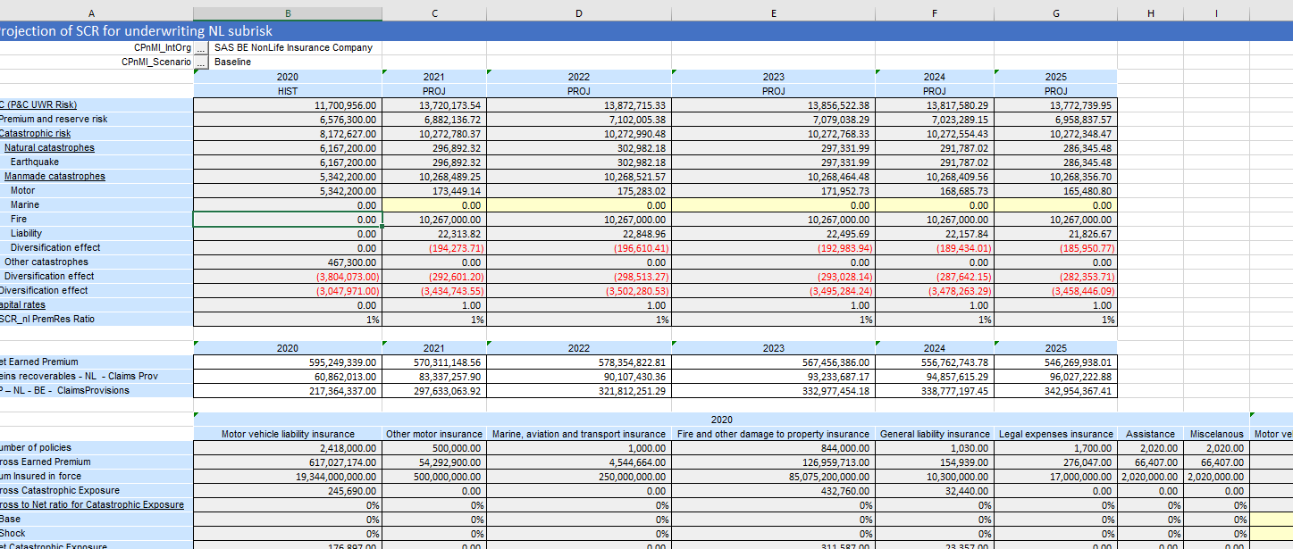
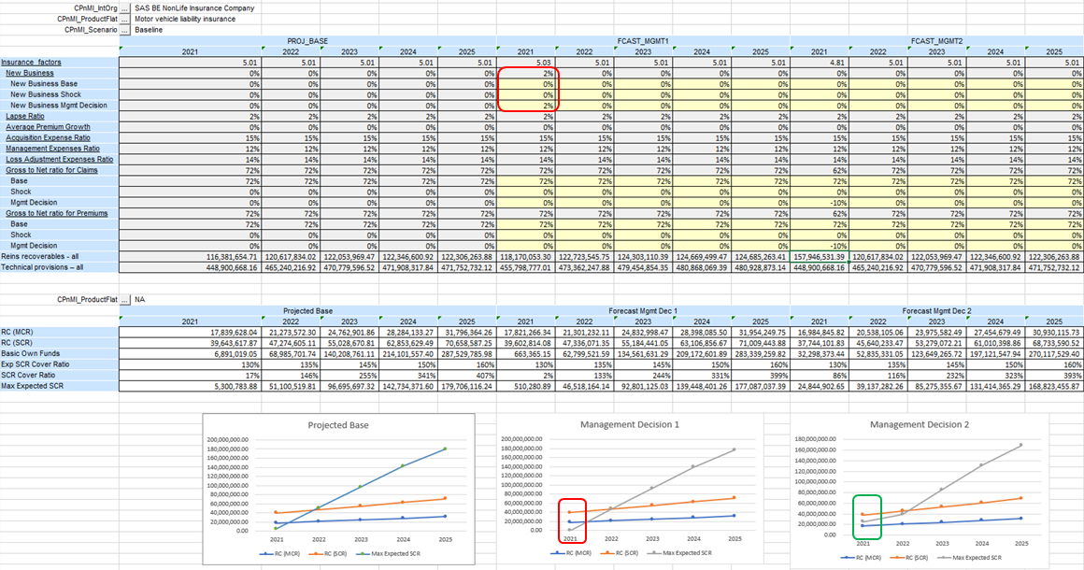
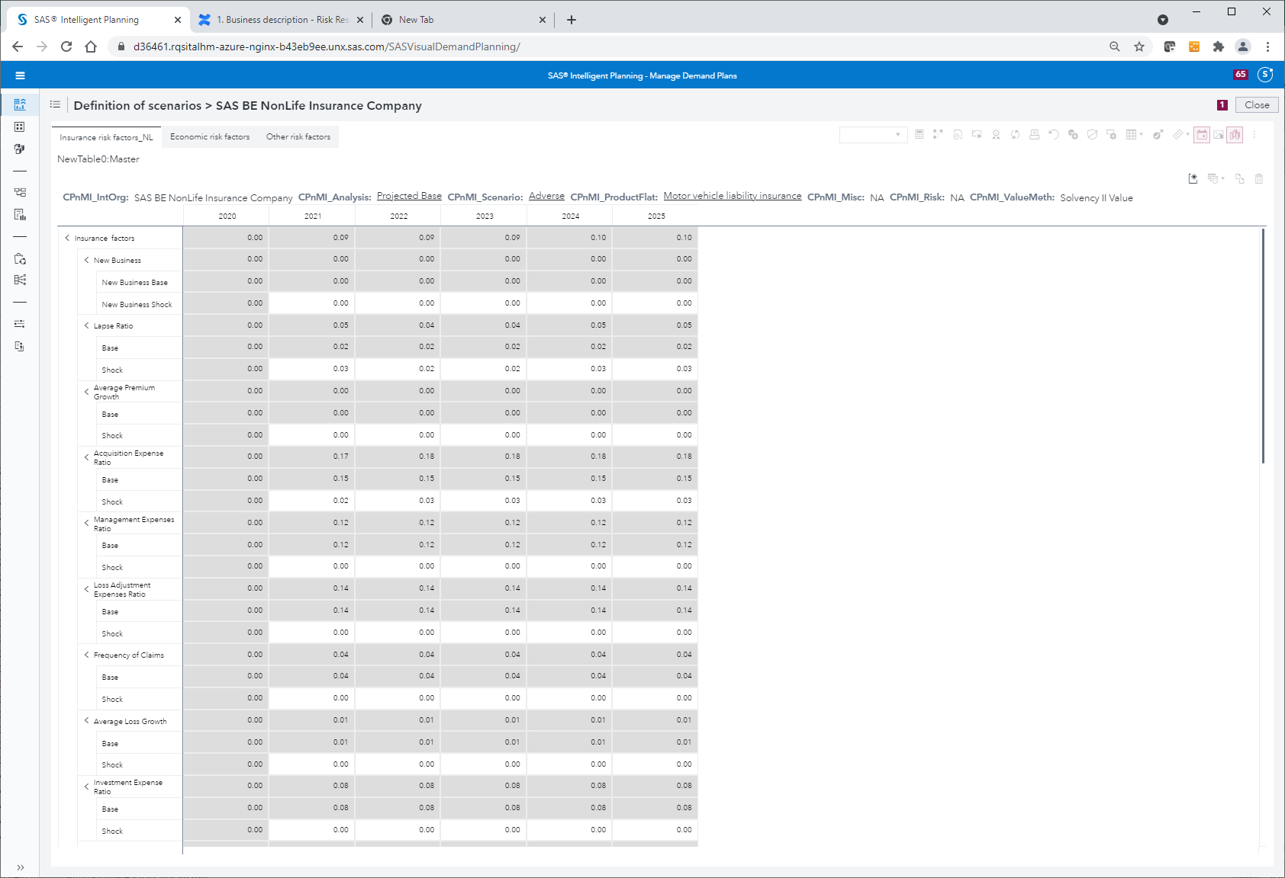
Capital Projection A3 : Process
Definition of the business model
Prepare the input data
Projections
Analyze mgmt decisions/Optimization
Definition of economic factors
Definition of Technical (insurance) risk factors
Definition of the approach to forecasting the risk factors
Definition of derivation formulas where possible
Load the input data - historical time series
Definition and running the forecasting models for the risk factors
Derivation of proxy functions using LSMC
Load the input data on BS and P&L/ SCI
Define scenarios
Based on input data and predefined model – perform projections for all required items under all scenarios
Test alternative management decisions by changing mgmt decision factors, recalculate and analyze their influence on final measures
Optimization
Premium projection
Claims projection
Assets projection
Capital Requirements projections
Other products’ specific projection
KPI calculations

Slide 15
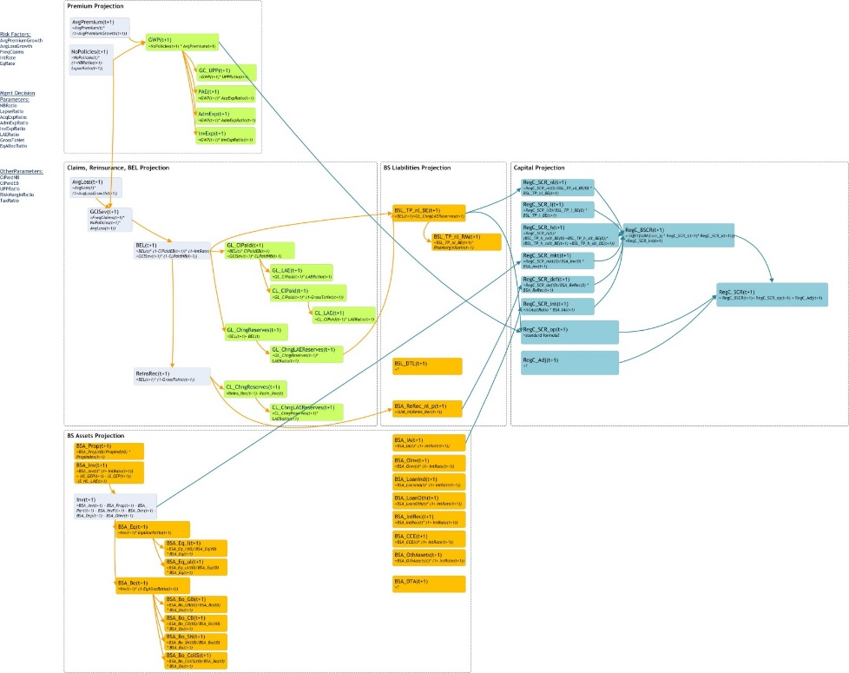
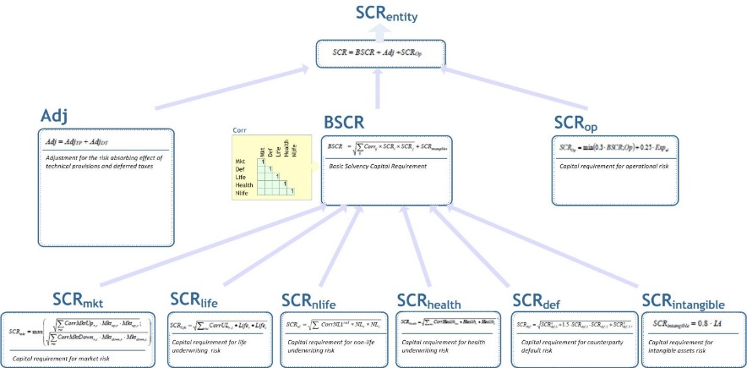
Capital Projection A3 : Business model
Risk Factors
Income Statement
Balance Sheet
Capital required
Risk measures
Parameters
Capital owned
Insurance Risk factors
(subject to shocks and some are subject to management actions):
NB ratio
Lapse Ratio
Average Premium Growth…
Economic risk factors
Interest rate
Credit spread
Return on properties, equities..
Driver rates
Risk margin ratios
Capital rates or MCR..

Slide 16
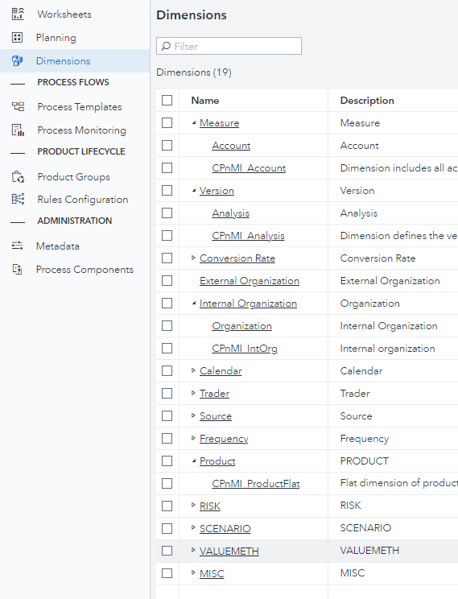
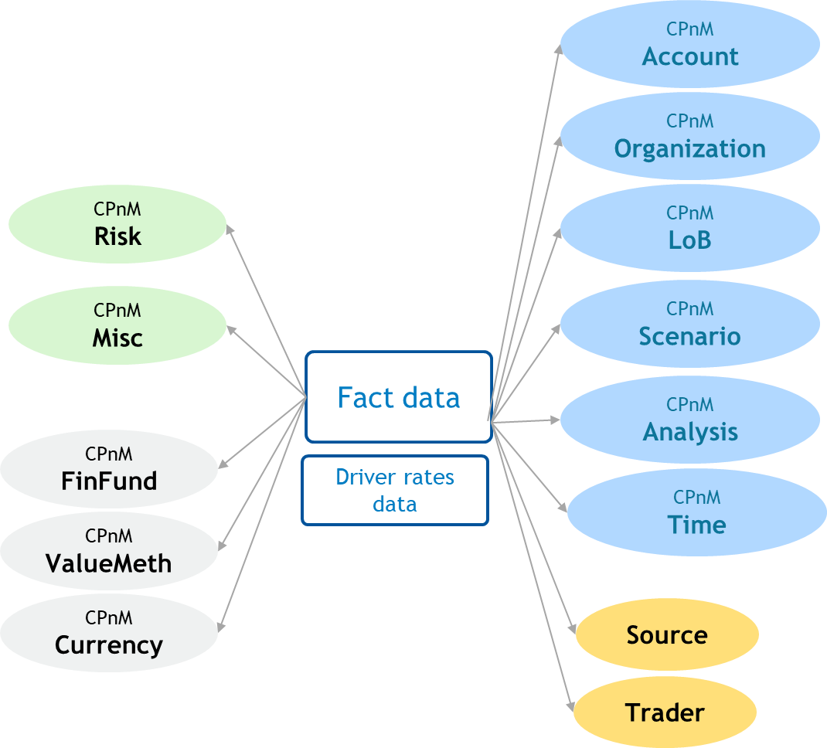
Capital Projection A3 : Multidimen model

Slide 17
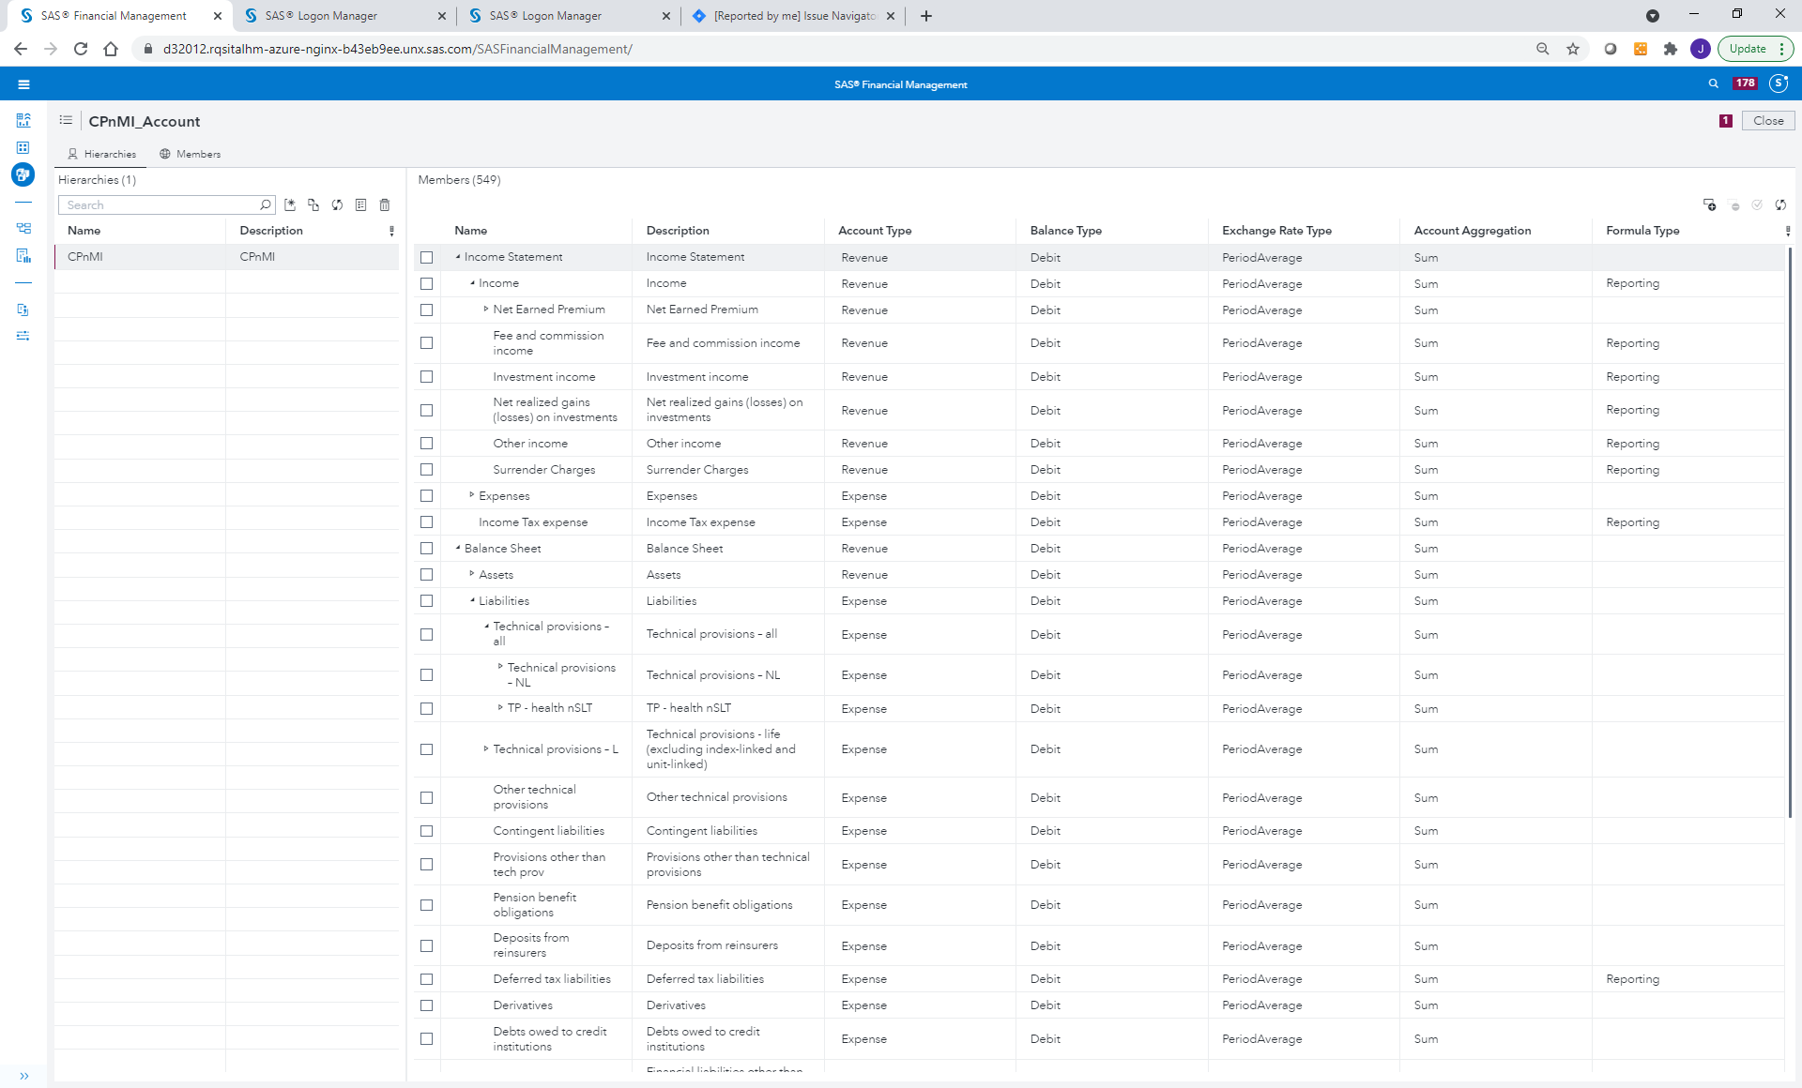
Capital Projection A3 : Multidimen model

Slide 18
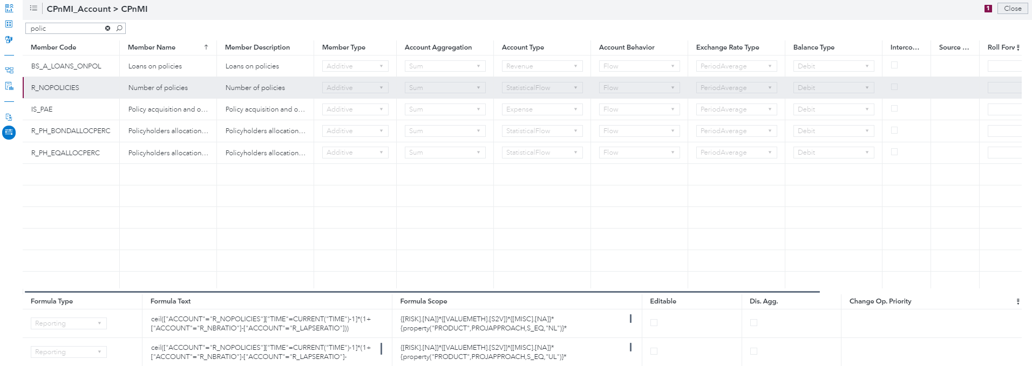
Capital Projection A3 : Multidimen model

Slide 19
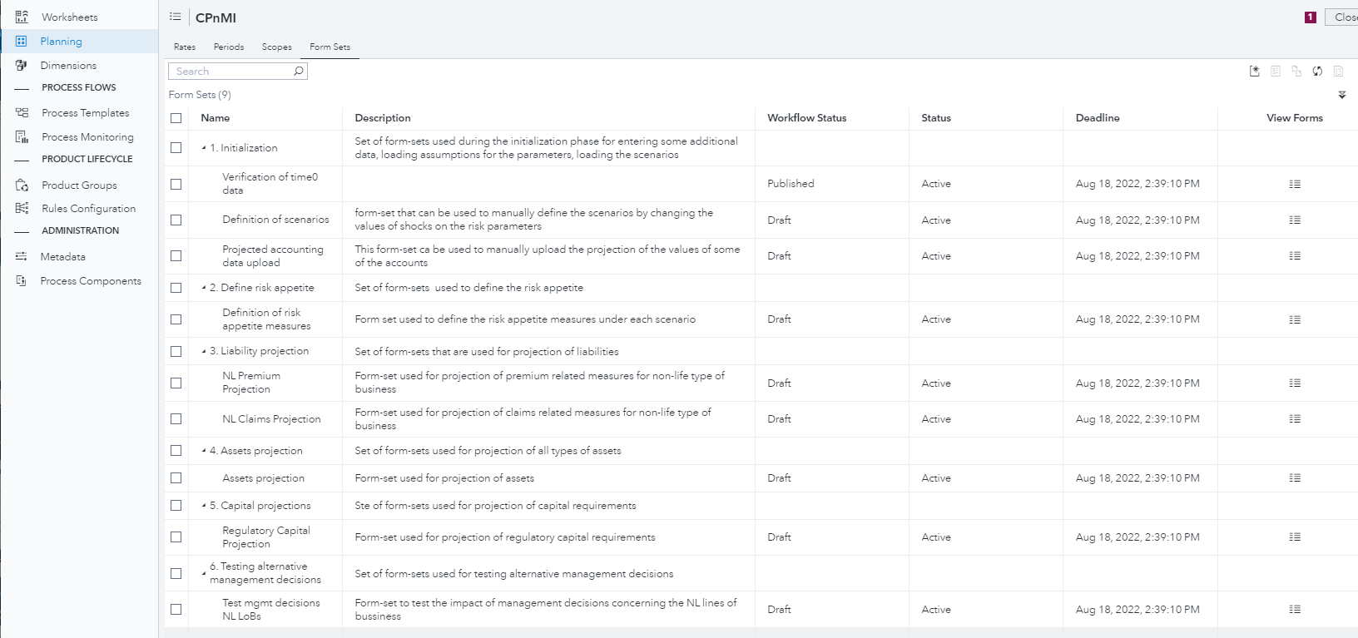
Capital Projection A3 : User Experience

Slide 20
Capital Projection A3 : User Experience

Slide 21
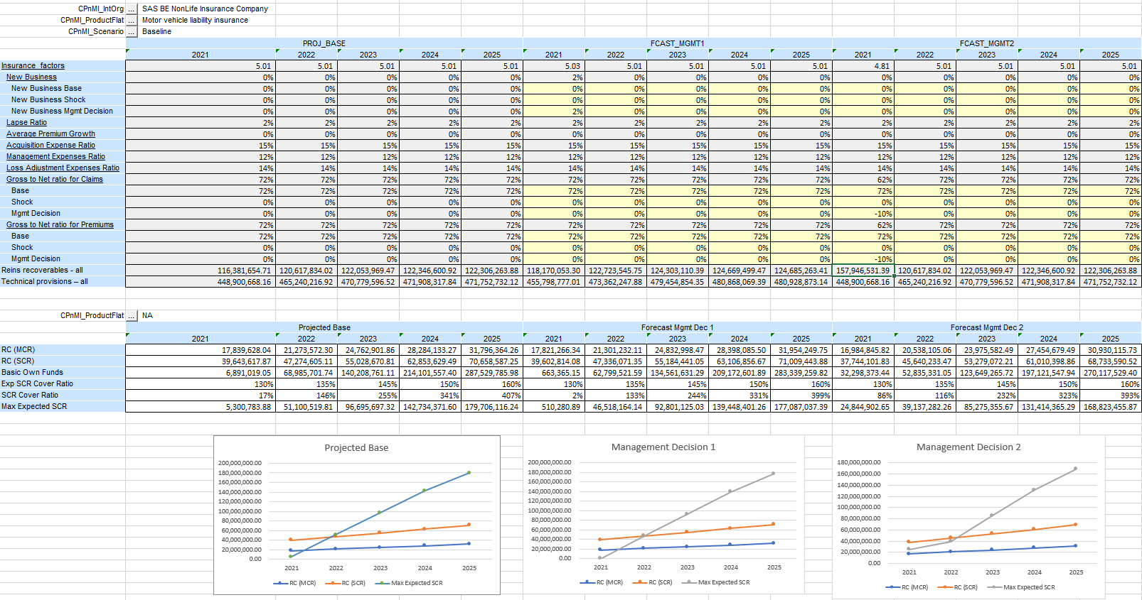
Capital Projection A3 : User Experience

Slide 22
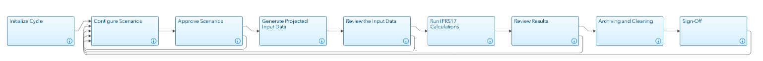
IFRS 17 Projection A2 : Process
Planning exercise should be run as a project/cycle using a certain template, for example:
Setting: length of projection, entity, granularity;
Possibly – cleaning the plans from previous years
Definition of parameters for each scenario – might be quite complex depending on the number and complexity of risk factors
Review of provided params (incl comparison against assumptions from previous period) and approval
Generation of packages of input data for each scenario and each projected reporting period
Using dedicated report to view pieces of the data
Using SAS or external tool to run the Ifrs17 calculations for each of t reporting periods and scenarios
Viewing the results (incl comparison against plans/projection from previous years)
Archiving and deleting some of the data
Exclusions
Some requirements
Generation of input data for other than SAS IFRS17 tool will be subject of the implementation project
No stochastic calculations (with thousands of scenarios)
CFs for life:
  Generation excluded
  Modification yes
  Proxy possibly
Planning on monthly basis for first year and then on quarterly or annual basis for remaining years
System should be able to differentiate the real input data for given period from those which are generated by the planning project/cycle
System should be able to store the results with adequate labels of projects enabling the comparison of the projected values against the realized ones.
There should be a set of KPIs and reports provided that would enable meaningful comparison of the results

Slide 23
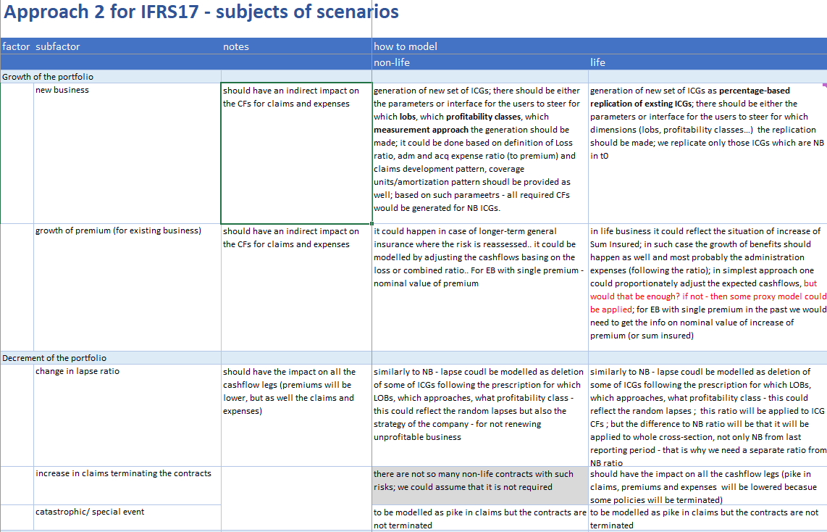
IFRS 17 Projection A2 : Assumptions
for data generation
Scenarios should make allowance for several aspects:
Growth of the portfolio
Decrement of the portfolio
Changes in expenses
Changes in Technical risk
Changes in reinsurer’s shares
Changes in economic factors (IR, FX)
System should also enable to simulate:
New ICG belonging to the same mutualization group
Difference between expected and actual CFs
Changes in the expectations
Changes in risk adjustment
Changes in counterparty (reinsurer’s) default risk

Slide 24
IFRS 17 Projection A2 : Data storage
There should be a proper archiving + cleaning process in place
Unless given Customer would require to make comparison of plans vs plans from previous years:
Grey arrows present the projection based on data from t₀
Blue arrows present the comparison of realization (actuals) against the plan (from recent and previous years)
Brown arrows present the comparison of plans

Slide 25
IFRS 17 Projection : Planning Report Mart
To manage big volumes of data and enable separation of real closing values from those which are part of planning or stress testing exercise, it would be recommended to introduce a planning report mart (PR)
Landing Area
Personal Area
Subledger
Result Report Mart
For each k_x_l of calculations (k – nbr of scenarios, l – nbr of planned periods), dedicated Landing Area folders, data in Personal Area and finally data in Subledger and Result Report Mart would be created.
Reports on plans, monitoring realization could be created based on the data in PR
Those data could be kept only during the planning process. Once the plan is accepted, then only a selection of results is pushed to the Planning Report Mart. All of the data in {Landing Area, Personal Area, Subledger, Result Report Mart} for those projects would be „erased”
Planning Report Mart (PR)
Questions:
Which data scope?
What level of granularity?
Realized/actual values could be copied to PR to enable verification of planned vs realized values

Slide 26
Overall planning / projections
RISK MANAGEMENT
Projection of basic figures
Premium
Claims
Expenses..
ACCOUNTING
Projection of Solvency II provisions
Premium provisions
Claims provisions
Projection of
Assets
Other BS items not related to liabilities
IFRS17’ related projections
Liability for remaining coverage
Liability for incurred claims
Statement of Comprehensive Income
Projection of Solvency II Balance Sheet
Integrated IFRS Balance Sheet
Projection of Solvency II Capital Requirements
Premium provisions
Claims provisions

Slide 27
SAS’ Vision
Solutions
P&C Pricing
IFRS 9 CECL
IFRS 17 LDTI
Solv II ICS 2.0
Reserving
MRM
Budgeting
ALM
……
Common Business Objects
Common Data Repository
Workflow
Reporting
Technology
Model Implementation Platform
Infrastructure for Risk Management
Risk Governance Framework
Deployment
On premise
Hosted
Cloud
RaaS
This Photo by Unknown Author is licensed under CC BY-NC

Slide 28
Separation of Platform and Content
Quicker Release of Regulatory Updates
IFRS 17
Open Platform for Content Development
Content can be developed by Customers or Partners
Market Risk
Insurance
ORSA
Custom
Content
Partner
Content
Pricing
Underwriting
risk for P&C
IFRS 9
Content
Packages
Solvency II
ICS 2.0
Technical Platform
SAS Infrastructure for Risk and Finance Management
Technical Platform
Openness
Versioning
Automation
Transparency
Cooperation
Use of different functionalities
Use of existing models and methods (without migration to SAS)
Keep old versions after changes
Easy deployment of updates
Improved Performance: System optimizes the processing automatically
In-memory and parallel computing
Availability of documentation on activity level
Traceability and Reconciliation
Efficiency within and across teams
Re-use of processes and methods
Reporting Engine
Configuration
User Interface
Solution
Data Mart
Data Management
Execution Engine
UI for DQ rules
UI for SLAM configuration
Unified user experience
Customization of interface
Process Manager

