Slide 1


Analytics in General Insurance
29 Oct 2021
Advanced Analytics in
General Insurance – Use Case – Optimization
Sharad Bajla
SAS – APAC Leader Actuarial Transformation

Slide 2



Agenda
Use Case on Optimization (Sharad)
  Introduction
  The Process
  Advanced Algorithms
  Time to Market
  Visualization
  Governance
Use Cases on IFRS17 Consequences (Stefan)
Questions
www.actuariesindia.org

Slide 3
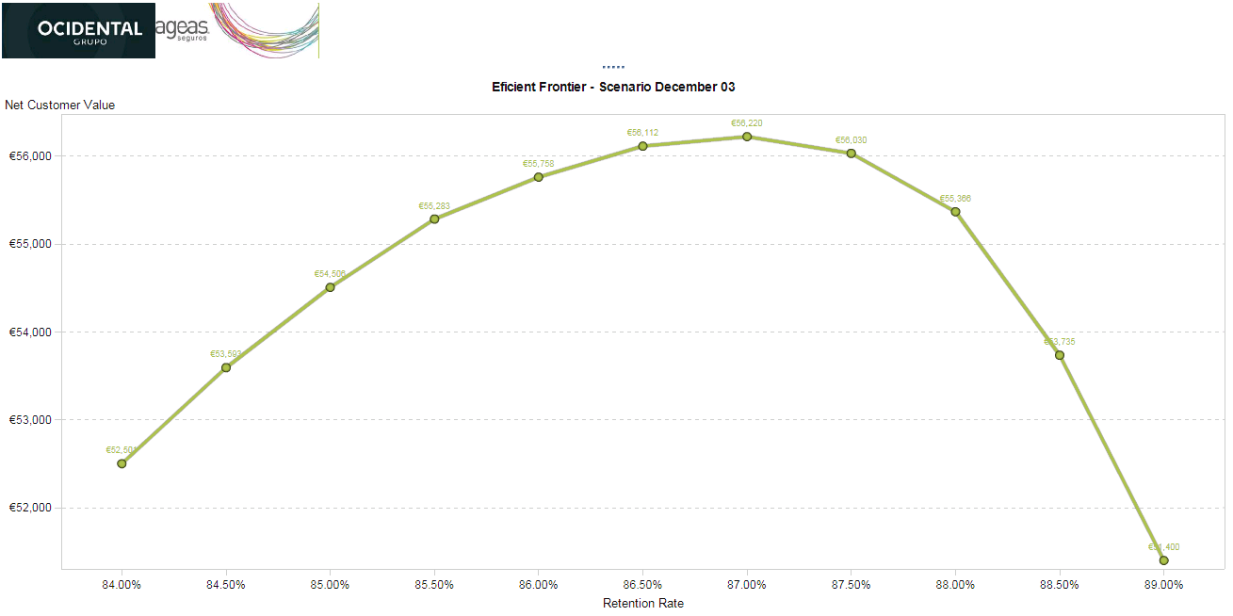
The Efficiency frontier
Maximum
Each point in the frontier is a single scenario (includes all the portfolio policies) with a certain retention rate (constraint) and a profit as result, every point is an optimized scenario
“Not doing anything” is the
base scenario with the
maximum retention rate
If you increase the Price profit increases but retention rate decreases up until the maximum
Expected Profit
Base Scenario
Retention Rate
www.actuariesindia.org

Slide 4
Types of Optimization
Premium Optimization
  Commercial Tariff - Back-engineering optimum tariff with a GLM based on business and technical constraints and conversion rate
  Renewals - Select the optimum renewal increase for each customer in order to maximize profit with optimum retention from current portfolio
  Campaign Pricing - Select the right discount for the right profile in order to achieve the campaign objective in terms of conversion and revenue
Portfolio Optimization
  Within a particular line of business – Select optimum premium volumes from each significant variables and distribution channel.
  Across lines of businesses - Select optimum premium volumes from different lines of businesses.
www.actuariesindia.org

Slide 5


Poll Question 1a
Which area of General Insurance constitutes most of your work?
Pricing
Reserving
Balanced between 1 & 2
Other (Capital, Planning, Management, etc.)
Non-General Insurance

Slide 6
Poll Question 1b
How would you define the pricing optimization process in your organization?
No optimization
Excel (or similar) to run simple scenarios
Algorithm based optimization (open source or software)
Don’t know
Not applicable to my company

Slide 7
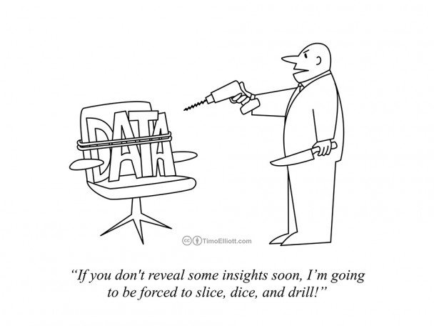
The Process
www.actuariesindia.org

Slide 8
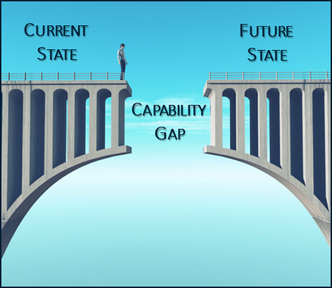
Capability Gap
Actuarial Data management
Predicting customer’s behavior needs large datasets with complex transformations
Data from multiple sources – technical premiums, claims, sales channels, etc.

Slide 9
Where are analytics teams focusing their energy?
Ref: Cleaning Big Data (Forbes)
www.actuariesindia.org

Slide 10




Timeframe of an Actuarial Project
VALUE OF ANALYTICS
OVER / UNDER UTILIZED INFRASTRUCTURE = WASTED EXPENSE / MISSED OPPORTUNITY
ELAPSED TIME = MISSED OPPORTUNITY
NO MANAGEMENT = DECAYING VALUE
Eroding Trust
TIME
Limited Model
Governance / Monitoring / Retraining
Provision SW/HW
Prepare Data
Build Model
Recode Model
Manually Deploy
www.actuariesindia.org
Notes:
Let’s take a look of how all these concepts play out in terms of putting analytics into production.
On this chart, you can see how the value from analytics is achieved over time. First, there is negative value, or cost, associated with model development that takes place before the models start returning value.
Provisioning software on prem with fixed hardware creates an issue with having over or under utilized infrastructure. Lifting and shifting VMs to cloud helps some, but isn’t the most efficient way to provision and scale computing of this type anymore. [build]
In terms of modeling effort, From the time you start to prepare data until the model is deployed, the effort hasn’t created business value. Once deployed, positive value starts to accrue but it begins to decline as the model decays. We know that deploying and managing model performance is the real challenge. Often it takes many months and by then the models may already be decaying, producing suboptimal insights. After a while, people no longer trust the results, or worse, trust them when they’re not accurate.

Slide 11




How it should be!
CLOUD-NATIVE ARCHITECTURE = OPTIMIZED INFRASTRUCTURE
AUTOMATED AND OPERATIONALIZED = SUSTAINED VALUE
VALUE OF ANALYTICS
Retrain/rebuild/replace model
Trusted decisions
Model monitoring/
governance
Automated
data prep & model Creation
Streamlined model deployment
TIME
Scalable cloud-native architecture
www.actuariesindia.org
Notes:
We believe SAS Viya gives you the ability to shorten the development cycle, and sustain value. This is because Viya gives you the ability to quickly scale with a cloud native architecture, and drive through the last mile extremely fast, so you can operationalize your models quickly, and start creating business value sooner. It lets you match your compute with demand, and scale up or out quickly.
It also enables a ModelOps approach. This improves the quality of insights. Monitoring and managing models and embedding them into decision flows at scale means you have a sustained business impact. And people are making decisions on trusted results knowing you’re continuously and efficiently iterating, tuning, and improving them.
Think about the ROI on your analytics as you shift from the lower curve to the higher curve. You are investing less up front, and recouping a higher level of value over a sustained period of time. You can also react to changes more quickly, and reduce technical debt.

Slide 12
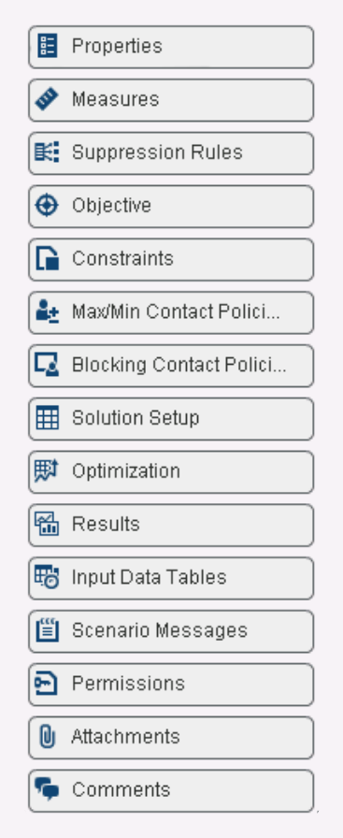

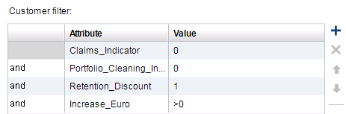
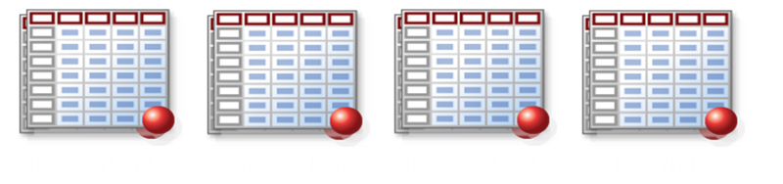
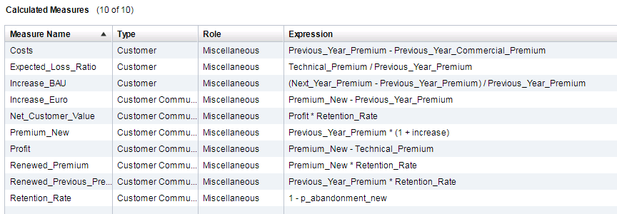
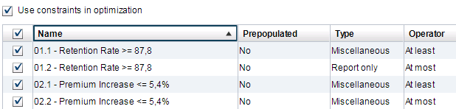
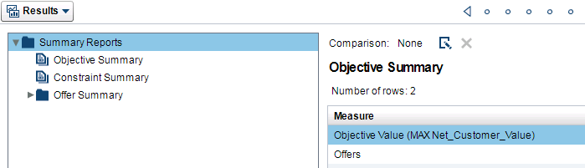
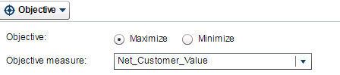
Optimization Process
Simple Data Model
Suppression Filters
Input format needed by SAS Optimization Solution
2
4
3
5
Measures definition
Constraints
6
1
Optimization & Efficiency Frontier
Objective Function

Slide 13
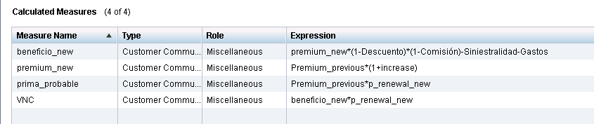
Function to be optimised
New premium: Premium_new= Premium_previous * ( 1 + increase)
Profit Function (beneficio_new in the figure below) is defined as the premium_new minus the discounts, the commission the broker / agent is earning – Claims cost – Expenses. In the example the formula is the following
  Profit = Premium_new*(1-discount)*(1-commision) – Claims cost – Exp.
Net Clients Value: Is the objective measure to optimize (Maximize) in the example below is defined as the [Profit * probability of renewal]

Slide 14
Optimisation Constraints
Suppression Rules and Constraints
Suppression Rules
Suppression rules are Filters, they mean that you will exclude several possible solutions for a segment. Examples:
  If #claims >=1, then premium increase cannot be <3%
  If #policies for a customer >4, then increase cannot be >4%
Constraints
Constraints are equations or limits that must be fulfilled by the solution.
Examples:
  Average increase of the portfolio =3%
  Policy retention level = 98%

Slide 15
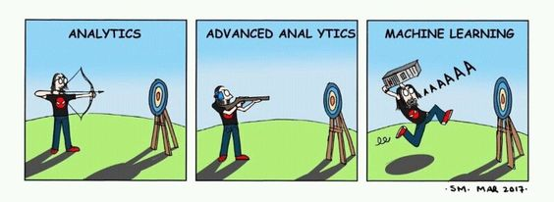
Advanced Algorithms
www.actuariesindia.org

Slide 16
Capability Gap
Actuarial Data management
Predicting customer’s behavior needs large datasets with complex transformations
Data from multiple sources – technical premiums, claims, sales channels, etc.
Use of AI/ML
Customer behavior is not linear. AI/ML techniques are exponentially better predictors.
Optimization is an iterative process, so the system must be highly responsive.

Slide 17
Lapse model
Customer renewal price sensitivity
An accurate price sensitivity model is key to obtain useful optimisation results
The lapse model tells us how likely a customer within each specific segment is to renew his/her policy if we change premiums by x%
Calibrating a lapse model can be done by historical data or a PILOT

Slide 18
Building a Lapse Model
Customer Retention Probabilities
Loss Estimation (different from technical price)
Competitor Prices
A/B Testing Data
Past Retention Information
Actuarial/Underwriter Judgement

Slide 19
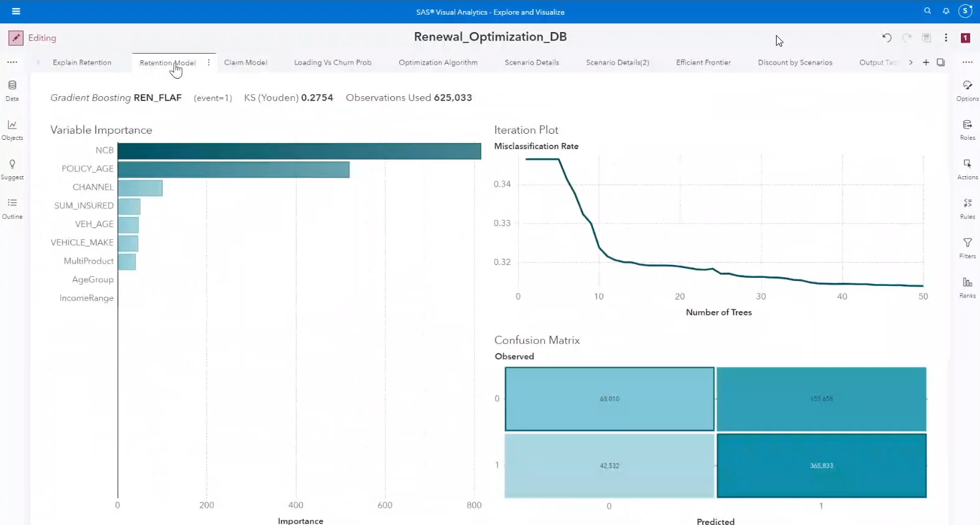

Slide 20
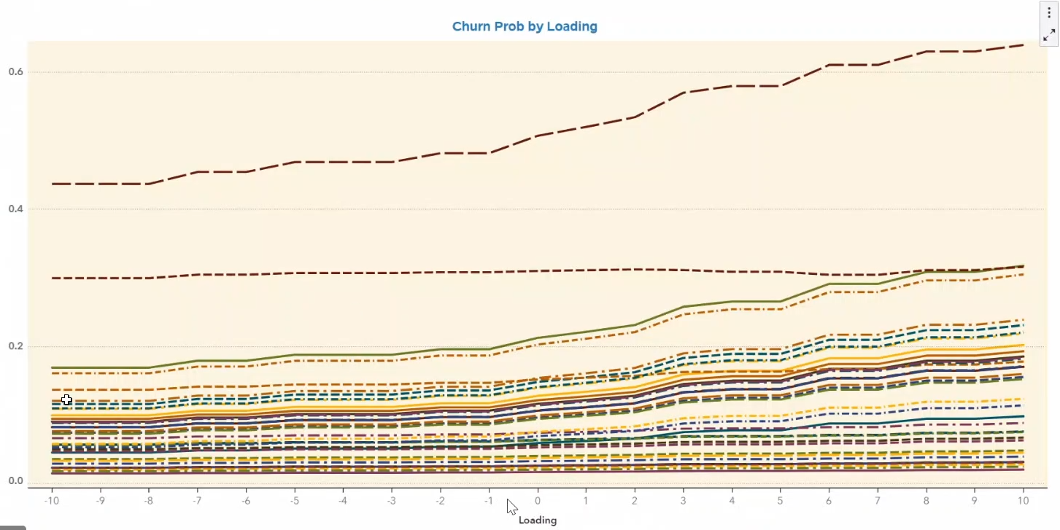

Slide 21
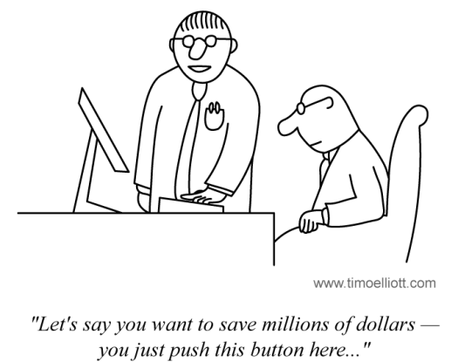
Time to Market
www.actuariesindia.org

Slide 22
Capability Gap
Actuarial Data management
Predicting customer’s behavior needs large datasets with complex transformations
Data from multiple sources – technical premiums, claims, sales channels, etc.
Use of AI/ML
Customer behavior is not linear. AI/ML techniques are exponentially better predictors.
Optimization is an iterative process, so the system must be highly responsive.
Integration / Realtime Deployment
Optimization scenarios are time sensitive. Need instant deployment of price changes to distribution channels.
Collaborative analysis with other relevant departments – underwriting, management, etc.

Slide 23
Underwriting Engine
Flexibility and Reduced Time to Market
It takes weeks (even months) to deploy changes in the tariff.
Business can not test and simulate the results of the new tariff before engaging IT.
Business opportunities lost due to long time to market
Inability to immediately stop accepting high risk policies
Operational risk due to the need of recoding the underwriting logic in the production environment
It is difficult to guarantee that the underwriting logic is consistent across different pricing systems
(brokers, call center,
web, etc…)
How can I stop providing my pricing strategy to web bots?
www.actuariesindia.org

Slide 24
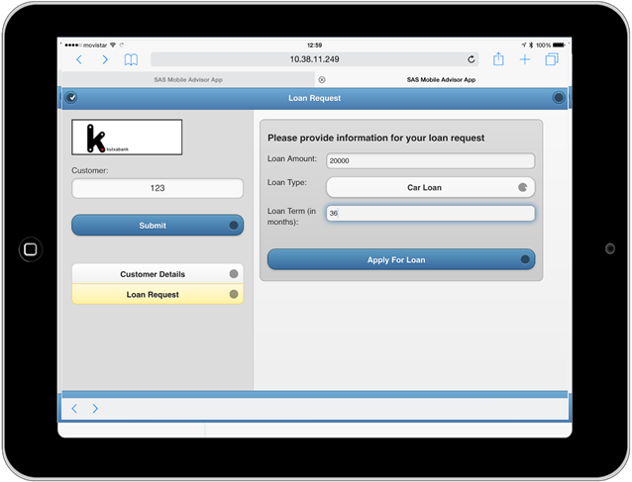
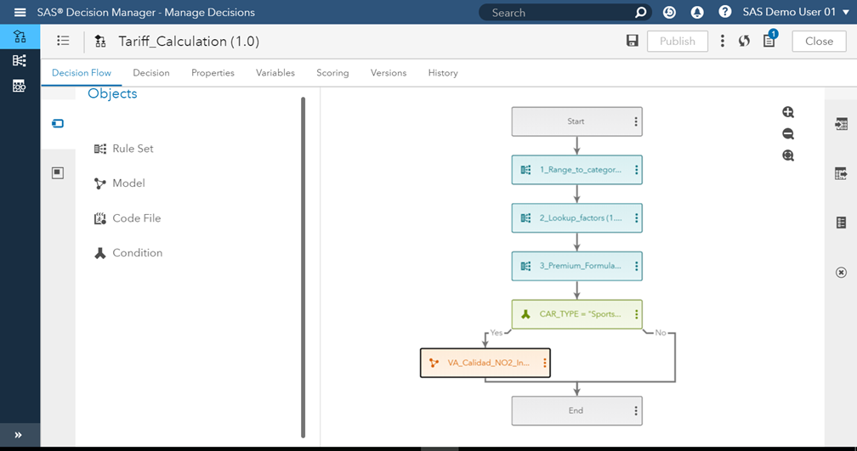

Real Time Pricing & Underwriting Engine
Benefits
Business user oriented tool
Flexible decision logic
Simulation & Test capabilities
Segregation of roles and responsibilities
Low involvement of IT resources
No need to recode for production
Short deployment time
Integration with corporate front-ends using web-services
www.actuariesindia.org

Slide 25
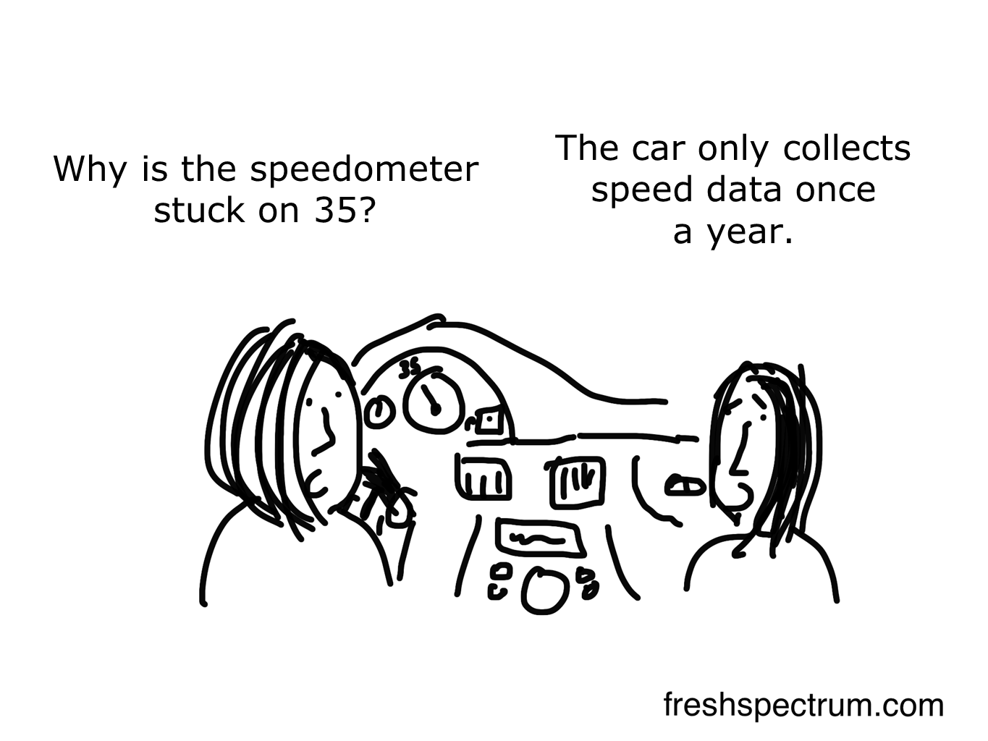
Visualization
www.actuariesindia.org

Slide 26
Capability Gap
Actuarial Data management
Predicting customer’s behavior needs large datasets with complex transformations
Data from multiple sources – technical premiums, claims, sales channels, etc.
Use of AI/ML
Customer behavior is not linear. AI/ML techniques are exponentially better predictors.
Optimization is an iterative process, so the system must be highly responsive.
Integration / Realtime Deployment
Optimization scenarios are time sensitive. Need instant deployment of price changes to distribution channels.
Collaborative analysis with other relevant departments – underwriting, management, etc.
Visualization
Optimization results need to be paired with powerful visualization to understand the impact.
Collaboration with various departments.

Slide 27
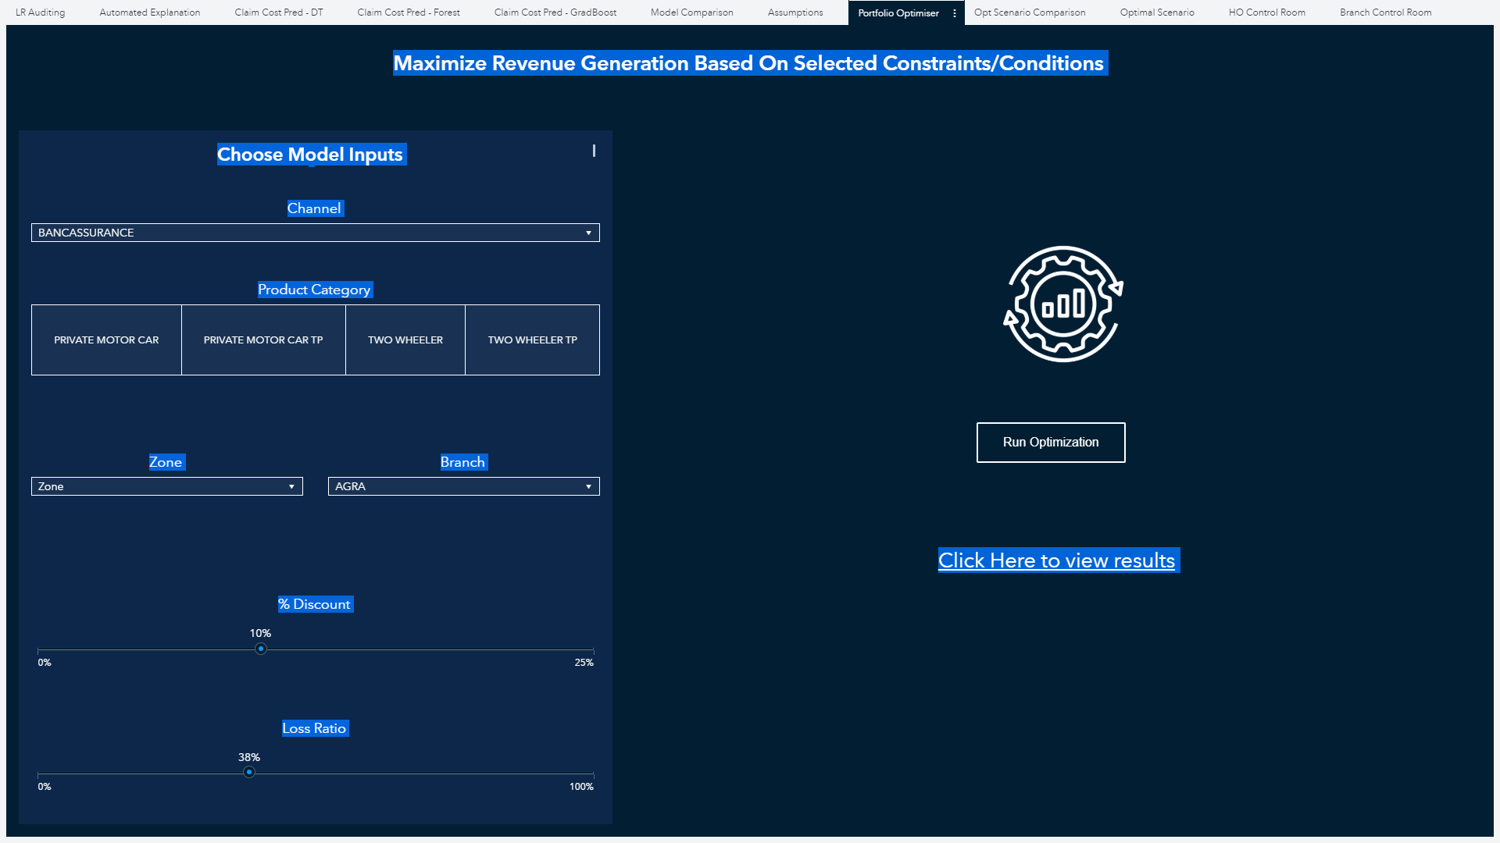
UI for business to run Optimisation Scenarios

Slide 28
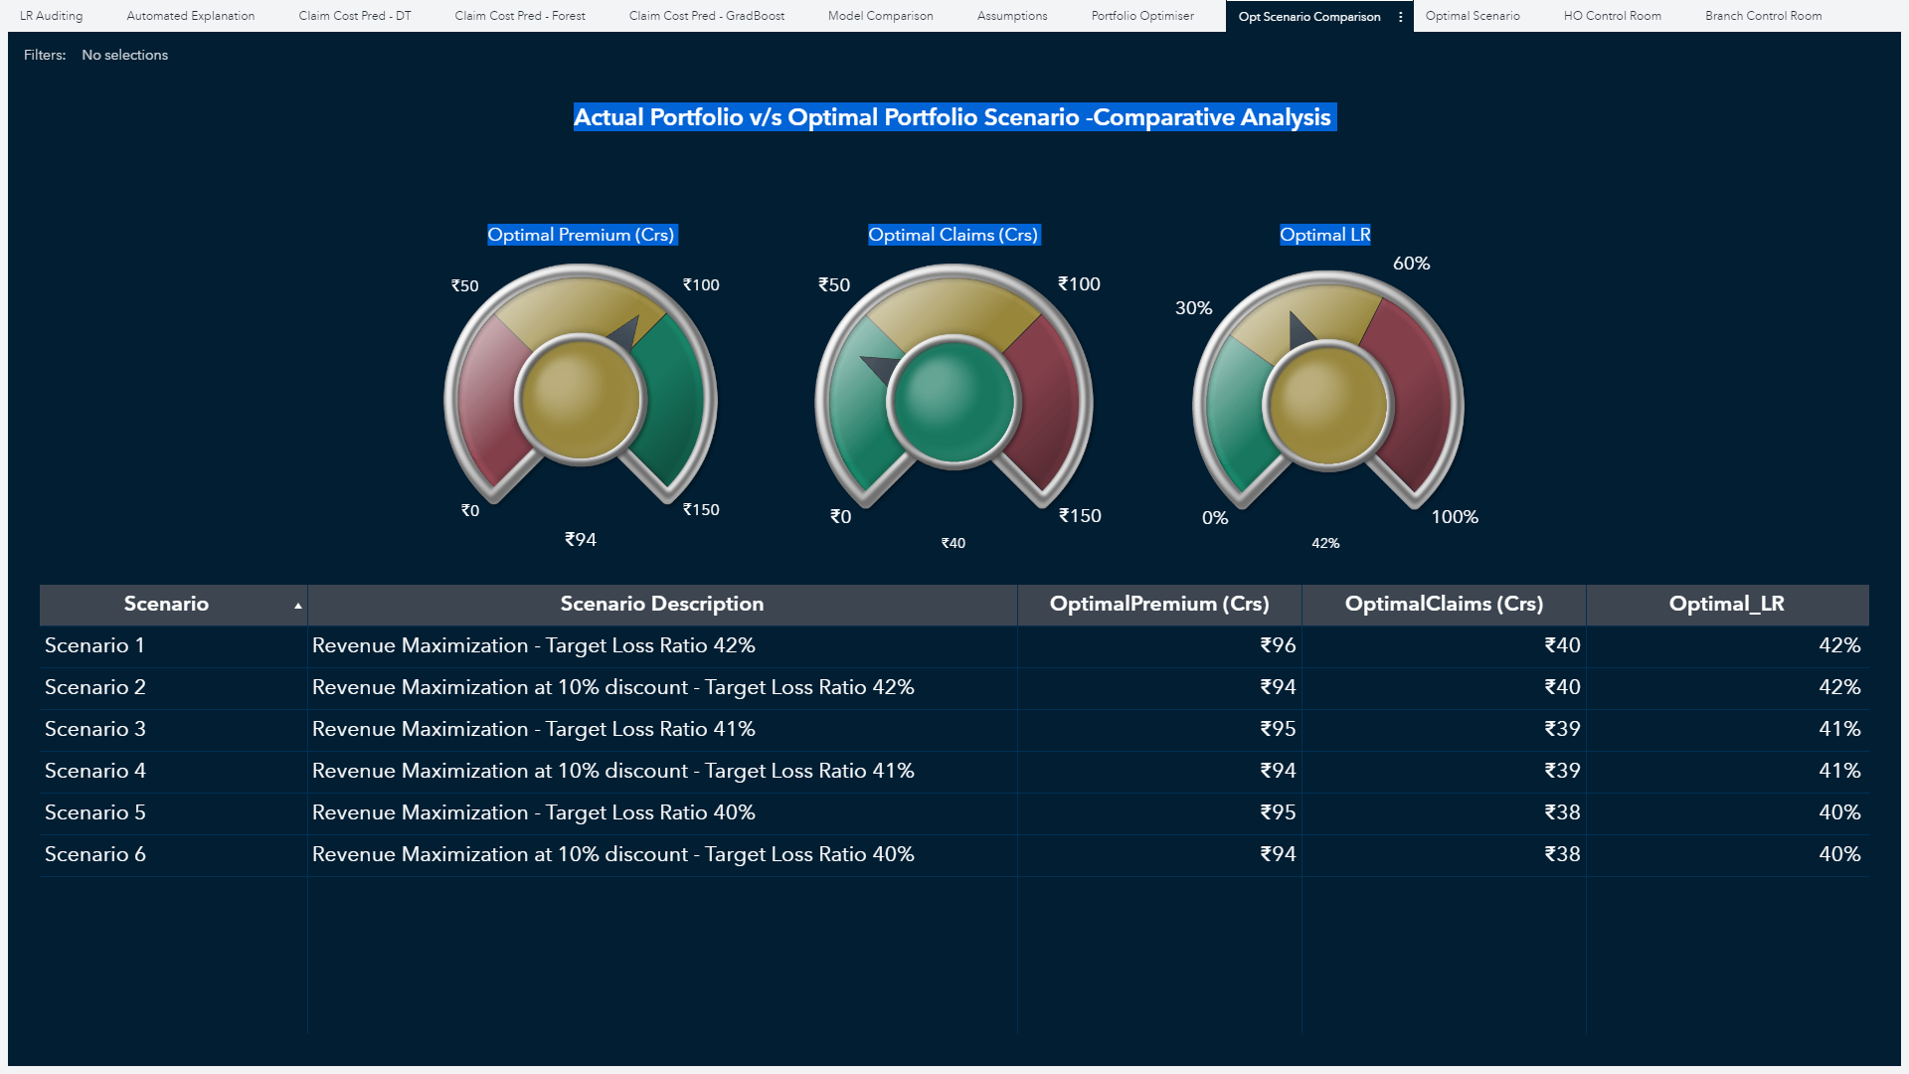
Output post running Optimisation Scenarios

Slide 29
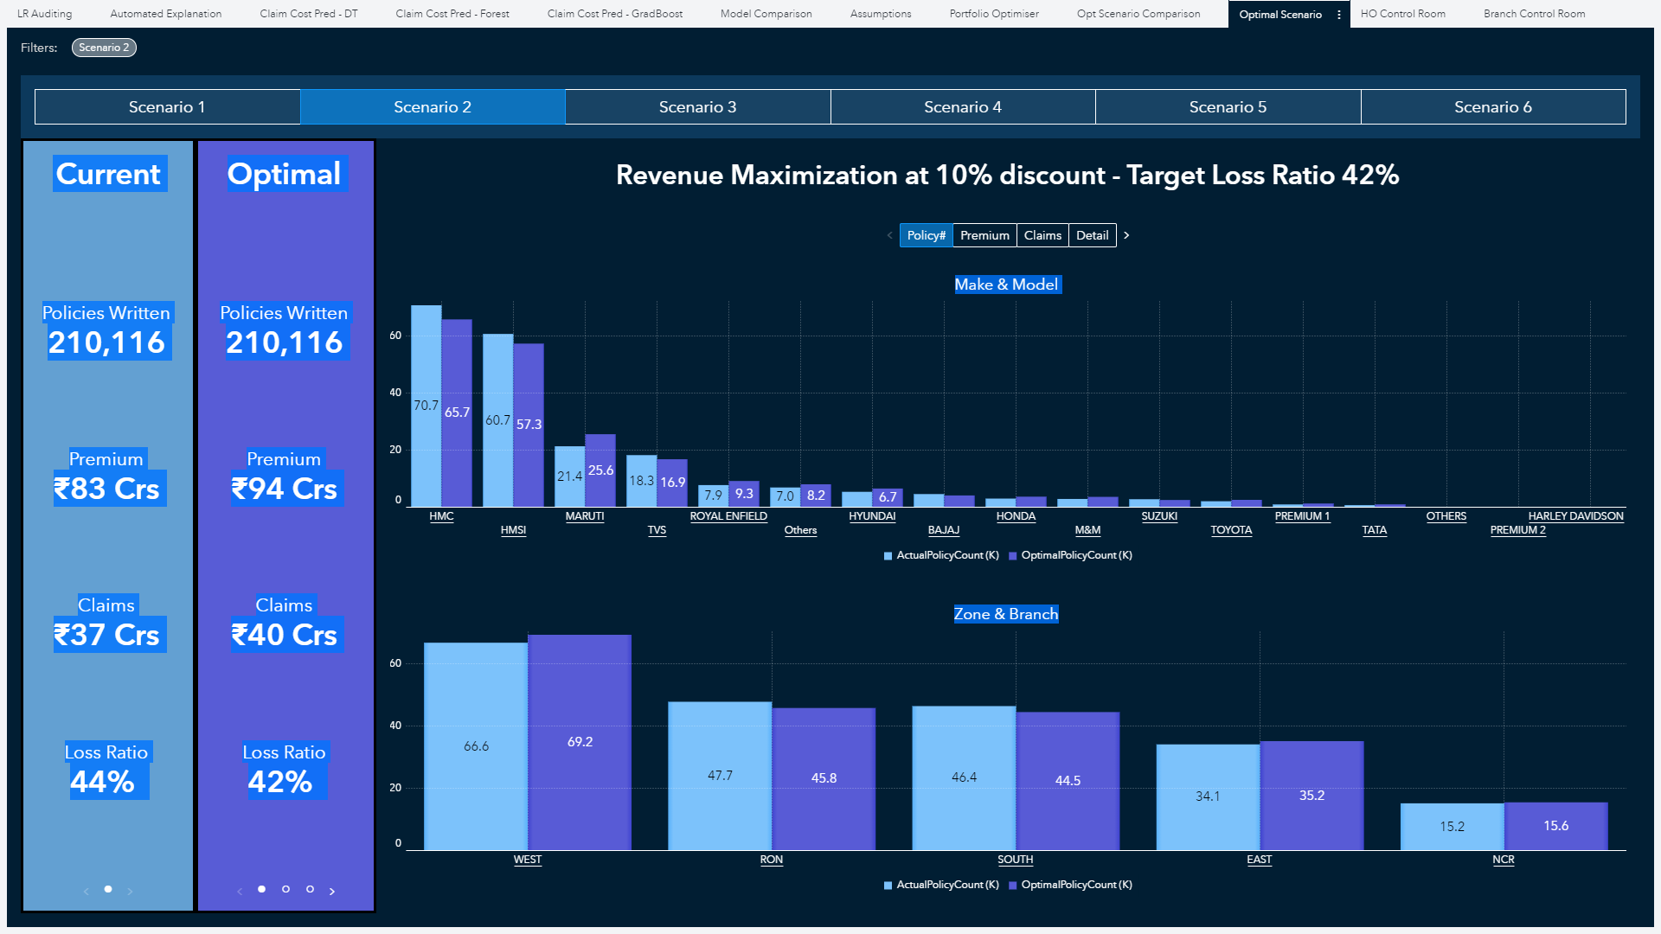
Drill down to each scenario to analyse output

Slide 30
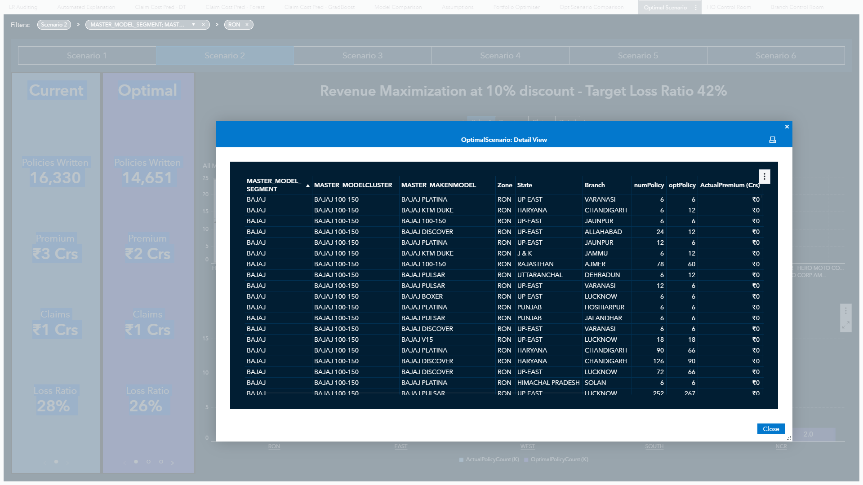
Get access to granular level output of the optimised scenario

Slide 31
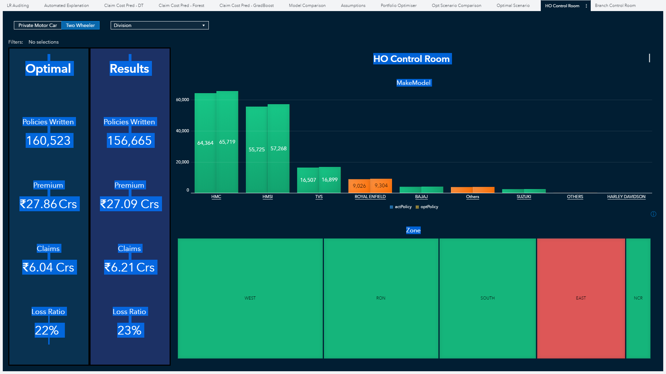
HO Control Room to monitor the approved Optimised Workplan

Slide 32
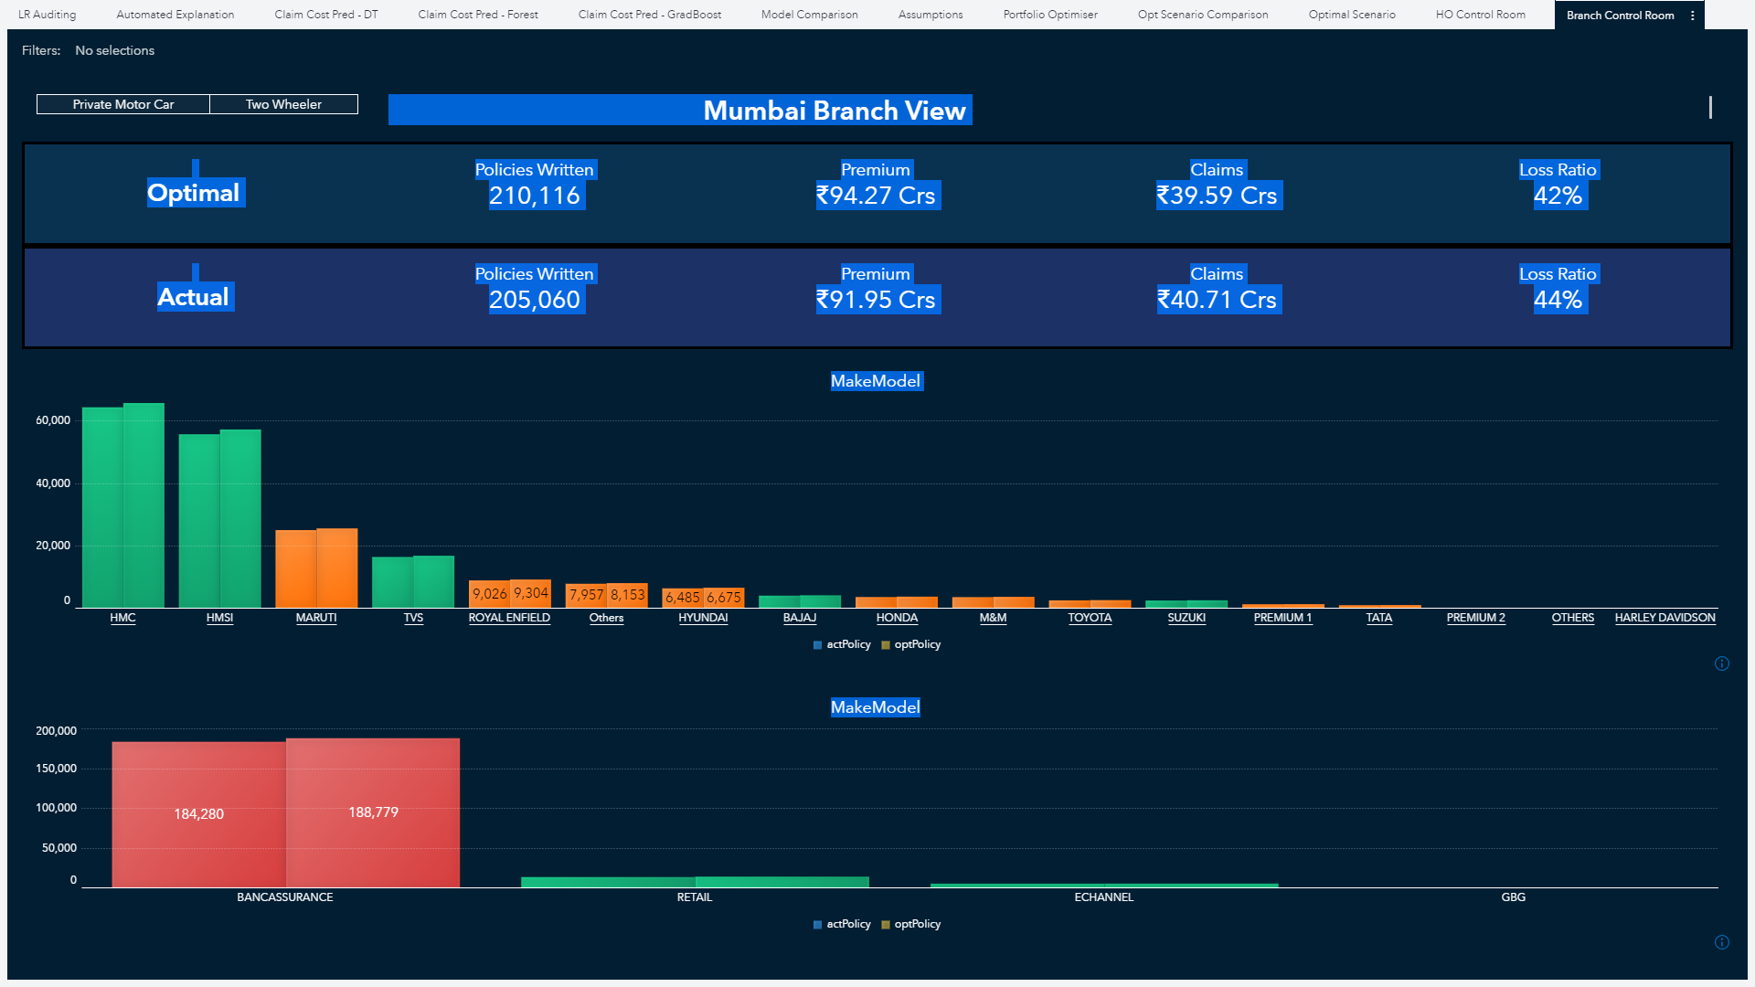
Regional/Branch Level Views to ensure control at all levels

Slide 33
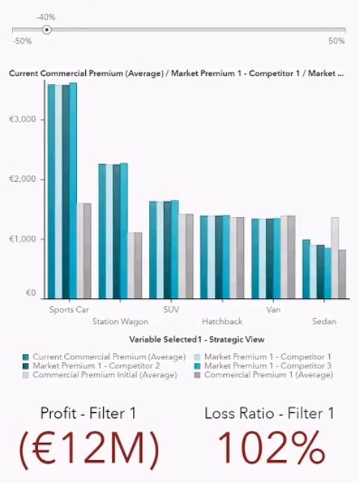
Realtime Price Adjustment Impact
Show impact to the portfolio on a real-time basis due to changes in rates.
Slider to adjust the loading/discount for a particular rating variable.
(Push to the rating engine for fast implementation)
Comparison of rates against different competitors, model premium, etc.
Tweak the rates until adjusted rates are sensible.
See real-time predicted impact on portfolio using analytics from actuaries – change in business volume, profit, loss ratio, etc.
33
www.actuariesindia.org

Slide 34
Poll Question 2
Do you think the technology used by your team is able to scale up the optimization process?
A lot of functionality is missing.
Some functionality is missing.
Generally works fine, but scope for improvement.
We are using the best there is!

Slide 35

Governance
www.actuariesindia.org

Slide 36
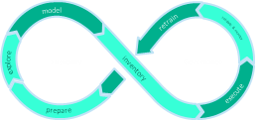

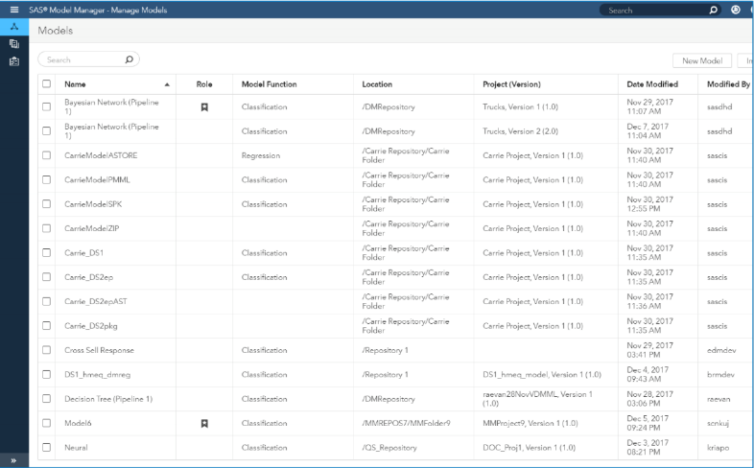
Analytical Model Governance
Centrally Manage ALL Analytic Models
GOVERN
Interoperability with third-party modeling tools to form a model management hub
CENTRALLY MANAGE
Monitor ALL models in production to maximize business value
Govern ALL analytic models
Share & collaborate
Trace & prove with workflow and versioning
www.actuariesindia.org
Notes:
So, why is governance important for analytical models? Of course, the more organizations move towards using analytical models to drive their operational business decisions, the more they need to ensure these models are accurate and reliable. Analytically driven organizations also build a lot of models, it may be dozens or even hundreds. And these models are usually built by different teams. So, governance enables the enterprise to manage all models in the organization in a central repository. It also enables organizations to constantly monitor production models to make sure they are still performing. Model governance allows organizations to share best practices and analytical assets easily and support collaboration between different teams. And it traces the development of analytical assets from the raw data to the models in production with workflow and versioning. Analytical model management enables organizations to govern their models across the enterprise and make sure that all stakeholders of the ModelOps process are able to carry out their required work as quickly and seamless as possible. It also supports the creation of necessary metadata around the models in the repository for transparency, documentation and compliance

Slide 37
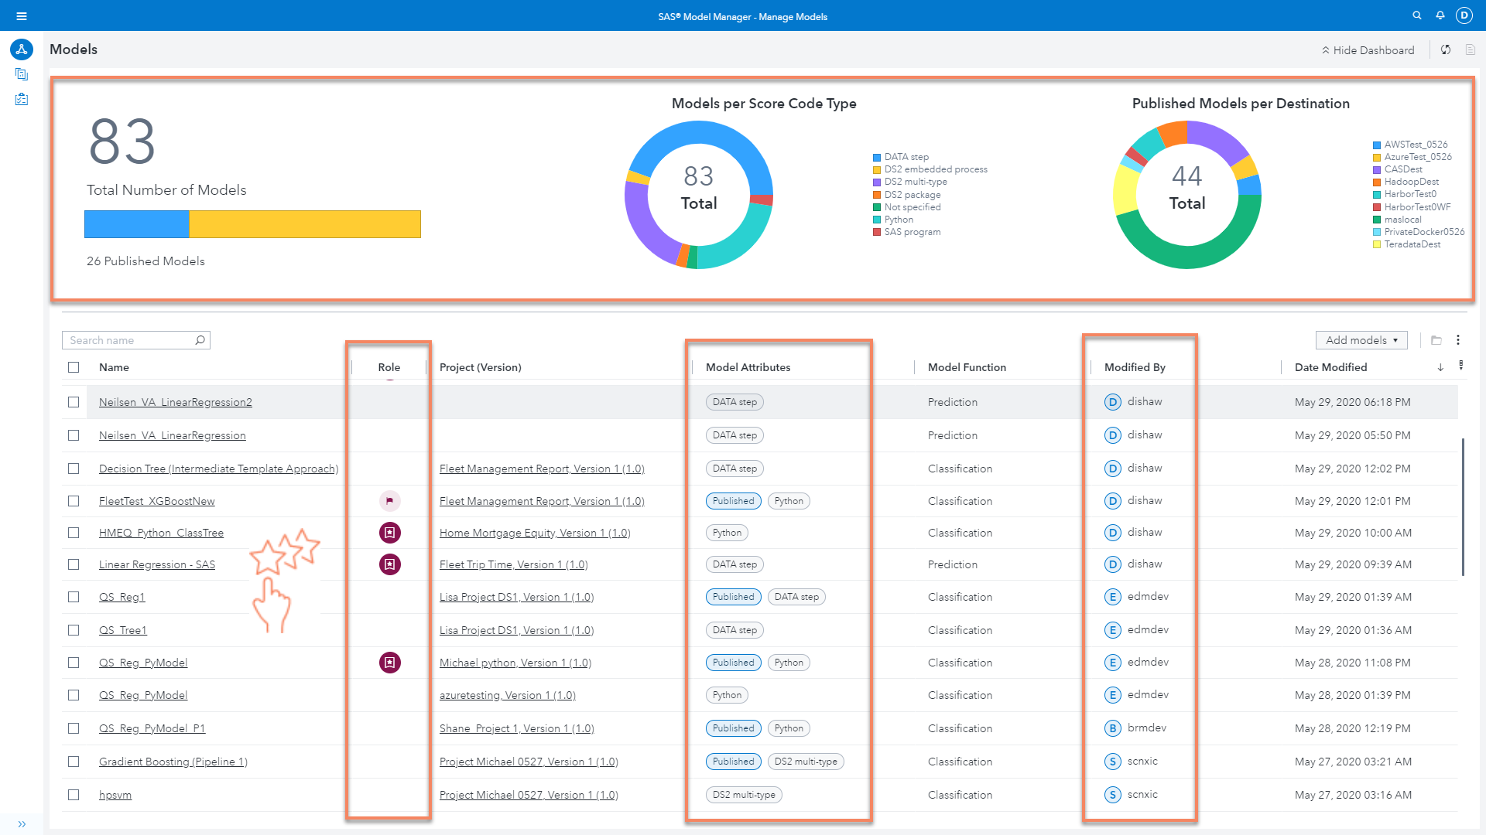
Notes:
New Models View
Notice the increased range of available publishing destinations
See the model role flag is updated.
See how model attributes included automatically tagged information (i.e. which models are published, what type of score code is the model using)

Slide 38
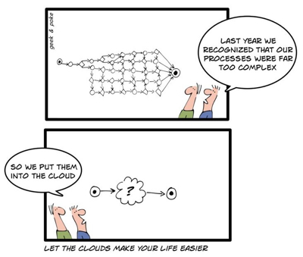
Leverage the cloud?
www.actuariesindia.org

Slide 39
Thank You

Slide 40
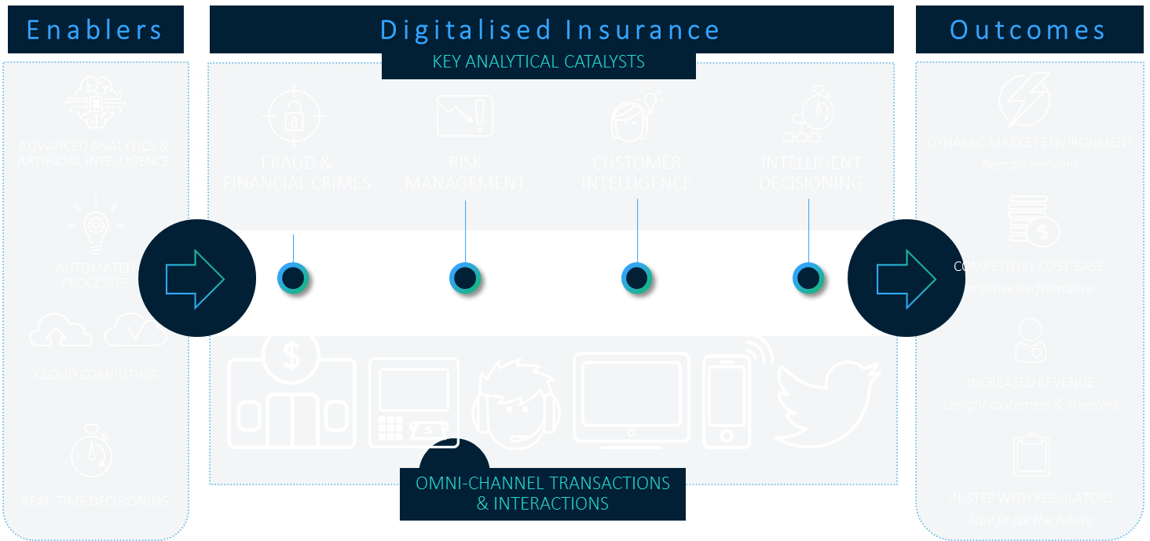
Enabling the Digital Insurer
SAS and Insurance Sector
www.actuariesindia.org

Slide 41
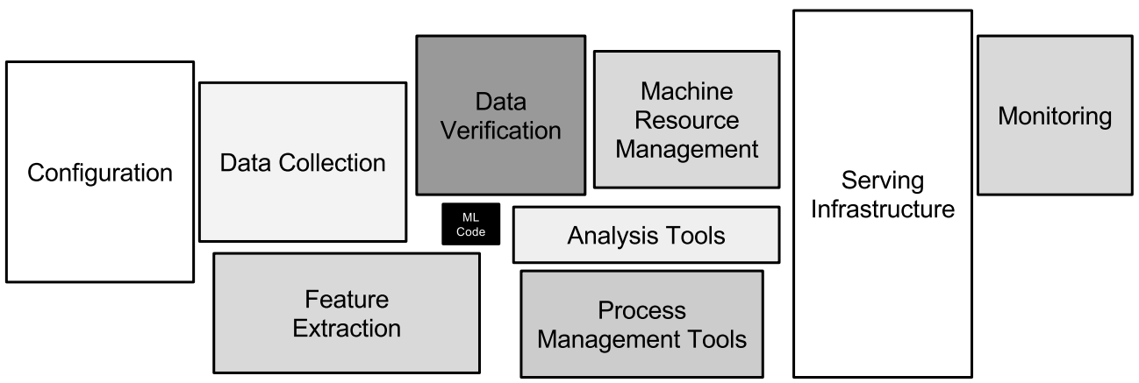


Analytics as a commodity
Ref: “Hidden Technical Debt in Machine Learning Systems”, Google Inc.
www.actuariesindia.org

Slide 42
Key Benefits of Enterprise Analytics Platform for Actuaries
Visual
  Interface allows the actuary to visually assess models faster, prototyping models in seconds and using drag and drop interface to add or remove variables on the fly.
Automated
  Automated data preparation steps drastically improve efficiency in the process, allowing actuaries to spend more time gathering meaningful insights.
Machine
Learning
  Profit from advanced techniques to discover new variables, use variable rankings and variables selected
  as benchmark
Faster
  Interactive process (30 seconds to run a model and obtain results). Optionally, leverage the power of the cloud with our cloud-native solutions.
Smooth
Integration
  Co-exists and complements existing software. Open Source integration enables use of different technologies (Python, R…) within the governance framework

Slide 43
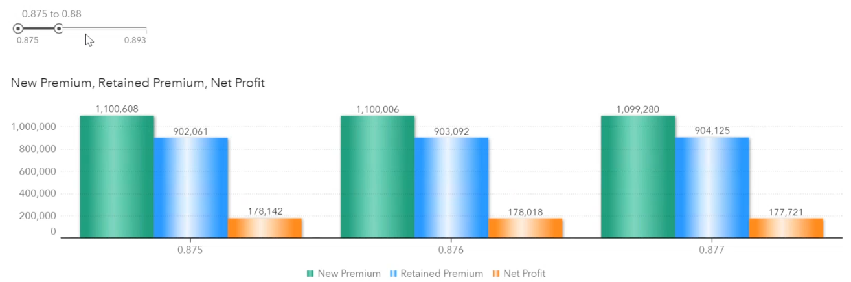
Optimization Scenarios
Charge the premium that achieves highest profits for a minimum retention
Adjust different retention rates that are acceptable to the business.
The model shows the results from the optimization run: higher retention = higher renewal premium + lower profit
43
www.actuariesindia.org

