Slide 1


3rd Techtalk on Employee Benefits
Online Edition 2021
2 June 2021
Defined Contribution Pension Schemes
Practice in Good Design and Governance

Slide 2








Introduction
Mute
Q&A
IAI support
C
P
D
Recording
Feedback
www.actuariesindia.org

Slide 3
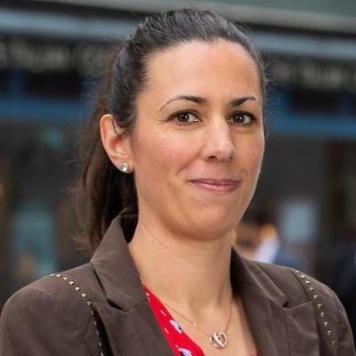
Speaker Introductions
Stéphanie Payet
Pension analyst at the OECD Consumer Finance, Insurance and Pensions Division based in France.
Undertakes analytical work on issues related to retirement savings adequacy, pension coverage, taxation of retirement savings, and plan design.
Contributes to various OECD publications, including the OECD Pensions Outlook and the OECD Reviews of Pension Systems.
Also responsible for the OECD Global Pension Statistics data collection, which monitors the private and funded pension systems across OECD and non-OECD countries.
French national
Master of Science in Statistics from the French National School for Statistics and Information Analysis.
www.actuariesindia.org

Slide 4
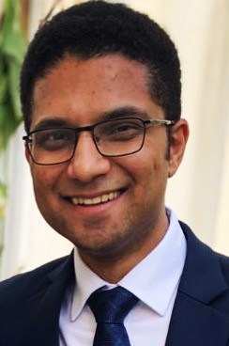
Speaker Introductions
Suranjan Banerjee
FIA, FIAI, CERA
Consulting actuary with over 13 years of experience in employee benefits
Partner, Willis Towers Watson Retirement Benefits LLP
Started career at Aon where he was involved with preparing and delivering funding and accounting advice to Corporate and Trustee clients of DB pensions arrangements in the UK.
Currently, delivers advice and reports to clients based in the Indian subcontinent which cover various aspects such as governance, accounting, funding, asset liability modelling and other DC based solutions such as the National Pension System (NPS).
www.actuariesindia.org

Slide 5
Good design of DC pension plans
TechTalk on Retirement Benefits
2 June 2021
Institute of Actuaries of India
Stéphanie Payet
Pension Analyst, OECD

Slide 6
Assets in retirement savings plans and importance of DC plans
Split of assets
Assets in retirement savings plans around the world, % of GDP
6
www.actuariesindia.org

Slide 7
OECD Roadmap for the Good Design of DC Pension Plans
Coherence
Coverage
Contributions
Financial incentives
Costs
Investment strategies
Retirement benefit options
Management of longevity risk
Communication to members
Financial education
7
www.actuariesindia.org

Slide 8
2. Coverage

Slide 9
Coverage of retirement savings plans, % of the working-age population
9
www.actuariesindia.org

Slide 10
Automatic enrolment more widely adopted as an alternative to compulsion
United States (occupa-tional plans)
Canada, United Kingdom
United States (state-based auto IRAs)
Italy, New Zealand
Turkey
Germany
Lithuania, Poland
1980s
2007
2012
2015
2017
2018
2019
10
10
www.actuariesindia.org

Slide 11
Evolution of participation rates in countries with automatic enrolment schemes
11
www.actuariesindia.org

Slide 12
Main characteristics of automatic enrolment schemes
Employers’ obligation: Italy, Canada (Quebec), New Zealand, Poland, Turkey, UK, US (state-based auto-IRAs)
Target population: employees only, except in Lithuania
Opting-out window: 1-6 months
Automatic re-enrolment (2-4 years): Canada (Quebec), Lithuania, Poland, Turkey, UK
12
www.actuariesindia.org

Slide 13
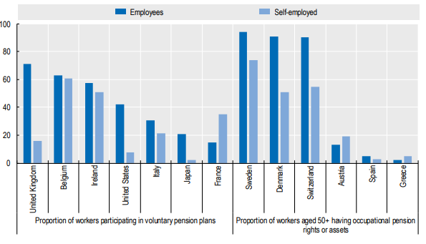
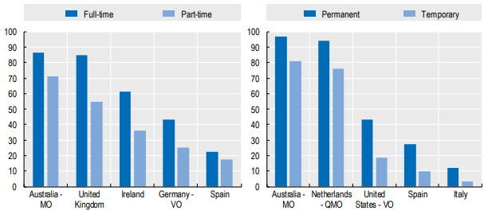
More limited access to pensions by non-standard workers
Self-employed lack access to occupational plans
Minimum income, minimum number of working hours or minimum length of employment penalise part-time and temporary employees
Vesting periods and limited portability of occupational pension rights and assets affect workers switching jobs frequently, in particular temporary employees
13
www.actuariesindia.org

Slide 14
Encouraging non-standard workers to join retirement savings plans
Applying the same rules as for standard employees
  Remove eligibility criteria
  Extending mandatory and automatic enrolment
Facilitating access in the workplace
  Multiple employer plans
  Workplace personal plans (including for platform workers)
Offer dedicated products
  Self-employed and informal workers (e.g. PM-SYM)
14
www.actuariesindia.org

Slide 15
3. contributions

Slide 16
Minimum or mandatory contributions rates in mandatory and automatic enrolment schemes
16
www.actuariesindia.org

Slide 17
Encouraging higher and more regular contributions
Automatic escalation
Flexible contributions, combined with reminders
Hybrid products combining emergency and retirement savings
Employer matching contributions
Simple contribution process
Financial planning tools
Long contribution periods improve chances of reaching one’s desired retirement income: starting early and postponing retirement
17
www.actuariesindia.org

Slide 18
4. Financial incentives

Slide 19
Poll Question
Do you know what is the most common tax treatment for retirement savings (contributions, investment returns and withdrawals) in the OECD?
      Taxed-Taxed-Exempt (TTE)
      Exempt-Exempt-Taxed (EET)
      Taxed-Exempt-Exempt (TEE)
      Exempt-Taxed-Taxed (ETT)
19
www.actuariesindia.org

Slide 20
Tax treatment of retirement savings
Tax rules should at least not discourage individuals to save for retirement
They should be straightforward, stable and common across retirement saving plans to avoid confusion
20
www.actuariesindia.org

Slide 21
More countries offer non-tax financial incentives to promote retirement savings
Non-tax financial incentives | OECD Countries
Employer matching contributions | Germany, Iceland, Italy, New Zealand, Poland, United States
Government matching contributions | Australia (50%), Austria (4.25%), Chile (50% or 15%), Colombia (20%), Czech Republic (20%), Hungary (20%), Mexico (325%), New Zealand (50%), Turkey (25%), United States (50% to 100%)
Government fixed nominal subsidies | Chile, Germany, Lithuania, Mexico, Poland, Turkey
21
www.actuariesindia.org

Slide 22
5. costs

Slide 23
Measures to promote low-cost and cost-efficient retirement arrangements
Disclosure, comparability, and transparency are essential
Pricing solutions
  Fee structure and fee caps
Structural solutions
  Tender mechanisms
  Allocation of individuals to low-cost providers
  Cost-efficient consolidations
  Large industry-wide non-profit providers
  Independent centralised provider
23
www.actuariesindia.org

Slide 24
6. Investment strategies

Slide 25
Default investment strategies
No default | Conservative fund | Diversified fund | Life-cycle strategy
Czech Republic Estonia Korea Slovak Republic | Italy Latvia New Zealand | Australia Canada Colombia United States | Australia Canada Chile Israel Lithuania Mexico Poland Slovenia Sweden United Kingdom United States
For people willing to choose their investment strategy, different investment horizons and risk profiles should be offered
Importance of assessing and monitoring the appropriateness of investment strategies against a policy objective
25
www.actuariesindia.org

Slide 26
7. Retirement benefit options

Slide 27
Protection against longevity risk
Some level of lifetime income should be provided as a default for the pay-out phase
  Annuities with guaranteed payments
  Non-guaranteed arrangements where longevity risk is pooled among participants
Flexibility: partial, deferred or delayed lifetime income combined with programmed withdrawals
Full lump-sums should be discouraged in general, except for low account balances or extreme circumstances
27
www.actuariesindia.org

Slide 28
Thank you!
TechTalk on Retirement Benefits
2 June 2021
Institute of Actuaries of India
Stéphanie Payet
Pensions Analyst, OECD

Slide 29
3rd Techtalk on Employee Benefits
Online Edition 2021
2 June 2021
Defined Contribution Pension Schemes
Practice in Good Design and Governance

Slide 30
Agenda
In this session we will look at…
A broad view of the Indian landscape – how are we doing
Some insights from WTW surveys – how do individuals feel about retirement
The Indian context – benefits and associated information available to members
International Organisation of Pension Supervisors – how can we leverage pension projections
Case study for a deterministic projection
Case study for a stochastic projection
www.actuariesindia.org

Slide 31
Agenda
In this session we will look at…
A broad view of the Indian landscape – how are we doing
Some insights from WTW surveys – how do individuals feel about retirement
The Indian context – benefits and associated information available to members
International Organisation of Pension Supervisors – how can we leverage pension projections
Case study for a deterministic projection
Case study for a stochastic projection
www.actuariesindia.org

Slide 32
Poll 1 – Question
Based on an RBI study of 2017¹, how much wealth does the average Indian household hold in the form of financial assets (e.g. currency, bank savings, stocks, mutual funds, etc.)
5%
10%
20%
40%
¹Report of the Household Finance Committee, July 2017
www.actuariesindia.org

Slide 33
Poll 1 – Answer
Based on an RBI study of 2017¹, how much wealth does the average Indian household hold in the form of Financial Assets (e.g. currency, bank savings, stocks, mutual funds, etc.)
5%
10%
15%
20%
The answer is a staggeringly low figure of only 5% with Real Estate (77%) and Physical Goods (7%) making up 84% and Gold making up 11%
¹Report of the Household Finance Committee, July 2017
www.actuariesindia.org

Slide 34
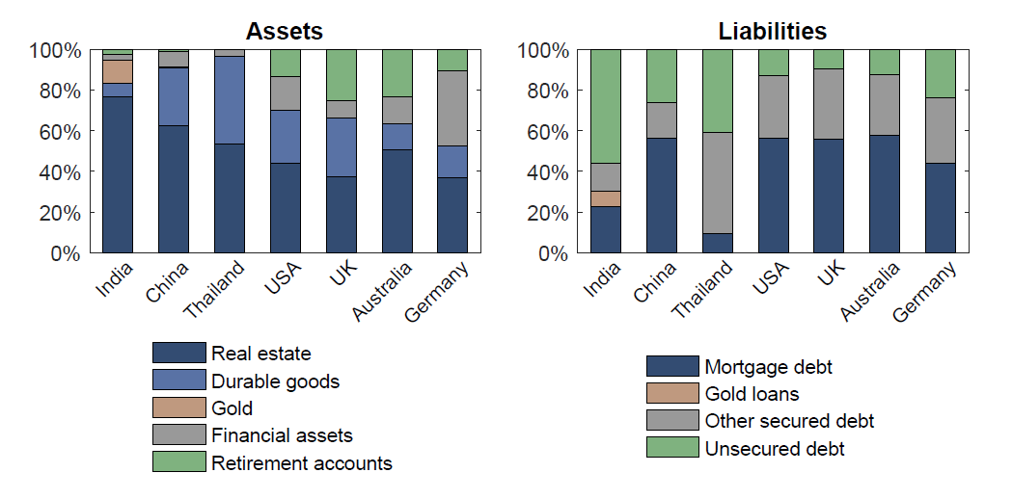
Where does retirement fit in? (1)
The ‘balance sheet’ of the average Indian household suggests we aren’t creating ring fenced financial assets for retirement…
Source: Report of the Household Finance Committee, July 2017
www.actuariesindia.org

Slide 35
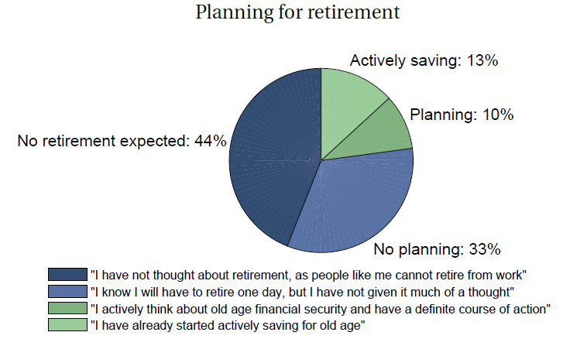
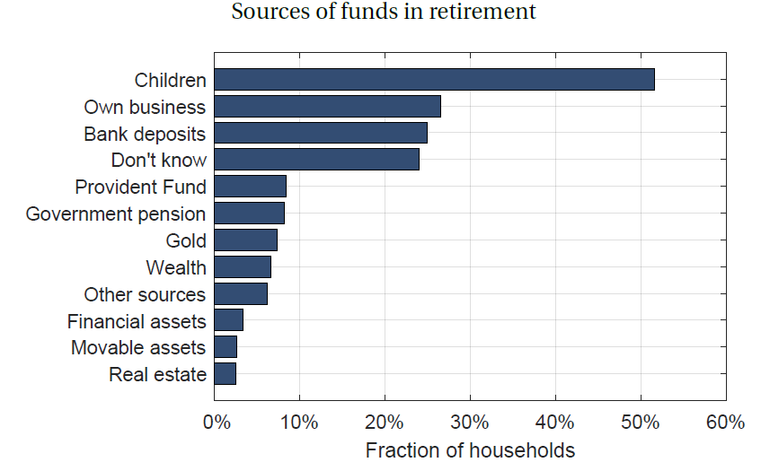
Where does retirement fit in? (2)
More than 3 in 4 households either do not expect to retire or have no planning in place for retirement
More than 1 in 2 households will be relying on their children to support them in old age
Does not add to 100% as respondents could choose multiples options
Source: Report of the Household Finance Committee, July 2017
www.actuariesindia.org

Slide 36
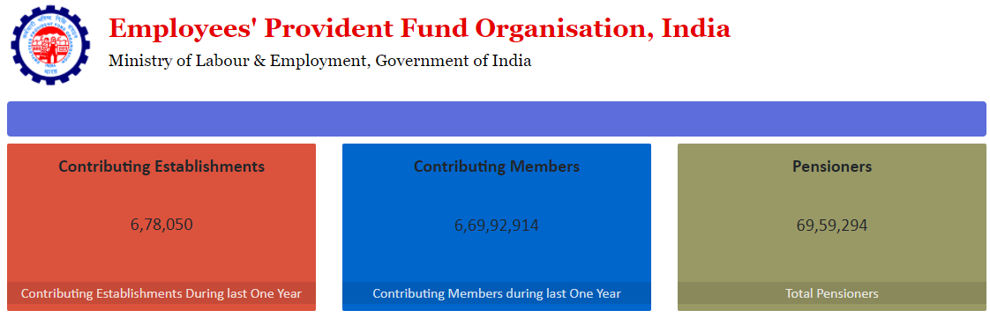
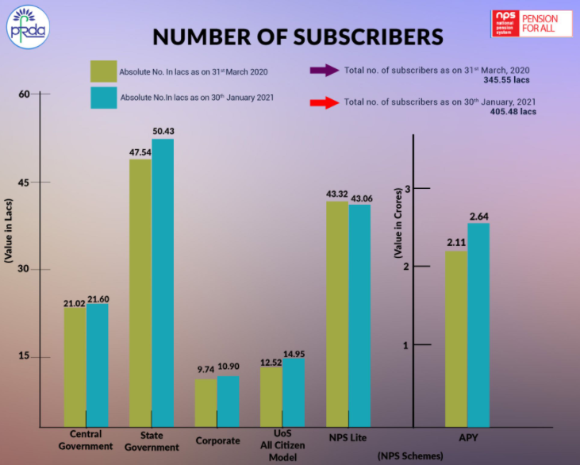
We are getting there…
Recent data suggests that there has been an increase in EPFO membership
Data from the PFRDA shows higher enrolments in NPS for the organized sector as well as APY for the unorganized sector
The NPS has still not really found a foothold in the private sector space with membership mainly being voluntary
APY numbers have increased though still a long way to go and need to ensure accounts remain active
Source: PFRDA; EPFO
www.actuariesindia.org

Slide 37
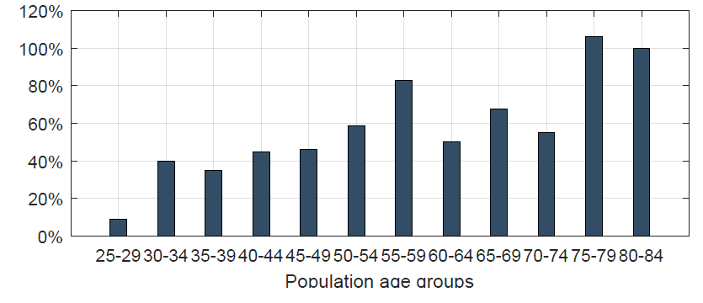
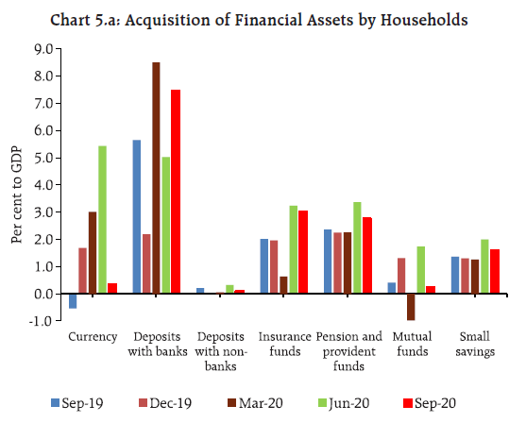
… but need to step up further
Despite the ticking time bomb…
Relative change in population age between 2017 and 2031
… we are still allocating less than 3% of GDP to pension assets
Source: Report of the Household Finance Committee, July 2017; RBI Q2:2020-21 Estimates of Household
Financial Savings and Household Debt-GDP Ratio
www.actuariesindia.org

Slide 38
Agenda
In this session we will look at…
A broad view of the Indian landscape – how are we doing
Some insights from WTW surveys – how do individuals feel about retirement
The Indian context – benefits and associated information available to members
International Organisation of Pension Supervisors – how can we leverage pension projections
Case study for a deterministic projection
Case study for a stochastic projection
www.actuariesindia.org

Slide 39
Poll 2 – Question
Based on a Willis Towers Watson survey¹, what percentage of corporate sector employees in India feel they are not saving adequately for retirement?
10%
20%
40%
60%
¹2019 Global Benefits Attitudes Survey, India
www.actuariesindia.org

Slide 40
Poll 2 – Answer
Based on a Willis Towers Watson survey¹, what percentage of corporate sector employees in India feel they are not saving adequately for retirement?
10%
20%
40%
60%
59% respondents said that they are saving less than they should for their retirement
¹2019 Global Benefits Attitudes Survey, India
www.actuariesindia.org

Slide 41
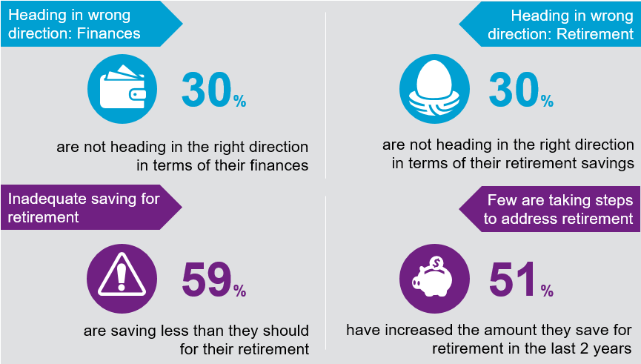
Employee readiness
The employee perspective…
Sample: All employees.
Source: 2019 Global Benefits Attitudes Survey, India
www.actuariesindia.org

Slide 42
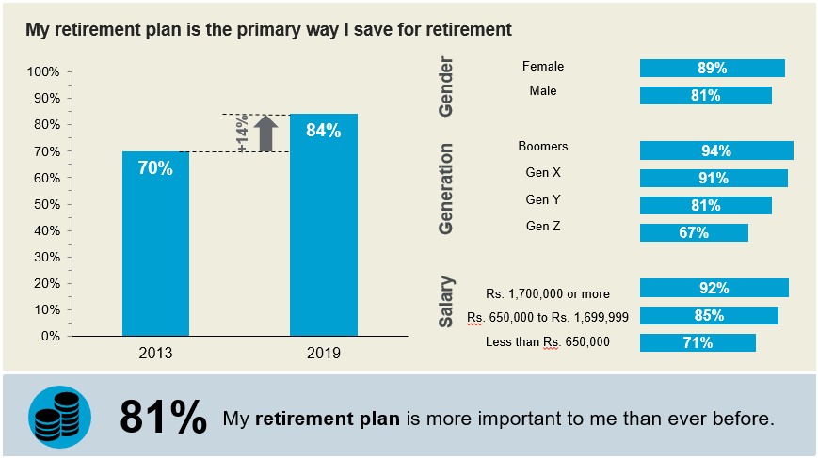
Employer retirement plans continue to be the foundation of employees’ retirement planning
Sample: Employees with an employer retirement plan.
Source: Several years of Global Benefits Attitudes Survey, India
www.actuariesindia.org

Slide 43
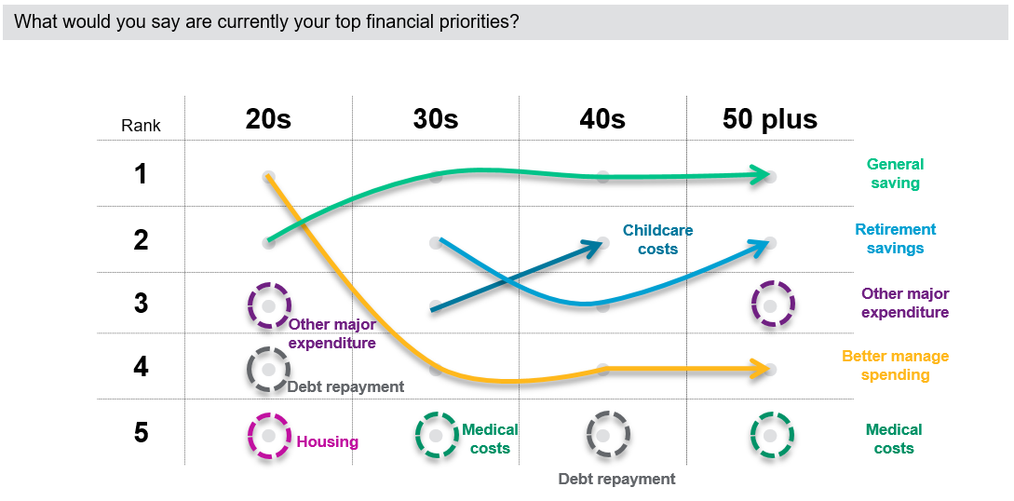
Saving for retirement is a top financial priority for most employees
Sample: All employees.
Source: 2019 Global Benefits Attitudes Survey, India
www.actuariesindia.org

Slide 44
Agenda
In this session we will look at…
A broad view of the Indian landscape – how are we doing
Some insights from WTW surveys – how do individuals feel about retirement
The Indian context – benefits and associated information available to members
International Organisation of Pension Supervisors – how can we leverage pension projections
Case study for a deterministic projection
Case study for a stochastic projection
www.actuariesindia.org

Slide 45
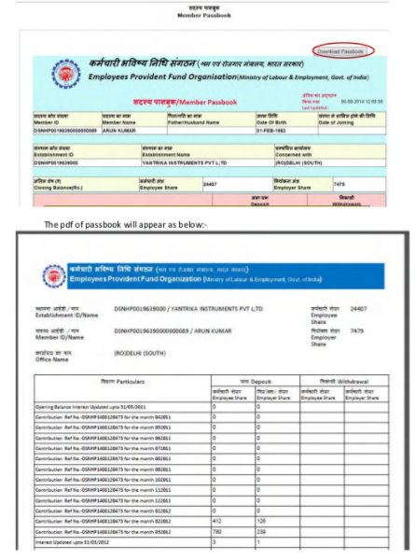
The key retirement benefits in India for the corporate sector employees – EPF
Employees’ Provident Fund (EPF) – monthly contributions of 12% employee and employer using a certain definition of pay which is usually 40-50% of total fixed pay
Option to cap the contributions corresponding to a salary of INR 15,000 – in practice seldom enforced and membership generally considered mandatory
Contributions are tax free up to certain thresholds, interest is tax free in the accumulation phase, part of the benefit is a DB pension, rest is provided as a tax-free cash sum at retirement age
No investment freedom as these decisions are taken by a Central Board of Trustees who are empowered to take decisions on behalf of its members
Passbook can be accessed which shows the opening balance, contributions made, interest credited and closing balance
www.actuariesindia.org

Slide 46
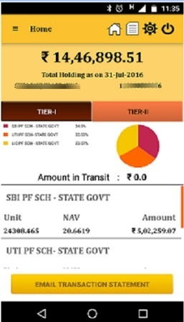
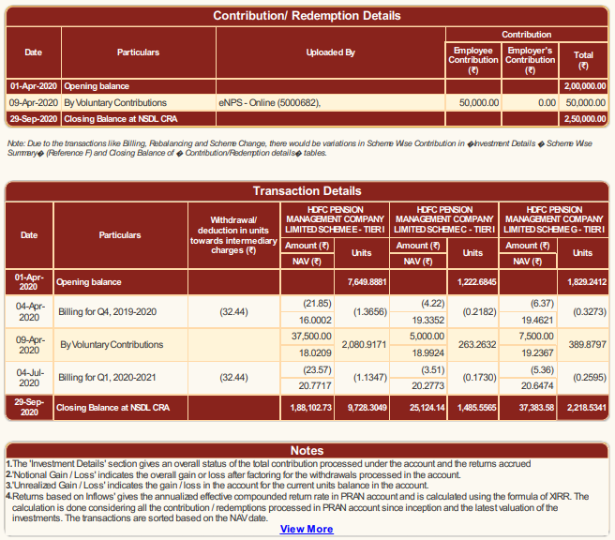
The key retirement benefits in India for the corporate sector employees – NPS
National Pension System (NPS) – monthly contributions of 10% using a certain definition of pay which is usually 40-50% of total fixed pay
Currently provided as a voluntary benefit where any contributions are carved out of total compensation
Contributions are tax free up to certain thresholds, interest is tax free in the accumulation phase, 60% of accumulations can be taken as tax-free cash and 40% must be exchanged for an annuity at retirement age
Complete investment freedom to appoint a fund manager as well as choose an investment strategy
Members can access their accounts to check balances on a real-time basis as well make additional contributions etc.
Also proactively provided with ‘at-retirement’ options to those reaching retirement age
www.actuariesindia.org

Slide 47
Agenda
In this session we will look at…
A broad view of the Indian landscape – how are we doing
Some insights from WTW surveys – how do individuals feel about retirement
The Indian context – benefits and associated information available to members
International Organisation of Pension Supervisors – how can we leverage pension projections
Case study for a deterministic projection
Case study for a stochastic projection
www.actuariesindia.org

Slide 48
International Organisation of Pension Supervisors (IOPS) – Technical Committee
Good practices for designing, presenting and supervising pension projections (draft for public consultation, February 2021)
Pension projections can be a powerful tool to manage expectations of pension plan members and influence their retirement decisions (e.g. the chosen contribution rate, length of saving time, level of risk).
1
2
Projections can educate members about likely values of their future retirement income and effects of retirement decisions taken.
However, pension projections may also pose several risks that relate to improper methodology and assumptions or improper communication.
3
www.actuariesindia.org

Slide 49
1. Design of pension projections
1.1. Methodology and assumptions should be made available to the users. For stochastic projections, assumptions relating to variability of key variables such as asset returns should be communicated.
1.2. Methodology and assumptions should be standardised as far as possible to allow comparability of different projections, avoid potential for miscommunication and facilitate supervision.
1.3 Pension projections should be made available on websites of pension plans or pension providers. Users should be able to modify the assumptions to understand range of possible outcomes.
1.4. There could also be a single electronic website developed, if appropriate and feasible, (by public and/or private sector) in which forecasts of retirement income from different pension pillars,
1.5. Projections should be personalised as much as possible to provide meaningful information to individuals.
1.6. Projections should take into account all costs, including of investment and, if possible, costs of retirement product that will be purchased by the user.
www.actuariesindia.org

Slide 50
2. Presentation of pension projections
2.1. Forecasted values should be expressed in real terms and should present future lifetime monthly income rather than solely in the form of value of accumulated assets. Additionally, replacement rates may be used.
2.2. A stochastic calculation method used for projections can offer more insightful estimates. Deterministic projections, if adopted, should provide a range of results rather than a single number.
2.3. Projections could also provide results for different intervals (e.g. 10-years or 20-years horizons) or where applicable, for early, normal and late retirement.
2.5. Projections should be accompanied by a disclaimer indicating the uncertain nature of forecasted results and a statement that projected benefits are shown in today’s currency.
2.6. Potential outcomes should be clearly distinguished between guaranteed and non-guaranteed payments.
2.7. Results should be accompanied by information illustrating what decisions the user can take (e.g. increase contributions, postpone retirement, choose retirement product) and what might be the expected effect of these decisions.
2.8. Results should also be accompanied by information about tax treatment provisions.
2.10. Projections should be delivered by post or electronically on a regular basis (for instance yearly).
2.12. In case of on-line projections, inputs should be prefilled with default values to help the users.
www.actuariesindia.org

Slide 51
3. Supervision of pension projections
3.1. …pension supervisory authorities should have a mandate (i.e. supervisory and regulatory power) and capacity for supervising issues related to pension projections…
3.2. Provisions should be made for information sharing where projections may require cooperation between different pension supervisory authorities and/or cross-jurisdictional information sharing.
3.3. Pension supervisory authorities should require pension providers to help users understand the meaning of the likely values of their future retirement income and effects of retirement decisions taken by making available tools…
3.4. …consider developing or encouraging industry associations of providers to develop standardised methodology and assumptions for use by providers.
3.5. Providers of projections should disclose the methodology and assumptions used for pension projections and be able to explain why they chose a particular methodology and, if this is the case, why their assumptions differ from typical market expectations developed by others.
3.6. Pension supervisory authorities or other relevant authorities (e.g. conduct authority) should have a power to ban misleading market communication practices. If not standardised by pension supervisory authorities, some self-regulation of the market (in terms of good practices) in the area of communication should be promoted and expected.
www.actuariesindia.org

Slide 52
Agenda
In this session we will look at…
A broad view of the Indian landscape – how are we doing
Some insights from WTW surveys – how do individuals feel about retirement
The Indian context – benefits and associated information available to members
International Organisation of Pension Supervisors – how can we leverage pension projections
Case study for a deterministic projection
Case study for a stochastic projection
www.actuariesindia.org

Slide 53
Deterministic Model – PF + NPS Projections
Simple Excel based tool which accounts for
Basic input parameters from the user such as age, sex, salary, expected future increases in pay
Other PF / NPS specific inputs such as contribution level and investment strategy
Expected returns initially set up as default values but can be made open to the user for stress testing
Annuity rates estimated based on retail rates available in the open market
Could also build in allowance for current balances – added as initial lump sums
Further refinements to include tax circumstances, type of annuity etc.
Probably a long way to go before we tick all the boxes of recommended standards!
www.actuariesindia.org

Slide 54
Illustration of Deterministic Projection
Net Replacement Ratio
The Net Replacement Ratio (NRR) outlines the projected pension at retirement expressed as a percentage of final salary (simplified illustrations ignore any tax or other deductions).
PF @24% of Basic Pay
NPS @10% of Basic Pay
Starting Age of Contribution | Estimated Fixed Pay At age 60 years | Monthly Pension |  |  | Net Replacement Ratio
 |  | PF | NPS | PF + NPS | PF | NPS | PF + NPS
25 | 768,269 | 238,830 | 122,988 | 361,818 | 31% | 16% | 47%
35 | 768,269 | 177,598 | 84,638 | 262,236 | 23% | 11% | 34%
45 | 768,269 | 110,977 | 49,666 | 160,643 | 14% | 6% | 20%
CPI Inflation: 5% p.a.
Basic Salary at 25 years: 25,000 per month (50% of Fixed Pay)
Retirement Age: 60 years
All proceeds at retirement converted to Pension
Assumptions Used
Salary growth: 8% p.a.
PF interest rate: 8% p.a.
NPS return: 9% p.a. (moderate risk)
Lump sum conversion to pension based on current LIC annuity rates
Pension option without increases with 50% Last Survivor benefit
PF contribution assumed on uncapped PF Wages
Gross of taxes and expenses for simplicity
www.actuariesindia.org

Slide 55
Agenda
In this session we will look at…
A broad view of the Indian landscape – how are we doing
Some insights from WTW surveys – how do individuals feel about retirement
The Indian context – benefits and associated information available to members
International Organisation of Pension Supervisors – how can we leverage pension projections
Case study for a deterministic projection
Case study for a stochastic projection
www.actuariesindia.org

Slide 56
Stochastic Model – NPS Projections
Python based tool which accounts for
Basic input parameters from the user such as age, sex, salary, expected future increases in pay
Other NPS specific inputs such as contribution level and investment strategy
Asset returns, volatilities, correlation currently pegged to historic data on NPS averaged across the fund managers
Annuity rates estimated based on retail rates available in the open market
Only meant to be a research project and not fit to use in its current form
Main objective was to try and establish how we can enable more informed decision making from the subscribers
Probably a long way to go before we tick all the boxes of recommended standards!
www.actuariesindia.org

Slide 57
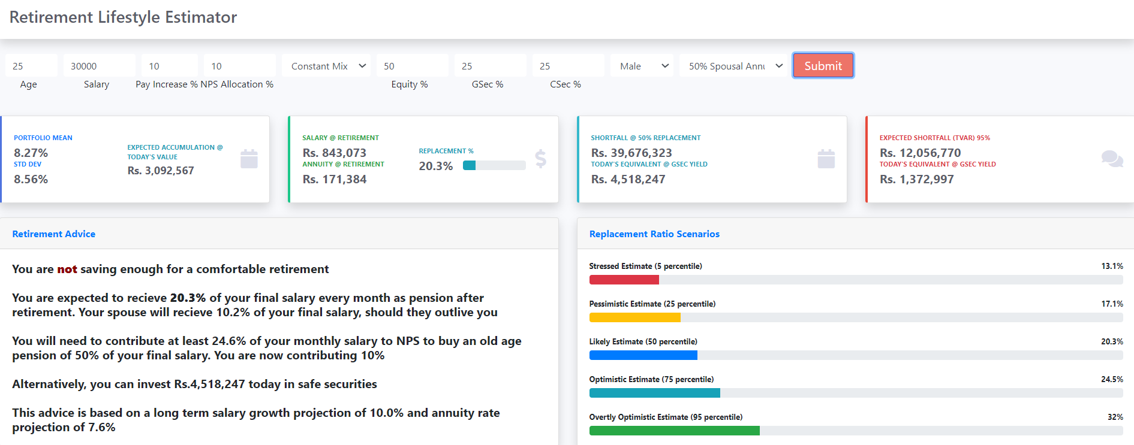
Stochastic Model – NPS Projections
www.actuariesindia.org

Slide 58
Thank you!
www.actuariesindia.org

Slide 59


Q&A
www.actuariesindia.org

Slide 60
Upcoming Webinars
 |  | Date | Time | CPD
6th Webinar on Health Insurance Fraud Detection in Health Insurance Claims – A Machine Learning (ML) Approach |  | 25 June 2021 | 3:00pm – 4:30pm | 1.5hrs – Health Insurance
35th India Fellowship Webinar (IFS Online)
Module 1 - IFS | 9 July 2021 | 9 July 2021 | 9:30 – 11:00 am 11:30am – 1:00pm | 3 hrs | 3 hrs
Module 2 – IFS | 10 July 2021 | 10 July 2021 | 9:30 – 11:00 am 11:30am – 1:00pm | 3 hrs | 3 hrs
Module 3 – IFS | 16 July 2021 | 16 July 2021 | 9:30 – 11:00 am 11:30am – 1:00pm | 3 hrs | 3 hrs
Module 4 - IFS | 17 July 2021 | 17 July 2021 | 9:30 – 11:00 am 11:30am – 1:00pm | 3 hrs | 3 hrs
www.actuariesindia.org

Slide 61
3rd Techtalk on Employee Benefits
Online Edition 2021
2 June 2021
Defined Contribution Pension Schemes
Practice in Good Design and Governance

