Slide 1


Data Science and Analytics Webinar
22nd May, 2020
Solving Business Problems in Insurance using Data Analytics
Sandeep Patil FSA, CERA
Director & Lead Actuary, Spraoi.ai

Slide 2



Agenda
Data analytics in Insurance Industry
Life and Non-life use cases
Final Thoughts
Q&A
www.actuariesindia.org

Slide 3
Data Analytics in Insurance - Key Factors and Challenges
Key Drivers of Data Analytics Deployment
Key Data Sources in Insurance Industry
No clear companywide vision and strategy
Value of many data analytics solutions is not defined and measured clearly
Outdated data infrastructure
Adoption Challenges in Insurance Industry
Lack of data science expertise in Insurance
Lack of understanding of business by data scientists
Data Analytics solutions in most companies are not operationalized yet - lack of understanding by the business process users
*Source: Willis Towers Watson Survey
www.actuariesindia.org

Slide 4
Data Analytics in Insurance - Value Chain Prioritization by Region
North America
Distribution
Underwriting
Policy Servicing
Claims
EMEIA
Policy Servicing
Claims
Contact Centre
APAC
Underwriting
Policy Servicing
Claims
Fraud Detection
Claims Triaging
Pricing Optimization
Customer Segmentation
Personalised Product Development
Policy Recommendation engines
*Source: KPMG Report
www.actuariesindia.org

Slide 5
Poll Question 1
How are you currently involved in data analytics?
Part of data analytics team/projects in my company
Working on external project / initiative (Kaggle)
Currently training on data analytics techniques
No involvement yet
www.actuariesindia.org

Slide 6
Data Analytics Use Cases
www.actuariesindia.org

Slide 7
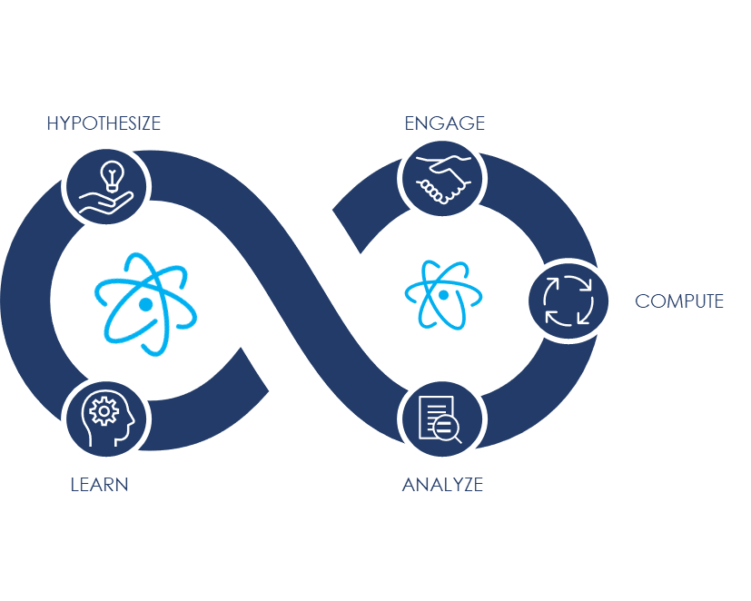





End to End Data Analytics Solution
HYPOTHESIZE. Understand the why of the problem. Should additional data be pursued?
ANALYZE. Consider what data is available, what data is missing and what data can be removed.
COMPUTE. Draft and iteratively adjust the model(s) to best fit the data and derive maximum insight from underlying patterns.
ENGAGE. Design an experience for your user group. Is the information pushed? Pulled? Periodic? Episodic? Integrated?
LEARN. Consider desired confidence thresholds and adjust accordingly. Leverage additional data to further refine/tune results.
www.actuariesindia.org

Slide 8
Claims Analytics for Subrogation Decision - Motor Insurance
Business Problem: Identify claims for subrogation action for motor line of business.
Triage Claims for subrogation
Improve subrogation success and operational efficiency
Propensity of the claim for subrogation
NLP (Natural Language Processing) for unstructured data
ML model based on composite data - structured and unstructured
Model learns based on subrogation success
Periodic Model refresh (based on claims velocity and volume)
Exploratory Data Analysis [EDA]
Structured and unstructured data
www.actuariesindia.org

Slide 9
Marketing Lead Generation Analytics - Life Insurance
Business Problem: Improve the propensity to convert a marketing lead into an actual customer.
Triage leads for next action
Improves Lead conversion efficiency + Identify optimum lead sources + Recommend optimum product to the lead
Propensity of a marketing lead to convert to an actual customer
Principal Component Analysis (PCA)
Lead qualifier model
        Lead quantifier model
        Product predictor model
Model learns based on conversion of leads
Periodic Model refresh (based on leads velocity and volume)
Exploratory Data Analysis [EDA]
Lead data from various marketing sources – offline & online
www.actuariesindia.org

Slide 10
Policy Application Fraud Detection Analytics - Fixed Annuity
Business Problem: To detect inconsistency or fraud in a new policy application.
Company currently doesn’t have fraud detection mechanism.
Propensity of a new policy application to be inconsistent or fraudulent
Deploy business rules to detect inconsistent applications
Get application processer feedback
Analyze policyholder and agent behavioral anomalies
Develop rules to detect fraudulent applications
Organize data to utilize feedbacks for building predictive model
Exploratory Data Analysis [EDA]
Analyze underwriting, new applications, and inforce policies data
www.actuariesindia.org

Slide 11
Poll Question 2
In your company, which area has most deployments of data analytics initiatives?
Claims
Pricing and product development
Distribution
Customers engagement
Risk management
www.actuariesindia.org

Slide 12
Final Thoughts
www.actuariesindia.org

Slide 13
Emerging Technologies in Insurance - Actuaries should focus on
2
1
Internet of Things (IoT)
(Wearables, Telematics)
Machine Learning & Deep Learning
(NLP, Computer Vision)
3
Blockchain
(Smart Contracts)
6
Cloud Computing
(SaaS, PaaS, IaaS)
4
5
Robotic Process Automation
(Process Bots)
Big Data
(Unstructured, Open Source, IoT data)
www.actuariesindia.org

Slide 14
Q & A
www.actuariesindia.org

