Slide 1


Impact of IFRS 17 on insurance products – Indian perspective
1st Webinar on IFRS 17
16 July 2020
Kshitij Sharma
Partner, EY Actuarial Services LLP

Slide 2
Key Drivers for Surplus Emergence
Need to consider Accounting & Shareholder Value impacts separately
Attributable Expenses
Level of Risk Adjustment
Expected Investment Returns
Coverage Units
Onerous Contracts
Shareholder Value will depend on Regulatory Solvency regime

Slide 3
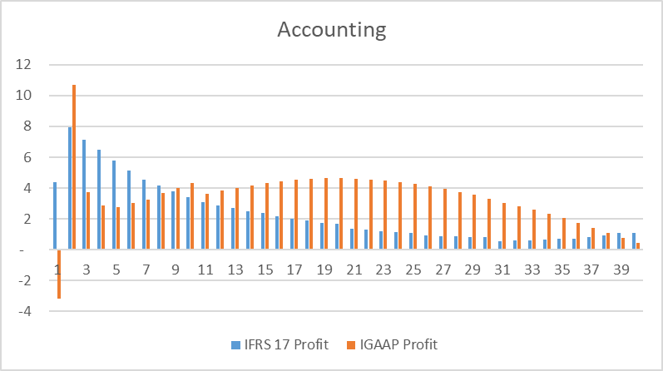
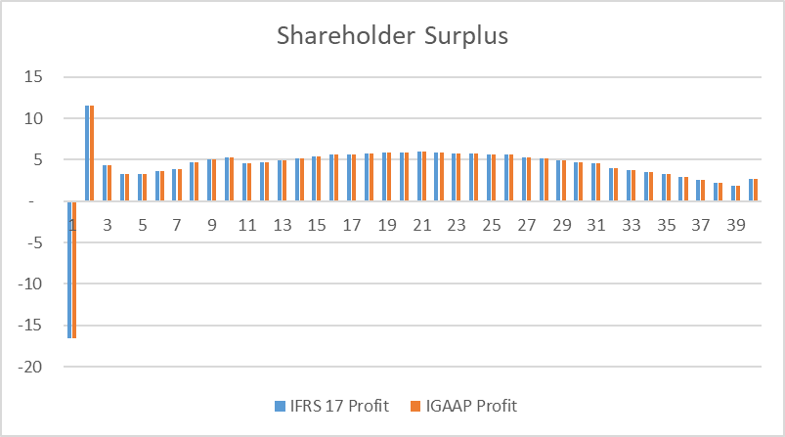
Example – Regular Pay Protection
IGAAP initial strain due to acquisition expenses and flooring of statutory reserves at zero
IFRS17 profit in Year 1 higher due to amortisation of attributable acquisition costs
Shareholder surplus same given high Solvency Capital requirements, which are greater than FCF under IFRS17

Slide 4
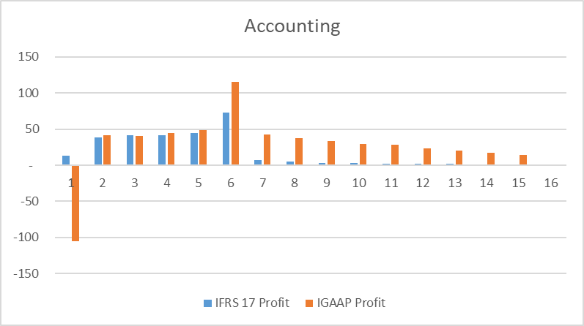
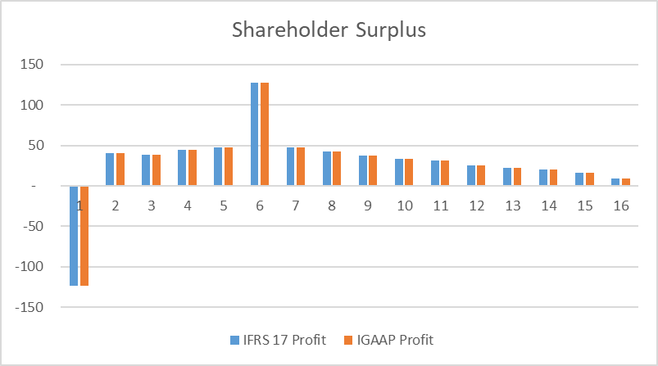
Example – Regular Pay ULIP
IGAAP initial strain due to acquisition expenses and flooring of statutory reserves at unit value
IFRS17 profit in Year 1 higher due to amortisation of attributable acquisition costs and liability accounting
Shareholder surplus same given high Solvency Capital requirements, which are greater than FCF under IFRS17

Slide 5
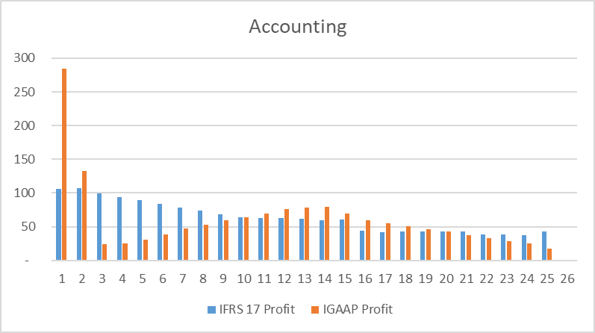
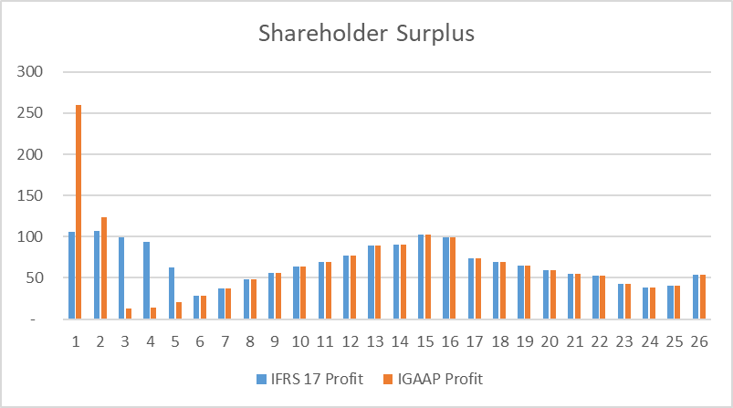
Example – Regular Pay Savings
First year IGAAP profits due to higher case size and profitability able to absorb first year strains
IFRS17 profit in Year 1 lower due to CSM limiting immediate recognition of profit margin
Shareholder surplus emergence restricted by CSM, deferring transfer of surplus to shareholder funds as per CSM run-off pattern
IFRS17 FCF > Statutory Reserve + Solvency Capital

Slide 6



Key Impacts
Accounting
Onerous contract testing to be incorporated as part of product pricing
Level of attributable expenses key determinant of onerous contracts
New Business Strain (excluding Capital) | Expected Impact * | Reason | Sample Products
High |  | Amortisation of attributable acquisition costs | ULIP, Protection
Low |  | Amortisation of profit recognition (CSM) | Non-Linked Savings
* Actual impacts to depend on product features and current profitability
Shareholder surplus emergence delayed for contracts with IFRS17 FCF (BEL + RA + CSM) > Statutory Reserve + Capital
Shareholder Value

