Slide 1


4th Webinars on Data Science and Analytics
22nd May, 2020 (Friday)
Data Science & the IFoA
Michael Tripp, FIA, Partner at Mazars UK

Slide 2

Overview – THE IFoA AND MODERN ANALYTICS
2015/2016
2017/2018
2019/2020
Modelling, Analytics and Insights from Data working party
GI initially, but cross domain
Research, thoughts and scenarios
International linkages
Reported to Council
Need for change
MIG started
Council and Royal Statistical Society
4 brainstorm workshops
Best practice project design
Ethical principles
Council Committee
New qualification
CPD
Research
Role of Actuaries in the future
IFoA Strategy – reposition the profession, member experience, international influence
2

Slide 3




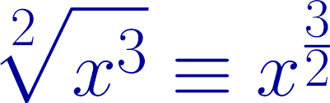
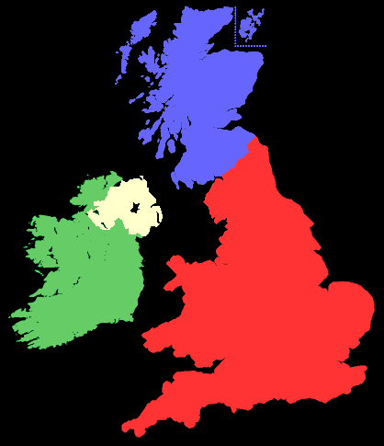

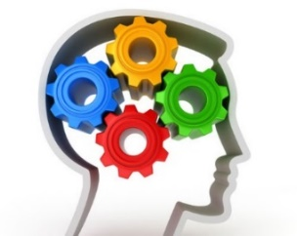
Data Science…….. Problem Types
Time series predictions
Clustering
Knowledge
Decisions
Identifying
Explanatory
Variables
Pattern recognition
(including text)
GLM
Optimisation Logistics
Cognitive reasoning
Modelling
Likely outcomes
probabilities
3

Slide 4
Methods – Maths & Neuroscience
model assessment, selections, bias : train, test, validate
GLMs, GAMS
Regression
Trees
NLP
(text)
Bayesian
Boosting
Machine learning
Prototypes
Association
Principal
Components
Algorithms
Nearest neighbour
Supervised
Neural nets
Boot strapping
Penalised Regression
K clustering
Random forests
Google page rank
Proprietary Algorithms
Deep learning
Undirected graphics
Unsupervised
Black box
Transparent
4

Slide 5
Synthesised from 4 workshops and wider discussion
A Guide for Ethical Data Science – The Institute & Faculty of Actuaries and Royal Statistical Society
SEEK TO ENHANCE THE VALUE OF DATA SCIENCE FOR SOCIETY
AVOID HARM
APPLY AND MAINTAIN PROFESSIONAL COMPETENCE
SEEK TO PRESERVE OR INCREASE TRUSTWORTHINESS
MAINTAIN ACCOUNTABILITY AND OVERSIGHT

Slide 6
Physics, Quantum Mechanics
DOES AGENCY REQUIRE PHYSICAL CAUSATION?
Humans or machines – a philosophical or physics Question
WHAT IS LIFE?
WHAT IS INTELLIGENCE – ARTIFICIAL OR NATURAL
CONSCIOUSNESS – THE SOUL?
AGENCY – INTENTIONS, DECISIONS
FREE WILL

Slide 7
Added Value
The GROWTH Mindset
What might this mean for the future of the actuarial profession?
SOME (OR MUCH?) OF WHAT WE DO MAY BE AUTOMATED
WHAT IS OUR UNIQUE ADDED VALUE?
PROBLEM DEFINITION
SOLUTION INTERPRETATION
JUDGEMENT?
LONGER TERM PERSPECTIVE
COMMON SENSE?
PROFESSIONAL STANDARDS

