Slide 1


Webinar on Risk Management
July 31, 2020
Time 1400 to 1530 IST
COVID-19 and Operational Risks
Sanchit Maini FIAA, FIAI, FSAS, CERA
Chief Financial and Operational Risk Officer, Prudential Corporation Asia

Slide 2


Agenda
Areas impacted
Risk management response
Conclusion
1
2
3
www.actuariesindia.org 2

Slide 3
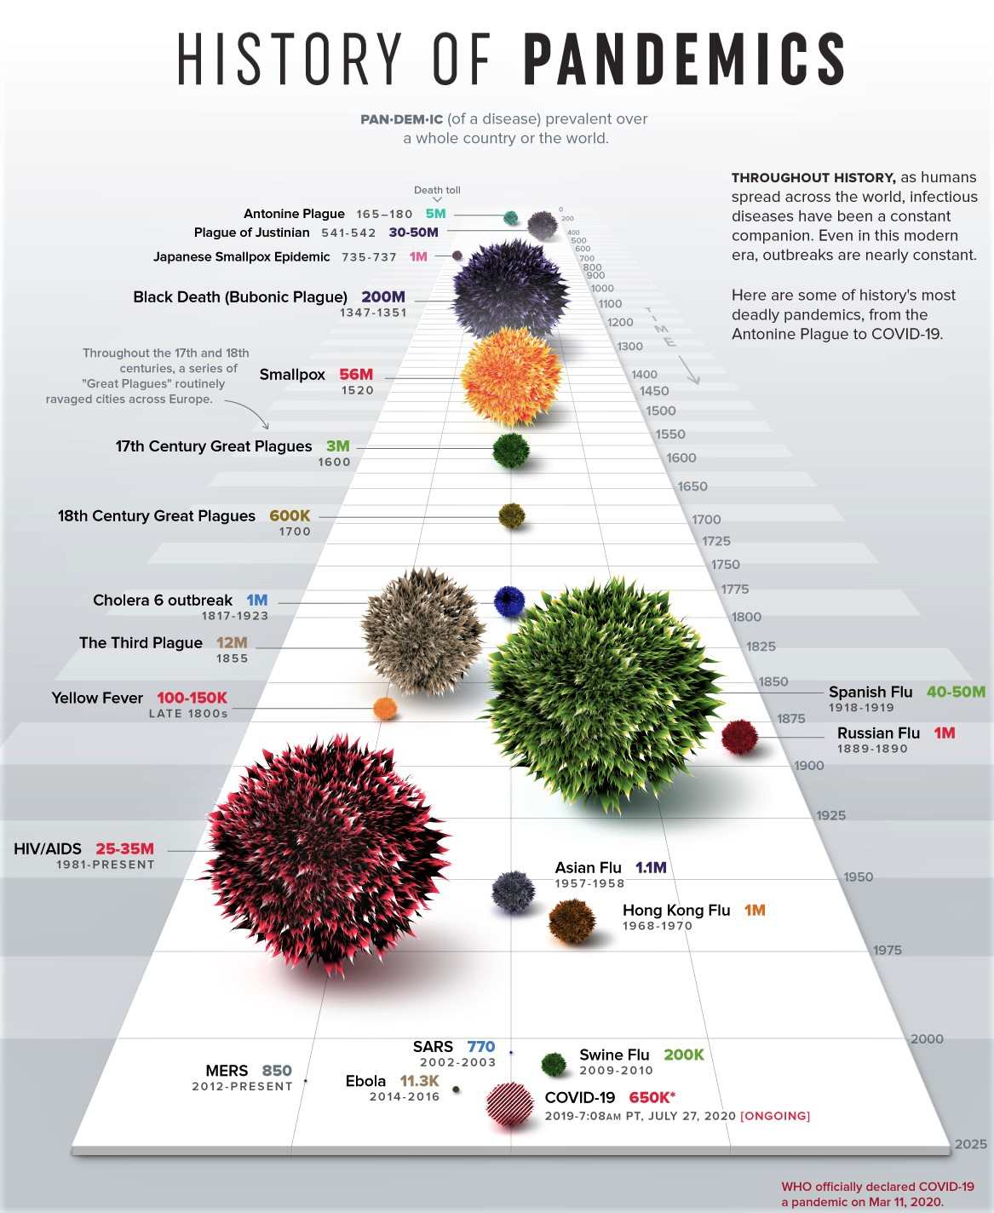
Source:https://www.visualcapitalist.com/history-of-pandemics-deadliest/
www.actuariesindia.org 3

Slide 4
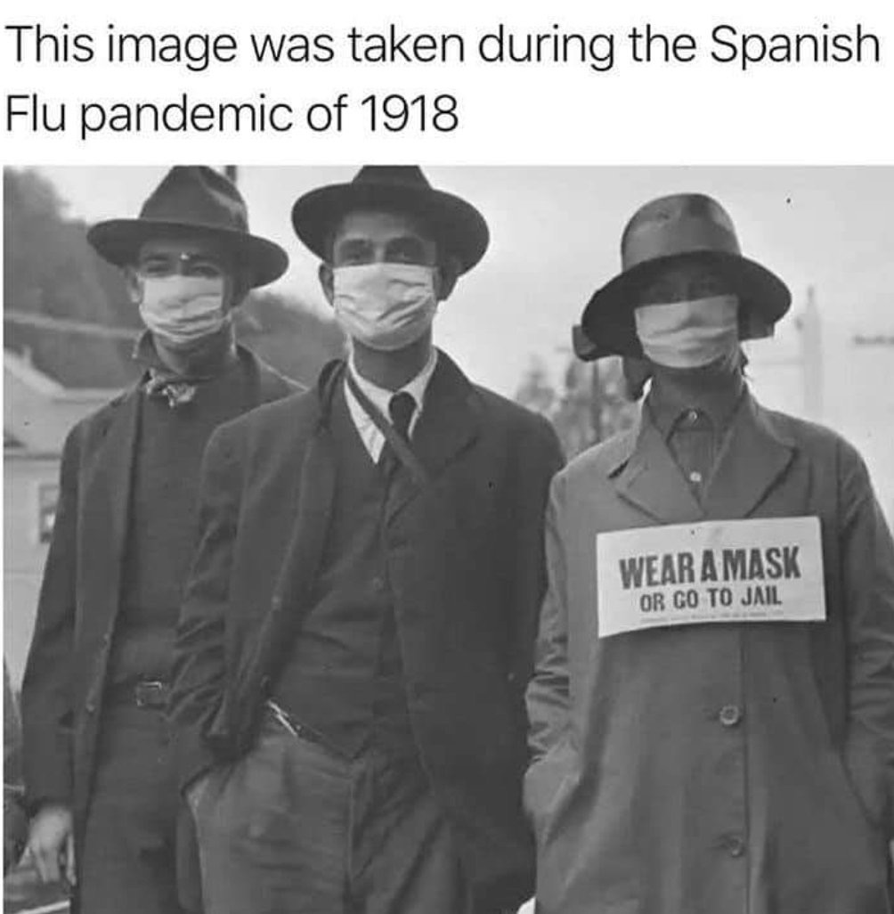
www.actuariesindia.org 4

Slide 5
Polling Question #1
www.actuariesindia.org 5

Slide 6
www.actuariesindia.org 6

Slide 7
Macro themes
Political and Geopolitical risks
Rising nationalism
US/China tensions
Technological divide
Role of central banks and monetary policy
Lower interest rates for longer? Negative rates?
Technology and Climate
Data and associated risks
Cyber risk
Climate change
Insurance Industry
Rapid transformation underway: digital, partnerships, use of AI
Ethical considerations of AI
Insurtechs parsing the insurance value chain
Societal
Income and wealth inequality
Social unrest and protests
Longevity, genetics, targeted treatments
Urbanisation
Future of capitalism?
www.actuariesindia.org 7

Slide 8
Areas of concern
Unique event impacting both assets & liabilities
Several operational aspects across business have been impacted:
Employee Health
and Safety
Business Continuity & Resilience
Information security and cyber risk
Political
risk
Customer
services
Claims
Culture & Conduct
Persistency
Operational incidents have also led to manifestation of other financial risks and crystallization of such risks have also led to operational errors e.g. liquidity risk.
COVID-19 is a complex problem in a complex system¹, requiring systems thinking to address the problem. This requires acknowledging the inherent uncertainties, paradoxes and reflecting collectively to make iterative improvements.
^{1.} Source: British Medical Journal, https://blogs.bmj.com/bmj/2020/07/22/managing-uncertainty-in-the-covid-19-era/
www.actuariesindia.org 8

Slide 9
Risk management response
Identify changes in risk profile
Examples: People Risk (employee safety and health), Information Security and Cyber Risk, Processes (BCP, Claims, Premium Payments)
Changes in processes (eg WFH) require controls to be refreshed
Establish reporting
Establish new COVID-19 dashboard covering relevant risk areas eg People, Technology, Cyber, Solvency, Liquidity, Claims, Premium Payments, Sales, Regulatory
Dynamic, enabling continuous monitoring and effective response to dynamic risk environment
Establish new key risk indicators engaging with subject matter experts, aligned with risk appetite and company strategy
Status of risk and controls
Internal (e.g. Senior Management, Board) and external stakeholder management (e.g. Regulators, Media, Rating Agencies)
Refresh risk priorities
Not BAU, significant additional focus on areas, what areas can be given less priority?
Additional forums: Incident Management Teams, Critical Incident Groups
Align risk resources to priorities
www.actuariesindia.org 9

Slide 10
Polling Question #2
www.actuariesindia.org 10

Slide 11




Operational risk management
Resilient, Responsive, Reflexive
Resilient
Prioritise critical processes and systems
Business operations resilience
Technology resilience
Cyber resilience
Third Party resilience
Resilience testing against new assumptions
Responsive
Increased frequency of risk reporting to stakeholders (internal, external)
Additional metrics, key risk indicators, and targeted dashboards
2nd line challenge and oversight
Collaboration with first line teams
Deep dives
Reflexive
Account for dependencies, second order effects
Iterative, incremental improvements
Societal attitudes, values and norms
www.actuariesindia.org 11

Slide 12
Risk management focus
Question every assumption
Example: RAID Log
Risk | Assumptions | Issues | Dependencies | Risk Response
Business continuity | Disaster recovery No “war like” situation | Lockdowns Remote access to systems | Ability to WFH Alternate sites Third party reliance | BCP to Operational Resilience
Information security & cyber risk | Latest patches installed Reliance on Third Parties, ecosystem partners Disclaimers | Lack of due diligence on partners Data flows between ecosystem partners | Staff up to date with security training Ecosystem partners | Comprehensive response covering all vendors, Heightened focus on cyber risk eg simulated phishing with COVID-19 theme Specialists
Culture & Conduct | Employee and agent behaviour Trainings attended Alignment of stakeholder interests | Large scale WFH requires alternates Virtual F2F sales | People, systems, technology, training | Increase in training frequency, bite-sized, delivered online but interactive Employee surveys
Persistency | Policyholder behaviour Affordability at point of sale No economic shocks | Lockdowns and payments Rise in unemployment | Investment performance Distributor / agent | Flexibility in grace period Ease of online payments
www.actuariesindia.org 12

Slide 13
Risk Reporting
Example: COVID-19 Dashboard
Area | Detail | Description
Solvency | Company Fund | Actual levels with trends, latest forecasts, target levels Stress and sensitivity analysis Breakpoint analysis Management actions identified Update on actions/ initiatives
Liquidity | Company Fund | Liquidity Coverage Ratio, forecasts, target levels Stresses Bespoke scenarios Collateral for derivatives Incidents
Staff Business Continuity | Employees Agents Critical business functions/ processes | Staff statistics eg WFH %, mandatory quarantine, staff with flu-like symptoms, staff with suspected C-19, staff with confirmed C-19 Incidents
Sales | By channel Relevant granularity | Trends, forecasts, targets Initiatives with impact Incidents
Customer | Claims Premium payments Persistency | Trends, stress tests Premium outstanding decay curve Persistency trends with granularity Initiatives and impact Incidents
www.actuariesindia.org 13

Slide 14
In Conclusion
1
Crises has brought risk management to the fore
Develop risk management response, challenge and oversight to ensure operational excellence and business resilience
Enhance risk detection and controls with data, real-time analytics, dashboards
Specialist talent as well as tools needed to address range of operational risks, including several emerging risks on the horizon
Action oriented, incremental initiatives with constant refinements
2
3
4
5
www.actuariesindia.org 14

Slide 15
Polling Question #3
www.actuariesindia.org 15

Slide 16
Questions?
Thank you for listening and participating.
Sanchit Maini
www.actuariesindia.org 16

