Slide 1


2nd Webinar on Life Insurance
13 August 2020
Medical update on COVID-19 and impact on risk management
Dr (Maj) A.Arun Kishore
Chief Underwriting Officer (Life), Hannover Rück SE – India Branch

Slide 2



Disclaimer
The information provided in this presentation does in no way whatsoever constitute legal, accounting, tax or other professional advice.
While we have endeavoured to include in this presentation information it believes to be reliable, complete and up-to-date, the company does not make any representation or warranty, express or implied, as to the accuracy, completeness or updated status of such information.
Therefore, in no case whatsoever will Hannover Rück SE and its affiliated companies or directors, officers or employees be liable to anyone for any decision made or action taken in conjunction with the information in this presentation or for any related damages.
© Hannover Rück SE. All rights reserved.
Hannover Re is the registered service mark of Hannover Rück SE.
www.actuariesindia.org

Slide 3
Major impacts of COVID-19
Global and local businesses have been disrupted including academic activities, sports, entertainment, etc.
COVID-19 driven recession has driven default risk higher
Disruptions in logistics and supply lines
National and state Governments finances in doldrums
It has challenged our belief that we are technologically advanced and better placed to control pandemics
Shaken the foundations of institutions like WHO, NEJM (est. 1812), etc., questioned the authenticity of medical research
Frequent changes in treatment guidelines
The only thing which has been certain is…..UNCERTAINTY
www.actuariesindia.org

Slide 4
Agenda
1
COVID-19: An overview
2
Second level impact
3
Implications on Risk management

Slide 5
Agenda
1
COVID-19: An overview
2
Second level impact
3
Implications on Risk management

Slide 6
Agenda
1
COVID-19: An overview
2
Second level impact
3
Implications on Risk management

Slide 7
Agenda
1
COVID-19: An overview
2
Second level impact
3
Implications on Risk management

Slide 8
Are we going back to the basics?
www.actuariesindia.org

Slide 9
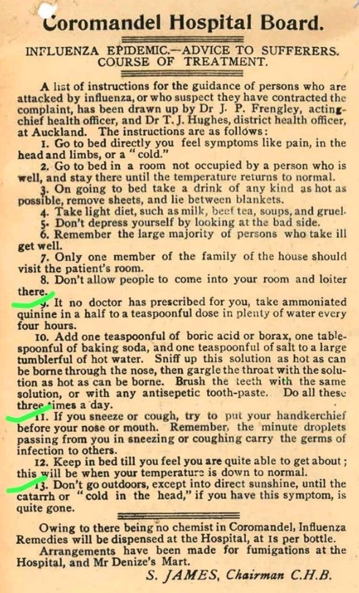
www.actuariesindia.org

Slide 10
COVID-19: An overview
www.actuariesindia.org

Slide 11
COVID-19: An overview
In December 2019, a novel coronavirus, now named as SARS-CoV-2, caused a series of acute atypical respiratory diseases in Wuhan, Hubei Province, China
The disease caused by this virus was termed COVID-19
CoVs have a crown-like appearance under an electron microscope (coronam is the Latin term for crown) due to the presence of spike glycoproteins on the envelope
The subfamily Orthocoronavirinae of the Coronaviridae family (order Nidovirales)
www.actuariesindia.org

Slide 12
COVID-19: An overview
Primarily through surface contact
Respiratory droplets from coughing and sneezing
Aerosol transmission is possible in case of protracted exposure to elevated aerosol concentrations in closed spaces
Possible smear, stool, tear fluid and blood
Transmission
www.actuariesindia.org

Slide 13
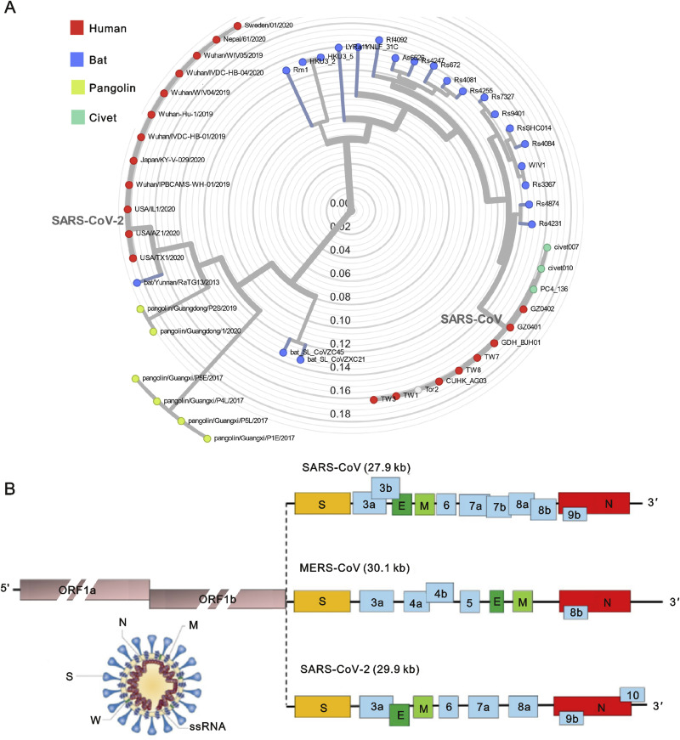
COVID-19: An overview
Virology
Coronaviruses form enveloped and spherical particles of 100–160 nm in diameter
Contain a positive sense single stranded RNA (ssRNA) genome of 26–32 kb in size
The Coronaviridae members MERS CoV, SARS CoV 1 and SARS CoV 2 all belong to the beta coronavirus (β CoV) genus and share highly homologous genomic sequences
There are three main viral proteins in the envelope of the virion: the spike protein (S), the membrane protein (M) and the envelope protein (E)
www.actuariesindia.org

Slide 14
COVID-19: An overview
Incubation period
  The incubation period is 1-14 days, mostly 3-7days
Criteria for suspected cases (typical)
Epidemiology history in the past 14 days, any 2 of the 3 clinical manifestations or all of the clinical manifestation without epidemiology history:
  Fever and/or respiratory symptoms
  Pneumonia indication by imaging test
  Decrease of WBC count, or lymphocyte count
Laboratory (early stages)
  Normal WBC in early stage, lymphocytes were below the normal range
  Elevated C-reactive protein (CRP) and erythrocyte sedimentation rate (ESR) in most case
  Elevated liver function tests, LDH, creatinine and myohemoglobin in some patients
Atypical presentations
  Non respiratory symptoms and still counting..
www.actuariesindia.org

Slide 15
COVID-19: An overview
Clinical stages
Mild
Mild or no symptoms
No evidence of pneumonia
Moderate
Fever and respiratory symptoms
Pneumonia confirmed by imaging test
Severe
Respiratory distress - RR≥30/min
Finger SpO2 ≤93% at resting
PaO2/FiO2 ≤300mmHg
Critical
Respiratory failure - mechanical ventilation
Shock
Other organ function failure
ICU required
www.actuariesindia.org

Slide 16
COVID-19: Clinical stages
Critical
Severe
Respiratory failure - mechanical ventilation required
Shock
Complication of other organ function failure
ICU required
Respiratory distress - RR≥30/min
Finger SaO2 ≤93% at resting
PaO2/FiO2 ≤300mmHg (1mmHg=0.133kPa)
Moderate
Fever and respiratory symptoms
Pneumonia confirmed by imaging test
Mild
Mild symptoms
No evidence of pneumonia
www.actuariesindia.org

Slide 17
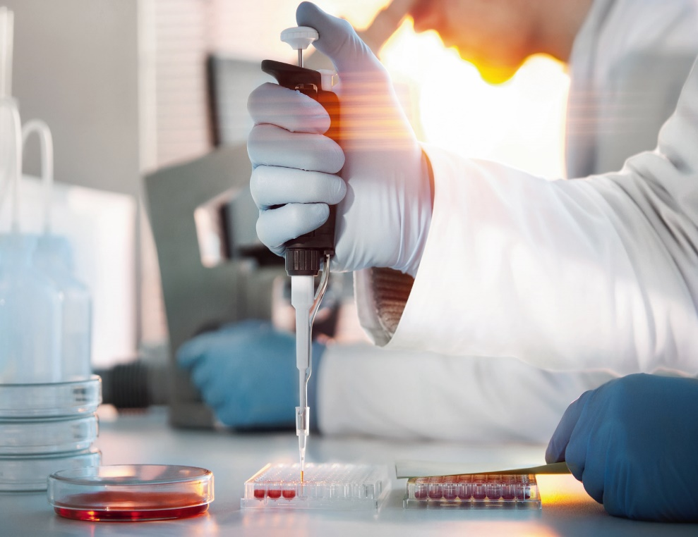
COVID-19: An overview
Diagnostic tests
PCR Test for the novel coronavirus
of throat swab
Chest Imaging – Ground glass opacity
and/or pleural effusion (less common)
Antibody test
www.actuariesindia.org

Slide 18

COVID-19: An overview
Current treatment strategies
Supportive therapy
Anti-viral therapy
Anti-bacterial therapy
Glucocorticoids therapy
Antibody and plasma therapy
www.actuariesindia.org

Slide 19
COVID-19: An overview
Current treatment strategies
Anti-viral therapy
Like SARS-CoV and MERS-CoV, there is currently no clinically proven specific antiviral agent available for SARS-CoV-2 infection
Targeted inhibitors like Remdesivir, an adenosine analogue that can target the RNA-dependent RNA polymerase and block viral RNA synthesis, has been a promising antiviral drug against a wide array of RNA viruses
Remdesivir and chloroquine (HCQs) have been demonstrated to inhibit SARS-CoV-2 effectively in vitro
Hence, other nucleoside analogues, such as favipiravir (+/-Doxy), ribavirin and galidesivir may be potentially be effective against SARS-CoV-2
RLF -100 (Aviptadil, a Vaso Intestinal Peptide) and list goes on…
www.actuariesindia.org

Slide 20
COVID-19: An overview
Severity and transmission
A 2006 study estimated the potential mortality of an influenza pandemic, using data from the Spanish flu pandemic of 1918-20. The analysis found that if such a pandemic were to occur today, there would be an estimated 62 million deaths, of which 96% would occur in the developing world, increasing global mortality by 114%.
It is interesting to see that the R naught for the Spanish flu was 1.8 with a 2.5% mortality rate, while the current pandemic of SARS-CoV was assumed to have a R naught of 2 with a mortality rate of 4.5%.
We are amidst of a pandemic that has a mortality rate greater than that of one of the historically most deadly pandemics and which could reappear once confinement measures are released. Once confinement is lifted, massive testing abilities are needed to be able to prevent a flare-up.
www.actuariesindia.org

Slide 21
COVID-19: An overview
Severity and transmission
A 2006 study estimated the potential mortality of an influenza pandemic, using data from the Spanish flu pandemic of 1918-20. The analysis found that if such a pandemic were to occur today, there would be an estimated 62 million deaths, of which 96% would occur in the developing world, increasing global mortality by 114%.
It is interesting to see that the R naught for the Spanish flu was 1.8 with a 2.5% mortality rate, while the current pandemic of SARS-CoV was assumed to have a R naught of 2 with a mortality rate of 4.5%
We are amidst of a pandemic that has a mortality rate greater than that of one of the historically most deadly pandemics and which could reappear once confinement measures are released. Once confinement is lifted, massive testing abilities are needed to be able to prevent a flare-up.
2002–03 outbreak of SARS CoV-1 in Guangdong (China), affected 8096 people and caused 774 deaths worldwide (mortality rate ~9.6%)
2012 Outbreak is Saudi Arabia : MERS-CoV (mortality rate ~ 34.4%)
2019 SARS CoV-2……Mortality rate of ~1.5 to 3.6%
www.actuariesindia.org

Slide 22
COVID-19: An overview
Severity and transmission
Occurrence and spread of SARS-CoV-2 depends on the interaction between the virus and the individual’s immune system
Viral factors like virus type, mutation, viral titre and viability of the virus in vitro
The individual’s immune system, factors include genetics (such as HLA genes), age, gender, nutritional status, neuroendocrine-immune regulation and physical status
All these factors contribute to whether an individual is infected with the virus, the duration and severity of the disease and the risk of reinfection
www.actuariesindia.org

Slide 23
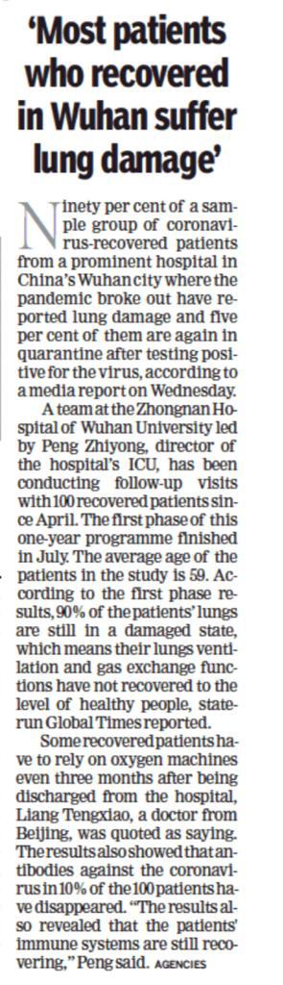
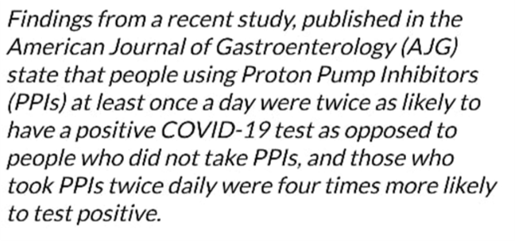
Severity & Spread
www.actuariesindia.org

Slide 24
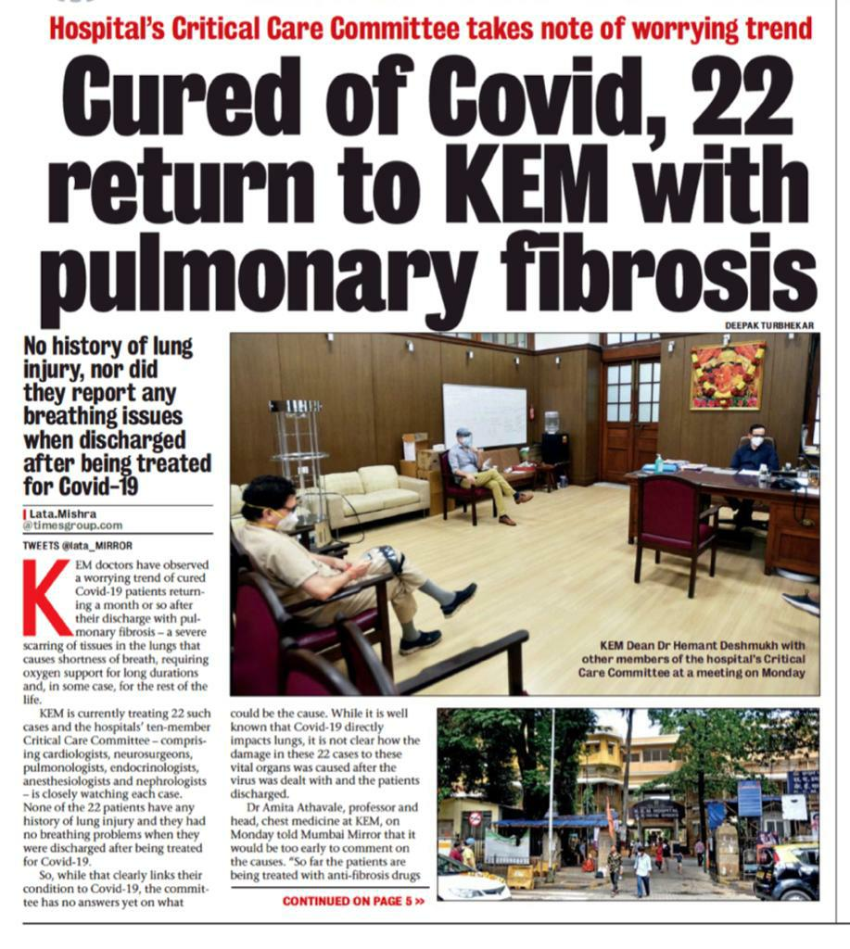
COVID-19: An overview
Complications
www.actuariesindia.org

Slide 25
Audience Question
Which of the following holds good for you?
a) Have not gained weight in the last 06 months
b) Have gained 3kg in the last 06 months
c) Have gained 5kg in the last 06 months
d) Have lost weight in the last 06 months
www.actuariesindia.org

Slide 26
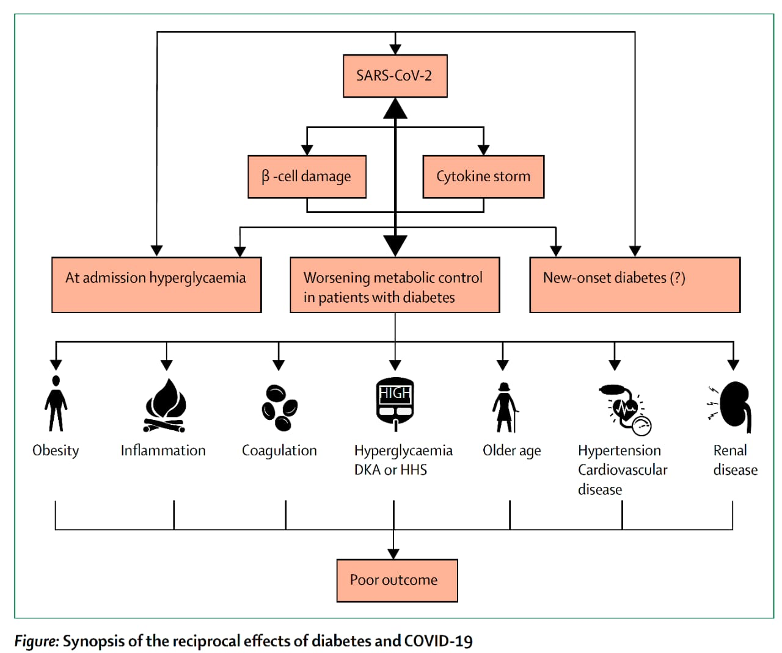
COVID-19: An overview
Complications and co-morbidities
www.actuariesindia.org

Slide 27
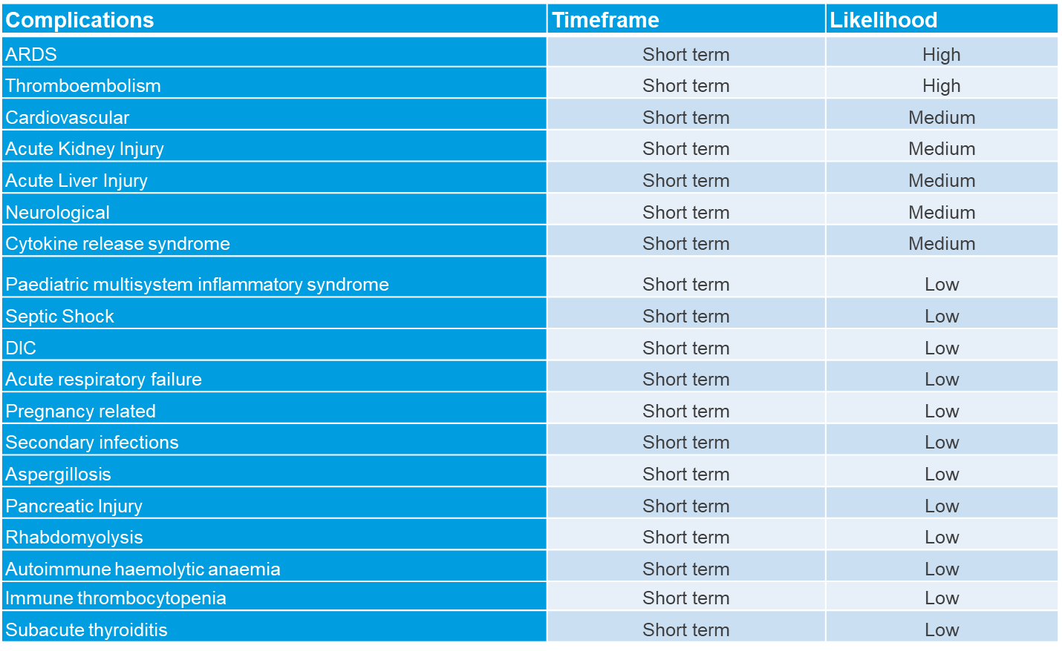
COVID-19: An overview
Complications
www.actuariesindia.org

Slide 28
COVID-19: An overview
Complications
Happy hypoxia syndrome
Hypoxia (low oxygen) on SPO2 and ABG
Individual looks happy - no respiratory symptoms, no tachycardia, no tachypnoea
How is hypoxia compensated - unknown
Treatment
  Sleep in the prone position for at least 4 to 6 hours
  LMWH (prophylactic dose) if D-dimer and ferritin is high
  Oxygen support
  Supportive therapy
Prognosis – If diagnosed early, require oxygen for few days and then oxygen requirement goes down and recover fast so the overall good prognosis
www.actuariesindia.org

Slide 29
COVID-19: An overview
Complications
Learning - Measure SPO2 in all individuals even if asymptomatic
Men with COVID-19 are 3 times more at risk for worse outcomes and death (independent of age) !
Smokers were 14 times more likely to show worse outcomes !
The only thing which again has been certain is…..UNCERTAINTY
www.actuariesindia.org

Slide 30

Second level impacts
Anxiety, depression and fear of COVID-19, isolation, etc. leading to increase in mental health disorders
Substance abuse withdrawal symptoms leading to violent behaviour and suicides
Individuals are trying to avoid hospital visits due to fear of exposure which may have an impact on long term mortality/morbidity
Financial stress and loss of income contributing to suicides, some cardiac related ailments, etc.
www.actuariesindia.org

Slide 31
Second level impacts
Job loss, financial insecurity leading to increase in crimes with associated mortality and morbidity, self-induced as well as otherwise
Increase in financial fraud, a concern for insurers
Increase in domestic violence
Reduction in RTA’s and occupation related accidents
www.actuariesindia.org

Slide 32
Audience Question
COVID-19 has lead to a change in the consumer behaviour. Will this result in protection (Life and Health) products becoming a pull product rather than a push product?
  Pull product
  Push product
  No idea
www.actuariesindia.org

Slide 33
Implications on risk management
Life Insurance – Underwriting challenges
Limited direct customer contact
Reluctance in providing info like financials, KYC, etc.
Challenge in obtaining medicals
Request from distribution to waive requirements
Demand for allowing NRI’s, exposed population
In spite of the volatile situation, requests for peak exposures
Financial fraud, over-insurance, anti-selection including suicide
Evolving challenges...
www.actuariesindia.org

Slide 34
Implications on risk management
Life Insurance – Underwriting adaptations
Properly designed COVID Questionnaire and guidelines
  Travel and contact history, co-morbidities, occupational risk, current residential status, demographic risk, availability of treatment facilities
Approach based on client vintage/profile, product offerings, etc.
Enhanced digital journey
Alternate medicals
Risk scoring models
IIB data, industry network
Video MER, PIVC – additional measures
www.actuariesindia.org

Slide 35
Implications on risk management
Life Insurance – Claims challenges and adaptations
Delayed intimations
Availability of document and non cooperation of claimants, hospitals, etc.
Field investigation including
Challenge with employer checks
Demand for expediting COVID claims
Changing modus operandi of fraudsters
Risk selection and profile of the claim is the key to judicious claims assessment
www.actuariesindia.org

Slide 36
Q&A
ABC
www.actuariesindia.org

