Slide 1


2nd Webinar on Life Insurance –
Impact of COVID 19 on Life Insurers
13 August 2020
Evaluating our response to the pandemic
Madhusudhanan Sridharan
Chief Underwriting and Pricing Officer,
Munich Re, APAC, Middle East and Africa

Slide 2



What I plan to present
Some thoughts on the pandemic
Responses and learnings
Key takeaways
www.actuariesindia.org

Slide 3
Are we too early?
For the skeptics…
  We are still in the pandemic
  Full impact of our responses is yet to come
Types of evaluation
  Formative / Process / Outcomes / Impact
  (https://www.cdc.gov/std/Program/pupestd/Types%20of%20Evaluation.pdf)
www.actuariesindia.org

Slide 4
Caveats
Deluge of information
Choices: ascetic or skeptic
These are my personal Views
Not representing my employer
www.actuariesindia.org

Slide 5
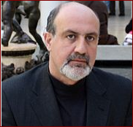

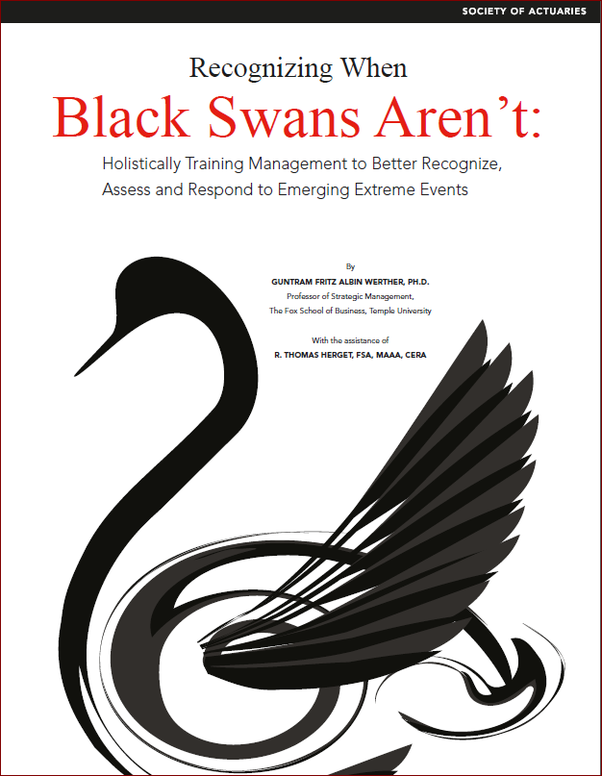
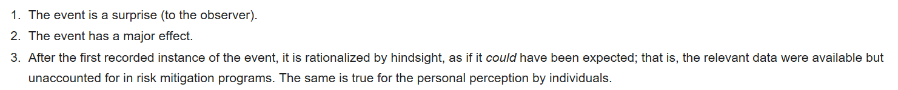
A black swan event?
According to Taleb, COVID 19 is not a black swan but a white swan as it is compatible within statistical properties (source: Wikipedia)
www.actuariesindia.org

Slide 6
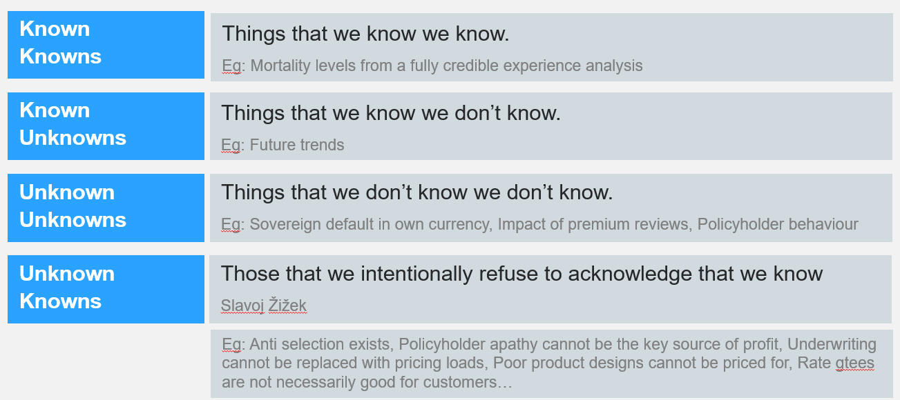
Some thoughts on risk
www.actuariesindia.org

Slide 7
Unknown known?
Is Pandemic an unknown unknown or is it more of an unknown known?
Eg: Anti selection exists, Policyholder apathy cannot be the key source of profit, Underwriting cannot be replaced with pricing loads, Poor product designs cannot be priced for, Rate gtees are not necessarily good for customers…
Wasn’t pandemic identified as an imminent threat?
www.actuariesindia.org

Slide 8
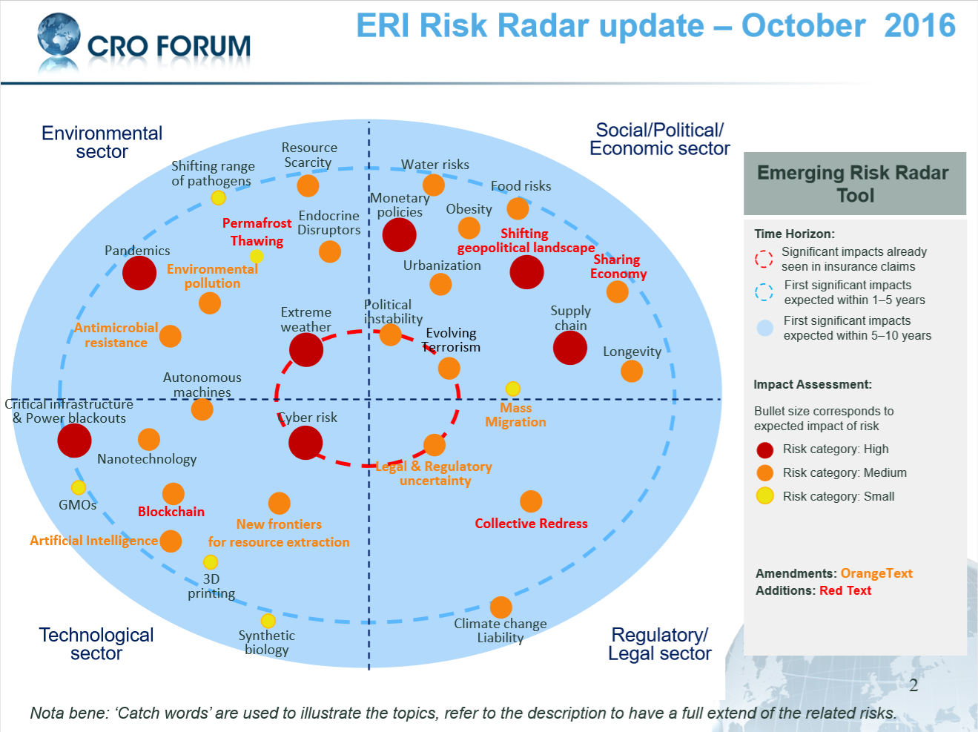
ERI Risk Radar 2016
www.actuariesindia.org

Slide 9
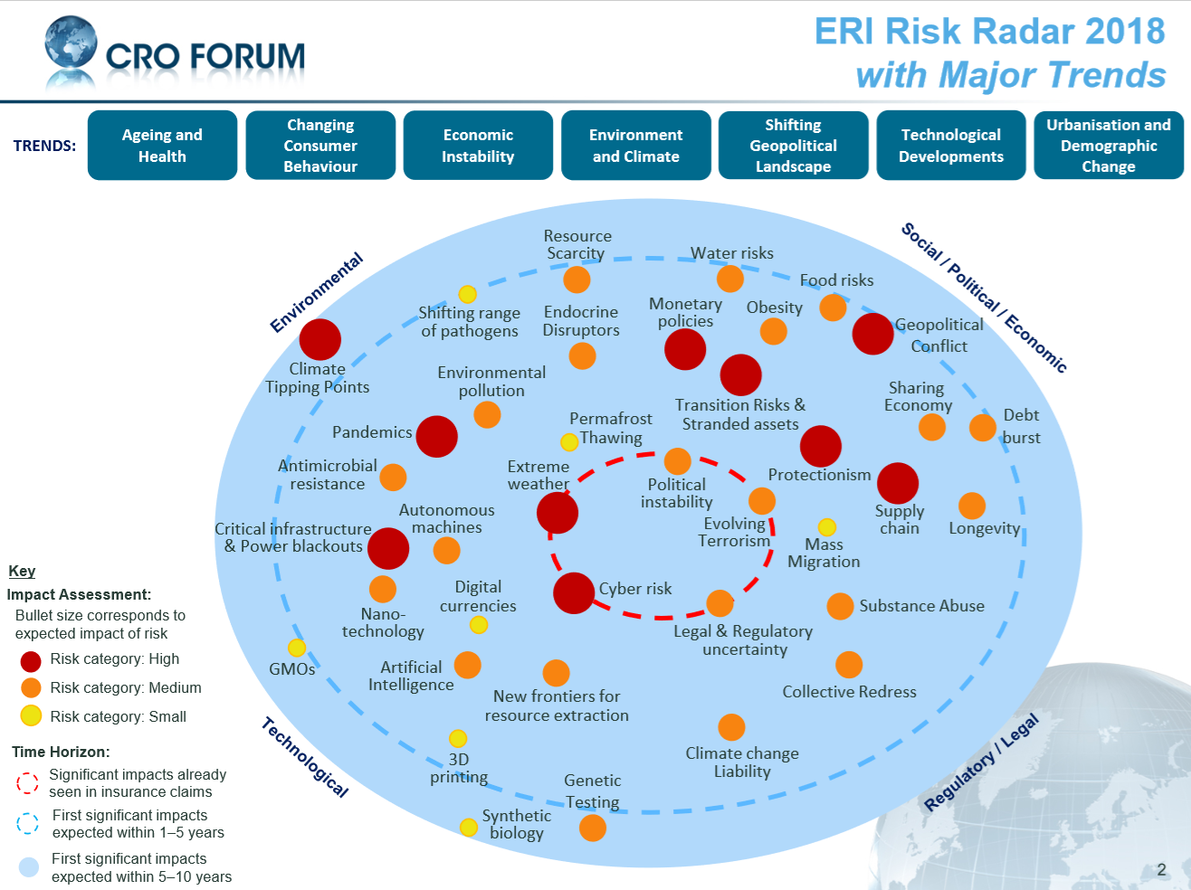
ERI Risk Radar 2018
www.actuariesindia.org

Slide 10
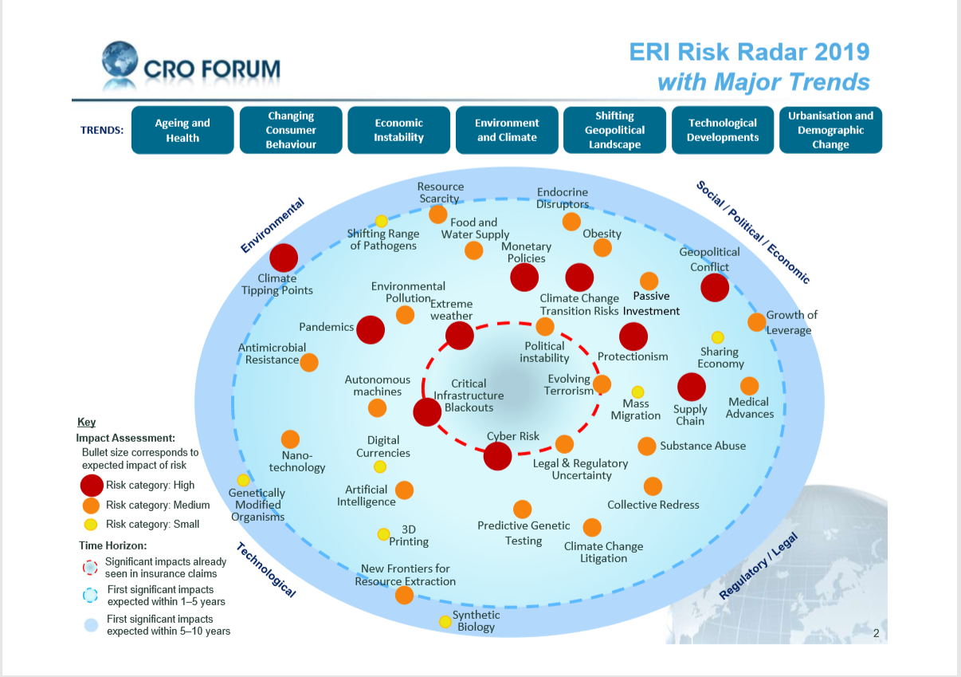
ERI Risk Radar 2019
www.actuariesindia.org

Slide 11
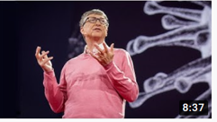
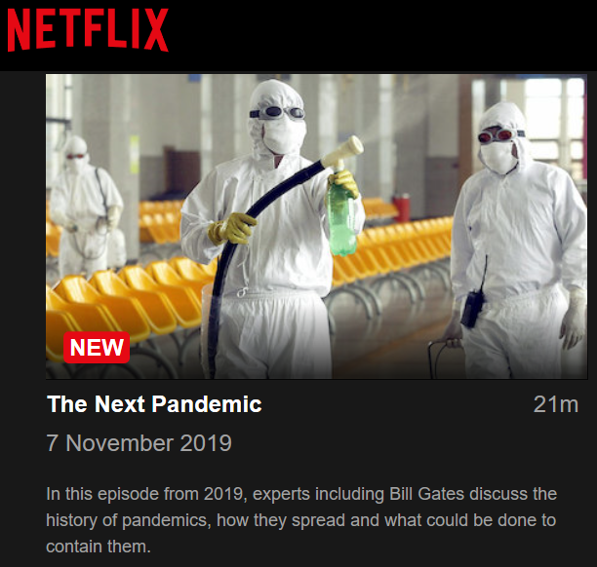

Unknown known?
www.actuariesindia.org

Slide 12
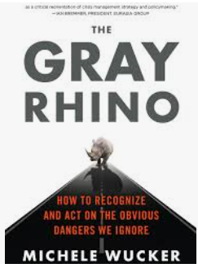
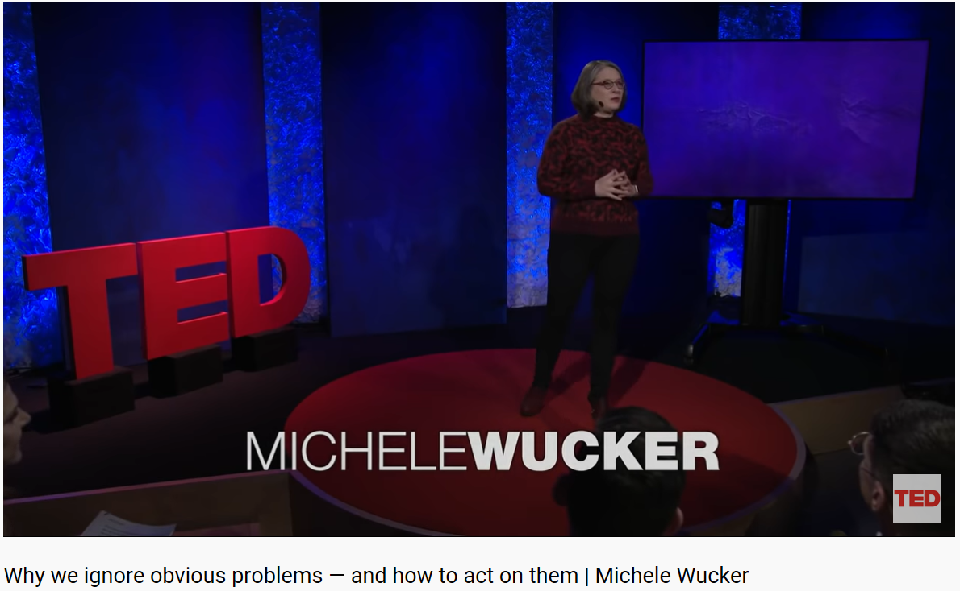
Or is it a Gray Rhino?
A gray rhino is a highly probable, high impact event – obvious yet a neglected threat.
www.actuariesindia.org

Slide 13
Poll questions
Four poll questions on your views on the following:
  Response seen in S&P 500
  Response from some governments / regulators
  Impact on various lines of business
  Actuaries’ ability to model pandemics
www.actuariesindia.org

Slide 14
Poll Question 1
Sales, revenues and earnings per share of most of the companies in the S&P 500 index have taken a severe beating during this pandemic.
What would you expect the S&P index to be now, as compared to its level on 1 Jan 2020 (pre-crisis).
  lower than its level as on 1 Jan 2020
  higher than its level as on 1 Jan 2020
  same level as it was on 1 Jan 2020.
www.actuariesindia.org

Slide 15
Poll Question 2
Let us assume that claims arising out of pandemics are specifically excluded in the contract between the insurer and the insured.
Despite this, the government or the regulator issues a directive to insurers instructing them to ignore the exclusion in the contract. What do you think about this?
  Correct as insurers do have a social responsibility
  Not correct as agreements cannot be unilaterally changed by third parties without consent and such exposures have not been priced
  Probably correct and, probably incorrect too.
www.actuariesindia.org

Slide 16
Poll Question 3
Of the following four lines of business which one, in your view, would have been heavily negatively impacted by the COVID pandemic:
  Mortality benefits
  Living benefits issued by life insurers like critical illness, disability benefits
  Health insurance
  General insurance (non-life and health)
www.actuariesindia.org

Slide 17
Poll Question 4
With which one of the following statements do you agree:
  Actuaries are best suited to modelling pandemics as they have the necessary knowledge and the skill set to understand the drivers and dynamics of pandemics.
  Actuaries do not have the necessary knowledge, or the skill set to understand the drivers and dynamics of pandemics. Hence actuaries should not be modelling pandemics without support from subject matter experts.
  No one can model pandemics and hence there is nothing wrong in actuaries trying to model the pandemic.
www.actuariesindia.org

Slide 18
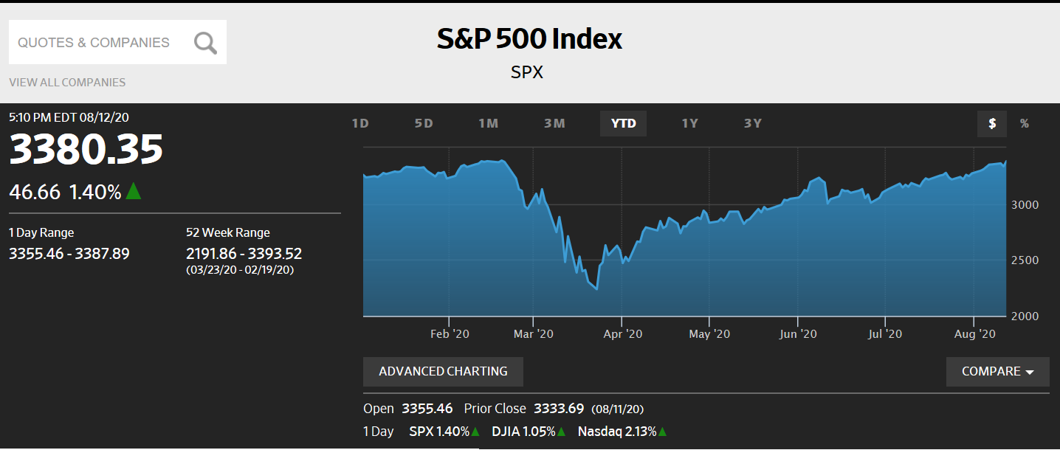
Market response –
S&P Index
https://www.wsj.com/market-data/quotes/index/SPX/historical-prices
www.actuariesindia.org

Slide 19
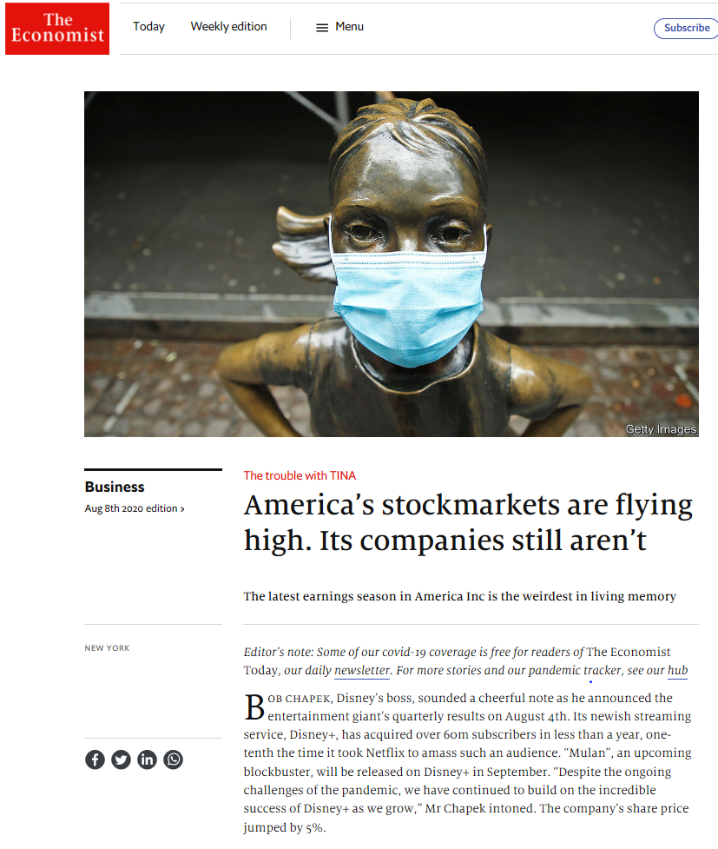
S&P Index
https://www.economist.com/business/2020/08/08/americas-stockmarkets-are-flying-high-its-companies-still-arent
TINA – There is no alternative
Betting on vaccines
Green shoots of recovery but very low base to start off
Seeing what they want to see – FAMAA vs other 495 in S&P 500
Popular sentiment but private nervousness
www.actuariesindia.org

Slide 20
Governments’ response
Typically, in most markets, government absorbed COVID related cost of diagnosis and treatment…
…mostly treated in government hospitals or facilities that were specifically built for this purpose.
Fungibility of definitions and hence strength of mitigations through contract wording is a lesson learnt.
(eg. definition of hospital, hospital stay, definition of ICU ward, treatments in an ICU, limits on no. of beds available in a country, etc.)
www.actuariesindia.org

Slide 21
Governments’ response
In some markets, after an initial period, health or insurance regulators, either gently nudged or issued a directive to ignore any exclusions in the policy contract and cover cost of COVID related diagnosis and treatment cost.
www.actuariesindia.org

Slide 22
Governments’ response
Certainty in an insurance contract
    who will be indemnified
    in which circumstances
    who is liable for what
Retroactive changes to contract by a third party without the consent of the parties to the contract is undesirable.
www.actuariesindia.org

Slide 23
Impact on Insurers
By product line
  Mortality benefits – underwritten / funeral plans
  Critical illness – long term impact of COVID and treatment, yet unknown
  Disability benefits – income: short deferment periods, strength of definitions, voluntary stay-at-home
  Unemployment benefits – definitions of voluntary unemployment and inability to earn income, offsets from government benefits
  Health insurance – reduction in non-COVID claims
  General insurance – event cancellation, business interruption, contract wordings
www.actuariesindia.org

Slide 24
Impact on Insurers
Horrible 10 days for specialty reinsurers at Lloyds.
  Hurricane Isaias – ca. $1 to $4.2 bln
  Ethiopian cargo flight fire – ca.$200m
  Beirut explosion – ca. $250m
  Air India flight crash – ??
  Oil spill near Mauritius – ??
(rough preliminary estimates from one source, Insurance Insider, purely for illustration purposes. Not to be treated as loss guidance.)
www.actuariesindia.org

Slide 25
Insurers’ response
Three waves of response – First Wave
  Scramble to develop COVID specific covers
    Lack of understanding of the drivers of incidence and prognosis of the pandemic
    Ability to price and manage the portfolio
    Over-charging end customers?
    Regulatory stance on such covers – encouragement and in some cases, caution.
www.actuariesindia.org

Slide 26
Insurers’ response
Second wave
  How to address drop in sales, difficulties in underwriting new applications and possible stress on persistency
    No silver bullet – large / small insurers, legacy / new systems processes, by product line
    Premium holidays, extension of grace periods, free continuation of covers, etc.
www.actuariesindia.org

Slide 27
Insurers’ response
Third wave
  What is the new normal?
    Temporary measures to improve sales, underwriting and persistency to be extended
    Substantial and possibly permanent changes to the way insurance business was transacted and administered.
www.actuariesindia.org

Slide 28
Some lessons learnt
  Sales – impact on both face-to-face and direct marketing (call centres)
  Underwriting – adapted application forms quickly but need to adapt leaner processes
  Contract wordings – specifically, living benefit contracts
  Claims – Poor ability to gather information and monitor COVID related claims
  Pricing and monitoring – a good opportunity to test our assumptions on efficacy of risk mitigants.
www.actuariesindia.org

Slide 29
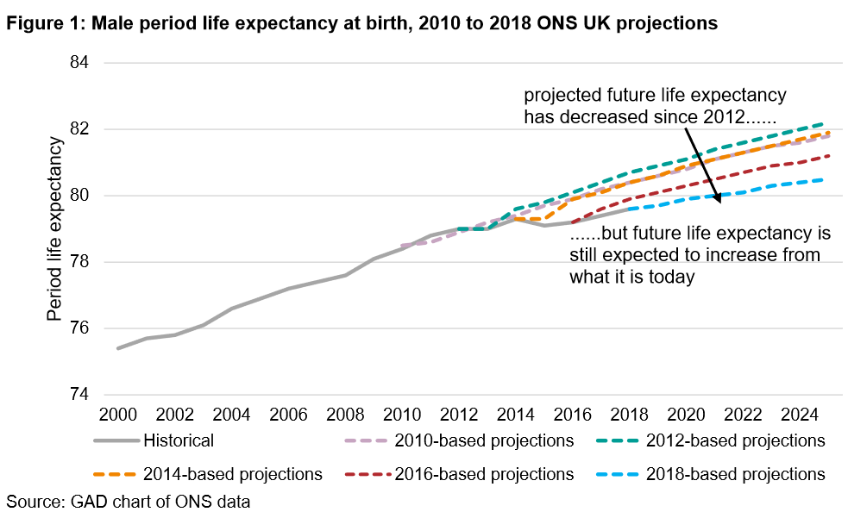
Our track record in modelling
www.actuariesindia.org

Slide 30
Modeling Pandemic
Evidently poor-quality data (missing extra deaths)
Lack of understanding of the drivers of experience and hence the inability to model future incidence
Unclear or inappropriate objectives of modelling
Unclear description of assumptions underlying the model
Lack of clarity on whether the results are best estimates or merely scenarios
Worse or better than central scenario being considered as worse and best-case scenarios
Lack of caveats on uncertainty in the model and hence lack of guidance on how to use it
Lack of continuous validation of the model with updated data and assumptions
www.actuariesindia.org

Slide 31
Modeling Pandemic
References for good practice in modelling 1 - Modelling and COVID 19 by Louise Pryor, IFoA
  (https://www.actuaries.org.uk/news-and-insights/news/modelling-and-covid-19)
  Five questions to be asked
    What purpose was the model developed for?
    What assumptions does the model depend on?
    Do the model results represent a best estimate or something else?
    Are the assumptions or outputs at the extremes of possibilities?
    How has the model been validated?
Reference 2 – Wrong but Useful – What COVID-19 Epidemiological models can and cannot tell us (https://www.nejm.org/doi/full/10.1056/NEJMp2016822)
www.actuariesindia.org

Slide 32
Some more thoughts…
Crisis is an opportunity for us to test things that we could not do before. Have we?
With the deluge of information, one needs to be either ascetic or a skeptic. Question everything – including our own beliefs.
More often, we get a holistic view of the problem when we don’t become a part of it.
Crisis like this reminds us of the value of the actuarial training - technical and professional.
It also reminds us that with our core skills, there is much more for us to contribute.
www.actuariesindia.org

Slide 33
2nd Webinar on Life Insurance –
Impact of COVID 19 on Life Insurers
13 August 2020
Evaluating our response to the pandemic
Madhusudhanan Sridharan
Chief Underwriting and Pricing Officer,
Munich Re, APAC, Middle East and Africa
Thank you for your attention!

